Slide 1



B.E., Pharmaceutical Engineering
Pharmacology
Medicinal Chemistry
Pharmacy
Biochemistry
M.S., Biostatistics
Statistical Methods
Data Science
Clinical Trial Design
Survival Analysis
2015
2019
2021
2017
Psychology
Biopsychology

Slide 2



Sep 2020 ~ Dec 2020
Statistical Programmer Intern
CDASH → SDTM → ADaM → TLFs
+

Slide 3

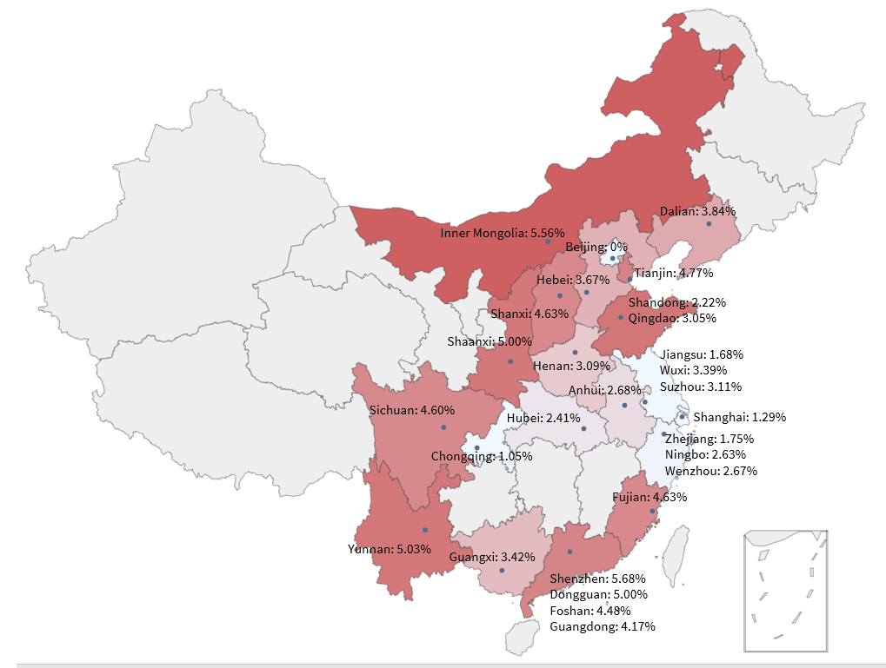
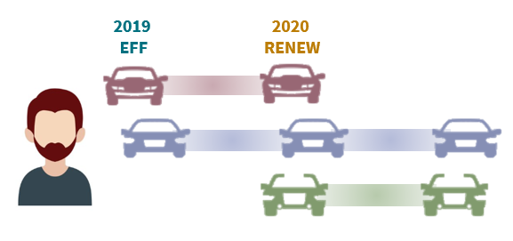
May 2020 ~ Aug 2020
Data Science Intern
Retention Rate Analysis
- Python + SQL

Slide 4
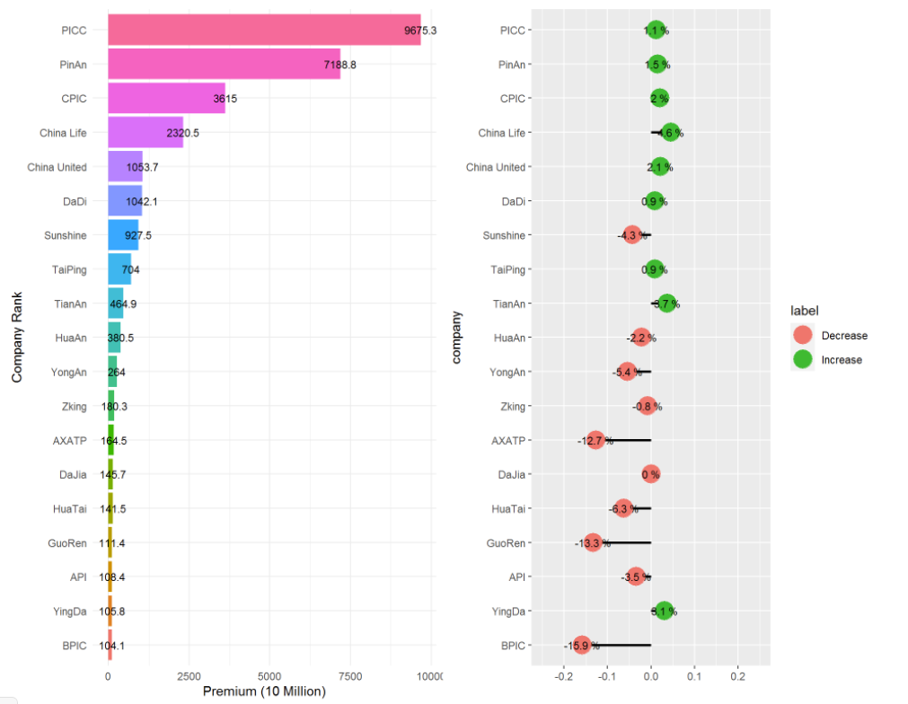
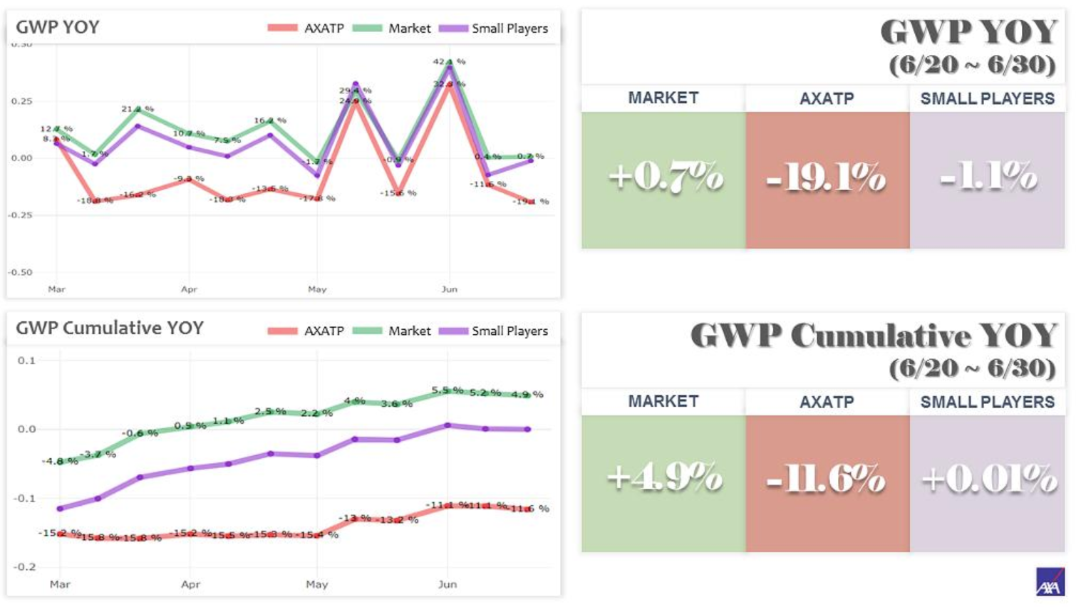
CBIT Market Report Website
- Rmarkdown + Python + SAS

Slide 5
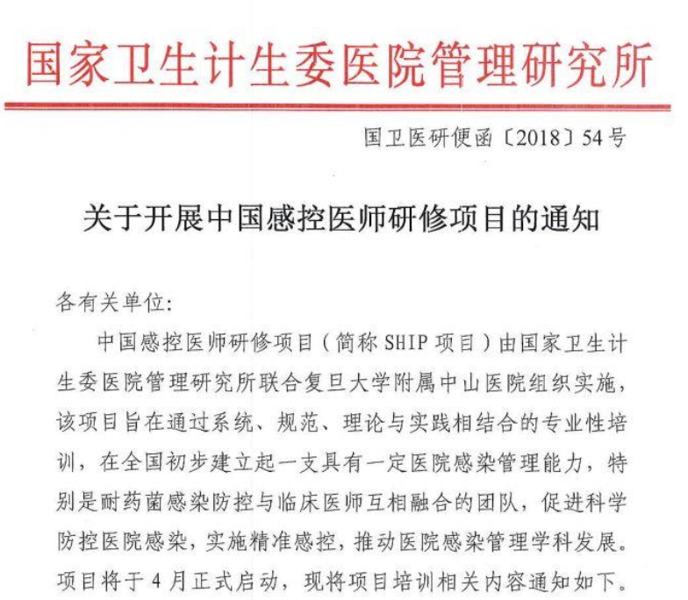



Aug 2018 ~ Dec 2018
Medical Affairs Intern
Jan 2018 ~ Feb 2018
Research Analyst Intern

Slide 6


Strategic & Market Entry Consulting

