Slide 1
CS:5980
Foundations of Embedded Systems
Hybrid Systems
Part I
Copyright 2014-26, Rajeev Alur and Cesare Tinelli.
Created by Cesare Tinelli at the University of Iowa from notes originally developed by Rajeev Alur at the University of Pennsylvania. These notes are copyrighted materials and may not be used in other course settings outside of the University of Iowa in their current form or modified form without the express written permission of one of the copyright holders. During this course, students are prohibited from selling notes to or being paid for taking notes by any person or commercial firm without the express written permission of one of the copyright holders.

Slide 2
Models of Reactive Computation
Continuous-time model for dynamical systems
  Synchronous, where time evolves continuously
  Execution of system: Solution to algebraic / differential equations
Timed model
  Like asynchronous for communication of information
  Clocks evolve continuously, and constraints on delays allow synchronous/global coordination
Hybrid systems
  Generalization of timed processes
  During timed transitions, evolution of state/output variables specified using differential equations as in dynamical systems

Slide 3
Self-Regulating Switching Thermostat
off
on
cont 60 ≤ T ≤ 70
(T ≤ 62) ?
dT = -k₂
dT = k₁(70 - T)
T ≥ 60
(T ≥ 68) ?
T ≤ 70
State machine with two modes: on and off
State variable T of type cont (continuous), to model temperature
T can be tested and updated during mode-switches
T changes continuously during timed transitions given by differential equations
Invariants (as in timed model) constrain how long can a timed transition be

Slide 4
Executions of Thermostat
off
on
cont 60 ≤ T ≤ 70
(T ≤ 62) ?
dT = -k₂
dT = k₁(70 - T)
T ≥ 60
(T ≥ 68) ?
T ≤ 70
Initial state = (off, T₀) with T₀ in the interval [60,70]
While in off mode, T decreases continuously: T(t) = T₀ - k₂ t
Mode-switch to on enabled when T ≤ 62, and must happen before T goes below 60
While in on mode, T increases according to T(t) = 70 - (70 - T*) e ^{–k1(t-t*)}
t*, T* : time and temperature upon entry to mode on
Mode-switch to off enabled when T ≥ 68, and must happen before T goes above 70

Slide 5
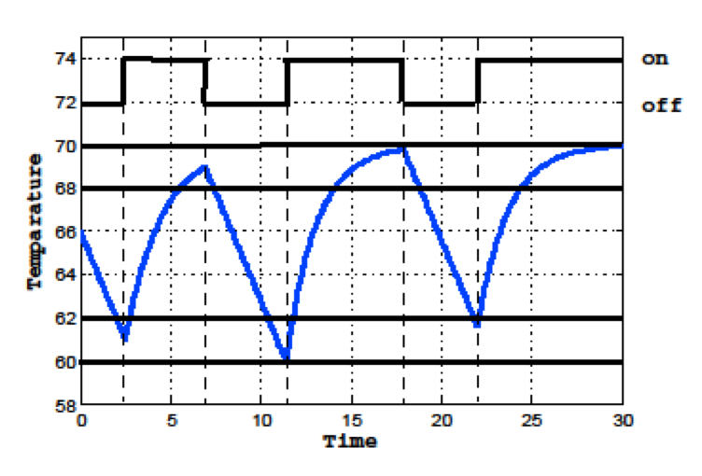
Simulation Plot of an Execution

Slide 6
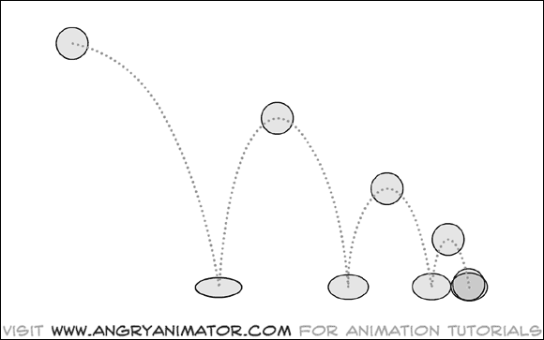
Modeling a Bouncing Ball
Ball dropped from an initial height h₀ with an initial velocity v₀
Velocity changes according to the differential equation dv/dt = -g
When the ball hits the ground (height h = 0), velocity changes discretely: v := -a v, where 0 < a < 1 is a dampening constant
Modeled as a hybrid system: mix of discrete and continuous behaviors

Slide 7
Hybrid Process for Bouncing Ball
Fall
h = 0 –> bump ! ; v := -a v
cont h := h₀ ; v := v₀
dh = v; dv = -g
h ≥ 0

Slide 8
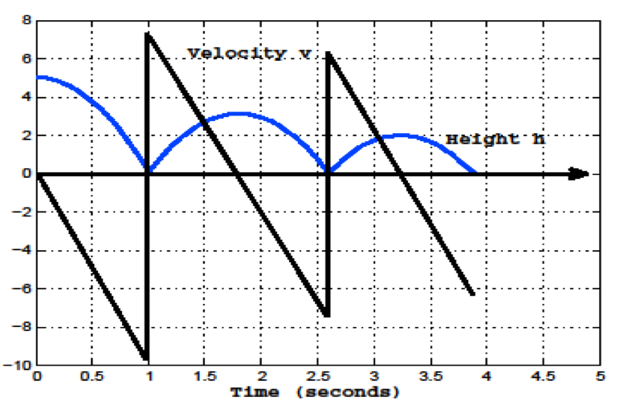
Execution of the Bouncing Ball Process
h₀ = 5 m
v₀ = 0
g = 9.8 m/s²

Slide 9
Definition of Hybrid Process: Syntax
A hybrid process HP consists of
An asynchronous process P, with
  continuous (I_{c}) and discrete (I_{d}) input variables I
  continuous (S_{c}) and discrete (S_{d}) state variables S
  continuous (O_{c}) and discrete (O_{d}) output variables O
A continuous-time invariant CI, a Boolean expression over S_{c}
For every output var y ∈ O_{c}, a (Lipschitz-continuous) real-valued expression h_{y}(S_{c}, I_{c}) defining y over time
For every state var x ∈ S_{c}, a (Lipschitz-continuous) real-valued expression f_{x}(S_{c}, I_{c}) defining the rate of change of x over time
Input, output, internal and timed actions

Slide 10
Self-Regulating Switching Thermostat
off
on
cont 60 ≤ T ≤ 70
(T ≤ 62) ?
dT = -k₂
dT = k₁(70 - T)
T ≥ 60
(T ≥ 68) ?
T ≤ 70
I = {}
S = { cont T, {on, off} mode } initial value: off
O = { cont T } initial value: in [60, 70]
CI = (mode = off => T ≥ 60) & (mode = on => T ≤ 70)
f_{T} = T
h_{T} = if mode = off then -k₂ else k₁(70 - T)

Slide 11
Definition of Hybrid Process: Semantics
Inputs, outputs, states, initial states, internal actions, input actions, output actions: Defined exactly as in the asynchronous model
Timed actions: Given
  a state s₀, a real-valued time δ > 0 and
  a continuous input signal I(t) giving values for I_{c} over interval [0, δ],
signals S(t) and O(t) over [0, δ] are uniquely defined so that
  S(0) = s₀
  For each y ∈ O_{c}, O_{y}(t) = h_{y}(S(t), I(t))
  For each x ∈ S_{c}, dS_{x}(t) = f_{x}(S(t), I(t))
  For all t ∈ [0, δ], S(t) satisfies the invariant CI
  Note: At all times t ∈ [0, δ], discrete state variables stay unchanged

Slide 12
Executions of Hybrid Processes
Starting from an initial state, execute either
a timed step of some duration δ > 0 (only continuous variables change) or
a discrete, instantaneous step: input, output, or internal action
(mode, temp)
(off, 66) –2.5–> (off, 61) –> (on, 61) –3.7–> (on, 69.02) –> (off, 69.02)
–4.4–> (off, 60.22) –> (on, 60.22) –7.6–> (on, 69.9) –> (off, 69.9)
–4.1–> (off, 61.7) –> (on, 61.7) –> …
Concepts based on transition systems such as reachable states, safety and liveness requirements, all apply to hybrid systems

Slide 13
Block Diagrams
Component processes can now be hybrid processes
  Need to define instantiation, composition, output hiding
Channels connecting processes of two types
  Sender/receiver communication during discrete steps,
  as in the asynchronous model
  Continuously evolving signals during timed steps,
  as in the model of continuous-time dynamical systems

Slide 14
Composition of Hybrid Processes
Instantiation, variable renaming and output hiding:
  Defined as usual
Composition:
  Compose discrete parts together as in the asynchronous model
  (asynchronous composition)
  Compose continuous parts of internal actions together as in dynamical systems
  (synchronous composition)
  Generate continuous-time invariants of as conjunction of same invariants of component processes
Compatibility of two hybrid processes:
  State variables are disjoint and output variables are disjoint
  No cyclic await dependencies among shared input/output variables

Slide 15
Nuclear Reactor Example
cont T
ReactorPlant
ReactorControl
{add1, add2, rem1, rem2} u

Slide 16
Reactor Plant
PlantRod1
dT = T/10 - 56
(u = add1) ?
(u = rem1) ?
cont T := 510
PlantNoRod
dT = T/10 - 50
(u = add2) ?
(u = rem2) ?
PlantRod2
dT = T/10 - 60

Slide 17
Reactor Controller
ConRod1
dy1 = dy2 = 1
510 ≤ T
(550 ≤ T ∧ c ≤ y1 ∧ y2 < c) –> u := add1
cont y1 := c
cont y2 := c
T ≤ 510 –> u := rem1 ; y1 := 0
ConNoRod
dy1 = dy2 = 1
T ≤ 550
550 ≤ T ∧ c ≤ y2 –> u := add2
T ≤ 550 –> u := rem2 ; y2 := 0
ConRod2
dy1 = dy2 = 1
510 ≤ T
Note: T’s change rate is specified in Reactor Plant

Slide 18
Summary of the Model
Generalizes timed model
    Variables evolving continuously during a timed action can have complex dynamics, clocks being a very special case
Generalizes continuous-time dynamical systems
    Discontinuous changes to system state now can be modeled
Generalizes asynchronous model
    Distributed/multi-agent systems can be modeled
Suitable for modeling of cyber-physical systems in full generality
Commercial tool support: Modelica, Stateflow/Simulink
Analysis is challenging
    Even if dynamics in individual modes is linear, due to discrete changes it is not possible to obtain closed-form solutions, or general theorems about stability

Slide 19
Analysis of Bouncing Ball Model
Fall
h = 0 –> bump ! ; v := -a v
cont h := h₀, v := 0
dh = v ; dv = -g
h ≥ 0
Evolution in height during first bounce: h(t) = h₀ - g t² / 2
Time at which first bump occurs: t₁ = Sqrtr (2 h₀ / g)
Speed just before first bump occurs: v₁ = Sqrt (2 g h₀)
Speed just after first bump : v₂ = a v₁
Evolution of height during second bounce: h(t) = v₂ t - g t² / 2
Time between first and second bump: t₂ = 2 v₂ / g
Speed just before second bump occurs: v₂ and after 2nd bump v₃ = a v₂

Slide 20
Modeling a Bouncing Ball
Speed after k bumps: a^{k} v₁
Duration between k^{th} and following bump: a^{k} v₁ / g
Sum of durations between successive bumps converges to v₁ (1 + a) / (1 - a)
Infinitely many discrete actions in finite time: Zeno behavior!

Slide 21
Zeno’s Paradox
Described by Greek philosopher Zeno in context of a race between Achilles and a tortoise
Tortoise has a head start over Achilles, but is much slower
In each discrete round, suppose Achilles is d meters behind at the beginning of the round
During the round, Achilles runs d meters, but by then, tortoise has moved a little bit further
At the beginning of the next round, Achilles is still behind, by a distance of a d meters, with 0 < a < 1
By induction, if we repeat this for infinitely many rounds, Achilles will never catch up!
If the sum of durations between successive discrete actions converges to a constant K, then an execution with infinitely many discrete actions describes behavior only up to time K (and does not tell us the state of the system at time K and beyond)

Slide 22
Formalization
An infinite execution of a hybrid process HP is of the form
s₀ –t₁–> s₁ –t₂–> s₂ –t₃–> s₃ …, where t_{i} is the duration of i^{th} step
  Input/output/internal actions are instantaneous (duration 0)
An infinite execution is called
  Zeno if the infinite sum of all the durations is bounded above by a constant, (e.g., ∑_{n>0} 1/(n²+n) = 1) and
  non-Zeno if the sum diverges (e.g., ∑_{n>0} 1/n)
A state s of the process HP is called
  Zeno if every execution starting in state s is Zeno
  Non-Zeno if there is some non-Zeno execution starting in s

Slide 23
Formalization
A hybrid process HP is non-Zeno if every reachable state of HP is non-Zeno
  At every point during an execution it is possible for time to diverge
A Zeno system could end up in a state from which duration between successive steps must get smaller and smaller
Examples
  Thermostat: non-Zeno
  Bouncing ball: Zeno

Slide 24
Zeno vs Non-Zeno
clock x := 0 ;
real d := 1
x ≤ d
x = d –> m ! ; d := d/2 ; x := 0
Zeno! Every possible execution is Zeno
clock x := 0
x ≤ 1
x > 0 –> m ! ; x := 0
Non-Zeno! Some executions are Zeno and some are non-Zeno
clock x := 0 ;
real d := 1
x = d –>
a! ; d := d/2 ; x := 0
x ≤ d
x ≤ 1
x > 0 –> a! ; x := 0
Zeno! System may end up in a state from which only Zeno executions are possible

Slide 25
Zeno Processes and Reachability
How does existence of Zeno processes influence analysis?
Recall:
  A state s of a system H is reachable if there exists a finite execution starting in an initial state and ending in state s
  A property P is invariant for H all reachable states satisfy P
A
B
clock x := 0
x = 3 ?
x ≤ 3
Is mode B reachable ?

Slide 26
Zeno Processes and Reachability
y = d –>
d := d/2 ; y := 0
A
B
clock y := 0 ;
real d := 1
clock x := 0
x = 3 ?
x ≤ 3
y ≤ d
composition
Is mode B reachable ?
clock x, y := 0
real d := 1
A
B
x = 3 ?
Presence of a Zeno process in the system can stop time from advancing and make states of other processes unreachable!
x ≤ 3 ∧
y ≤ d
y = d –>
d := d/2; y := 0

Slide 27
Making Bouncing Ball Non-Zeno
Fall
h = 0 –> bump ! ; v := -a v
cont h := h₀, v := v₀
dh = v
dv = -g
h ≥ 0
Stop
h = 0 ∧ v < ε –> bump ! ; v := 0
dh = 0
dv = 0
If velocity is too small, stop modeling dynamics precisely
In this model, there is a lower bound on duration between successive bumps

Slide 28
Stability of Hybrid Systems
A
B
ds1 = -s1 - 100s2
(s2 = -0.2s1) ?
ds1 = -s1 + 10s2
ds2 = 10s1 - s2
ds2 = -100s1 - s2
S2 ≥ -0.2s1
(s2 = 5s1) ?
S2 ≥ 5s1
Is the dynamics in mode A stable?
Is the dynamics in mode B stable?
Each mode has stable dynamics but switching causes instability!

Slide 29
Stability of Hybrid Systems

Slide 30
Credits
Notes based on Chapter 9 of
Principles of Cyber-Physical Systems
by Rajeev Alur
MIT Press, 2015

