Slide 1
冒險故事
(VTube Studio)
Notes:
大家好，今天來分享一下我的冒險故事

Slide 2
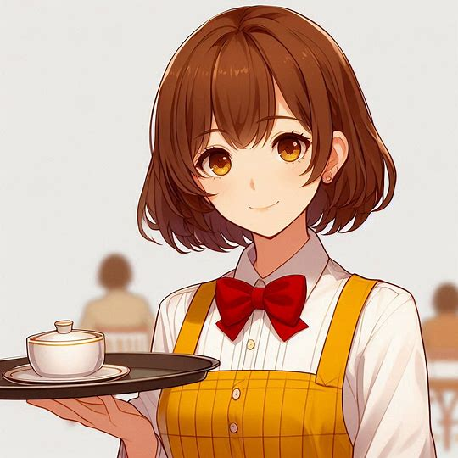
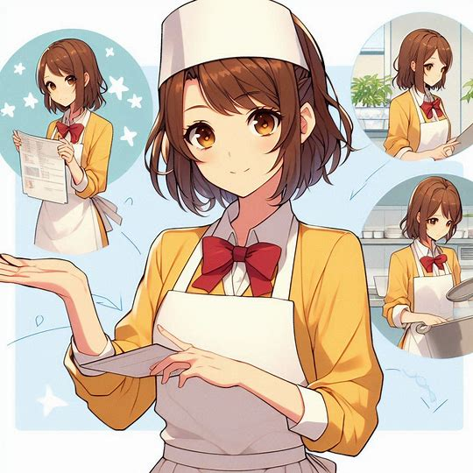
Notes:
Generate a picture of the protagonist going to work in a restaurant, the protagonist is a high school girl with short brown hair, brown eyes, wearing a yellow dress, white collar, red bow tie, and anime style!
我的目標是想通過在當地餐廳的打工，

Slide 3
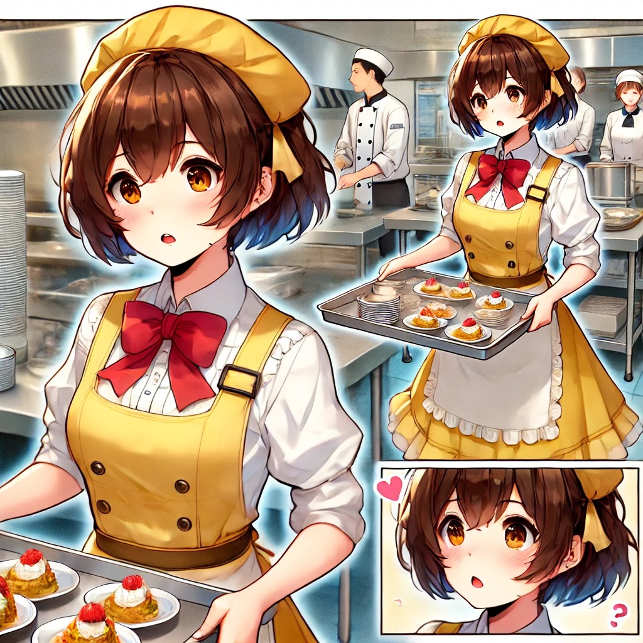
Notes:
Generate picture content for the protagonist to learn the practical experience of the catering industry, to develop their sense of responsibility and interpersonal communication skills, but also hope to earn some pocket money to ease the burden on the family. The protagonist is a high school girl with short brown hair, brown eyes, wearing a yellow dress, white collar and red bow tie.
學習到餐飲業的實際經驗，培養自己的責任感與人際溝通能力，同時也希望能賺取一些零用錢來減輕家裡的負擔。

Slide 4
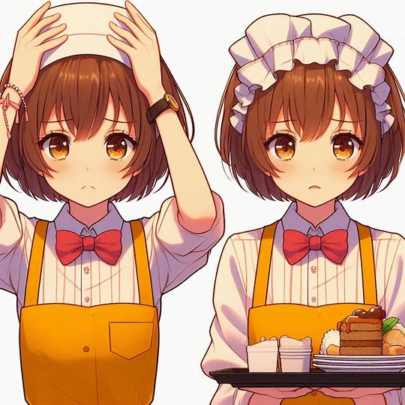
Notes:
Generate images for the main character to learn restaurant part-time, at first, the work is more difficult than expected. The main character is a high school girl with short brown hair, brown eyes, wearing a yellow dress, white collar, red bow tie, anime style, and can be divided into several stages of the picture!
一開始，餐廳的工作比我想的還要困難。

Slide 5
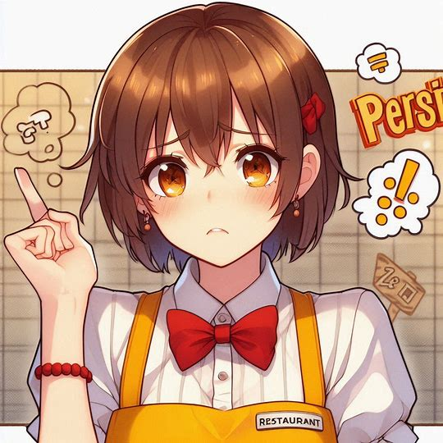
Notes:
Generate images for the main character to learn restaurant part-time, at first, the work is more difficult than expected. The main character is a high school girl with short brown hair, brown eyes, wearing a yellow dress, white collar, red bow tie, anime style, and can be divided into several stages of the picture!
Generated picture content for the protagonist to learn restaurant part-time work, thought part-time work is just simple delivery and cleaning, but every day to face a large number of customers, memorize the complex menu, and often meet the picky customers. The main character is a high school girl with short brown hair, brown eyes, wearing a yellow dress, white collar, red bow tie, anime style.
我以為打工只是簡單的送餐和清潔，

Slide 6

Notes:
Generate images for the main character to learn restaurant part-time, at first, the work is more difficult than expected. The main character is a high school girl with short brown hair, brown eyes, wearing a yellow dress, white collar, red bow tie, anime style, and can be divided into several stages of the picture!
Generated picture content for the protagonist to learn restaurant part-time work, thought part-time work is just simple delivery and cleaning, but every day to face a large number of customers, memorize the complex menu, and often meet the picky customers. The main character is a high school girl with short brown hair, brown eyes, wearing a yellow dress, white collar, red bow tie, anime style.
但每天都要面對大量的顧客、記住複雜的菜單，而且還經常遇到挑剔的客人。我開始感到壓力很大，甚至懷疑自己是否能堅持下去。

Slide 7
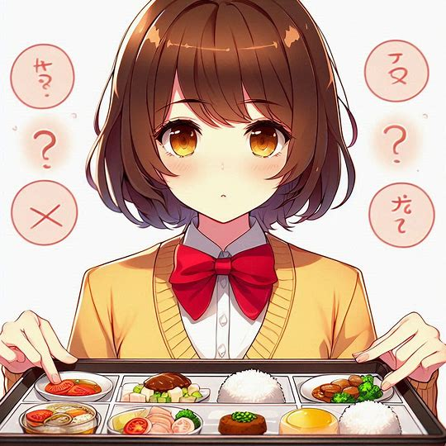
Notes:
Generate image content for Main character does not give up easily. The main character is a high school girl with short brown hair, brown eyes, wearing a yellow dress, white collar, red bow tie, and anime style.
但我不想輕易放棄。

Slide 8
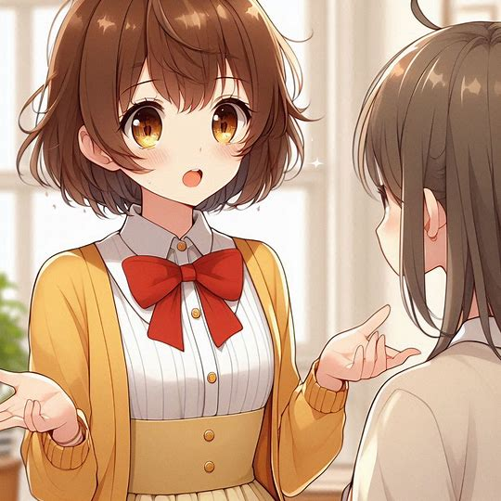
Notes:
image content for the protagonist begins to try to memorize the details of each dish. The main character is a high school girl with short brown hair, brown eyes, wearing a yellow dress, white collar, red bow tie, and anime style.
為了適應工作，我開始記住每道菜的細節，

Slide 9

Notes:
Generate a picture of the protagonist asking a senior colleague for advice on how to deal with a busy situation. The main character is a high school girl with short brown hair, brown eyes, wearing a yellow dress, white collar, red bow tie, and anime style.
當沒客人時，我就會請教資深的同事如何處理繁忙時的狀況。我還主動承擔更多責任，學會了如何高效管理時間和應對突發狀況。

Slide 10
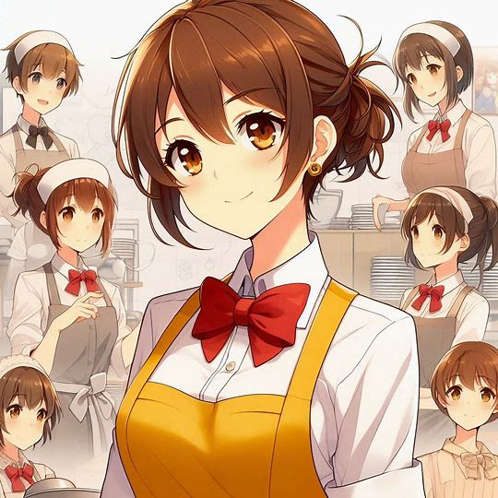
Notes:
Generate image content for the protagonist's restaurant work performance has improved greatly. The main character is a high school girl with short brown hair, brown eyes, wearing a yellow dress, white collar, red bow tie, and anime style.
經過幾個月的努力，我的工作表現也有了很大提升。

Slide 11
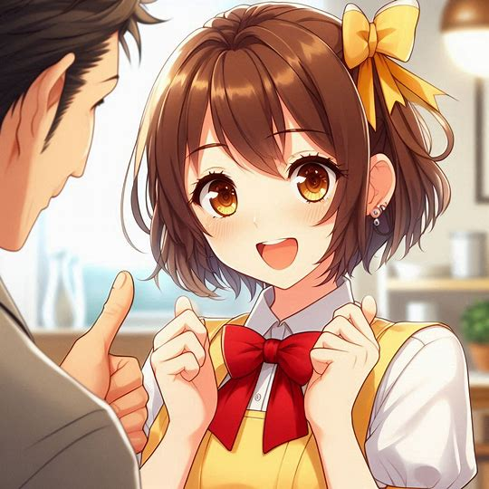
Notes:
Generate pictures of the protagonist skillfully dealing with different types of customers and begin to understand the details behind the operation of the restaurant. The main character is a high school girl with short brown hair, brown eyes, wearing a yellow dress, white collar, red bow tie, and anime style.
我能熟練地應對不同類型的客人，也開始理解餐廳運作背後的細節。

Slide 12
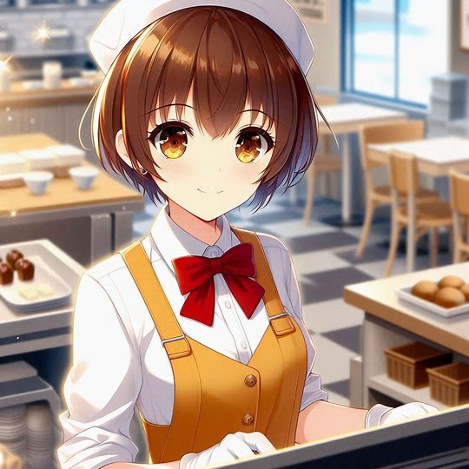
Notes:
Generate image content for the protagonist to be praised by the manager of the restaurant for my progress. The main character is a high school girl with short brown hair, brown eyes, wearing a yellow dress, white collar, red bow tie, and anime style.
餐廳經理注意到了我的進步，並對我的表現給予了高度肯定，這讓我感到非常開心。

Slide 13
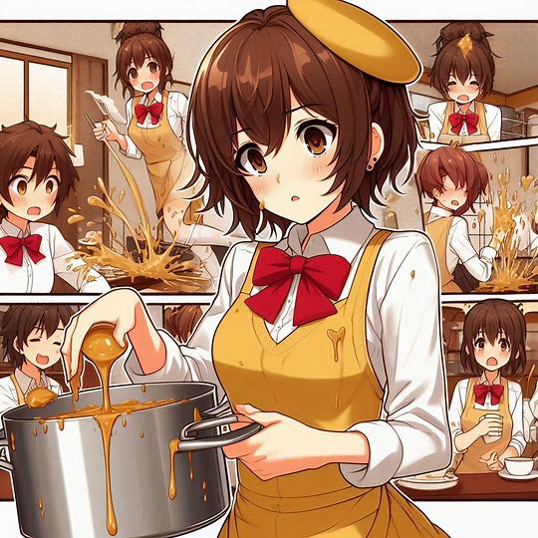
Notes:
Generate a picture of the main character working in a restaurant. The main character is a high school girl with short brown hair, brown eyes, wearing a yellow dress, white collar, red bow tie, and an anime style!
就在我逐漸適應工作的時候，

Slide 14

Notes:
Generated image content for the protagonist working in a restaurant, accidentally spilled the whole pot of soup, dirtying the clothes of several customers. The main character is a high school girl with short brown hair, brown eyes, wearing a yellow dress, white collar, red bow tie, and an anime style!
一次忙碌的晚餐時段，我不小心打翻了整鍋湯，弄髒了幾個客人的衣服。

Slide 15
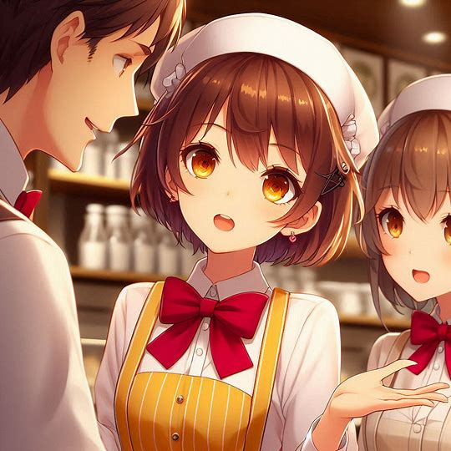
Notes:
Generate a picture of the main character worried being fired. The main character is a high school girl with short brown hair, brown eyes, wearing a yellow dress, white collar, red bow tie, and an anime style!
當時我感到非常緊張，覺得自己可能會被解僱。

Slide 16
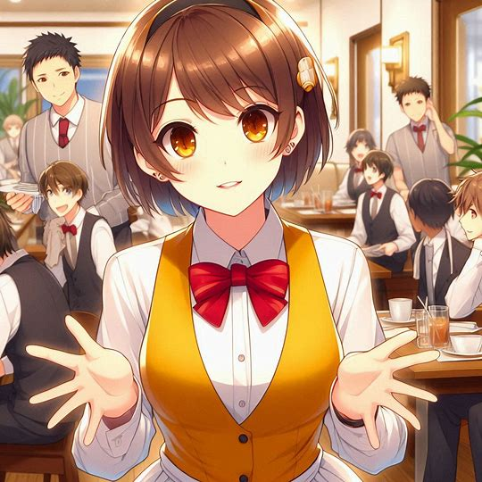
Notes:
Generated image content for protagonist Instead of blaming me, the manager of the restaurant encouraged me to calm down. The main character is a high school girl. The protagonist is a high school girl with short brown hair, brown eyes, wearing a yellow dress, white collar, red bow tie, and an anime style!
然而，經理沒有責怪我，反而鼓勵我冷靜處理問題。

Slide 17
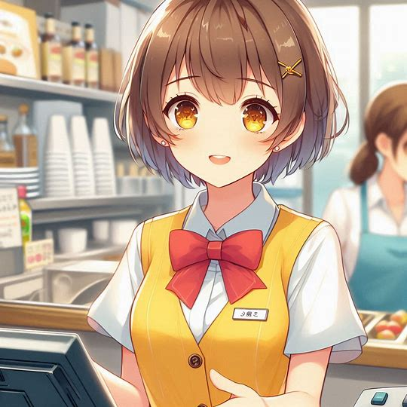
Notes:
Generate picture content for the protagonist to apologize to the restaurant guests and help colleagues to clean up the scene. The protagonist is a high school girl with short brown hair, brown eyes, wearing a yellow dress, white collar, red bow tie, and an anime style!
我馬上向客人道歉，並協助同事清理現場。這次意外教會我如何在壓力下保持冷靜並迅速解決問題。

Slide 18
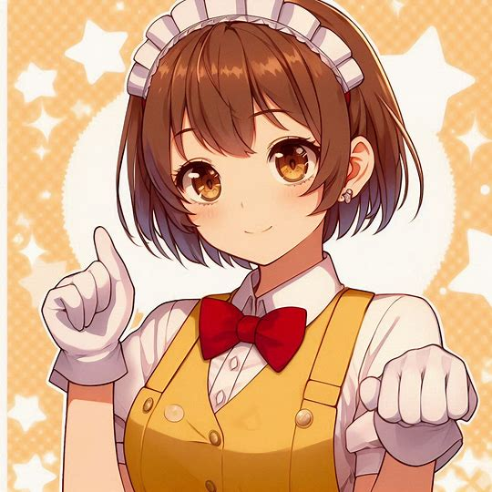
Notes:
Generated image content for the protagonist restaurant part-time job experience allows him to learn the work skills and understand the sense of responsibility and the importance of coping with challenges, the protagonist is a high school girl, short brown hair, brown eyes, wearing a yellow dress, white collar, red bow tie, to be anime style!
這次打工經歷讓我學到了工作技能，並明白了責任感和應對挑戰的重要性。

Slide 19
Notes:
Generated image content for the protagonist did not give up the restaurant part-time job, the protagonist is a high school girl, short brown hair, brown eyes, wearing a yellow dress, white collar, red bow tie, to be anime style!
雖然起初很困難，但我很慶幸沒有放棄，這些寶貴的經驗將成為我未來生活中的重要財富。以上是我的冒險故事，謝謝大家。

