Slide 1
自我介紹
(niziima Live)
Notes:
大家好，接下來用故事七步驟來跟大家分享我的故事

Slide 2
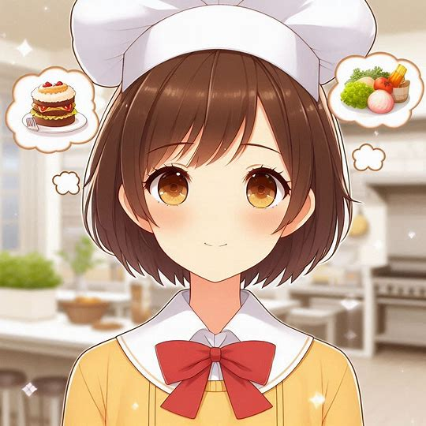
1.目標
Notes:
Generate a picture of a girl high school student with short brown hair, brown eyes, wearing a yellow dress with a white collar and a red bow tie, and dreaming of becoming a chef.
我是一名高中生，從小對料理充滿興趣。看到食材變成美味佳餚，讓我非常開心。我的夢想是成為專業廚師，開一間自己的餐廳，讓大家品嚐我的料理。

Slide 3
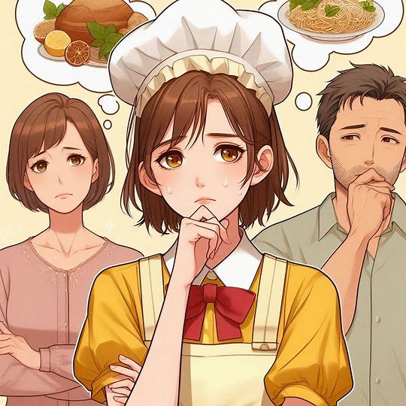
2.阻礙
Notes:
Generate a picture, content to be Family members think that being a chef is heavy and hard work, and worry that the income from this career is not stable, and their opposition makes me start to doubt whether my dream is realistic. The main character is a female high school student with short brown hair, brown eyes, wearing a yellow dress with a white collar and a red bow tie
不過，家人認為當廚師工作繁重且辛苦，還擔心這個行業收入不穩定，希望我能選擇一個更穩定的職業。他們的反對讓我開始懷疑自己的夢想是否現實。

Slide 4
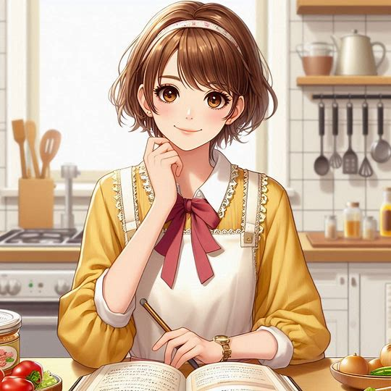
3.努力
Notes:
Generate a picture, after continuous learning and practice, my cooking skills gradually improved, not only gained the appreciation of my family and friends. This made me even more determined to become a chef. The protagonist is a female middle school student with short brown hair, brown eyes, wearing a yellow dress with a white collar and a red bow tie
為了證明自己，我在課後自學烹飪，觀看節目、閱讀食譜，並在家中實驗。此外，我週末在當地餐廳打工，學習餐廳運作，體驗廚師的工作環境。

Slide 5

4.結果
Notes:
Generating a picture, the protagonist makes dishes that are appreciated by his family and friends, making him determined to become a chef. The protagonist is a female middle school student with short brown hair, brown eyes, wearing a yellow dress with a white collar and a red bow tie
經過不斷的學習與實踐，我的廚藝漸漸得到了提升，不僅獲得了家人與朋友的讚賞。這讓我更加堅定了想成為廚師的決心。

Slide 6
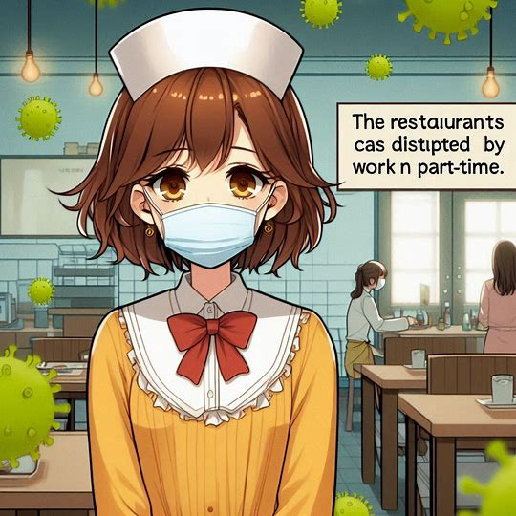
5.意外
Notes:
Generate a picture where the protagonist's plans are disrupted by an epidemic. The restaurant was closed and I could not continue to work part-time, which made me feel a bit lost because I could not continue to learn in a real-world setting. The protagonist is a female middle school student with short brown hair, brown eyes, wearing a yellow dress with a white collar and a red bow tie
然而，當我以為一切都步上正軌時，突如其來的疫情打亂了計畫。餐廳歇業，我無法再繼續打工，這讓我感到有些迷茫，因為無法繼續在實際環境中學習。

Slide 7
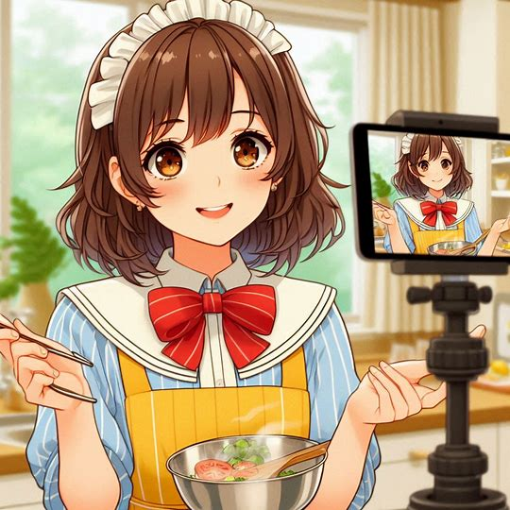
6.轉彎
Notes:
Generate a picture of the protagonist sharing my cooking tips online, which unexpectedly gained a lot of attention. The protagonist is a female middle school student with short brown hair, brown eyes, wearing a yellow dress with a white collar and a red bow tie
在困難時期，我反而嘗試新的烹飪方法，特別是用簡單食材創作料理，並在網路上分享心得，意外獲得了許多關注，為我開啟了新的道路。

Slide 8
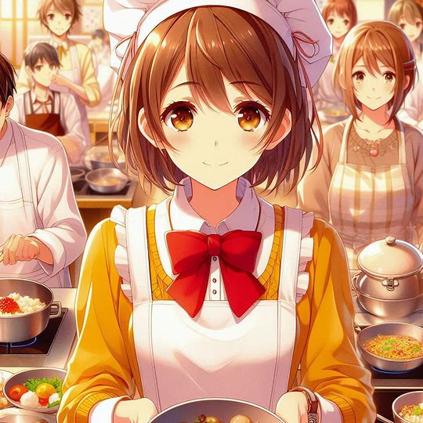
7.結局
Notes:
Generate a picture, will continue to improve their skills and touch more people with their cuisine. The protagonist is a female middle school student with short brown hair, brown eyes, wearing a yellow dress with a white collar and a red bow tie
雖然過程比我想像的更艱難，但這些經歷讓我更加確信，成為廚師不只是我的夢想，而是我能實現的目標。未來，我會繼續提升技術，用我的料理感動更多人。以上為我的自我介紹，謝謝大家。

