Slide 1
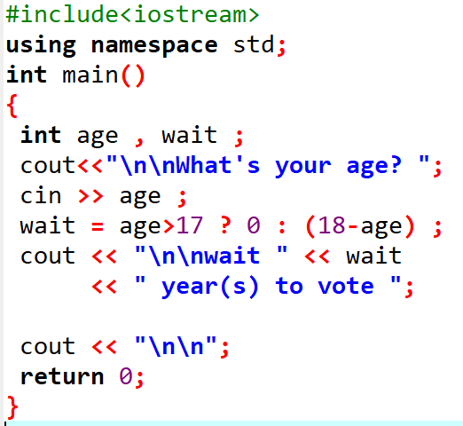

Slide 2
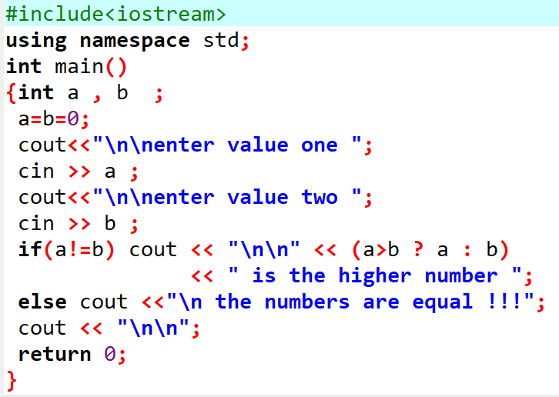

Slide 3
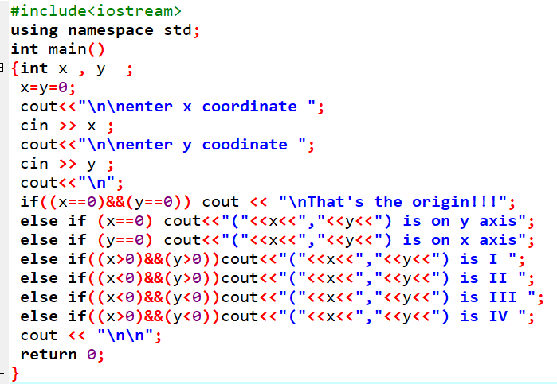
Can this be re-written well with the ? : operator ?
Or is it best left with if else statements ?

