Slide 1
Lab 1
Git and GitHub

Slide 2
Objectives
Towards the end of this lab, you should be able to
Differentiate between Git and GitHub
Create a GitHub account
Maintain both local and remote repositories using Git commands.

Slide 3
What is Git?
Git is a free and open source distributed version control system designed to handle everything from small to very large projects with speed and efficiency.
(https://git-scm.com/, 2015)

Slide 4
What is GitHub?
A website on which you can host and publish your Git repositories as well as collaborate with others.
Provides basic functionalities to maintain your repositories.
The difference between Git and GitHub can be found at https://youtu.be/B44jvGEdrko

Slide 5
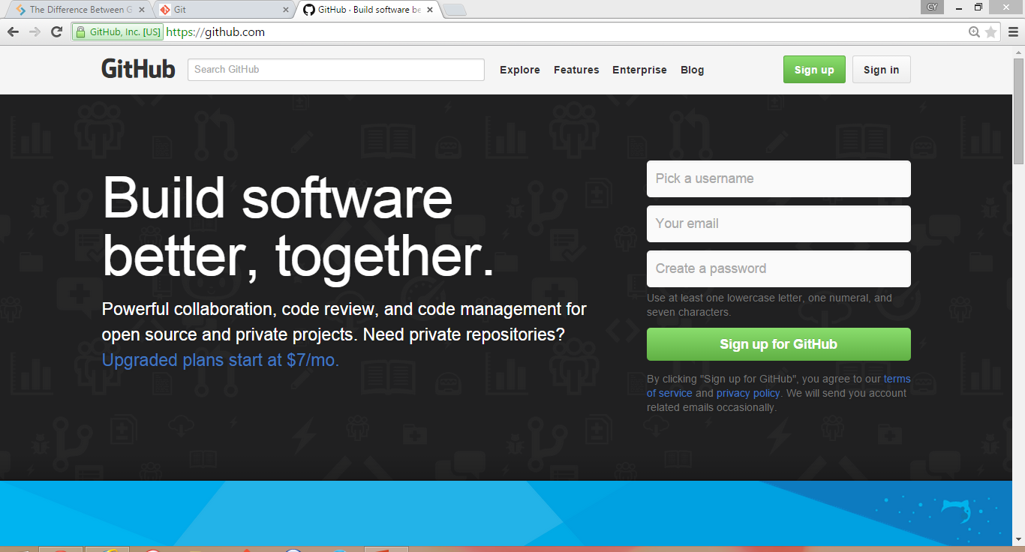
Creating a GitHub Account
Navigate to https://github.com
Create a new account by clicking at the “sign up” button.

Slide 6
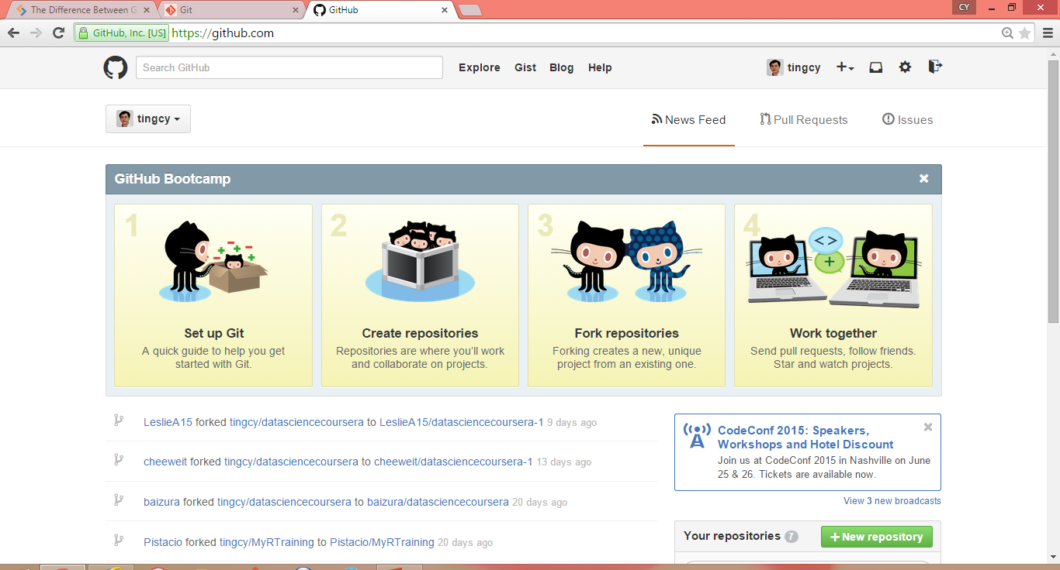
Creating a GitHub Account
Using your username and password, once log in, you should see your username appear at the right-upper corner of the webpage.

Slide 7
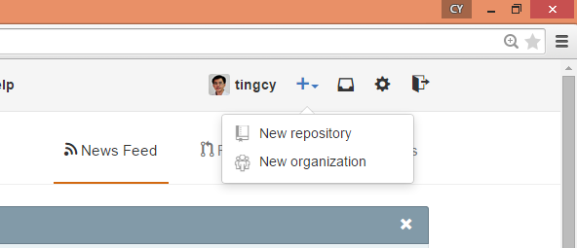
Creating a GitHub Account
Click at the “+” sign to create a new repository.

Slide 8
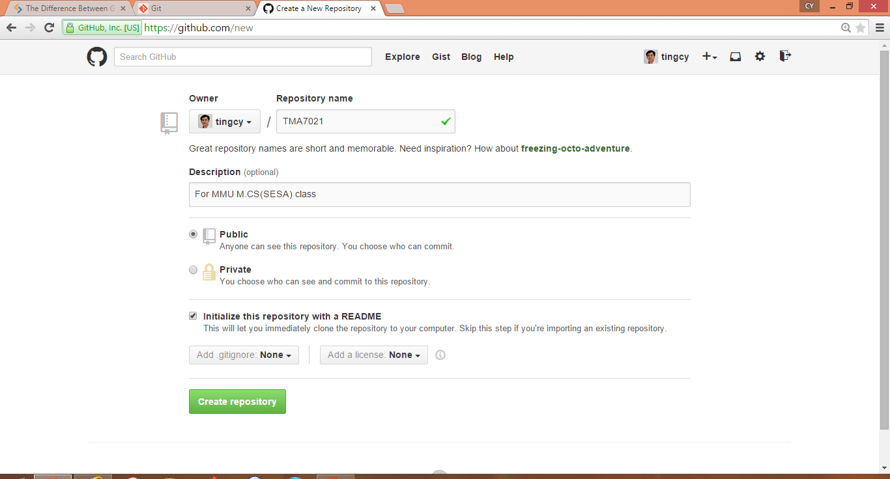
Creating a GitHub Account
Type “TMA7021” at the “Repository name”
Put some description to your repository (optional).
Tick at the checkbox “Initialize this repository with a README”
Lastly, click at the “Create repository” button.

Slide 9
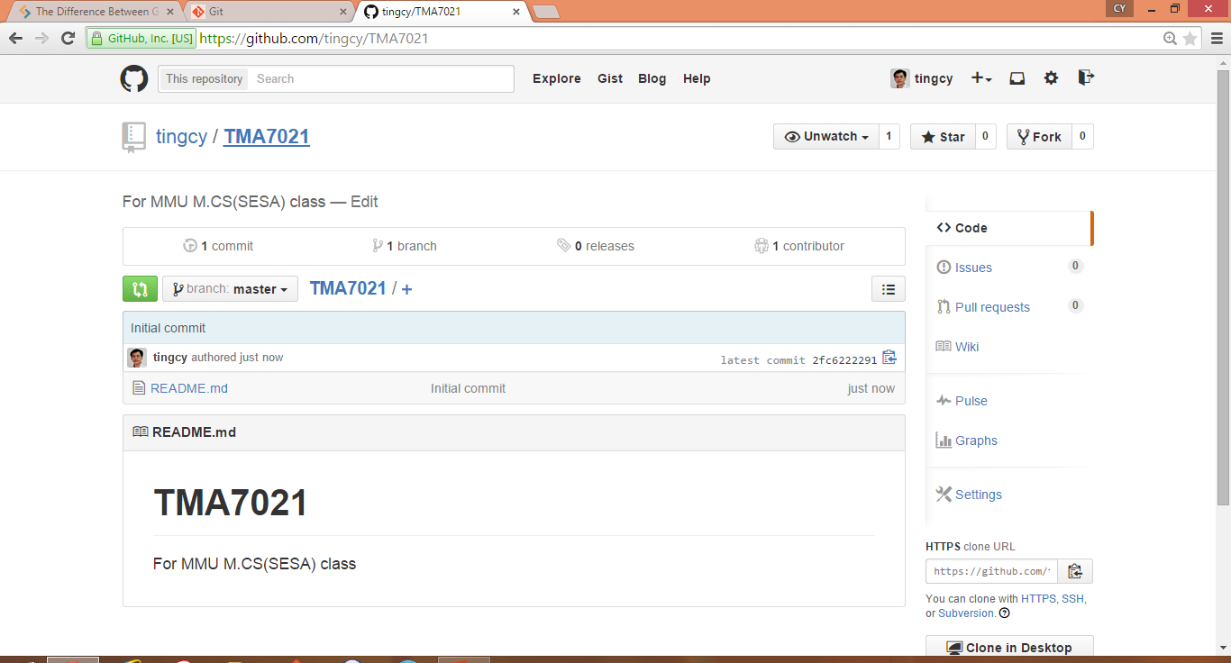
Creating a GitHub Account
A new repository TMA7021 has been successfully created for you!
The content of the README.md file is “TMA7021” and “For MMU M.CS(SESA) class”
At the HTTPS clone URL section, copy the URL.

Slide 10
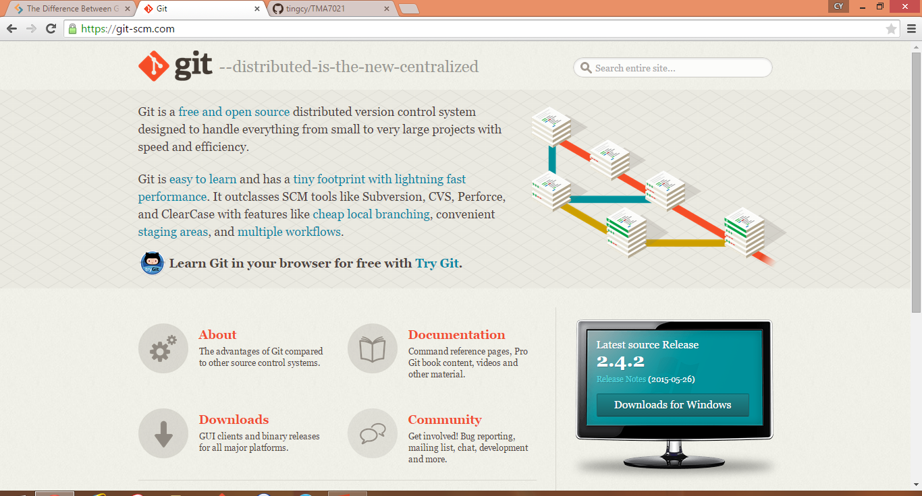
Installing Git
Navigate to https://git-scm.com/ to download git.
Select the appropriate platform.

Slide 11
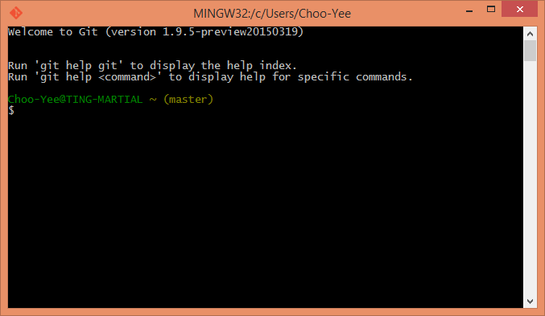
Git Bash
After installing git, execute the Git Bash program.

Slide 12
Git Bash Commands: Cloning a Repo
Type the following commands:
$ git config --global user.name "YOUR NAME“
$ git config --global user.email "YOUR EMAIL“
Navigate to the directory/folder where you want to place the clone copy of the remote repo. E.g., I want to place to clone repo into the directory Dropbox\Teaching\TMA7021_DMAnalytics, I type
$ cd Dropbox/Teaching/TMA7021_DMAnalytics

Slide 13
Git Bash Commands: Cloning a Repo
To list the content of the folder, you type:
$ ls
Before cloning, make sure you have copied the URL (see slide 9). To start cloning the remote repo TMA7021, you type:
$ git clone https://github.com/XXX/yyy.git
Type ls to check the content of the directory/folder, you should see TMA7021 created. Navigate into TMA7021 by using the command
$ cd TMA7021

Slide 14

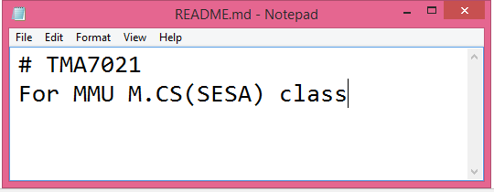
Creating a GitHub Account
Check the content of TMA7021 by issuing the command ls. You should see README.md
Open the file using
notepad and you will see
the content. You can edit
the content.

Slide 15
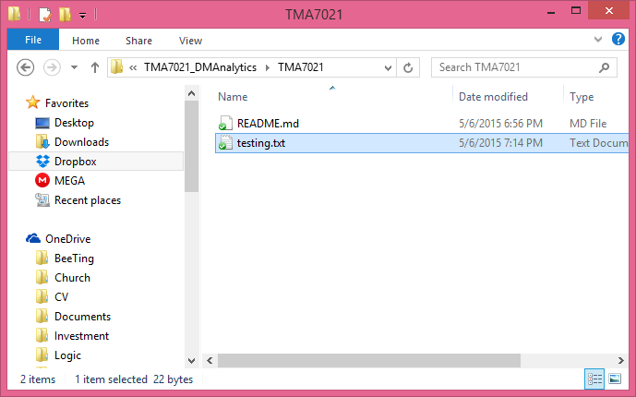
Adding a File to Remote Repo
If you are using Windows, use the File Explorer to navigate TMA7021.
Create a new file named testing.txt. The content of the file should be “This is my first test.”

Slide 16
Adding a File to Remote Repo
Using Git Bash, check whether testing.text is inside TMA7021.
Type the following set of commands to add the file into your remote repo:
$ git add testing.txt
$ git commit –m “adding new file”
$ git push
Key in your username and password of your GitHub account.

Slide 17
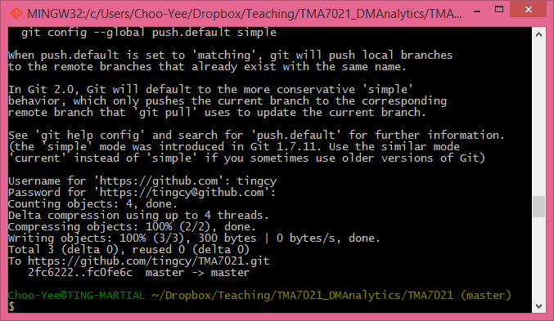
Adding a File to Remote Repo
Message is shown indicating that file has been successfully uploaded to your GitHub repo.

Slide 18
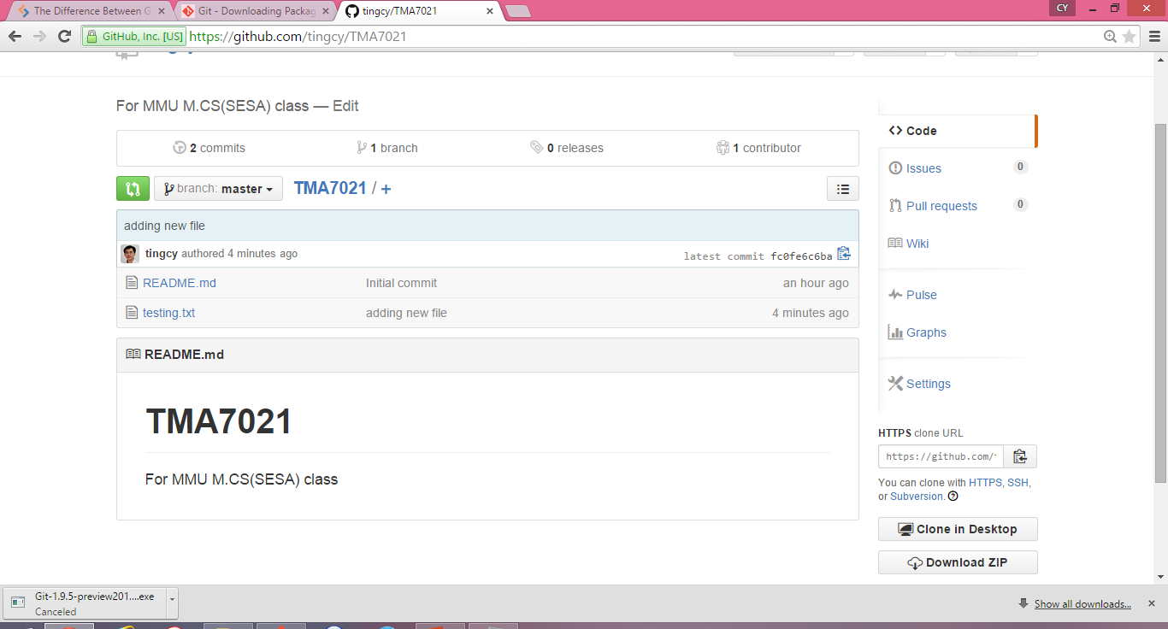
Adding a File to Remote Repo
Refresh your GitHub and testing.txt is added to your remote repo

Slide 19
Remove a Local Repo
In case you need to remove the current local repo, so that you can re-clone the remote repo, the command is
$ rm –rf TMA7021
Note: Make sure you know what you are doing.

Slide 20
Remove a File from both Local and Remote Repo
In case you need to remove a file (in this example testing.txt) from both local and remote repo, the command is
$ git rm testing.txt
$ git commit -m "remove file testing.txt
$ git push
You will need to key in username and password.
Note: Make sure you know what you are doing.

