Slide 1

CYBERBULLYING
TING HAO KAO & SHIRIN ABOUSALIH

Slide 2

PROJECT DESCRIPTION:
In the dataset, each row represents a tweet in Turkish and has a sentiment column ("IsCyberbullying") that gives the information if the tweet has or not cyberbullies

Slide 3
PROCESS:
To clean our dataset with Pandas Database storing through SQLalchemy
To show at least 3 output tables with queries

Slide 4
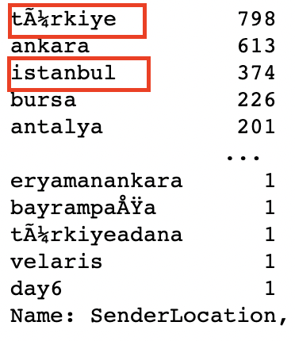
CHALLENGES:
Removing Mojibake
Abnormal Tweet ID and User ID
Deciding which columns to drop

Slide 5
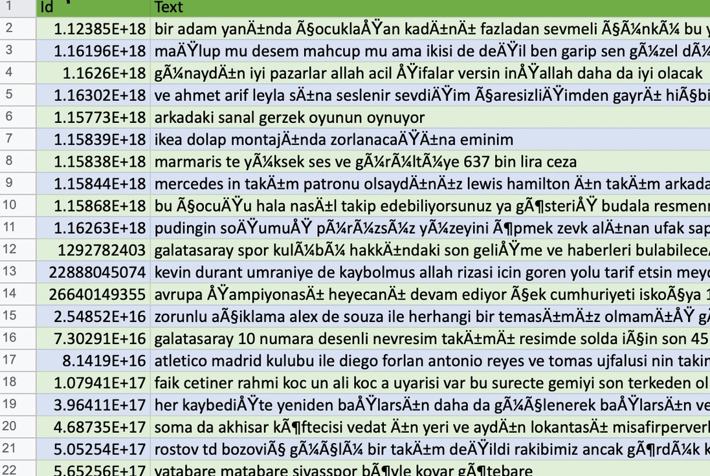
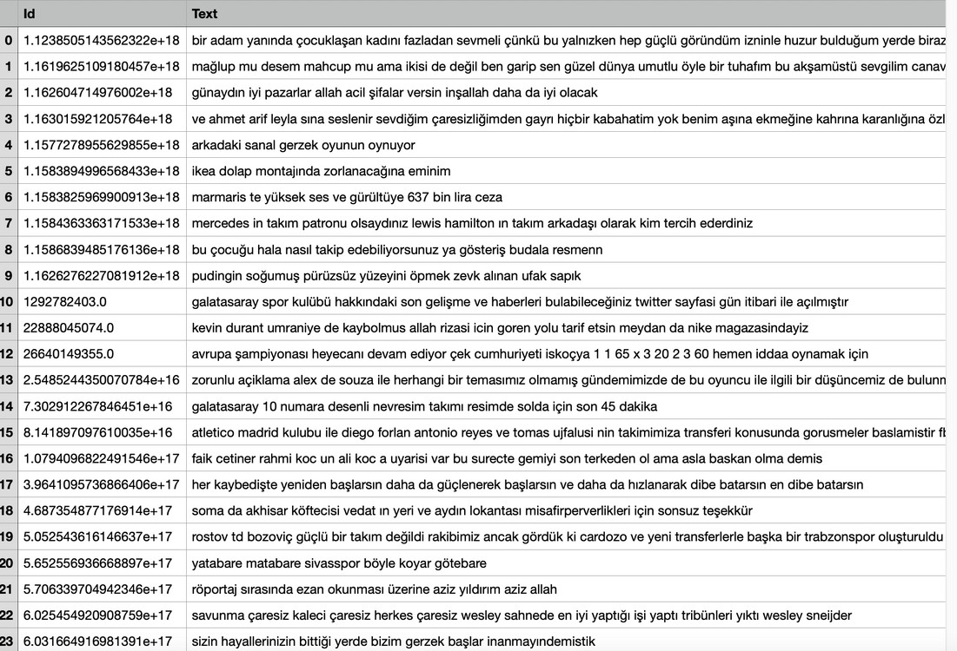
INITIAL & FINAL DATASET :

Slide 6
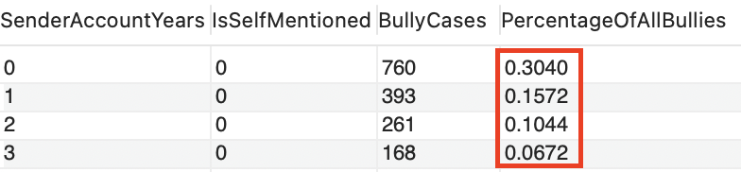
MAIN OBSERVATIONS:
More than 60% of Cyberbullying cases are from accounts with less than 3 years of existence
More than 70% of Cyberbullying cases are texts with less than 100 characters
More than 76% of Cyberbullying cases have less than 3 punctuations in the texts

Slide 7
DEMO TIME !

Slide 8
THANK YOU
ANY QUESTIONS ?

