Slide 1
AirBnB Prices and The Prices Of Houses In The Various Cities
Notes:
We also took a look at the prices of houses and the Airbnb listings in the different cities to see if there is any relationship between the two

Slide 2
INSTRUCTIONS FOR USE
The Question
Does the Price of houses in a particular city have a direct correlation to the price of AirBnB ?
Notes:
So our question here was ...

Slide 3
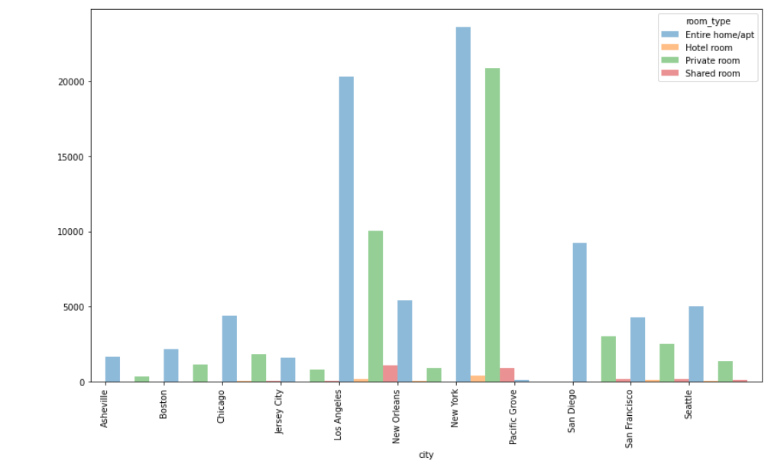
Airbnb Room Types
Notes:
So before we take a look at the correlation between the two variables, we wanted to show the different types of Airbnb in the various cities . Entire home or apartment made the majority of the listings across the cities and as we can see LA And New your had the most also the shared the room was the least and again LA and new your had a reasonable about of those

Slide 4
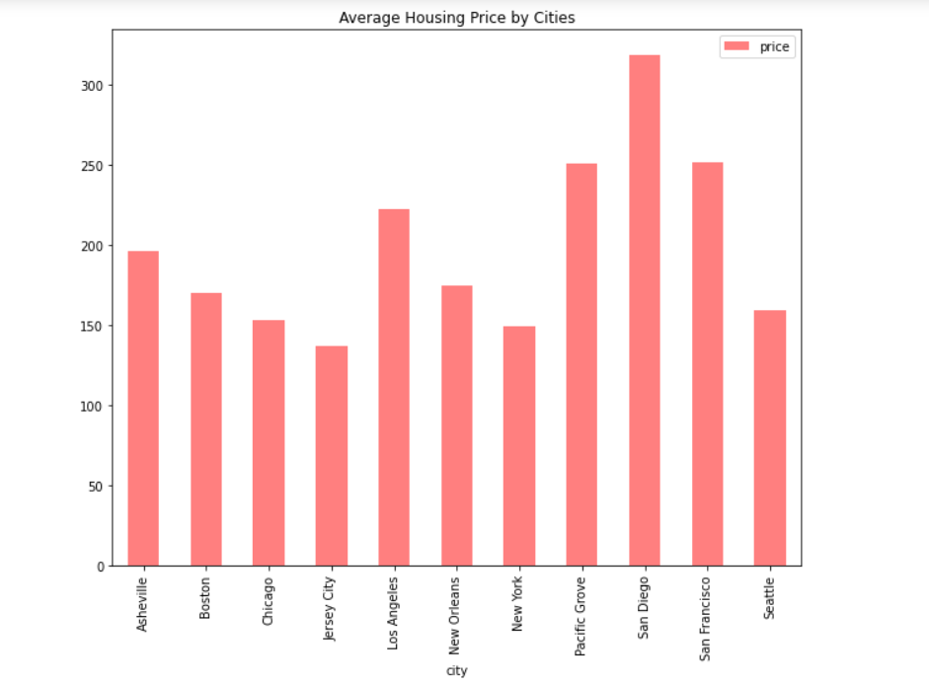
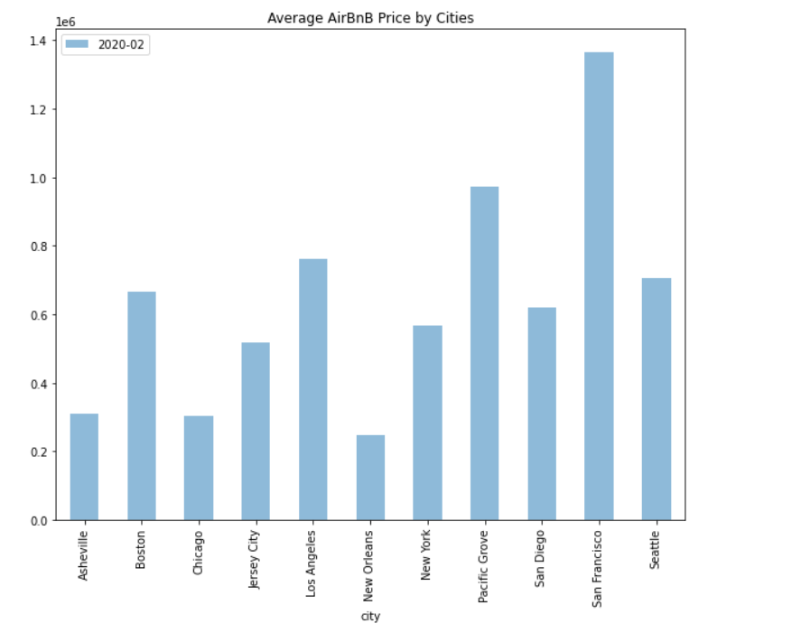
Notes:
We took a look at the average price of Airbnb and the average price of houses on the market.

Slide 5
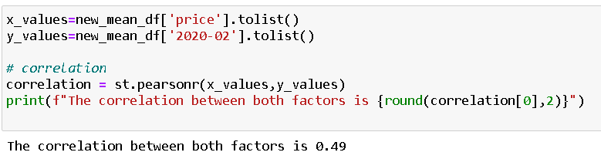
Do Housing Prices in Each City Correlate to the Prices of AirBnB
Notes:
Positive correlation of .49, which is a moderate correlation. Showing there is a moderate linear relationship between the housing prices and Aibnb prices.
There is 0.49 of variability of price of Airbnb is explained by price of houses and the rest is explained in the other factors that isn’t explained in our studies

Slide 6
THE END

