Slide 1

Airbnb and the Housing Market

Slide 2





A1 TEAM MEMBERS
Niraj Khatri
Clay Bazzle
Grace Arhin
Josh Mills
Ting Jennings

Slide 3
Does Airbnb Have an Impact on Housing?

Slide 4
About Airbnb and This Study
Airbnb is a member of the sharing economy
Controversies in the renting industry
Short term housing vs long term housing

Slide 5


Data Cleaning: Starting Files
Zillow real estate data: average sales price of homes by city from 2008 to the beginning of 2020
Airbnb rental data: mostly from 2020. Some properties did not have reviews left in 2020.

Slide 6
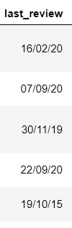
Data Cleaning: Challenges
Some dates in the Airbnb data set were formatted dd/mm/yyyy and others mm/dd/yyyy. The format was changed so they were all uniform and then they were converted to match the yyyy-mm format used in the Zillow data set.
Airbnb: “New York City” was sometimes labeled simply as “New York” and we grouped them together.
The merged DataFrame was done by city and based on 11 cities that matched between the two data sets.

Slide 7
Number of Airbnb Listings vs Housing Prices
1

Slide 8
Hypthoesis:
Did the number of Airbnb listings affect the change in home sale price over a given time period?

Slide 9
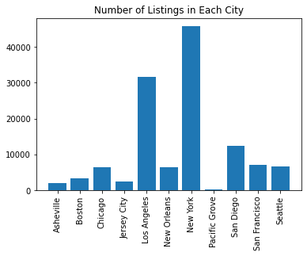
Airbnb Listings by City
City | # of Listings
Asheville | 2,074
Boston | 3,339
Chicago | 6,397
Jersey City | 2,488
Los Angeles | 31,536
New Orleans | 6,408
New York | 45,756
Pacific Grove | 179
San Diego | 12,404
San Francisco | 7,053
Seattle | 6,575

Slide 10
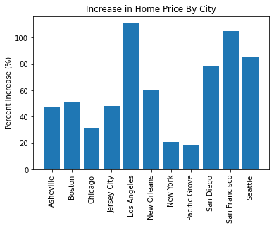
Housing Price Change by City
City | % Change
Asheville | 51.36%
Boston | 31.30%
Chicago | 48.00%
Jersey City | 110.82%
Los Angeles | 60.06%
New Orleans | 20.71%
New York | 19.07%
Pacific Grove | 78.80%
San Diego | 105.07%
San Francisco | 85.29%
Seattle | 51.36%

Slide 11
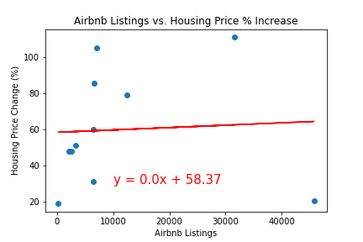
The correlation between both factors is .06
From the given data, it appears that the Airbnb listing count has little to no effect on the change in housing prices over multiple years

Slide 12
Reviews per Month vs Housing Prices
2

Slide 13
Hypothesis
Was there any correlation between average housing price and the Airbnb reviews left per month in each city?

Slide 14
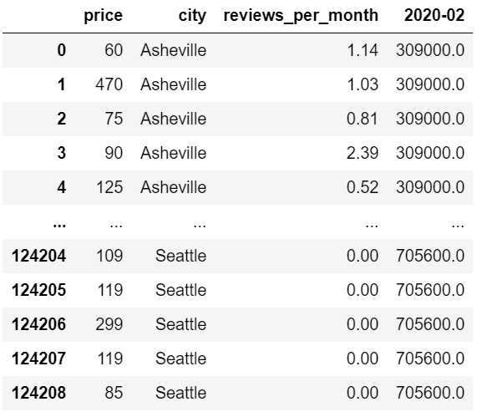
DataFrame

Slide 15
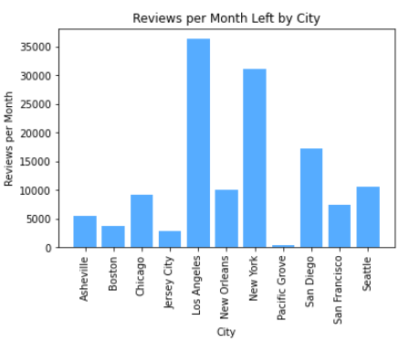

Slide 16
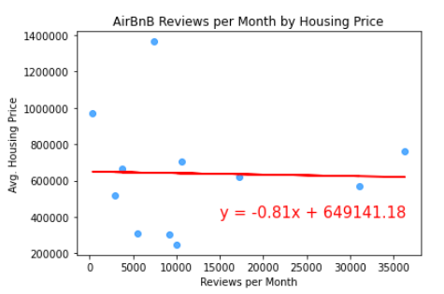
The r-squared value is: 0.000836.
There appears to be no correlation between average housing price and reviews left per month on Airbnb rentals.

Slide 17
Bonus Question
Was there any correlation between Airbnb rental price and the reviews left per month in each city?

Slide 18
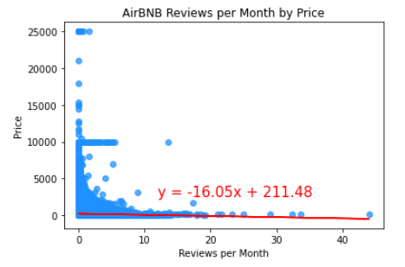
The r-squared value is: 0.00191.
There is a strong, negative, nonlinear association between the two variables.

Slide 19
Airbnb Listing Price vs Housing Prices
3

Slide 20
Hypothesis
Does the Price of houses in a particular city have a direct correlation to the price of Airbnb ?

Slide 21
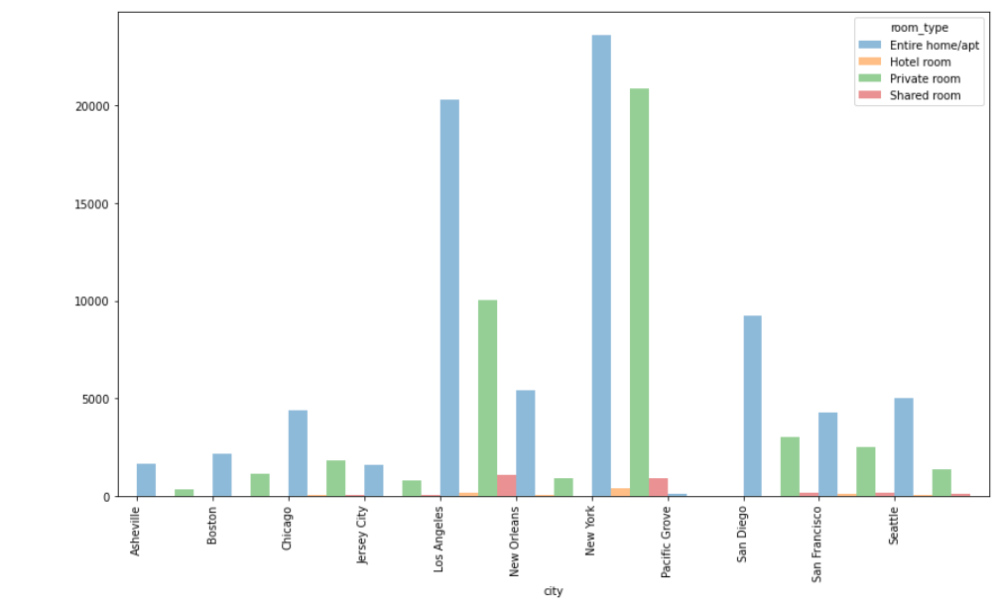
Airbnb Room Types
Notes:
So before we take a look at the correlation between the two variables, we wanted to show the different types of Airbnb in the various cities . Entire home or apartment made the majority of the listings across the cities and as we can see LA And New your had the most also the shared the room was the least and again LA and new your had a reasonable about of those

Slide 22
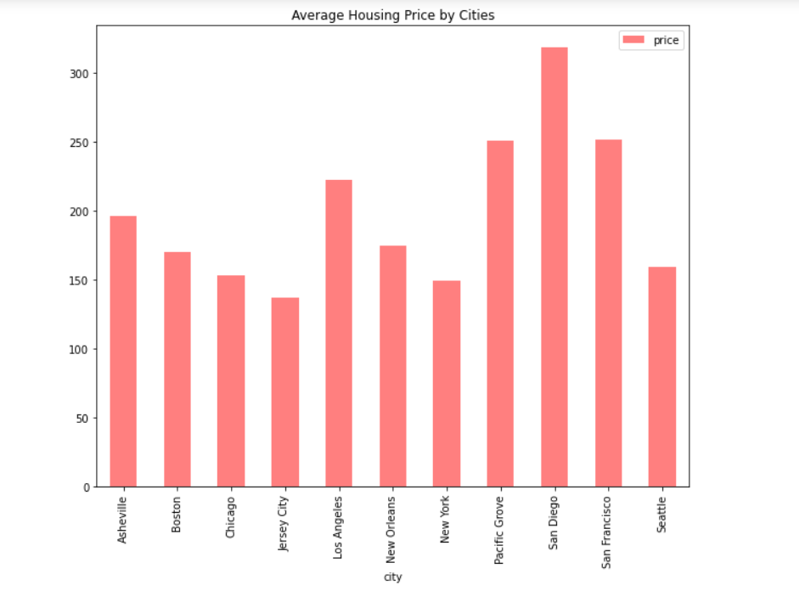
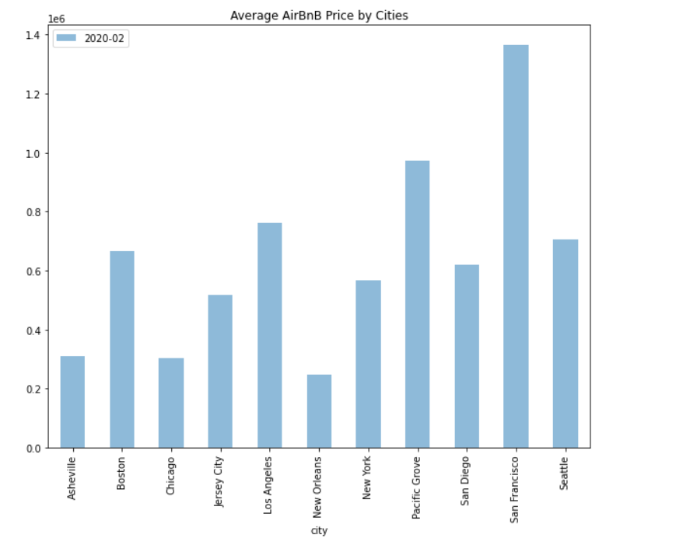
Notes:
We took a look at the average price of Airbnb and the average price of houses on the market.

Slide 23
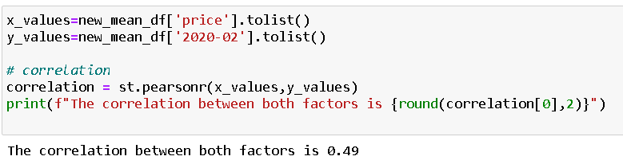
Do Housing Prices in Each City Correlate to the Prices of Airbnb
Notes:
Positive correlation of .49, which is a moderate correlation. Showing there is a moderate linear relationship between the housing prices and Aibnb prices.
There is 0.49 of variability of price of Airbnb is explained by price of houses and the rest is explained in the other factors that isn’t explained in our studies

Slide 24
Company/Privately Owned vs Housing Prices
4

Slide 25
Hypthoesis:
Do Airbnbs owned by a company have any affect on how the price of sold homes?

Slide 26
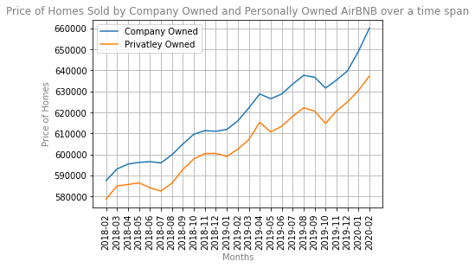
More than 5 companies owned by one lister is classified as company owned

Slide 27
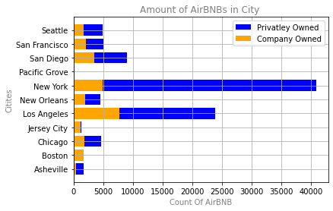
Count of Privatley Owned vs Company Owned
City | Privatley Owned | Company Owned | Total
Asheville | 1691 | 383 | 2074
Boston | 1675 | 1664 | 3339
Chicago | 4584 | 1813 | 6397
Jersey City | 1333 | 1155 | 2488
Los Angeles | 23870 | 7666 | 31536
New Orleans | 4496 | 1912 | 6408
New York | 40823 | 4933 | 45756
Pacific Grove | 120 | 59 | 179
San Diego | 8937 | 3467 | 12404
San Francisco | 4984 | 2069 | 7053
Seattle | 4862 | 1713 | 6575

Slide 28
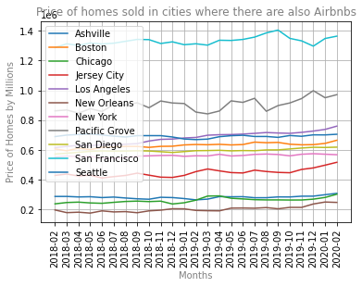
Average price of sold homes in collective cities vs Privatley and Company Owned

Slide 29
City Comparisons (New York, San Francisco, and Chicago)
5

Slide 30
Hypthoesis:
How do home prices and reviews in 3 cities compare with one another?

Slide 31
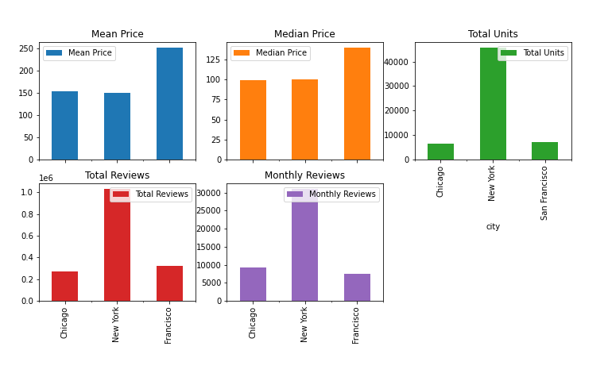
Notes:
Entire home/apt - Majority / shared room- least(LA & New York)

Slide 32
From the visualization, we can see that New York has the most units and the most reviews but San Francisco has the highest mean and median prices.

Slide 33
Final Data Considerations
More Airbnb Data Fields Required
For example, how many times a listing sold, the total revenue generated from the listing, dates when listings were sold
Only 11 Shared Cities
Only 11 cities appeared in both sets of the data. More cities would provide better clarity
More Recent Data Required
No 2021 data for either Zillow and Airbnb

Slide 34
THANK YOU!

Slide 35
INSTRUCTIONS FOR USE
EDIT IN GOOGLE SLIDES
Click on the button under the presentation preview that says "Use as Google Slides Theme".
You will get a copy of this document on your Google Drive and will be able to edit, add or delete slides.
You have to be signed in to your Google account.
EDIT IN POWERPOINT®
Click on the button under the presentation preview that says "Download as PowerPoint template". You will get a .pptx file that you can edit in PowerPoint.
Remember to download and install the fonts used in this presentation (you’ll find the links to the font files needed in the Presentation design slide)
More info on how to use this template at www.slidescarnival.com/help-use-presentation-template
This template is free to use under Creative Commons Attribution license. You can keep the Credits slide or mention SlidesCarnival and other resources used in a slide footer.

Slide 36
Did the number of Airbnb listings affect the change in price over a given time period?

Slide 37
YOU CAN ALSO SPLIT YOUR CONTENT
White
Is the color of milk and fresh snow, the color produced by the combination of all the colors of the visible spectrum.
Black
Is the color of ebony and of outer space. It has been the symbolic color of elegance, solemnity and authority.

Slide 38

A PICTURE IS WORTH A THOUSAND WORDS
A complex idea can be conveyed with just a single still image.
Namely making it possible to absorb large amounts of data quickly.

Slide 39

WANT BIG IMPACT?
USE BIG IMAGE.

Slide 40
USE CHARTS TO EXPLAIN YOUR IDEAS

Slide 41
MAPS
our office

Slide 42
89,526,124
Whoa! That’s a big number, aren’t you proud?

Slide 43
89,526,124$
185,244 users
100%
That’s a lot of money
And a lot of users
Total success!

Slide 44
OUR PROCESS IS EASY
first
second
last

Slide 45
LET’S REVIEW SOME CONCEPTS
Yellow
Is the color of gold, butter and ripe lemons. In the spectrum of visible light, yellow is found between green and orange.
Blue
Is the colour of the clear sky and the deep sea. It is located between violet and green on the optical spectrum.
Red
Is the color of blood, and because of this it has historically been associated with sacrifice, danger and courage.
Yellow
Is the color of gold, butter and ripe lemons. In the spectrum of visible light, yellow is found between green and orange.
Blue
Is the colour of the clear sky and the deep sea. It is located between violet and green on the optical spectrum.
Red
Is the color of blood, and because of this it has historically been associated with sacrifice, danger and courage.

Slide 46
4000
3000
2000
1000
0
You can insert graphs from Excel or Google Sheets

Slide 47
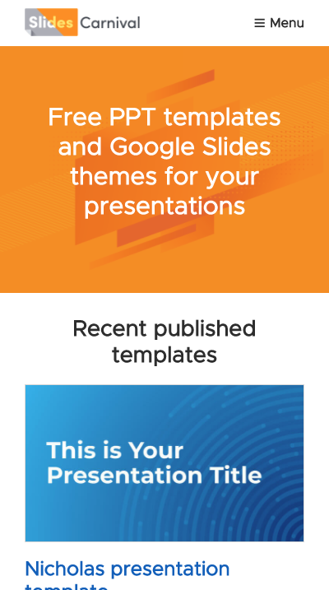
MOBILE PROJECT
Show and explain your web, app or software projects using these gadget templates.

Slide 48
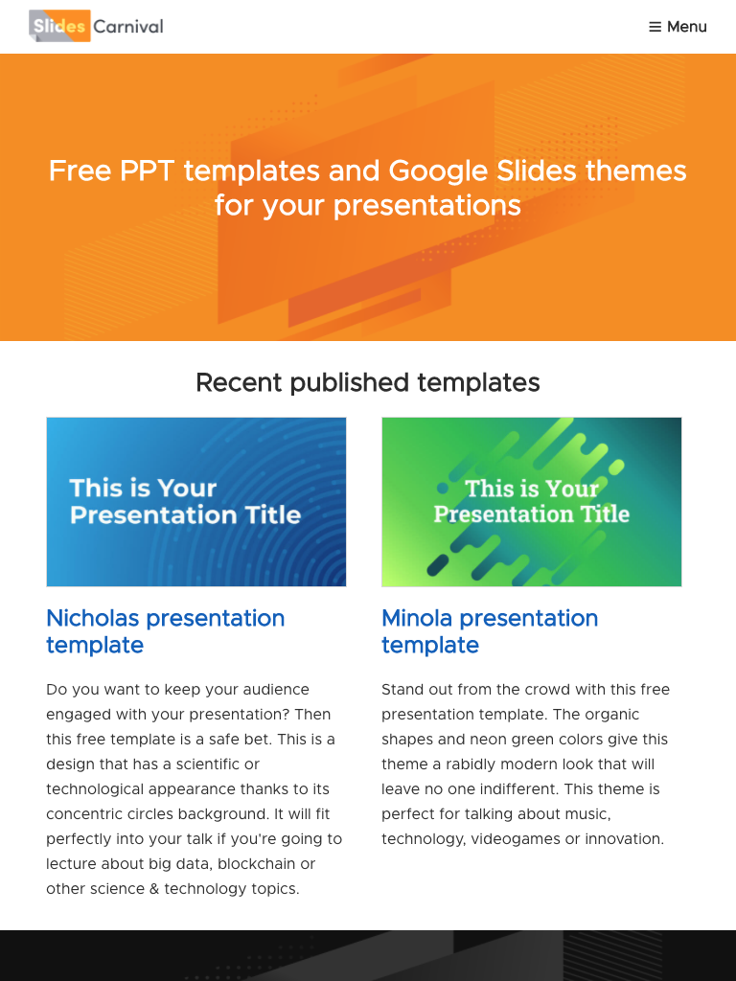
TABLET PROJECT
Show and explain your web, app or software projects using these gadget templates.

Slide 49
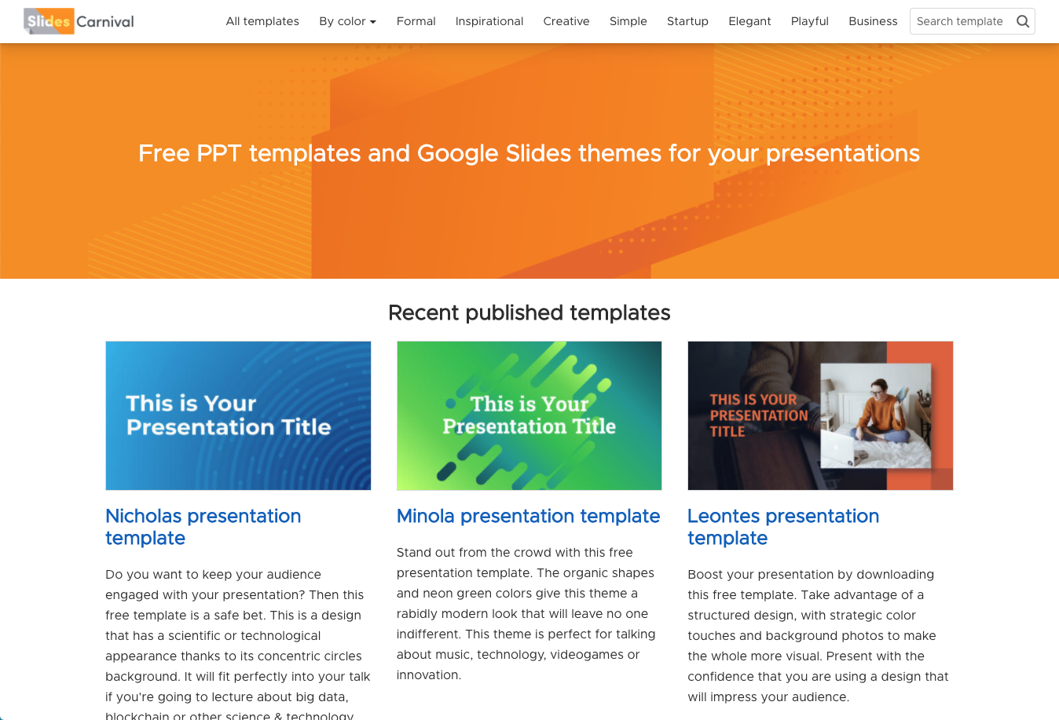
DESKTOP PROJECT
Show and explain your web, app or software projects using these gadget templates.

Slide 50
THANKS!
Any questions?
You can find me at
@username / user@mail.me

Slide 51
CREDITS
Special thanks to all the people who made and released these awesome resources for free:
Presentation template by SlidesCarnival
Photographs by Unsplash

Slide 52
PRESENTATION DESIGN
This presentation uses the following typographies:
Titles: Oswald
Body copy: Source Sans Pro
Download for free at:
https://www.fontsquirrel.com/fonts/oswald
https://www.fontsquirrel.com/fonts/source-sans-pro
You don’t need to keep this slide in your presentation. It’s only here to serve you as a design guide if you need to create new slides or download the fonts to edit the presentation in PowerPoint®

Slide 53
EXTRA RESOURCES
2
For Business Plans, Marketing Plans, Project Proposals, Lessons, etc

Slide 54
TIMELINE
Blue is the colour of the clear sky and the deep sea
Red is the colour of danger and courage
Black is the color of ebony and of outer space
Yellow is the color of gold, butter and ripe lemons
White is the color of milk and fresh snow
Blue is the colour of the clear sky and the deep sea
JAN
FEB
MAR
APR
MAY
JUN
JUL
AUG
SEP
OCT
NOV
DEC
Yellow is the color of gold, butter and ripe lemons
White is the color of milk and fresh snow
Blue is the colour of the clear sky and the deep sea
Red is the colour of danger and courage
Black is the color of ebony and of outer space
Yellow is the color of gold, butter and ripe lemons

Slide 55
ROADMAP
Blue is the colour of the clear sky and the deep sea
Red is the colour of danger and courage
Black is the color of ebony and of outer space
1
3
5
2
4
6
Yellow is the color of gold, butter and ripe lemons
White is the color of milk and fresh snow
Blue is the colour of the clear sky and the deep sea

Slide 56
GANTT CHART
 | Week 1 |  |  |  |  |  |  | Week 2
 | 1 | 2 | 3 | 4 | 5 | 6 | 7 | 8 | 9 | 10 | 11 | 12 | 13 | 14
Task 1
Task 2 |  |  |  |  |  | ◆
Task 3
Task 4 |  |  |  |  |  |  |  |  |  |  | ◆
Task 5 |  |  |  |  |  |  |  |  | ◆
Task 6
Task 7
Task 8

Slide 57
SWOT ANALYSIS
STRENGTHS
Blue is the colour of the clear sky and the deep sea
WEAKNESSES
Yellow is the color of gold, butter and ripe lemons
S
W
Black is the color of ebony and of outer space
OPPORTUNITIES
White is the color of milk and fresh snow
THREATS
O
T

Slide 58
BUSINESS MODEL CANVAS
Key Partners
Insert your content
Key Activities
Insert your content
Value Propositions
Insert your content
Customer Relationships
Insert your content
Customer Segments
Insert your content
Key Resources
Insert your content
Channels
Insert your content
Cost Structure
Insert your content
Revenue Streams
Insert your content

Slide 59
FUNNEL
AWARENESS
Insert your content
DISCOVERY
Insert your content
EVALUATION
Insert your content
INTENT
Insert your content
PURCHASE
Insert your content
LOYALTY
Insert your content

Slide 60
COMPETITOR MATRIX
HIGH VALUE 2
Competitor
Our company
Competitor
Competitor
LOW VALUE 1
HIGH VALUE 1
Competitor
Competitor
Competitor
LOW VALUE 2

Slide 61
WEEKLY PLANNER
 | SUNDAY | MONDAY | TUESDAY | WEDNESDAY | THURSDAY | FRIDAY | SATURDAY
9:00 - 9:45 | Task | Task | Task | Task | Task | Task | Task
10:00 - 10:45 | Task | Task | Task | Task | Task | Task | Task
11:00 - 11:45 | Task | Task | Task | Task | Task | Task | Task
12:00 - 13:15 | ✔ Free time | ✔ Free time | ✔ Free time | ✔ Free time | ✔ Free time | ✔ Free time | ✔ Free time
13:30 - 14:15 | Task | Task | Task | Task | Task | Task | Task
14:30 - 15:15 | Task | Task | Task | Task | Task | Task | Task
15:30 - 16:15 | Task | Task | Task | Task | Task | Task | Task

Slide 62
SlidesCarnival icons are editable shapes.
This means that you can:
Resize them without losing quality.
Change fill color and opacity.
Change line color, width and style.
Isn’t that nice? :)
Examples:

Slide 63
DIAGRAMS AND INFOGRAPHICS

Slide 64
Now you can use any emoji as an icon!
And of course it resizes without losing quality and you can change the color.
How? Follow Google instructions https://twitter.com/googledocs/status/730087240156643328
✋👆👉👍👤👦👧👨👩👪💃🏃💑❤😂😉😋😒😭👶😸🐟🍒🍔💣📌📖🔨🎃🎈🎨🏈🏰🌏🔌🔑 and many more...

Slide 65

Free templates for all your presentation needs
For PowerPoint and Google Slides
100% free for personal or commercial use
Ready to use, professional and customizable
Blow your audience away with attractive visuals

