Slide 1
CMUSphinx

Slide 2
About CMUSphinx
NLP toolkit developed by Carnegie Mellon University since 2000.
collects over 20 years of the CMU research
李开复 is the primary developer of Sphinx4 first version
GMM/HMM Acoustic Model & N-gram Language Model
BSD-like license which allows commercial distribution

Slide 3
Support languages
US English, UK English, French, Mandarin, German, Dutch, Russian

Slide 4
Toolkits
Pocketsphinx — lightweight recognizer library written in C.
Sphinx4 — adjustable, modifiable recognizer written in Java
Sphinxtrain — acoustic model training tools
CMUCLMTK — ARPA language model

Slide 5
Basic concept
Acoustic Model : a phoneme of a HMM
+ Dictionary : pinyin of a word
+ Language Model : sentence of words
AM
Phonemes
Dict.
Word or
Word Set
Result
LM
Sentence

Slide 6
LM
Keyword spotting
pure text
threshold
Grammar
.jsgf format
all utterances will be inferred in Grammar scope
ARPA n-gram LM
for large scale vocabulary continuous speech

Slide 7
A use case
86Hexapod with Speech Recognition
TurtleBot Voice Control using ROS + PocketSphinx

Slide 8
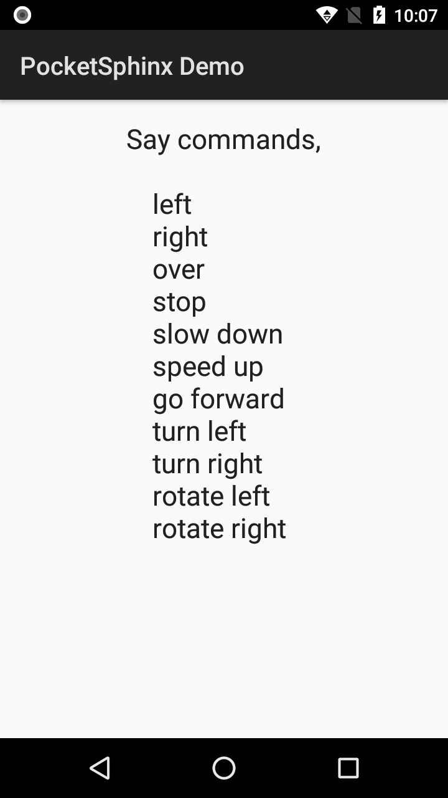
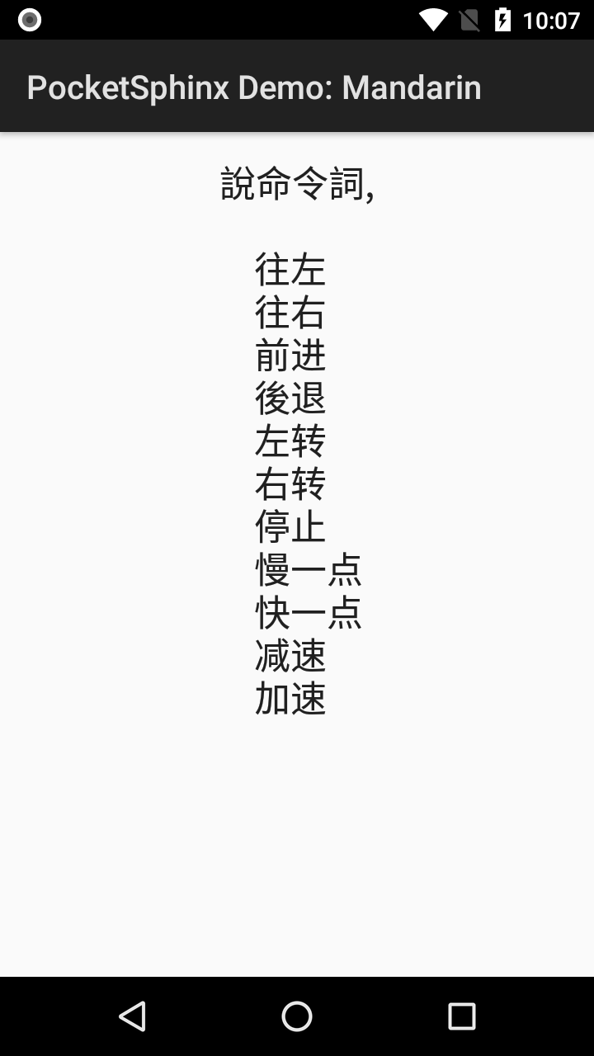
Demo
Official demo app in X588
My voice command in X588
English
Mandarin
Keyword
Grammar
LM <small>
LM
<small>

Slide 9
Bottleneck
Issue of false alarm or called False Positive(FP) ?
LM for Mandarin ?

Slide 10
Conclusion
Tool document is well SOP, but API document isn’t
For commercial use
English first
Small vocabulary better
Specify a short sentence for a specific purpose

