Slide 1
EE 4144 Final Project
Parallel Sorting
Team: BlinkingLEDs
Chong Shao, Vincenzo Panuccio

Slide 2
Introduction
Parallel Sorting
Merge Sort with Unbalanced Merging
Receive 500 integer values (hex bytes)
Split and distribute data into arrays of 400 and 100 values
Each MCU sorts its data
Master MCU receives Slave data and merge sorts data
Display and save sorted data

Slide 3
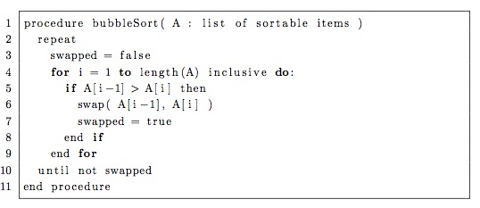
Sorting
Bubble Sort
average complexity O (n²)

Slide 4
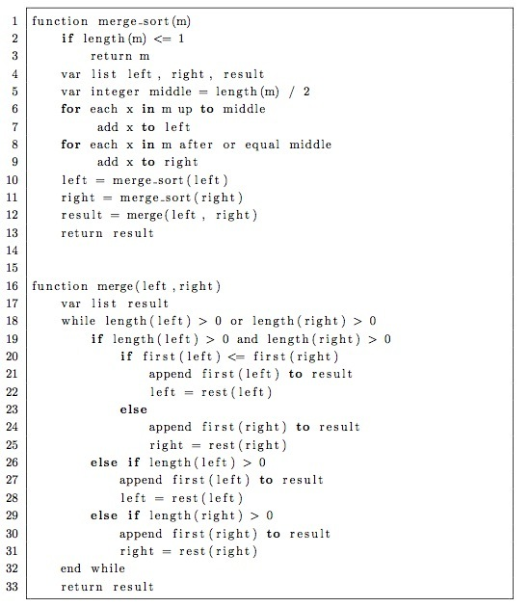
Sorting
Merge Sort
average complexity
O (n log n)

Slide 5
SPI Communication
Communication scheme
First initiate a handshake, then send data
Both MCUs can broadcast "ready to send" signals
After send request is initiated, the MCU waits for a reply "ready" signal
Handshake is done with additional connections
(P1.0 and P1.1)

Slide 6
Communication Code Structure
Code for when Master wants to send data
Master
"I want to send"
wait
wait
Initiate SPI transfer (Write Data)
Transfer complete
wait
"Transmission complete"
Slave
wait
Sees "I want to send"
Replies "you can send"
wait
Transfer complete
"Data received"
Reads data

Slide 7
Communication Code Structure
Code for when Slave wants to send data
Master
wait
wait
Sees "I want to send"
Replies "you can send"
Initiate SPI transfer (Write junk)
Transfer complete
"Data received"
Reads data
Slave
Writes data
"I want to send"
wait
wait
wait
Transfer complete
wait
"Transmission complete"

Slide 8
Demonstration

Slide 9
Potential Improvements
  Change the sorting algorithm
  In the SPI scheme,
We waited a lot
Only 4 wires are truly needed (no handshake)
  Code can be more flexible

Slide 10
Questions?

