Slide 1
Terry Stops Arrest Classifier
A Predictive Model for Arrest Decisions

Slide 2
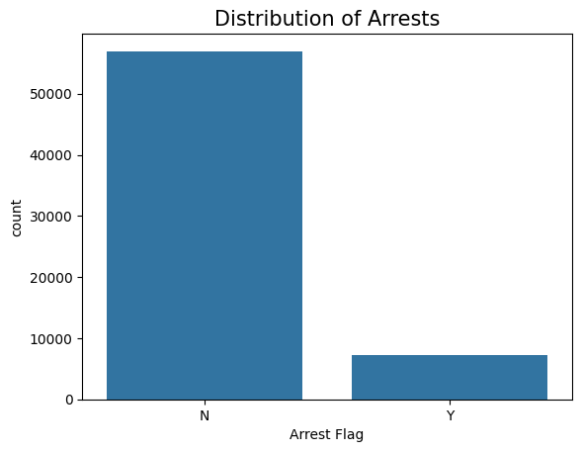
Overview
Objective: Predict arrest likelihood to spotlight key factors and potential biases.
Outcome: Insight-driven model supporting SPD accountability.

Slide 3
Business and Data Understanding
Business Goal: Enhance fairness, reduce unnecessary arrests, inform SPD policy.
Data Source: Seattle PD Terry Stop dataset – demographics, call types, timing, outcomes.

Slide 4
Modeling
Models Built:
Logistic Regression – interpretable baseline
Decision Tree – rule-based insights
Random Forest – highest performance via ensemble
Imbalance Handling: Used class_weight = 'balanced' for skewed target variable.

Slide 5
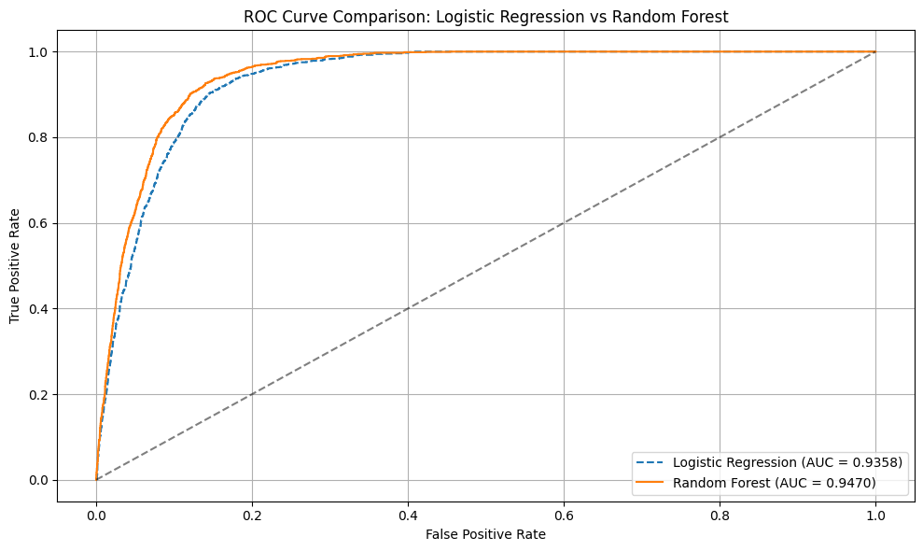
Evaluation
ROC AUC Scores:
Logistic Regression: 0.9358
Decision Tree: 0.8985
Random Forest: 0.9470 (best)

Slide 6
Recommendations
1. Monitor racial/gender disparities during stops.
2. Use the model to audit high-risk stops and inform training.
3. Engage communities using data-driven transparency.

Slide 7
Next Steps
Fairness Checks: Run disparity and bias diagnostics.
Interpretability: Apply SHAP to Random Forest.
Feature Expansion: Add officer–subject interaction terms, time-based effects.
Pilot Deployment: Start with internal audit before scaling to field use.

Slide 8
Thank You
Thank you for your attention — happy to answer questions!

