Slide 1
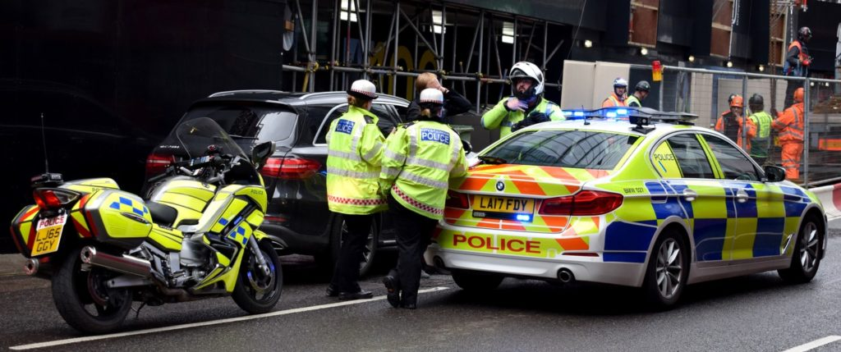
Terry Stops Arrests Classifier
A Predictive Model for Arrest Decisions

Slide 2
Overview
Terry Stop: A brief or temporary detention of an individual by law enforcement for investigation based on reasonable suspicion.
Goal: To creative a model to predict arrest likelihood from Terry Stops made by the police.
Value: Insight-driven policing that enhances policing accountability and effective resource utilization.

Slide 3
Business Understanding
Stakeholder: The Seattle Police Department (SPD)
Business Problem: Reasonable suspicion is subjective and officers may use it to effect Terry Stops based on racial or gender profiling.
Business Goal: Enhance fairness, reduce unnecessary arrests, inform SPD policy.

Slide 4
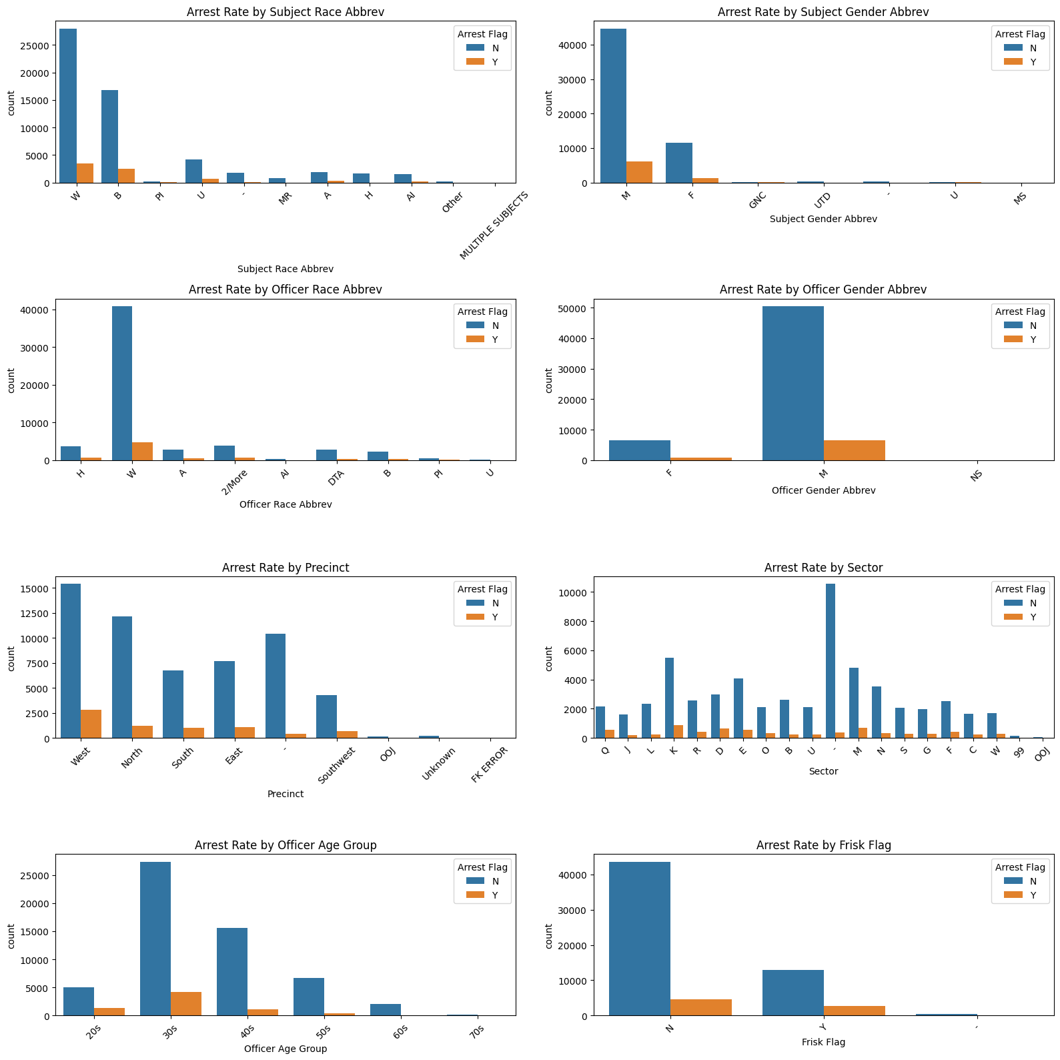
Data Understanding
Data Source: Seattle PD Terry Stop dataset.
Variables include: Subject/Officer gender and race, Reported Date, Sector etc.

Slide 5
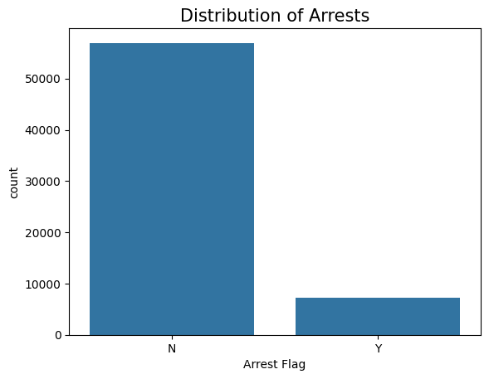
Model Target Variable: Arrest Flag
Distribution of arrests heavily favors non-arrests as shown below.

Slide 6
Modeling
Models Built:
Logistic Regression – interpretable baseline for categorical variables
Decision Tree – rule-based insights. Useful for understanding which features are most used to split the data and create decision boundaries
Random Forest – provides highest performance via ensemble methods

Slide 7
Modeling
Tuning Steps:
Imbalance Handling: Used class_weight = 'balanced' for skewed target variable.
Regularization: Infused L1 (Lasso) and L2 (Ridge) to address overfitting
Regularization Strength: Tuned ‘C’ to see which factors are zeroed out
Hyperparameter Tuning: Utilized GridSearchCV to find optimal parameters for model building
Feature Importance: Visualized importance features based on coefficients in both logistic and tree-based models

Slide 8
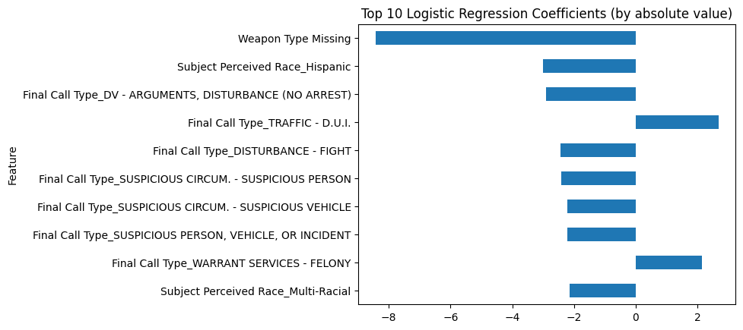
Feature Importance:
The Logistic Regression below shows the Positive Coefficients (that increase likelihood of arrest) and Negative Coefficients (that decrease likelihood of arrest).

Slide 9
Feature Importance Analysis
Feature importance analysis from both Logistic Regression and Random Forest helped identify key factors associated with arrests — such as:
- Certain call types (e.g., "Suspicious Circumstances")
- Presence or absence of weapons
- Demographics (e.g., subject age group, perceived race)
- Temporal variables (e.g., reported year, day)
These insights can guide the SPD in revising protocols: for example, adjusting the response to certain call types or focusing training on high-risk scenarios.

Slide 10
Evaluation
1. Logistic Model with Tuned Hyperparameters: Metrics Used:
Accuracy: 0.85
Precision: 0.42
F1 Score: 0.57
Recall: 0.92
2. Decision Tree with Tuned Hyperparameters: Metrics Used:
Accuracy: 0.83
Precision: 0.39
F1 Score: 0.55
Recall: 0.93

Slide 11
Evaluation
3. Random Forest: Metrics Used:
Accuracy: 0.89
Precision: 0.51
F1 Score: 0.64
Recall: 0.87
4. ROC AUC Scores:
Logistic Regression: 0.9358
the model struggled with recall on the minority class (arrests)
Decision Tree: 0.8985
provides high recall for class 1 (93%) — good for catching positives — but at a tradeoff in precision
Random Forest: 0.9470 (best)
5. Confusion Matrices

Slide 12
Evaluation
Random Forest emerged as the strongest model in predictive performance and robustness, making it the best candidate for arrest prediction.
Logistic Regression offered high interpretability and strong results, making it a valuable model for understanding key drivers of arrest decisions, especially for transparency and fairness assessments.
Decision Trees provided visual clarity and interpretability but did not match the performance of the other two.

Slide 13
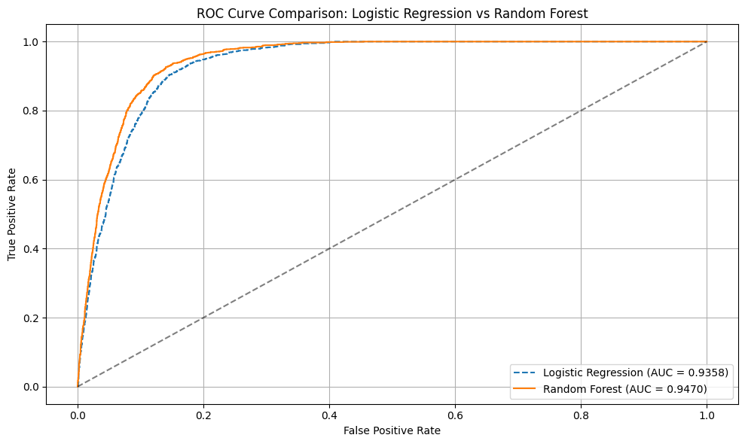
ROC Curve Comparison Plot
Random Forest is the best overall curve because it stays closest to the top-left corner. It indicates strong performance across thresholds due to ensembling and feature interaction handling.

Slide 14
Recommendations
1. Use model predictions to flag high-risk Terry Stops for internal review, especially where subject race and officer characteristics intersect.
2. Train officers to better assess ‘reasonable suspicion’ based on features the model finds less predictive, like “Final Call Type” or “Sector.”
3. Engage communities using data-driven transparency. Deploy the model in supervisory dashboards to monitor arrest likelihoods in real time and intervene when thresholds are exceeded.

Slide 15
Next Steps
Fairness Checks: Run disparity and bias diagnostics.
Interpretability: Apply SHAP partial Dependence Plots, or Feature Interaction Visuals to confidently say which combinations of features most influence arrests in the Random Forest model
Feature Expansion: Add officer–subject interaction terms, time-based effects.
Pilot Deployment: Start with internal audit before scaling to field use.

Slide 16
Conclusion
The Random Forest model:
enhanced predictive performance - especially improving recall on the arrest class (key for detecting true positives in an imbalanced dataset
provided a richer understanding of the data through feature importance scores.
These insights can inform:
policy reviews
officer training
resource allocation strategies - especially regarding high-risk call types and demographic dynamics.

Slide 17
Thank You
Thank you for your attention.
Happy to answer questions!

