Slide 1
Greenness, Happiness, and Willingness to Pay for the Environment:
Evidence from China
MACS 30123
Tingrui Zhang
May 2026
NDVI
CGSS
OLS
Notes:
Hi, my final project asks whether greener places are associated with higher happiness and different willingness to pay for environmental improvement in China. I combine CGSS 2018 survey data with satellite-derived NDVI from NASA HLS-VI. The project is both substantive and computational: substantively, it links environmental conditions to subjective well-being and policy preferences; computationally, it builds a scalable pipeline that processes many cloud-hosted raster files and connects them to survey microdata.

Slide 2
SOCIAL SCIENCE QUESTION
Research problem
Main exposure
Province-level annual mean NDVI from NASA Harmonized Landsat–Sentinel vegetation products.
Outcome variables
Self-reported happiness, 1–5 scale
Willingness to pay for three more good-air-quality days
Expected patterns
Greenness may raise happiness through amenities and quality of life.
Controls: age, gender, education, income, health, hukou, marriage, CCP membership, community type
Greener places may show lower WTP if residents perceive less need for additional improvement.
1. How does local greenness measure influence self-reported happiness in China?
2. What is the relationship between local greenness and people’s willingness to pay for environmental efforts?
Final project presentation · 2
Notes:
The social science question is whether environmental greenness is related to subjective well-being and to preferences over air-quality improvements. I use two CGSS outcomes: happiness and willingness to pay for three additional days of good air quality. The main exposure is annual mean NDVI, a satellite measure of vegetation greenness. The expected sign is not the same for both outcomes: greener environments may raise happiness, but they may lower willingness to pay if people already perceive their environment as relatively good.

Slide 3
COMPUTATIONAL MOTIVATION
Why this requires large-scale computing
Raw environmental data are cloud-hosted rasters, not a small CSV.
Scalable unit of work
Many GeoTIFFs across dates, tiles, and provinces
province = task
Each province requires download, mosaic, clipping, masking, and aggregation
province = task
SQS queue
Temporary NASA credentials make long local serial workflows fragile
province = task
Province tasks are independent, so the workload is naturally parallel
Scale by adding workers, not rewriting the code.
If a worker fails, the message reappears after the visibility timeout.
Final project presentation · 3
Notes:
The computing challenge comes from the environmental data. NDVI is stored as many cloud-hosted GeoTIFF files, not as a ready-made spreadsheet. For every province, the pipeline has to download relevant files, group them by date, mosaic overlapping tiles, clip to administrative boundaries, remove invalid values, and compute daily and annual means. This is expensive in storage and memory. But the key scalability insight is simple: one province can be treated as one independent task, so the pipeline can scale horizontally by adding workers.

Slide 4
PIPELINE ARCHITECTURE
Large-scale computing strategy
Modular storage, scheduling, compute, and analysis
S3 inputs
SQS tasks
EC2 workers
S3 outputs
EMR Spark
Results
Inputs: scripts, boundaries, province manifests, and cleaned CGSS CSV are kept in S3. SQS schedules one province per message. Stateless EC2 workers consume tasks and upload outputs. EMR Spark merges the outputs with survey data and runs regressions.
Scalability principle
More provinces, years, or vegetation indices can be handled by adding task messages and workers rather than changing the underlying computation.
Final project presentation · 4
Notes:
This slide summarizes the pipeline. S3 is the durable storage layer for code, boundaries, manifests, survey data, and outputs. SQS is the task scheduler: every message describes one province-year job. EC2 workers are stateless processors. They poll the queue, download the required files, process the rasters, and upload results. Finally, EMR Spark reads the survey and NDVI outputs, merges them, and runs the regression models. This modular design is what makes the workflow scalable and reproducible.

Slide 5
VALIDATION AND SCALING
From Shanghai pilot to full distributed run
Testing workflow, made concise
Full pipeline scale-up
Filter Earthdata links to NDVI-only S3 manifests
28 provinces with NDVI outputs
Run Shanghai locally: parse dates, mosaic tiles, clip to ADM1 boundary
11,061 CGSS observations merged
Move same workflow to EC2 with NASA temporary S3 credentials
SQS queue + EC2 workers
Fix hidden CRLF manifest issue and verify S3 upload of outputs
EMR Spark regression stage
The pilot established correctness; the queue-worker design established scalability.
The same code path was used for test and full run, reducing one-off manual steps.
Final project presentation · 5
Notes:
Before scaling, I validated the workflow on Shanghai. I filtered Earthdata links to NDVI-only files, confirmed the spatial clipping logic, and computed daily and annual NDVI. I then moved the same workflow to EC2 and verified that the worker could download NASA files, run the raster script, and upload outputs to my S3 bucket. After that validation, the same logic scaled to province tasks through SQS. The final merged data contain 28 provinces with NDVI outputs and 11,061 CGSS observations.

Slide 6
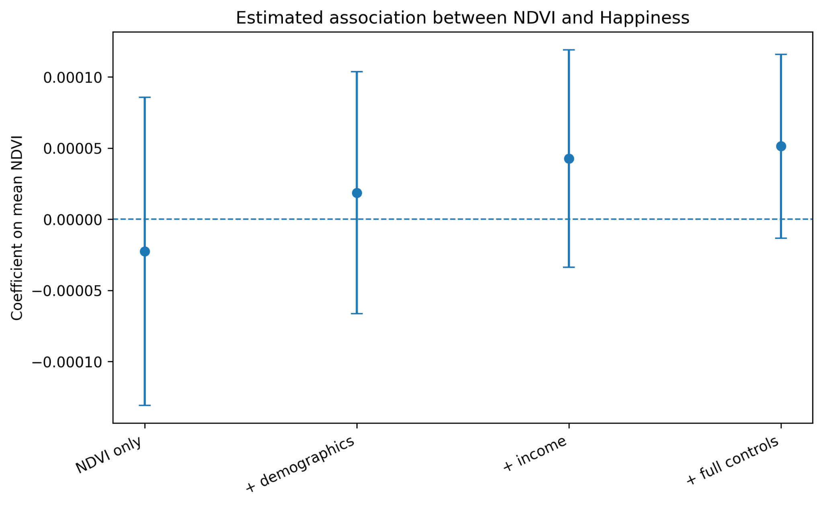
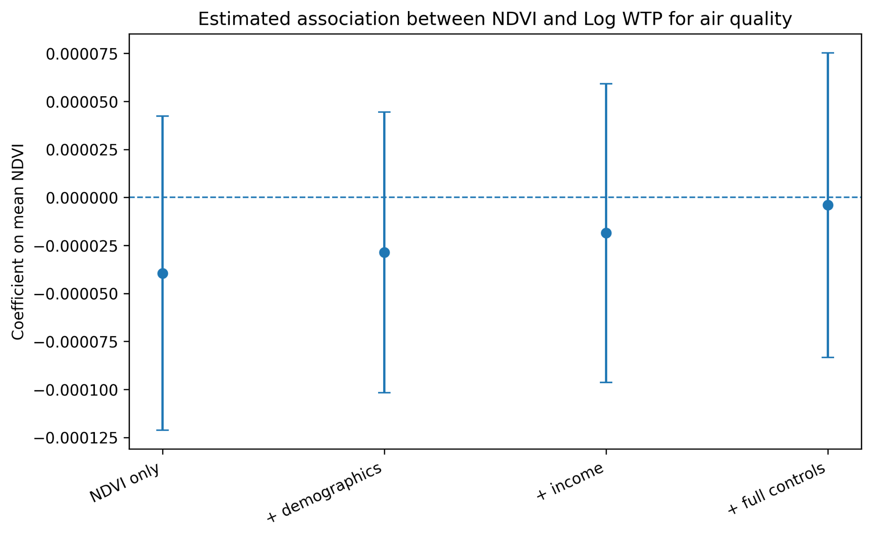
REGRESSION ESTIMATES
Main results: NDVI coefficients are noisy but intuitive
The 95% confidence intervals cross zero, so these are descriptive and imprecise estimates. But the signs match the expected pattern: greener provinces are associated with higher happiness in the fuller models and lower WTP for additional air-quality improvements.
Happiness: positive after controls
WTP: negative or near zero
Final project presentation · 6
Notes:
These are the main NDVI coefficient plots. For happiness, the coefficient is negative in the unadjusted model but turns positive once demographic, income, and full controls are added. For willingness to pay, the NDVI coefficient is negative in most specifications and very close to zero in the full model. The important caveat is that the confidence intervals cross zero. So I interpret this as noisy descriptive evidence, not causal proof. Still, the signs are consistent with the theoretical expectations.

Slide 7
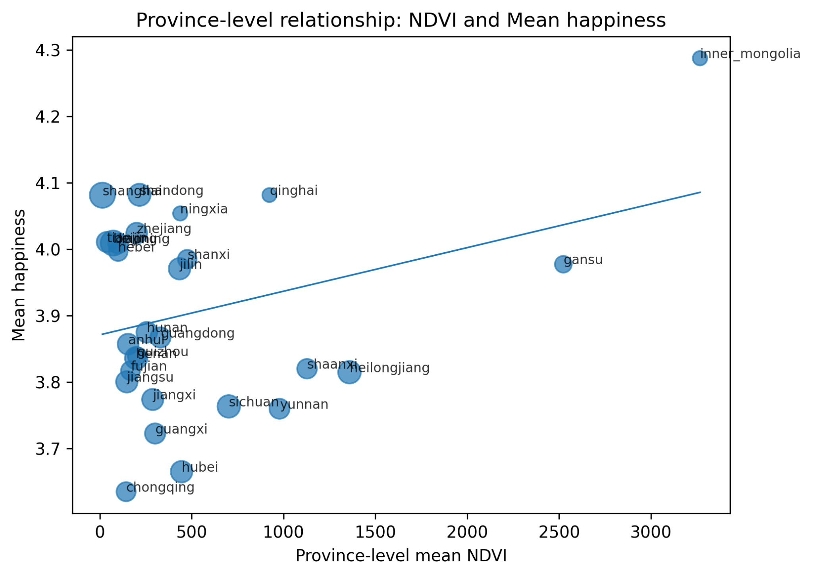
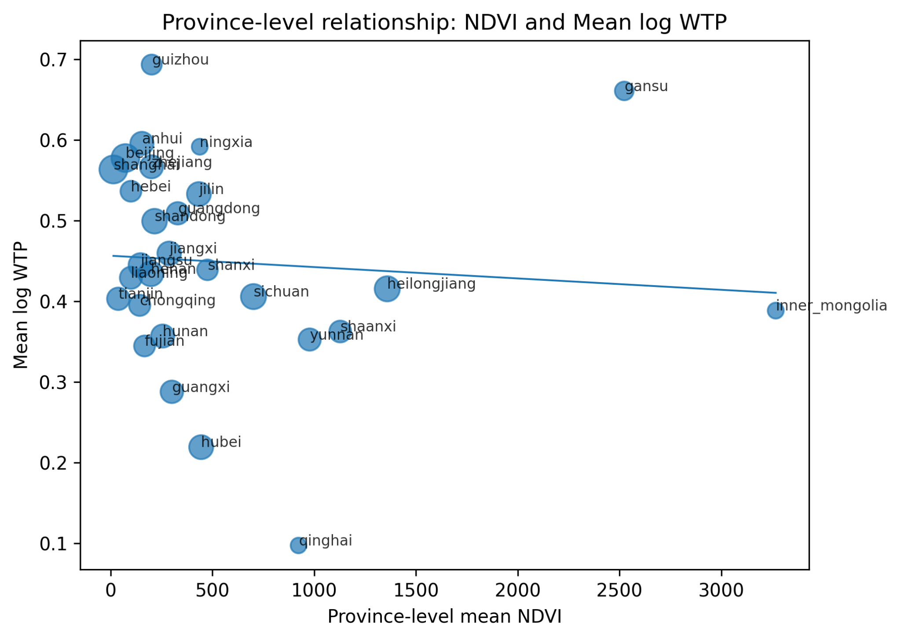
VISUAL DIAGNOSTICS
Province-level patterns behind the estimates
The province-level relationship is suggestive but sensitive to influential provinces. This reinforces the need for finer spatial exposure in future work.
Final project presentation · 7
Notes:
The scatter plots show the province-level data that drive the NDVI associations. The happiness relationship slopes upward, while the log willingness-to-pay relationship slopes slightly downward. At the same time, the points reveal why the estimates are noisy: the design relies on cross-province variation, and a few provinces have relatively high NDVI values. This is useful diagnostically and points to the next improvement: moving from province-level NDVI to more local measures, such as city, county, or neighborhood greenness.

Slide 8
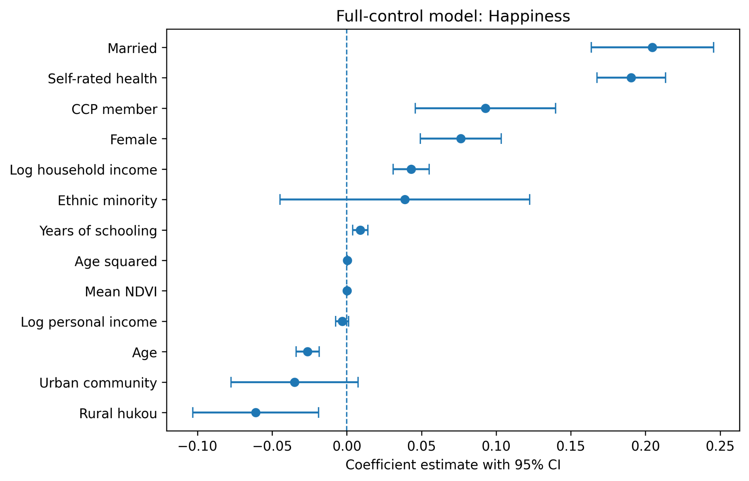
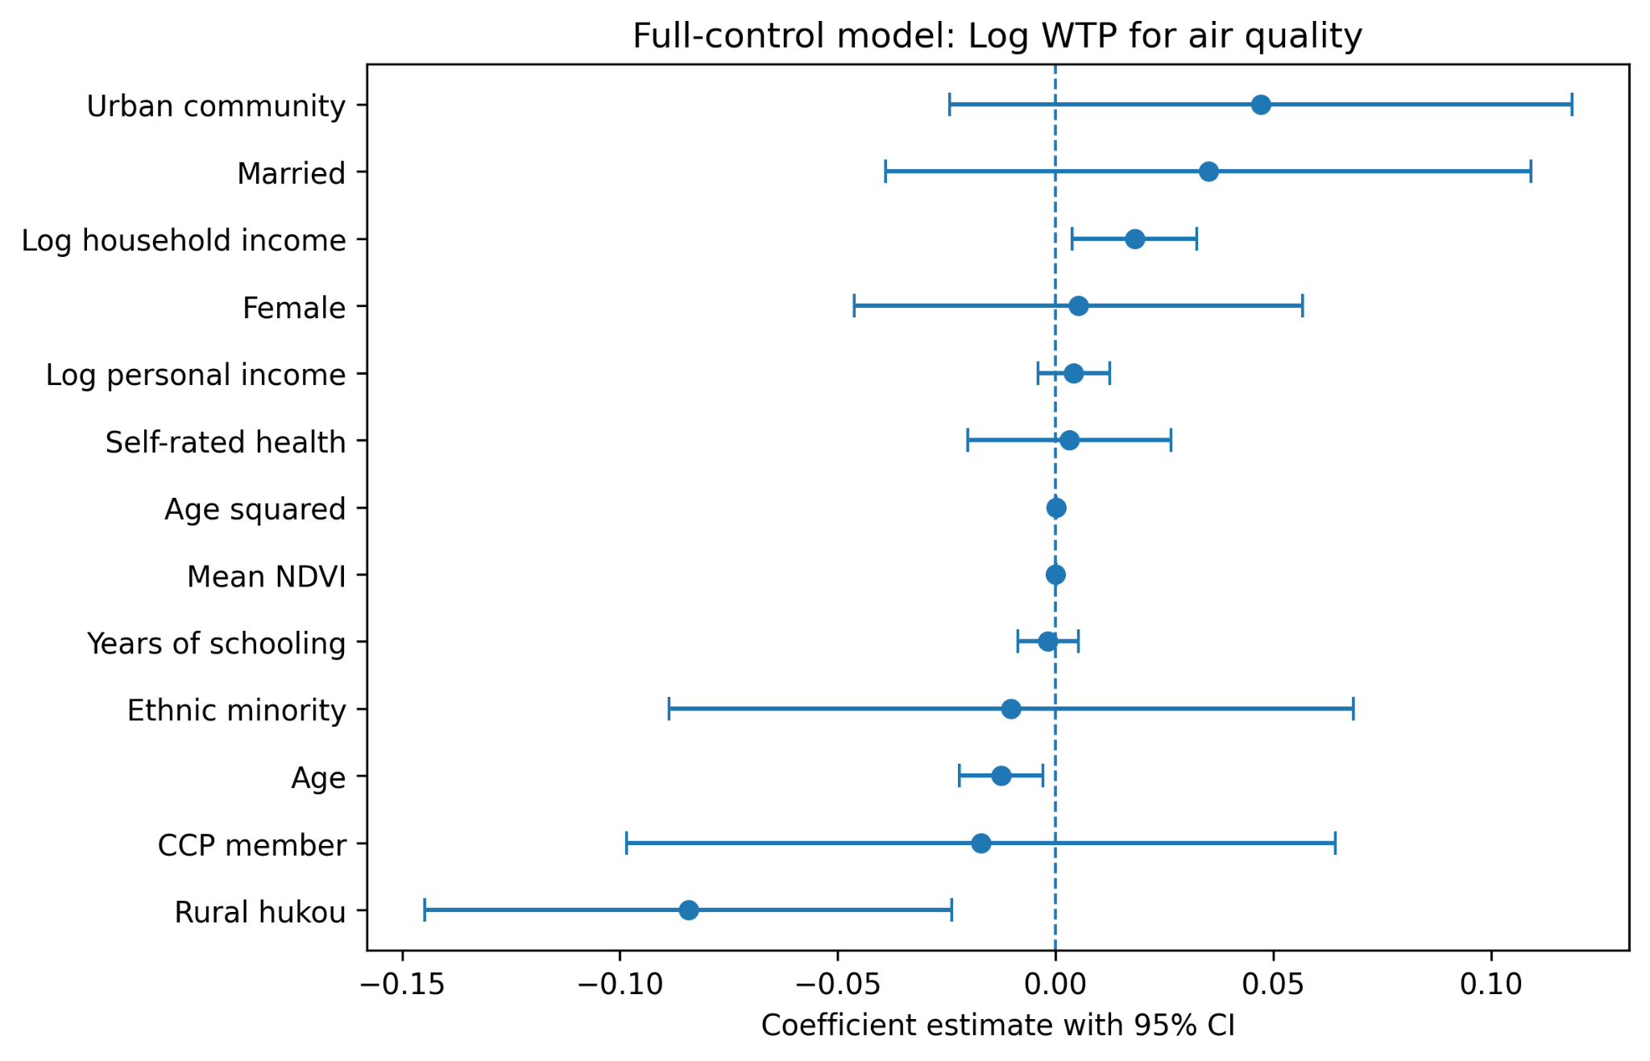
CONCLUSION
Takeaways: the pipeline works; the estimates motivate finer data
Substantive finding
Computing contribution
Individual characteristics such as health, marriage, income, age, and hukou explain more variation than province-level NDVI.
S3 + SQS + EC2 + EMR provides a reusable scalable template for linking satellite rasters to survey microdata.
Next steps: city/county-level NDVI, air-pollution controls, and heterogeneous effects by urban status or income.
Final project presentation · 8
Notes:
The final coefficient plots show that individual controls are much stronger predictors than province-level greenness. For happiness, health and marriage are especially important; for willingness to pay, hukou and income matter more than NDVI. My main conclusion is therefore twofold. Substantively, province-level greenness gives noisy but plausible descriptive patterns: higher NDVI is associated with higher happiness and lower willingness to pay. Computationally, the project succeeds in building a scalable, reproducible pipeline for linking satellite rasters to social survey outcomes. Future work should use finer geography and additional environmental controls.

