Slide 1
Automated Coverage-driven Test Data Generation Using Dynamic Symbolic Execution
Ting Su¹, Geguang Pu¹, Bin Fang¹, Jifeng He¹, Jun Yan², Siyuan Jiang³ and Jianjun Zhao⁴
¹Shanghai Key Laboratory of Trustworthy Computing, East China Normal University, China
²State Key Laboratory of Computer Science, Chinese Academy of Sciences, China
³Department of Computer Science and Engineering, University of Notre Dame, USA
⁴School of Software, Shanghai Jiao Tong University, China
June 30, 2014

Slide 2
Background
Unit testing is important for software reliability.
A program is composed of units.
50%~70% software maintenance cost.
Many test adequacy/coverage criteria [DO-178B], [TESTING’09], [ICSEA’09], [GECC’09]
Test Case/Data Generation
Manual testing
Random testing [IBMSJ’83] [TSE’90] [ICSE’07]
Notes:
Software testing is one of most commonly adopted techniques to improve software reliability.
In unit testing, a program is usually composed of units, where a unit contains a number of functions.
There are also many code-based coverage criteria: statement, branch, logical, data flow, path coverage, … in unit testing.
Manual testing or random testing have some shortcomings: high human and time cost, redundant test cases incurring expensive execution cost, only cover limited program behaviours.

Slide 3
What we want?
Faster coverage testing.
Lower testing cost.
Meet different coverage criteria.
Notes:
What we want?
Or what we most would like to solve?

Slide 4
How to do?
Dynamic Symbolic Execution (DSE)
Combine concrete execution and symbolic execution [PLDI’05] [ICSE’11]
Explore all possible paths
Tools: DART [PLDI’05], CUTE[FSE’05], CREST [ASE’08], PEX [TAP’08], KLEE [OSDI’08], SAGE [ACM Queue’12] , …
Support statement/block/branch coverage [ICSM’10]
Notes:
Dynamic symbolic execution emerged in 2005 and has already achieved great success in test data generation problem.
Test budgets are usually constrained in coverage-driven testing.
Some automated testing tool：Testbed, Testwell CTC++, CoverageMeter, GCT, …
Search-based Tools : Genetic algorithm, Hill Climbing, Simulated Annealing, …

Slide 5
DSE-based Approach
int double (int v) {
return 2*v;
}
void testme (int x, int y) {
z = double (y);
if (z == x) {
if (x > y+10) {
…
}
}
}
Notes:
Let’s get a quick idea of the application of DSE in test data generation and how these tools work.
And How we can improve this technique in coverage-driven testing.

Slide 6
DSE-based Approach
int double (int v) {
return 2*v;
}
void testme (int x, int y) {
z = double (y);
if (z == x) {
if (x > y+10) {
…
}
}
}
2*y == x
T
F
x > y+10
F
T
Notes:
There are two functions, four branches in this example prgoram.
We want to achieve branch testing.

Slide 7
DSE-based Approach
int double (int v) {
return 2*v;
}
void testme (int x, int y) {
z = double (y);
if (z == x) {
if (x > y+10) {
…
}
}
}
Concrete Execution
Symbolic Execution
concrete state
symbolic state
path condition
x = 22, y = 7
x = x₀, y = y₀

Slide 8
DSE-based Approach
int double (int v) {
return 2*v;
}
void testme (int x, int y) {
z = double (y);
if (z == x) {
if (x > y+10) {
…
}
}
}
Concrete Execution
Symbolic Execution
concrete state
symbolic state
path condition
x = 22, y = 7, z = 14
x = x₀, y = y₀, z = 2*y₀

Slide 9
DSE-based Approach
int double (int v) {
return 2*v;
}
void testme (int x, int y) {
z = double (y);
if (z == x) {
if (x > y+10) {
…
}
}
}
Concrete Execution
Symbolic Execution
concrete state
symbolic state
path condition
2*y₀ != x₀
x = 22, y = 7, z = 14
x = x₀, y = y₀, z = 2*y₀

Slide 10
DSE-based Approach
int double (int v) {
return 2*v;
}
void testme (int x, int y) {
z = double (y);
if (z == x) {
if (x > y+10) {
…
}
}
}
Concrete Execution
Symbolic Execution
concrete state
symbolic state
path condition
Solve: 2*y₀ == x₀
Solution: x₀ = 2, y₀ = 1
2*y₀ != x₀
x = 22, y = 7, z = 14
x = x₀, y = y₀, z = 2*y₀

Slide 11
DSE-based Approach
int double (int v) {
return 2*v;
}
void testme (int x, int y) {
z = double (y);
if (z == x) {
if (x > y+10) {
…
}
}
}
Concrete Execution
Symbolic Execution
concrete state
symbolic state
path condition
x = 2, y = 1
x = x₀, y = y₀

Slide 12
DSE-based Approach
int double (int v) {
return 2*v;
}
void testme (int x, int y) {
z = double (y);
if (z == x) {
if (x > y+10) {
…
}
}
}
Concrete Execution
Symbolic Execution
concrete state
symbolic state
path condition
x = 2, y = 1, z = 2
x = x₀, y = y₀, z = 2*y₀

Slide 13
DSE-based Approach
int double (int v) {
return 2*v;
}
void testme (int x, int y) {
z = double (y);
if (z == x) {
if (x > y+10) {
…
}
}
}
Concrete Execution
Symbolic Execution
concrete state
symbolic state
path condition
2*y₀ == x₀
x = 2, y = 1, z = 2
x = x₀, y = y₀, z = 2*y₀

Slide 14
DSE-based Approach
int double (int v) {
return 2*v;
}
void testme (int x, int y) {
z = double (y);
if (z == x) {
if (x > y+10) {
…
}
}
}
Concrete Execution
Symbolic Execution
concrete state
symbolic state
path condition
2*y₀ == x₀
x₀ ≤ y₀+10
x = 2, y = 1, z = 2
x = x₀, y = y₀, z = 2*y₀

Slide 15
DSE-based Approach
int double (int v) {
return 2*v;
}
void testme (int x, int y) {
z = double (y);
if (z == x) {
if (x > y+10) {
…
}
}
}
Concrete Execution
Symbolic Execution
concrete state
symbolic state
path condition
Solve: (2*y₀ == x₀) ^ (x₀ > y₀ + 10)
Solution: x₀ = 30, y₀ = 15
2*y₀ == x₀
x₀ ≤ y₀+10
x = 2, y = 1, z = 2
x = x₀, y = y₀, z = 2*y₀

Slide 16
DSE-based Approach
int double (int v) {
return 2*v;
}
void testme (int x, int y) {
z = double (y);
if (z == x) {
if (x > y+10) {
…
}
}
}
Concrete Execution
Symbolic Execution
concrete state
symbolic state
path condition
x = 30, y = 15
x = x₀, y = y₀

Slide 17
DSE-based Approach
int double (int v) {
return 2*v;
}
void testme (int x, int y) {
z = double (y);
if (z == x) {
if (x > y+10) {
…
}
}
}
Concrete Execution
Symbolic Execution
concrete state
symbolic state
path condition
All branches
are covered !!
2*y₀ == x₀
x₀ > y₀+10
x = 30, y = 15
x = x₀, y = y₀
Notes:
Finally, we covered all four branches by enumerating all three paths and got three test cases.
Although this example is very simple, we can see that, in DSE, it tries to explore every available path it encounters during the program execution process.

Slide 18
Intuition
Quickly get a test suite with high code coverage w.r.t a “suitable” criterion.
Paths may be irrelevant w.r.t a target criterion (e.g. branch coverage)
Different paths have different contributions on a target criterion.
Notes:
However, there is a fact that, in software development practice, we usually would like to quickly get a test suite with the high code coverage w.r.t some criterion and use it to quickly check the implementation correctness of this program.
When the program under test has many paths, it is very time-consuming to search the whole path space with the aim to achieve a “suitable” criterion at that testing context (e.g. statement, branch, MC/DC) by exploring all possible paths.
So it is intuitive that some paths may be irrelevant w.r.t a target criterion (e.g. branch coverage), i.e., it once exercised may not improve code coverage.
Thus, we can reduce testing cost by safely skipping these irrelevant paths without sacrificing the code coverage.
On the other hand, different paths have different contribution on a target criterion.
For example, path A could cover 5 branches but path B could only cover 2 branches.

Slide 19
Coverage-driven Testing
Our goal:
Faster coverage-driven testing with lower testing cost.
Our Approach:
A general DSE-based coverage-driven test data generation framework
takes the unit under test (UUT) as input and generates test data w.r.t. a target criterion.
Statement, branch, MC/DC coverage
A novel path filtering algorithm
Prune paths are irrelevant w.r.t the target criterion
A new path exploration strategy: Predictive Path Search (PPS)
Prioritize paths according to their contributions

Slide 20
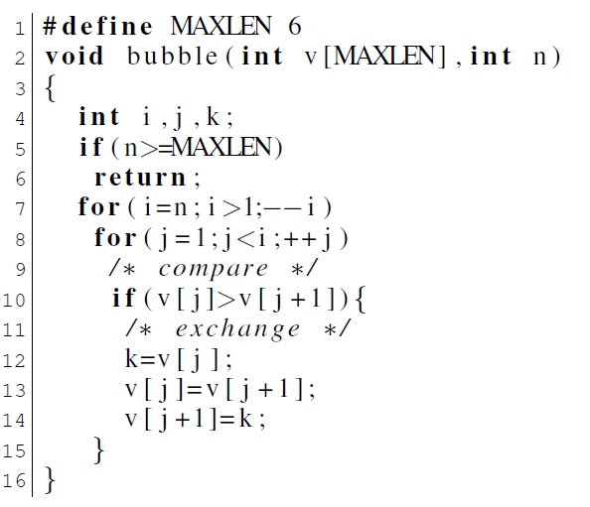
Example: bubble sorting
Total 8 branches, i.e, 5F, 5T, 7F, 7T, 8F, 8T, 10F and 10T.
Notes:
Let’s see a more clear example.
Sort the first n elements from array v in an ascending order.

Slide 21
Example: bubble sorting
Total 8 branches, i.e, 5F, 5T, 7F, 7T, 8F, 8T, 10F and 10T.

Slide 22
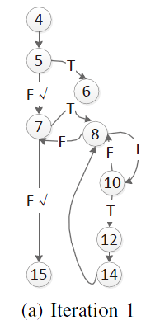
Example: bubble sorting
Test 1: (v=[4, 0, 1, 8, 0, 2], n=0) Path 1: (5F, 7F)

Slide 23
Example: bubble sorting
Test 1: (v=[4, 0, 1, 8, 0, 2], n=0) Path 1: (5F, 7F)

Slide 24
Example: bubble sorting
Test 1: (v=[4, 0, 1, 8, 0, 2], n=0) Path 1: (5F, 7F)
1. (5T)
2. (5F, 7T)

Slide 25
Example: bubble sorting
Test 1: (v=[4, 0, 1, 8, 0, 2], n=0) Path 1: (5F, 7F)
1. (5T)
2. (5F, 7T)
Path 2 can hit more branches than Path 1.

Slide 26
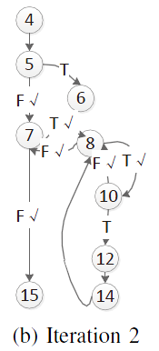
Example: bubble sorting
Test 2: (v=[4, 0, 1, 8, 0, 2], n=3)
Path 2: (5F, 7T, 8T, 10F, 8T, 10F, 8F, 7T, 8T, 10F, 8F, 7F)

Slide 27
Example: bubble sorting
Test 2: (v=[4, 0, 1, 8, 0, 2], n=3)
Path 2: (5F, 7T, 8T, 10F, 8T, 10F, 8F, 7T, 8T, 10F, 8F, 7F)
1. (5T)
--------------------------------------------
1. (5F, 7T, 8F)
2. (5F, 7T, 8T, 10T)
….
10. (5F, 7T, 8T, 10F, 8T, 10F, 8F, 7T, 8T, 10F, 8F, 7T)

Slide 28
Example: bubble sorting
Test 2: (v=[4, 0, 1, 8, 0, 2], n=3)
Path 2: (5F, 7T, 8T, 10F, 8T, 10F, 8F, 7T, 8T, 10F, 8F, 7F)
1. (5T)
--------------------------------------------
1. (5F, 7T, 8F)
2. (5F, 7T, 8T, 10T)
….
10. (5F, 7T, 8T, 10F, 8T, 10F, 8F, 7T, 8T, 10F, 8F, 7T)
Path 2 is more promising to cover the 10T branch with the shorter length than others.

Slide 29
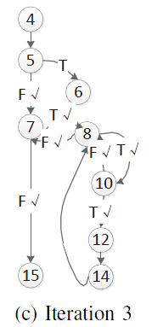
Example: bubble sorting
Test 3: (v=[4, 2, 1, 8, 0, 2], n=3)
Path 3: (5F, 7T, 8T, 10T, 8T, 10F, 8F, 7T, 8T, 10F, 8F, 7F)

Slide 30
Example: bubble sorting
Test 3: (v=[4, 2, 1, 8, 0, 2], n=3)
Path 3: (5F, 7T, 8T, 10T, 8T, 10F, 8F, 7T, 8T, 10F, 8F, 7F)
1. (5T)
--------------------------------------------
1. (5F, 7T, 8F)
….
10. (5F, 7T, 8T, 10F, 8T, 10F, 8F, 7T, 8T, 10F, 8F, 7T)
-----------------------------
….
remove the remaining paths, choose 5T
Notes:
8 paths in the second iterations as well as paths in the third iterations could be eliminated.
In other words, all paths starting with (5F, 7T) could be removed away.
Because they could not improve the branch coverage.

Slide 31
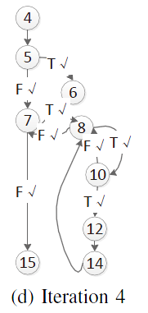

Example: bubble sorting
Test 4: (v=[4, 2, 1, 8, 0, 2], n=6) Path 4: (5T)
Prune paths according to the target coverage criterion
Prioritize paths according to their contributions
Notes:
In this example, we generate only 4 test cases with 4 fruitful program iterations in achieving 100% branch coverage.
But for random path selection/breadth-first path search, they requires much more program iterations and incurs more time cost.
So the key problem is how to decide whether a path is irrelevant w.r.t a target criterion (e.g. statement, branch, MC/DC) ?

Slide 32
Coverage Structure
Definition 1 (Control Flow Graph): A Control Flow Graph G of Program P is a directed graph G=(N, E, s, e), where
N is a set of nodes representing statements in P.
E is a binary relation on N, referred to as a set of edges which represent the flow of control in P.
s and e are, respectively, entry and exit nodes, s, e ∈ N.
Notes:
We decide the relevance of a path based on our unified coverage structure, which
1. derived from the CFG of the UUT.
2. records the criterion-specific information, updates the coverage status of the UUT and memorizes the path exploration history at runtime.

Slide 33
Coverage Structure
Definition (Coverage Structure): Coverage Structure S is a CFG G associated with the coverage criterion C, i.e., S=(G, C, Eval, Cov), where
G is a CFG.
Eval is a data structure which maps a CFG node to its all evaluation results. It maintains the evaluation results of all CFG nodes during program executions.
Cov is a function. It returns a set of new covered coverage items in the original program w.r.t C according to the current Eval.
Notes:
Some details informantion for Eval:
For a conditional statement, the evaluation result is its logical evaluation (true or false). For an instruction statement, the evaluation result is true if it is executed or false if not executed.
Our framework is based on the unified coverage structure (CS) to support coverage-driven testing.
Some merits:
1. Directly filter away irrelevant path candidates at runtime.
2. Memorizes the path exploration history.
3. Other applications (e.g., regression testing)

Slide 34
MC/DC
For a program (P) under test, its branch predicates are called Decisions (D), which contains one or more Conditions (C), i.e., Dp=C1⊕C2...Cn (⊕stands for ∧ or ∨).
Every point of entry and exit in P has been invoked at least once.
For every Dp has taken all possible outcomes.
For every Ci ∈ Dp has taken true and false at least once.
For every Ci ∈ Dp has been shown to independently affect Dp’s outcome. Ci is shown to independently affect Dp’s outcome by varying just Ci while holding fixed all other possible conditions Cj . Namely, we fix the logical value of Cj (j ̸= i), and then require Dp(Ci = true) ̸= Dp (Ci = false).
Notes:
Now let me take the MC/DC criterion as an example.
Illustrate how the coverage structure to record the MC/DC criterion.

Slide 35
An Example
if ( (A || B) && C ) { /* instructions */ } else { /* instructions */ }
1. A = false, B = false, C = true --->
decision is evaluated to "false“
2. A = false, B = true, C = true --->
decision is evaluated to "true“
3. A = false, B = true, C = false --->
decision is evaluated to "false“
4. A = true, B = false, C = true --->
decision is evaluated to "true"

Slide 36
A MC/DC Example
if ((A ∧ B) ∨ C) {s1;} else {s2;}
MC/DC criterion
three conditional nodes A, B, C.
record the evaluation results of A, B and C
compute the combination of these conditions’ evaluations.
at least 4 group evaluations to satisfy MC/DC.
A = false, B = false, C = true
A = false, B = true, C = true
A = false, B = true, C = false
A = true, B = false, C = true
Notes:
Cov(MC/DC, Eval)

Slide 37
Our approach
…
If( A && B) {…}
…
original code version

Slide 38
Our approach
code simplification
…
If( A && B) {…}
…
original code version

Slide 39
Our approach
code simplification
…
If( A) {
if(B) { … }
}
…
…
If( A && B) {…}
…
original code version
simplified code version

Slide 40
Our approach
code simplification
…
If( A) {
if(B) { … }
}
…
…
If( A && B) {…}
…
mapping
original code version
simplified code version

Slide 41
Our approach
We measure the test adequacy on the original program. But we conduct symbolic execution on the simplified program.
Coverage items (in the original program) and coverage goals (in the simplified program).
code simplification
…
If( A) {
if(B) { … }
}
…
…
If( A && B) {…}
…
mapping
original code version
simplified code version

Slide 42
Predictive Path Search
A CS-based path search strategy
A path candidate which tends to cover more coverage goals at one blow deserves higher priority.
Drive the path exploration to the code areas with more dense coverage goals.
Achieve reasonable testing budget allocation especially when the budgets are limited.
The code contribution of a path candidate could be statically predicated based on CS.

Slide 43
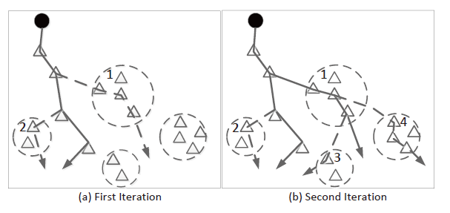
Predictive Path Search

Slide 44
Evaluation
Subject Program
Three open source projects: bash, make, and flex from SIR (14k LOC, 69 units)
One commercial automotive operating system conforming to the OSEK/VDX standard (10k LOC, 51 units).
One control system software of some satellites from China Academy of Space Technology(CAST) (15K LOC, 70 units).
Coverage Criterion
branch and MC/DC coverage.
CAUT
A dynamic symbolic executor for C program [TASE’09] [TTSS’11]
Notes:
We use cyclomatic complexities as a measurement to choose units.
Open source projects: cyclomatic complexities all exceed 8
Osek_os: complexity value 7.5 in average
Space_control: complexity value 9.4 in average
In software practice, when the cyclomatic complexity value of a unit or module exceed 10, this module is regarded as too complex and should be
split. So we choose units with complexity value above 8.

Slide 45
Research Question
RQ1: Based on the traditional DSE-based approach (DFS-based search strategy), how much does the efficiency increase with the help of our coverage-driven testing framework (with path filtering)?
Notes:
We compare between DFS and DFS+path filtering.
We limit the maximum testing budget (time cost) as 30 minutes.
We use the number of program iterations (ITER) and solved constraints (CON) as measurements on the performance of coverage testing

Slide 46
RQ1
Table 1: Branch Coverage (dfs/cs-dfs)
Project | #BR | #ITER (dfs/cs-dfs) | #CON (dfs/cs-dfs) | #COV (dfs/cs-dfs)
bash | 312 | 907/643 | 6981/4663 | 83.3%/83.3%
flex | 248 | 837/596 | 7367/4712 | 85.1%/86.7%
make | 436 | 1043/849 | 9518/5734 | 83.6%/85.8%
osek_os | 276 | 737/534 | 6458/4409 | 80.4%/80.4%
space_control | 424 | 1112/737 | 9692/6964 | 82.3%/84.4%

Slide 47
RQ1
Table 1: Branch Coverage (dfs/cs-dfs)
Project | #BR | #ITER (dfs/cs-dfs) | #CON (dfs/cs-dfs) | #COV (dfs/cs-dfs)
bash | 312 | 907/643 | 6981/4663 | 83.3%/83.3%
flex | 248 | 837/596 | 7367/4712 | 85.1%/86.7%
make | 436 | 1043/849 | 9518/5734 | 83.6%/85.8%
osek_os | 276 | 737/534 | 6458/4409 | 80.4%/80.4%
space_control | 424 | 1112/737 | 9692/6964 | 82.3%/84.4%
reduced 25.5% test cases
avoided 36.3% constraint solving

Slide 48
RQ1
Table 1: Branch Coverage (dfs/cs-dfs)
Project | #BR | #ITER (dfs/cs-dfs) | #CON (dfs/cs-dfs) | #COV (dfs/cs-dfs)
bash | 312 | 907/643 | 6981/4663 | 83.3%/83.3%
flex | 248 | 837/596 | 7367/4712 | 85.1%/86.7%
make | 436 | 1043/849 | 9518/5734 | 83.6%/85.8%
osek_os | 276 | 737/534 | 6458/4409 | 80.4%/80.4%
space_control | 424 | 1112/737 | 9692/6964 | 82.3%/84.4%
code coverage is improved

Slide 49
RQ1
Table 2: MC/DC Coverage (dfs/cs-dfs)
Project | #DC | #ITER (dfs/cs-dfs) | #CON (dfs/cs-dfs) | #COV (dfs/cs-dfs)
bash | 156 | 1231/984 | 9981/7663 | 80.2%/80.2%
flex | 124 | 1029/773 | 8460/5973 | 70.3%/76.6%
make | 218 | 1235/994 | 12518/8734 | 76.9%/77.9%
osek_os | 138 | 978/654 | 9827/6397 | 76.6%/76.6%
space_control | 212 | 1373/943 | 11739/8436 | 80.4%/83.1%

Slide 50
Result Analysis
Take the project flex as an example, compared with the traditional DSE-based approach, our approach reduced roughly 28% program executions and 36% solved constraints under branch coverage testing.
For MC/DC coverage, the situation is similar. Nearly 31% iterations and 28% constraints are avoided for space_control.

Slide 51
Research Question
RQ2: To what extend does the predictive path search strategy based on coverage structure (CAUT-PPS) improve the code coverage compared to other search strategies, i.e., CAUT-CREST and CAUT-KLEE on the same constrained testing budget?
Notes:
We compare PPS with two novel search strategies from CREST and KLEE.
We limit the maximum program iterations as 200 on one unit; repeat the testing 5 times for each heuristic because of their inherent randomness and take the average as the final result; the walk down level in PPS is set as 3.

Slide 52
Two novel search strategies
CFG-Directed Search in CREST
Drive the execution down the branch with the minimal distance towards uncovered goals measured by static CFG paths
J. Burnim and K. Sen, “Heuristics for scalable dynamic test generation,” in ASE, 2008, pp. 443–446.
https://code.google.com/p/crest/
RP-MD2U Search in KLEE
Interleave the Random Path strategy with Min-Dist-to-Uncovered heuristic
C. Cadar, D. Dunbar, and D. R. Engler, “Klee: Unassisted and automatic generation of high-coverage tests for complex systems programs,” in OSDI, 2008, pp. 209–224.
http://klee.llvm.org

Slide 53
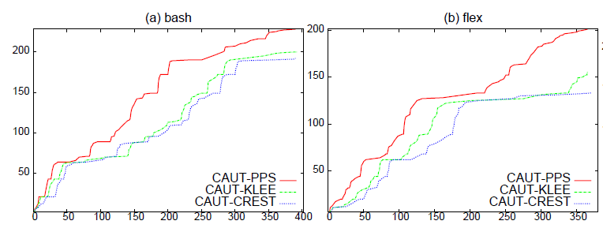
RQ2
Figure 1: Branch Coverage (open source projects, x: iterations, y: covered branches)

Slide 54
RQ2
Figure 1: Branch Coverage (open source projects, x: iterations, y: covered branches)
shorter spin time
steeper
Improve branch coverage 26.4% and 35.4% than crest & klee, respectively

Slide 55
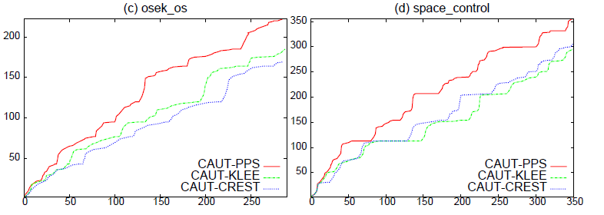
RQ2
Figure 2: Branch Coverage (industrial projects, x: iterations, y: covered branches)

Slide 56
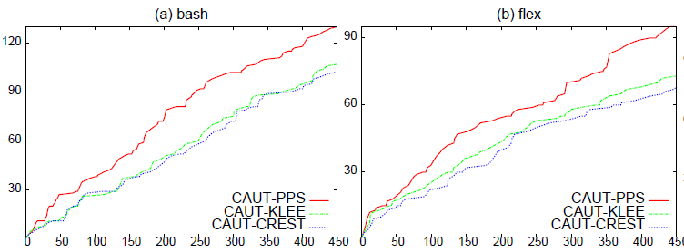
RQ2
Figure 3: MC/DC Coverage(open source projects, x: iterations, y: covered decisions)

Slide 57
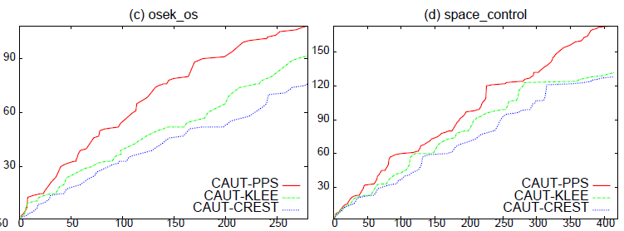
RQ2
Figure 4: MC/DC Coverage(industrial projects, x: iterations, y: covered decisions)

Slide 58
Result Analysis
CAUT-PPS improves about 26.4% and 23.2% in average than CAUT-KLEE for open source projects and industrial projects respectively on branch coverage. While compared with CAUT-CREST, it improves about 35.4% and 22.9% in average on the same constrained testing budget.

Slide 59
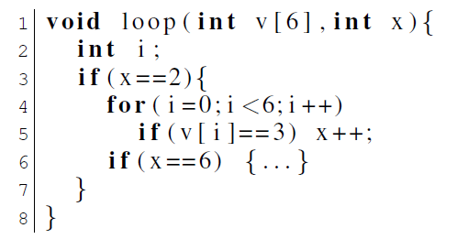
Result Analysis
Why CAUT-PPS sometimes fails ?

Slide 60
Result Analysis
Why CAUT-PPS sometimes fails ?

Slide 61
Result Analysis
Why CAUT-PPS sometimes fails ?
Initial input:
v[6] = {1,2,4,5,6,7}, x = -1
Data flow insensitive!

Slide 62
Result Analysis
We interleaves PPS with another search strategy (fitness guided path exploration from PEX), the performance could be further improved by 5%-8% in terms of iterations.
The two methods be regarded as orthogonal methods.
T. Xie, N. Tillmann, J. de Halleux, and W. Schulte, “Fitness-guided path exploration in dynamic symbolic execution.” in DSN. IEEE, 2009, pp. 359–368.

Slide 63
Conclusion
Faster coverage-driven testing with lower testing cost.
Our Approach:
A general DSE-based coverage-driven test data generation framework
A novel path filtering algorithm
Prune paths are irrelevant w.r.t the target criterion
A new path exploration strategy: Predictive Path Search (PPS)
Prioritize paths according to their contributions

Slide 64
Future work
Investigate the performance of the path filtering algorithm under different path search strategies.
Investigate how to interleave different search strategies by combining their respective advantages more effectively in coverage testing.
Optimize the PPS strategy.
Notes:
Threat to validity
Our implementation of the KLEE and CREST strategies in CAUT unavoidably differs from the originals.
Different front-end/parser from original KLEE (LLVM/CIL).
The KLEE and CREST strategies work on the whole program testing while the PPS strategy is designed on unit testing.

Slide 65
Thank You
CAUT: http://www.lab205.org/caut

