Slide 1




Guided, Stochastic Model-Based GUI Testing of Android Apps
Ting Su, Guozhu Meng, Yuting Chen, Ke Wu, Weiming Yang, Yao Yao, Geguang Pu, Yang Liu, Zhendong Su
ESEC/FSE 2017
PADERBORN, GERMANY

Slide 2
Mobile Apps
Mobile apps (Android, iOS, …)
Ubiquitous
3 Million+ apps on Google Play, and 50K+ new apps each month
Event-centric programs
accept inputs via Graphical User Interface (GUI)
Complex environment Interplay
users, fragmentations (different OSes, SDKs, sensors), other apps
Time-to-market pressure
deliver apps as quickly as possible to compete with the counterparts
They may not be thoroughly tested before releases
only test usage scenarios that are believed to be important
Inadequately test environment interplay
low code coverage

Slide 3
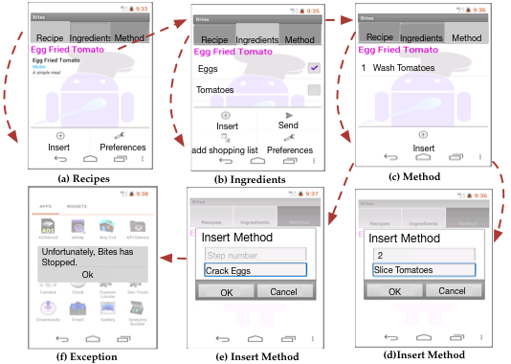
A Simple Cookbook App -- Bites
Add recipes from SMSs or files downloaded from Browser
Send Ingredients via SMSs
Interact with a third-party app to manage the shopping list
Share recipes via SMSs or emails
Fill in cooking methods
Create recipes
Bites: https://code.google.com/archive/p/bites-android/

Slide 4
Mobile Apps
Mobile apps (Android, iOS, …)
Ubiquitous
3 Million+ apps on Google Play, and 50K+ new apps each month
Event-centric programs
accept inputs via Graphical User Interface (GUI)
Complex environment interplay
users, fragmentations (different OSes, SDKs, sensors), other apps
However, ensuring app quality is challenging
Time-to-market pressure, manual testing, …
only test usage scenarios that are believed to be important
Inadequately consider the effects of environment interplay

Slide 5
Existing Research Work
Random Testing/Fuzzing
Google Monkey, Dynodroid[FSE’13]
Symbolic Execution
ACTeve[FSE’12], JPF-Android[SSEN’12]
Evolutionary (Genetic) Algorithm
Evodroid[FSE’14], Sapienz[ISSTA’16]
Model-based Testing (MBT)
GUIRipper[ASE’12], ORBIT[FASE’13], A3E[OOPSALA’13], SwiftHand[OOPSALA’13], PUMA[MobiSys’14], MobiGuitar[IEEE Software’15]
Other Approaches
MonkeyLab[MSR’15], CrashScope[ICST’16], TrimDroid[ICSE’16]

Slide 6
Challenges for MBT
Path Explosion Problem
Bites, 1027 LOC, its model has 21 states and 70 transitions.
6 one-event tests, 36 two-event tests, 567K three-event tests
Generate/Execute exhaustive tests from model is impossible/ineffective
No app models is available
Existing reverse-engineering tools achieves fairly low coverage (only half of the coverage achieved by Monkey)
Incomplete UI exploration
Inadequate testing strategies
Only consider UI-level events, neglect system-level events
Only target at model-based coverage, neglect code coverage

Slide 7
Our Approach
Stoat (Stochastic model App Tester)
A guided, stochastic model-based GUI testing approach
A fully-automatic tool for testing/fuzzing Android apps
Given an app as input,
Model Construction
Use dynamic/static analysis to learn a stochastic model
Test Generation
Adopt Gibbs sampling to iteratively mutate/refine the model and guide testing towards “fruitful” regions
Validate apps with various user/system-level events

Slide 8
Evaluation Results
Subjects
93 open-source android apps from F-droid
1661 closed-source, most popular apps from Google Play
Results
Models produced by Stoat cover 17~31% more code than those by MobiGuitar and PUMA.
Stoat detects 3X more unique crashes than Monkey and Sapienz.
Stoat detects 2110 unique previously-unknown crashes from 1661 Google Play apps
F-droid: https://f-droid.org/packages/
Google Play: https://play.google.com/store/apps?hl=en

Slide 9
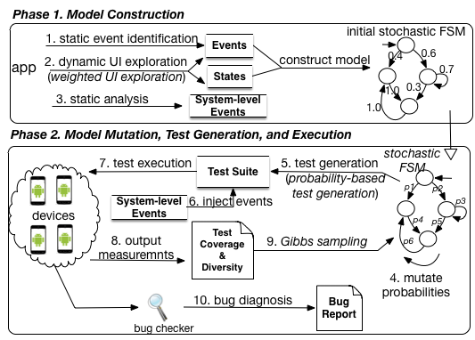
Workflow of Our Approach
Notes:
Add a slides to visualize how the tests are generated from the model (including model mutation, and test generation)

Slide 10
Test Suite Optimization (Sampling)
M_0
M_i
M_i+1
mutate
mutate
S0
S0
S0
0.4
0.6
p1
p2
p1’
p2’
s1
0.3
S2
0.2
…
s1
S2
p3
s1
p4
S2
p3
p4
1.0
p5
p5
S3
0.5
p6
S3
p6
S3
0.3
0.7
S4
p7
p8
S4
p7'
p8'
S4
Generate Tests
Generate Tests
Generate Tests
Continue …
Test Suite T_0
Test Suite
T_i
Test Suite
T_i+1
…
Execute Tests
Execute Tests
Execute Tests
yes
<?
Metric Values
f_0
Metric Values
f_i
No
Metric Values
f_i+1
Otherwise, discard M_i+1 with certain probability, and select M_i as the model for next mutation
Select M_i+1 as the model for next mutation

Slide 11
Our Approach
Model Construction
Dynamic Analysis
Static Analysis
Gibbs Sampling

Slide 12
Our Approach
Model Construction
Dynamic Analysis
Static Analysis
Gibbs Sampling

Slide 13
Model Construction
A stochastic, finite state machine M
Defined as a 5-tuple M = (Q,Σ,δ,s0,F)
Q: the set of app states, a state s ∈ Q
Σ: the set of input events, an event e ∈ Σ
δ : Q × Σ → P(Q × [0, 1]) the probabilistic transition function.
s0 ∈ Q , the starting app state, F ⊆ Q the set of final states
Notes:
P(·) is the powerset operator and each transition is of the form (s,e,(s’,p)), meaning that the probability of an event e triggering a state transition from s to s′ is p.

Slide 14
App State
An app state s is abstracted as an app page
represented as a widget hierarchy tree
non-leaf nodes denote layout widgets (e.g., LinearLayout), leaf nodes executable widgets (e.g., Button);
when a page’s structure (and properties) changes, a new state is created

Slide 15
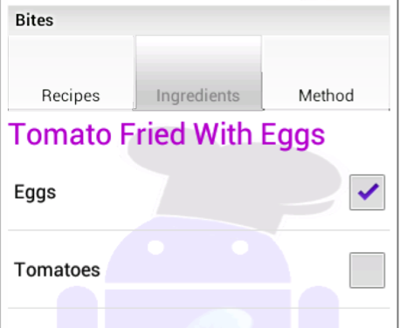
An app state is abstracted as a view hierarchy tree.
An app state is differentiated from others via this tree.
map
FrameLayout (0)
0
TextView (00)
(“Bites”)
0
1
TabHost(01)
TabWidget(010)
0
FrameLayout(011)
1
TextView (0110)
(“Tomatoes…”)
1
ListView(0111)
RelativeLayout(0100)
0
1
2
0
0
1
2
LinearLayout(01110)
0
1
LinearLayout(011)
TextView (01000)
(“Recipes”)
TextView (01001)
(“Ingredients”)
TextView (01002)
(“Method”)
0
1
0
1
TextView (011100)
(“Eggs”)
CheckBox(011101)
TextView (011110)
(“Tomatoes”)
CheckBox(011111)
Executable (leaf) Widgets
Inexecutable (leaf) Widgets
Layout Widgets

Slide 16
Dynamic analysis
Goal: Explore as many app behaviors as possible
Case Study: 50 most popular apps with 10 categories from Google Play
Three key observations to improve performance
Frequency of Event Execution
Type of Events (UI events、navigation events)
Number of Subsequent Unexercised Widgets
Notes:
Add the formula here

Slide 17
Transition Probability
A probability value p denoting the selection weight of e in test generation.
p is initially assigned the ratio of e’s observed execution times over the total execution times of all events w.r.t. s (e ∈ s).
Test Generation from the Model
Start from the entry state, and select next event according to its probability value
The higher the event probability value, the more likely the event will be selected.

Slide 18
Static Analysis
Static analysis identifies those events that are missed by dynamic analysis
Events that are registered on UI widgets (e.g., setOnLongClickListener)
Events that are implemented by overriding class methods (e.g., onCreateOptionsMenu).
Model Compaction
Identify structurally-different pages as different states, and merges similar ones.
Omit minor UI changes (e.g., text changes, UI property changes)

Slide 19
A Simple Cookbook App -- Bites

Slide 20
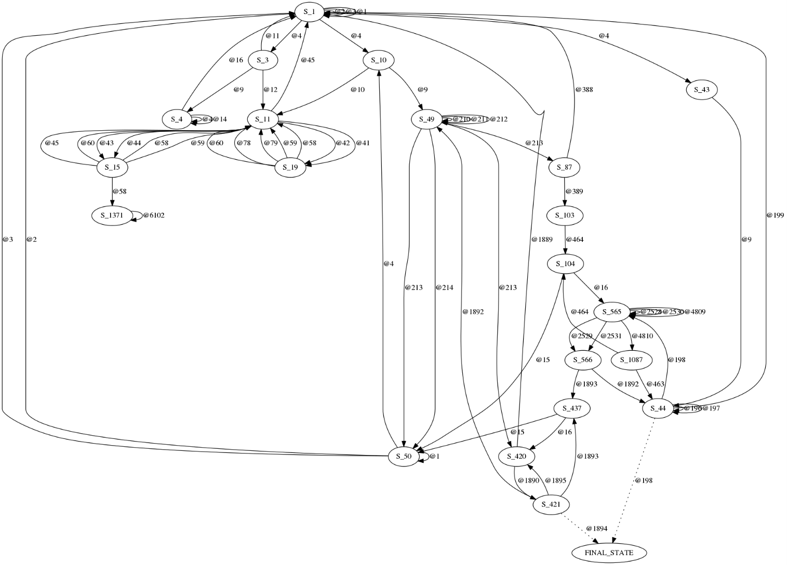
Model of Bites Produced by Stoat

Slide 21
Our Approach
Model Construction
Dynamic Analysis
Static Analysis
Gibbs Sampling
Optimization problem
Objective function

Slide 22
Gibbs Sampling
Metropolis Hastings algorithm is one of Markov Chain Monte Carlo (MCMC) methods
a class of algorithms to draw samples from a desired probability distribution p(x) , for which direct sampling is difficult
Gibbs Sampling is a special case of the Metropolis-Hastings algorithm
designed to draw samples when p(x) is a joint distribution of multiple random variables

Slide 23



Gibbs Sampling (Cont.)
Sampling acceptance ratio
In our Setting, we propose p(x) as
Simplified, which q is a symmetric function
constant value
Test suite T generated from M
Objective (optimization) function f
stochastic model M
exponential distribution exp

Slide 24
Guided Test Generation
Reduce guided testing as an optimization problem
Let all transition probabilities be random variables, and draw samples by iteratively mutating them.
Each stochastic model is a sample
Allow samples to be drawn more often from the region with “good” stochastic models.

Slide 25
Objective Function
By “good”, we mean …
favor test suites that can achieve high coverage and contain diverse event sequences
trigger more program states and behaviors, and thus increase the chance of detecting bugs

Slide 26
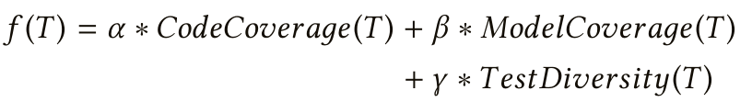
Objective Function (Cont.)
Three key metrics
Code coverage (measures how thoroughly the app code is tested)
Ting Su, Ke Wu, Weikai Miao, Geguang Pu, Jifeng He, Yuting Chen, and Zhendong Su. 2017. A Survey on Data-Flow Testing. ACM Comput. Surv. 2016.
Hong Zhu, Patrick A. V. Hall, and John H. R. May. 1997. Software Unit Test Coverage and Adequacy. ACM Comput. Surv. 1997
Model coverage (how completely the app model is covered)
Atif M. Memon, Mary Lou Sofa, and Martha E. Pollack. 2001. Coverage criteria for GUI testing. FSE’00
Test diversity (how diverse the event sequences are in the test suite)
Borislav Nikolik. 2006. Test diversity. IST’06
Qing Xie and Atif M. Memon. 2006. Studying the Characteristics of a "Good" GUI Test Suite. ISSRE’06
Line Coverage for open-source apps, and Method Coverage for closed-source apps
Event Coverage of the app model
Convert event sequences into vectors, and compute their cosine similarity as diversity

Slide 27
Evaluation
RQ1. Model Construction
RQ2. Code Coverage
RQ3. Fault Detection
RQ4. Usability and Effectiveness

Slide 28
RQ1: Model Construction
Comparison tools
MobiGuitar-Systematic (“M-S”)
Breadth-first Exploration of GUIs
MobiGuitar-Random (“M-R”)
Random Exploration of GUIs
PUMA (“PU”)
Sequentially explore GUIs, and stops exploring when all app states were visited.
Stoat (“St”)
Weighted UI Exploration + Static Analysis
Subjects
93 open-source apps from F-droid (including 68 widely-used subjects from previous work, and 25 subjects randomly selected from F-droid).

Slide 29
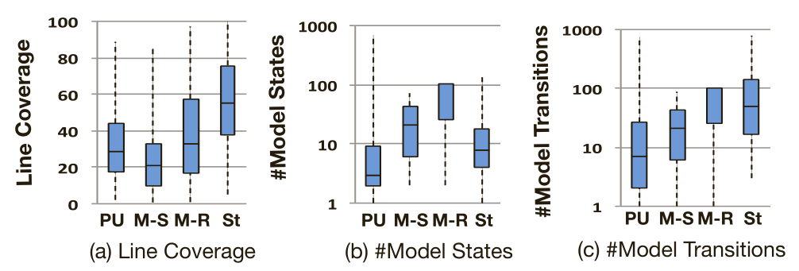
Results of RQ1
Stoat can cover more app behaviors, and produce more complete models
Stoat covers 31% and 17% more code, respectively, than M-S and M-R, and 23% more than PUMA.
Results of model construction: Line coverage

Slide 30
Results of RQ1
Stoat achieves higher code coverage, but the models are still compact.
Results of model construction: Model Complexity

Slide 31
RQ2: Code Coverage
Comparison tools
A3E (systematic exploration, “A”)
Monkey (random testing, “M”)
Sapienz (genetic algorithm, “Sa”)
Stoat (model-based testing, “St”)
Subjects
93 open-source apps from F-droid.

Slide 32
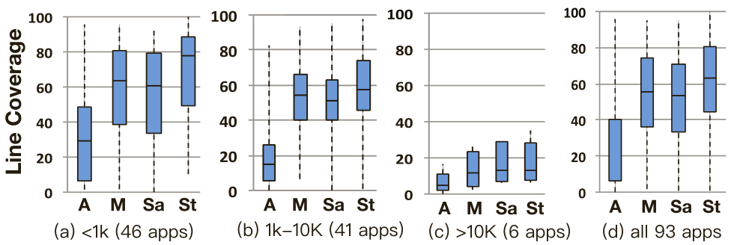
Results of RQ2
A3E, Monkey, Sapienz, and Stoat achieve 25%, 52%, 51%, and 60% line coverage, respectively.
Results of code coverage grouped by app sizes.

Slide 33
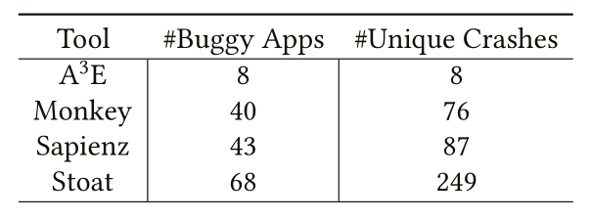
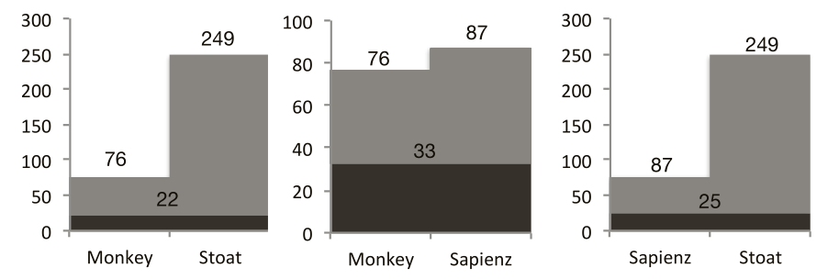
RQ3: Fault Detection
Results of pair-wise comparison of app crashes by Monkey, Sapienz, and Stoat.

Slide 34
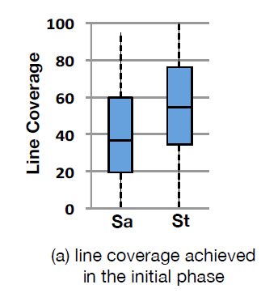
Comparison with Monkey/Sapienz
Finding 1: Stoat is more effective in UI exploration
Sapienz and Stoat on average take 56 and 60 minutes to finish the initial phase, and require 45 and 23 minutes to reach peak coverage, respectively

Slide 35
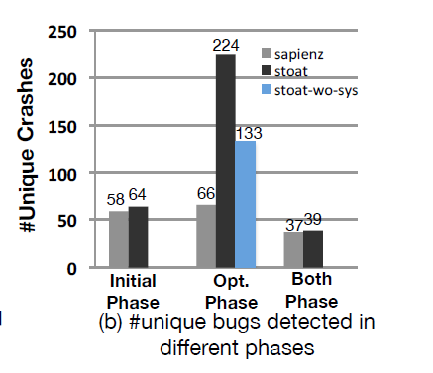
Comparison with Monkey/Sapienz
Finding 2: Stoat is more effective in detecting deep crashes
Sapienz generates new tests by randomly crossovering and mutating sequences. It may produce many “infeasible" ones, and is less likely to reach deep code.
Stoat guides test generation from an app’s behavior model (captures all possible compositions of events), which is more likely to generate meaningful and diverse sequences to reveal deep bugs

Slide 36
Comparison with Monkey/Sapienz
Finding 3: System-level events can reveal more unexpected crashes
An app mileage was crashed by IllegalArgumentException when Stoat launches its chart activities and sends them empty intents.
It directly takes the null values to make database queries without any sanitization.

Slide 37
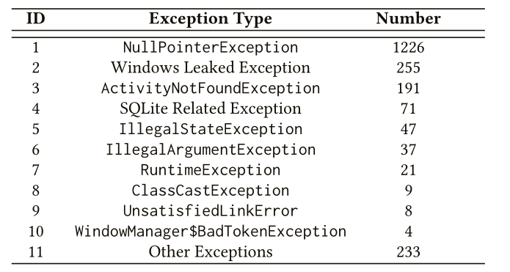
RQ4: Usability and Effectiveness
Subjects
1661 most popular apps from Google Play
Results
Detected 2110 unique previously-unknown crashes from 691 apps
452 crashes from model construction, 1927 from Gibbs sampling, and 269 are detected in both phases.
Distribution of found app crashes

Slide 38
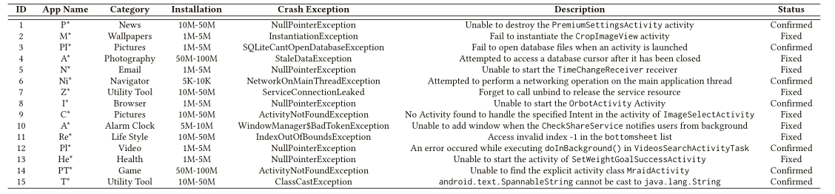
RQ4 (Cont.)
Results
43 developers have replied that they are investigating our bug reports.
20 of our reported crashes have been confirmed, and 8 have already been fixed.

Slide 39
Conclusion
Goal
thoroughly test the functionalities of an app, and validate the app’s behavior by enforcing various user/system-level interactions
Proposal: Stoat (Stochastic model App Tester)
A Guided, Stochastic model-based GUI testing approach
Model Construction (Weighted UI Exploration, Static Analysis)
Guided Test Generation (Gibbs Sampling-guided Optimization)
Stoat is available at https://tingsu.github.io/files/stoat.html

