Slide 1
Coverage-Directed Differential Testing of JVM Implementations
Yuting Chen¹, Ting Su², Chengnian Sun³, Zhendong Su³, and Jianjun Zhao^{1,4}
¹Shanghai Jiao Tong University
²East China Normal University
³University of California, Davis
⁴Kyushu University

Slide 2
Outline
Motivation
Testing of JVMs
Test redundancy
Goal + Key Observations
Design
Evaluation
Related Work and Conclusion

Slide 3
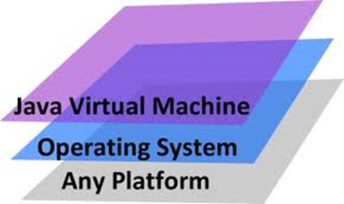


Background: JVM
*.class
*.jar
JVM
Execution results

Slide 4

JVM Testing
Testing a JVM using a number of test classfiles
class0
class1
Class2
…
How is a JVM defect exposed?
How is a test classfile achieved?

Slide 5
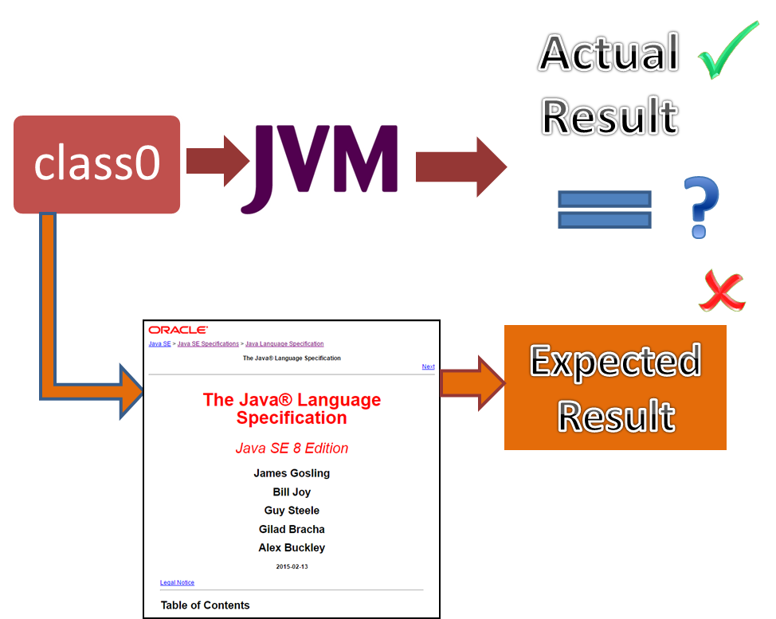
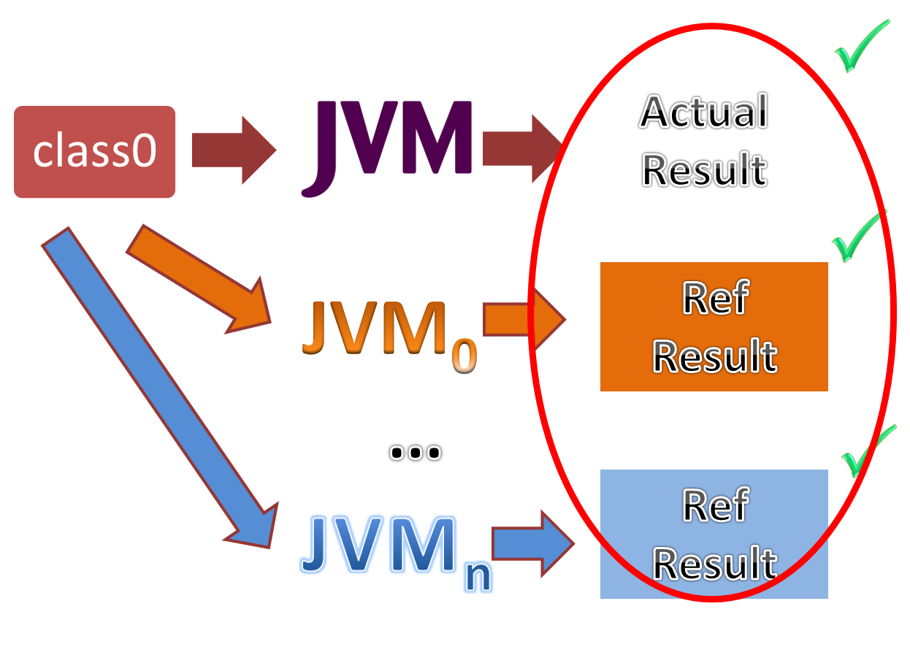
Challenge 1: How to expose a JVM defect?
Challenge:
no test oracles
Solution:
differential JVM testing

Slide 6
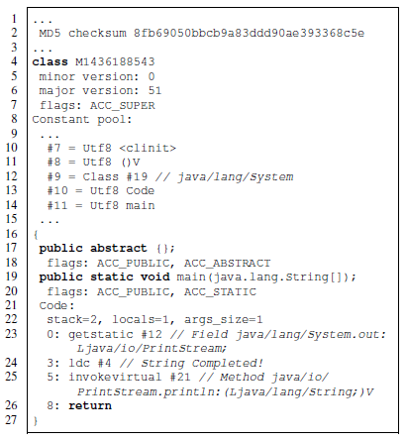
An Example of JVM Behavior Discrepancy
public abstract {};
HotSpot takes it as a ordinary method
J9 reports a format error
Cause: the JVM specification says that “other methods named <clinit> in a class file are of no consequence. They are not class or interface initialization methods. ”
A class method needs to be more strictly defined

Slide 7

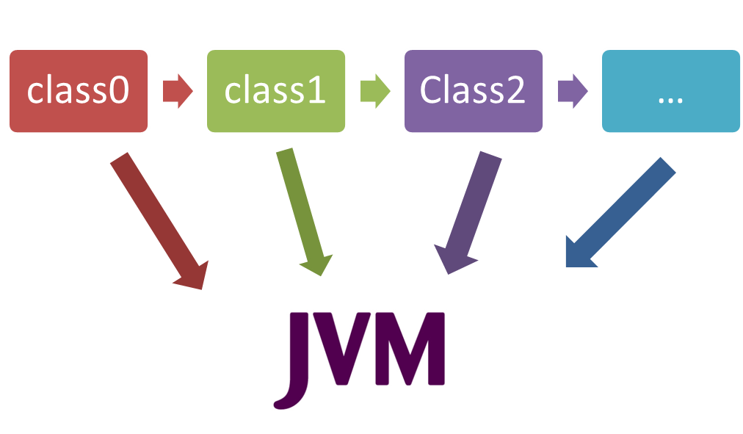
Challenge 2: How to obtain test classfiles?
Option 1: using the real-world classfiles
Option 2: domain-aware fuzz testing
Some classes can reveal compatibility issues

Slide 8
An Example of JVM Behavior Discrepancy
public abstract mymethod{};
clinit
More JVM discrepancies are revealed by domain-aware fuzz testing

Slide 9
Challenge 2: How to obtain test classfiles?
Option 1: using the real-world classfiles
Option 2: domain-aware fuzz testing
Some classes can reveal compatibility issues


Slide 10
Challenge 2: How to obtain test classfiles?
Solution 2: domain-aware fuzz testing
An infinite number of test classfiles can be created
They may reveal a small number of JVM discrepancies
Test redundancy

Slide 11
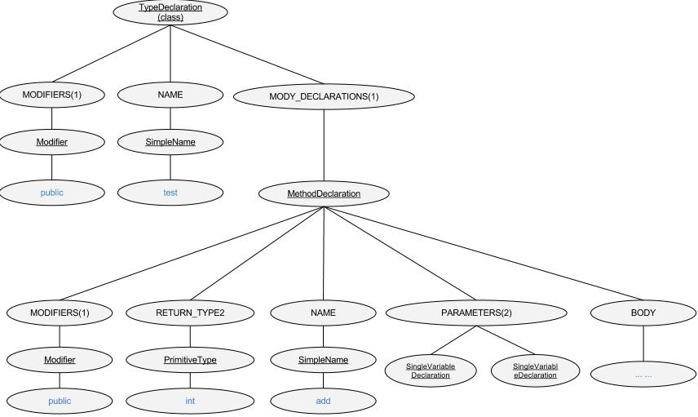


Key Observation (1)
A classfile can encompass intricate constraints
Corner cases can be created through rewriting seeds
legal or illegal
legal
X
Syntax tree
Revised syntax tree

Slide 12
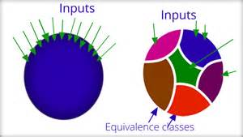
Key Observation (2)
Equivalence class partition (ECP) saves the testing cost
ECP works only if we can decide whether two tests belong to the same partition

Slide 13

Our Design: An Overview
HotSpot for Java7
HotSpot for Java8
HotSpot for Java9
IBM’s J9
GIJ

Slide 14

Our Design: An Overview
testing
selection
mutation
It makes the
classfile mutants
more representative
HotSpot for Java7
HotSpot for Java8
HotSpot for Java9
IBM’s J9
GIJ

Slide 15
Outline
Motivation
Design
Mutating classfiles
Selecting representative classfile mutants
Selectively applying mutators
Differentially testing JVMs
Evaluation
Related Work and Conclusion

Slide 16


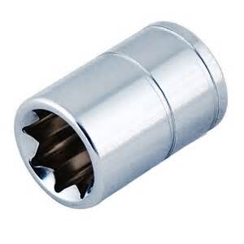
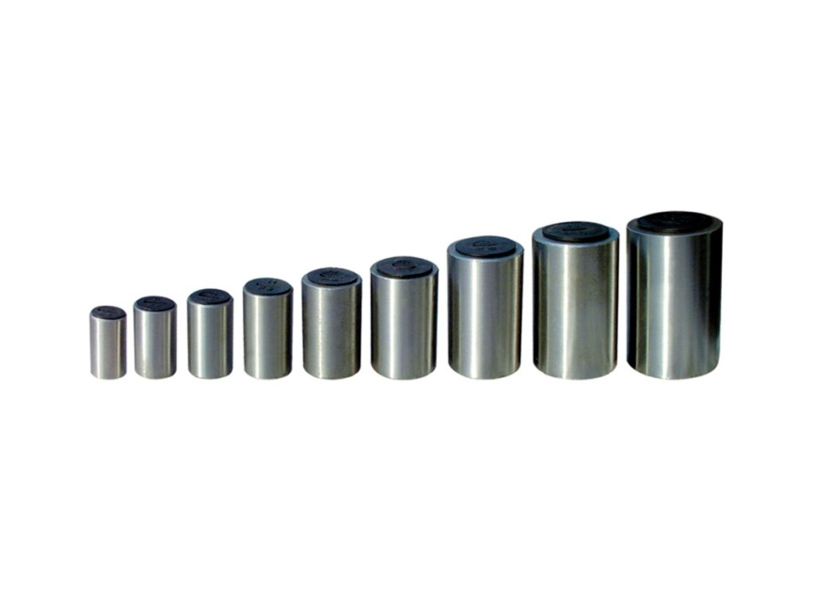
Mutating Classfiles
testing
selection
mutation
We have designed 129 mutators for mutating classfiles

Slide 17
Mutating Classfiles (2)
testing
selection
mutation
123 mutators are designed for rewriting the ASTs of the seeds
Six mutators are designed for rewriting the Jimple files of the seeds
r0:=parameter0: java.lang.String[];
r1:=<java.lang.System: java.io.PrintStream out>;
virtualinvoke $r1.<java.io.PrintStream:void println(java.lang.String)>("Executed");
…
X
“private”
Limitation: Only the JVMs’ startup processes can be tested
The mutated program constructs/attributes may be less likely to be activated during execution
class
class’

Slide 18
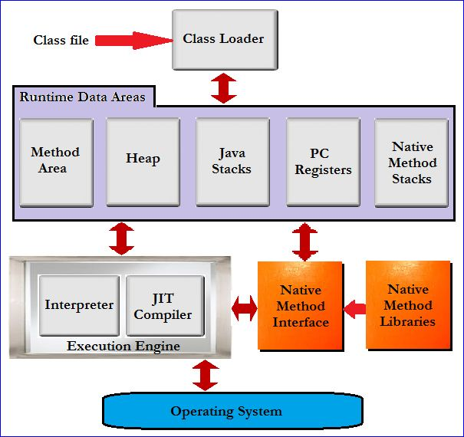
JVM Startup
Errors and exceptions
Linking
Initialization
Execution
Creation and loading
Errors and exceptions
Errors and exceptions
Errors and exceptions

Slide 19
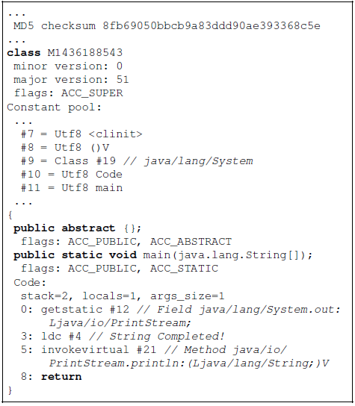
JVM Startup (2)
Errors and exceptions
Linking
Initialization
Execution
Creation and loading
Errors and exceptions
Errors and exceptions
Can this class be normally executed, or at which stage some errors or exceptions can be thrown out?
Errors and exceptions

Slide 20
Outline
Motivation
Design
Mutating classfiles
Selecting representative classfile mutants
Selectively applying mutators
Differentially testing JVMs
Evaluation
Related Work and Conclusion

Slide 21
Selecting Representative Classfiles
testing
selection
mutation
ECP
Do two classfiles belong to the same class?
Yes, if the reference JVM equally processes them
No, otherwise
HotSpot for Java9

Slide 22
Selecting Representative Classfiles (2)
testing
selection
mutation
Do two classfiles belong to the same class?
Seeds
7000 smts, 2300 branches
HotSpot for Java9
7020 stmts, 2340 branches
New mutant
? stmts, ? branches
Is it representative?
Several comparison criteria can be given here

Slide 23
Outline
Motivation
Design
Mutating classfiles
Selecting representative classfile mutants
Selectively applying mutators
Differentially testing JVMs
Evaluation
Related Work and Conclusion

Slide 24
Selecting Mutators
Goal: to create as many representative classfiles as possible
Fact: mutators are designed arbitrarily; some are effective, while some others are useless
A naïve solution: to select mutators by learning from prior knowledge

Slide 25
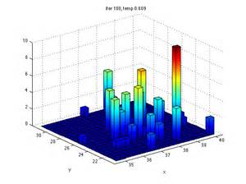
An MCMC Sampling Method
Which mutator will be selected at each step?
A desired distribution: geometric distribution
A has higher success rate than B, and thus it should be easier to be selected than B
The actual distribution
A
B
Proposition: The more number of representative classfiles have been created by a mutator, the more likely the mutator should be selected for further mutations

Slide 26


More Details
The desired distribution
Classfuzz picks up mutators at random, and then accepts or rejects the mutators by a Metropolis choice

Slide 27
Outline
Motivation
Design
Mutating classfiles
Selecting representative classfile mutants
Selectively applying mutators
Differentially testing JVMs
Evaluation
Related Work and Conclusion

Slide 28
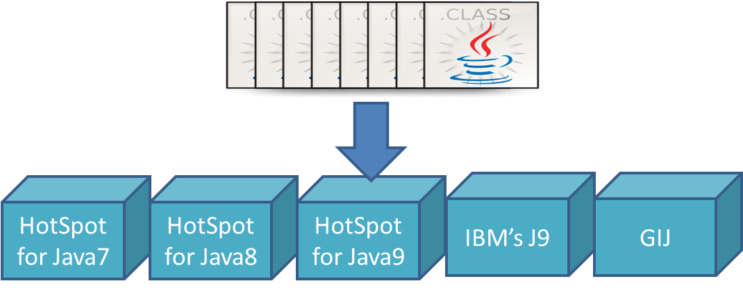
Execution Comparison
result₀ = jvm₀ (env₀, c, input)
result₁ = jvm₁ (env₁, c, input)
result₂ = jvm₂ (env₂, c, input)
result₃ = jvm₃ (env₃, c, input)
result₄ = jvm₄ (env₄, c, input)
A JVM discrepancy appears when result_{i}≠result_{j}
It can either be a JVM defect or a compatibility issue

Slide 29
Execution Comparison (2)
result₀ = jvm₀ (env₀, c, input)
result₁ = jvm₁ (env₀, c, input)
result₂ = jvm₂ (env₀, c, input)
result₃ = jvm₃ (env₀, c, input)
result₄ = jvm₄ (env₀, c, input)
A JVM defect appears when result_{i}≠result_{j}

Slide 30

Execution Comparison (3)
result₀ = jvm₀ (env₀, c, input)
result₁ = jvm₁ (env₀, c, input)
result₂ = jvm₂ (env₀, c, input)
result₃ = jvm₃ (env₀, c, input)
result₄ = jvm₄ (env₀, c, input)
A JVM defect appears when result_{i}≠result_{j}

Slide 31
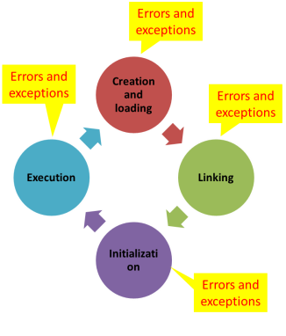
Execution Comparison (3)
result₀ = jvm₀ (env₀, c, input)
result₁ = jvm₁ (env₀, c, input)
result₂ = jvm₂ (env₀, c, input)
result₃ = jvm₃ (env₀, c, input)
result₄ = jvm₄ (env₀, c, input)
A JVM defect appears when result_{i}≠result_{j}
jvm₀ may miss catching some format errors
0
1
1
1
1

Slide 32
Outline
Motivation
Design
Evaluation
Setup
Results
Related Work and Conclusion

Slide 33
Setup
Coverage collection
HotSpot for Java9
GCOV + LCOV
Seeds
1216 classfiles in JRE 7
At each run the coverage can be conveniently collected

HotSpot (260K LOCs)
Cost for cov. analysis: 30+ mins
share/vm/classfile/ (11977 LOCs)
Cost for cov. analysis: 90 secs

Slide 34
Evaluated Methods
Classfuzz supplemented with a uniqueness criterion
[st], [stbr], [tr] – explained in the paper
Randfuzz, Greedyfuzz, Uniquefuzz
 | classfuzz |  |  | randfuzz | greedyfuzz | uniquefuzz
Mutation-based |  |  |  |  |  | 
Cov. analysis |  |  |  |  |  | 
Uniqueness criterion | [st] | [stbr] | [tr] |  | [stbr] | [stbr]
Mutator selection |  |  |  |  |  | 

Slide 35
Metrics
RQ1: How many test classfiles can be generated?
#Iterations, |GenClasses|, |TestClasses|
RQ2: How effective are the test classfiles?
|Discrepancies|, |Distinct Discrepancies|, diff rate
RQ3: Can the test classfiles find any JVM defects?

Slide 36
Outline
Motivation
Design
Evaluation
Setup
Results
Related Work and Conclusion

Slide 37
Results on Classfile Generation
X
Randfuzz generates 20 times as many classfiles as those generated by any other algorithm
Classfuzz[stbr] generates the most number of representative classfiles
Classfuzz[stbr] achieves the highest success rate among all the coverage-directed algorithms

Slide 38
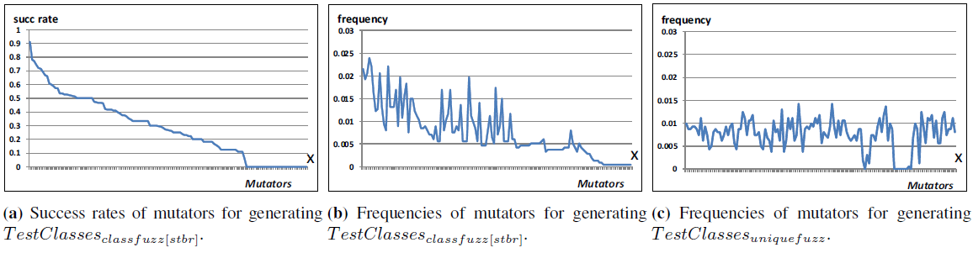
Results on Classfile Generation (2)
Classfuzz can utilize the prior knowledge to select mutators
strongly correlated
succ rate
classfuzz
randfuzz
weakly correlated

Slide 39
Results on Differential JVM Testing
Classfuzz can enhance the ratio of discrepancy triggering classfiles from 1.7% to 11.9%
JVMs are compatible for most of the classfiles, but differ in processing corner cases
We have experienced 898 different execution paths. 107 paths were related to JVM behavior differences

Slide 40
Discrepancy Analysis (1)
public abstract {};
HotSpot takes it as a ordinary method
J9 reports a format error
The JVM specification needs to be clarified

Slide 41
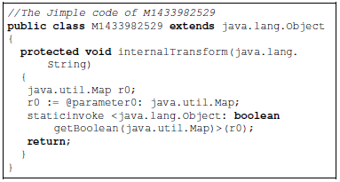
Discrepancy Analysis (2)
A type casting needs to be performed
JVMs take their own classfile verification and type checking polices

Slide 42
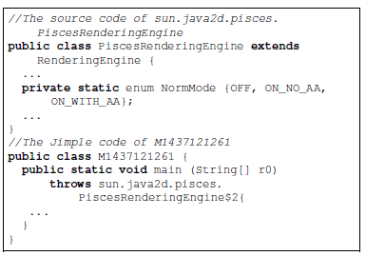
Discrepancy Analysis (3)
JVMs are not compatible to access some classes

Slide 43
Discrepancy Analysis (4)
More findings
J9 is less strict than HotSpot because J9 only verifies a method when it is invoked, while HotSpot verifies all methods before execution
GIJ can execute an interface having a main method
GIJ accepts a class with duplicate fields
…
These discrepancies can be found in a package of 62 discrepancy-triggering classes

Slide 44
Outline
Motivation
Design
Evaluation
Conclusion

Slide 45
Conclusion
Problem
Testing JVMs requires painstaking effort in designing test classfiles along with their test oracles
Proposal: classfuzz: coverage-directed fuzz testing
Test classfile generation
Mutating classes and selectively applying mutators
Deciding the representativeness of a classfile mutant
Differential JVM testing
Tool is available at http://stap.sjtu.edu.cn/˜chenyt/DTJVM/index.htm

