Slide 1

Final Project Image to Sentence Generation
SUN, TING
CSCI E-89 Deep Learning, Spring 2019
Harvard University Extension School
Prof. Zoran B. Djordjević

Slide 2
Introduction
Goal: automatically describe the content of an image using properly formed English. Also called Neural Image Captioning or NIC
A field in Artificial Intelligence that connects computer vision and natural language processing.
This report explores five different Keras model architectures from features generated on VGG16 and InceptionV3 Convenet networks, and on GLOVE pre-trained word embeddings.
The predicted sequences are generated with beam search and final sentence is predicted from a composite BLEU score for each image.
[1] Vinyals, Oriol, Toshev, Alexander, Bengio, Samy, and Erhan, Dumitru. Show and tell: A neural image caption generator
[2] Jason Brownlee’s blog
@SUN, Ting

Slide 3
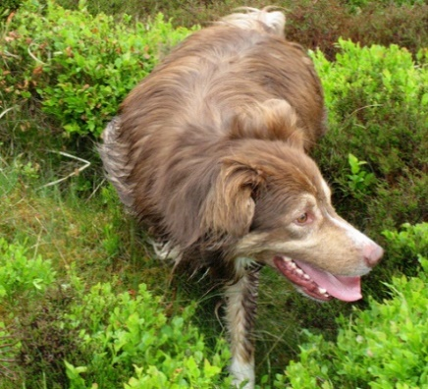
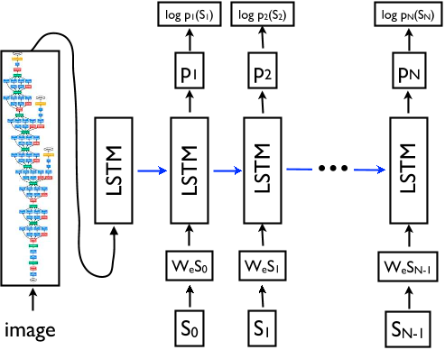
System Flow Chart
Encoder (deep CNN): transform the image into a rich fixed length vector
Decoder (RNN): take the output of encoder as input and generates the target sentence (LSTM Networks remembers information for long periods of time)
A brown dog is running through the grass

Slide 4
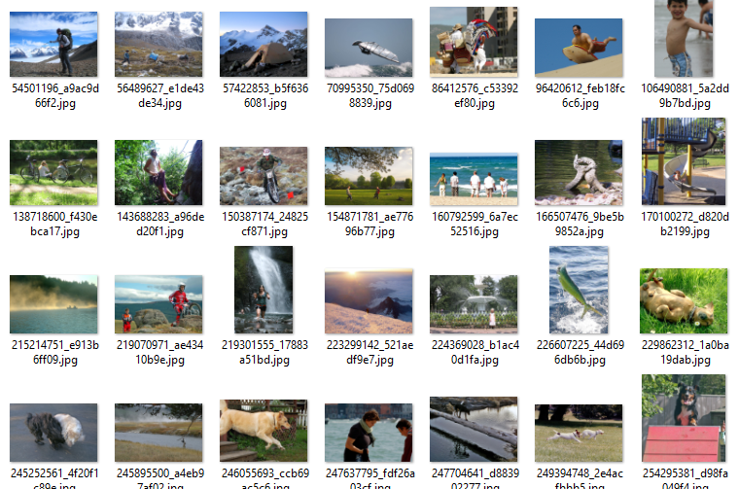
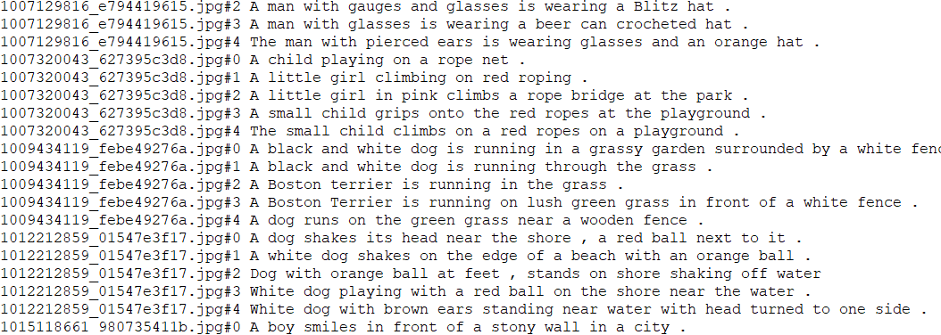
Corpus And Data Files
Raw data file (Flickr8k):
Images(with image ID) Annotations
Train: 6000+ imgs
Dev: 1000 imgs
Test: 1000 imgs
@SUN, Ting

Slide 5

Data Preprocessing & Feature Generation
Feature Extractor Encoder
Embedding
Encoder
VGG16.model.layers.pop()
Model(inputs=model.inputs, outputs=model.layers[-1].output)
VGG16.model.layers.pop()
Model(inputs=model.inputs, outputs=model.layers[-3].output)
Embedding(vocab_size,256)
Glove_Embedding(vocab_size,max_length)
features.pkl
features2.pkl
Dimension:(,4096)
Dimension:(,7,7,512)
Vocabulary Size: 8766
Max Sentence Length: 34
inceptionV3.model.layers.pop()
Model(inputs=model.inputs, outputs=model.layers[-1].output)
Features_inception.pkl
Dimension:(,2048)
@SUN, Ting

Slide 6
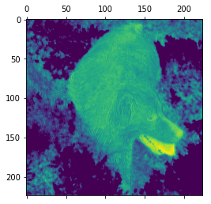
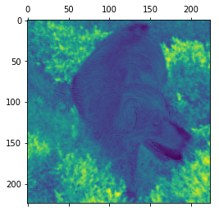
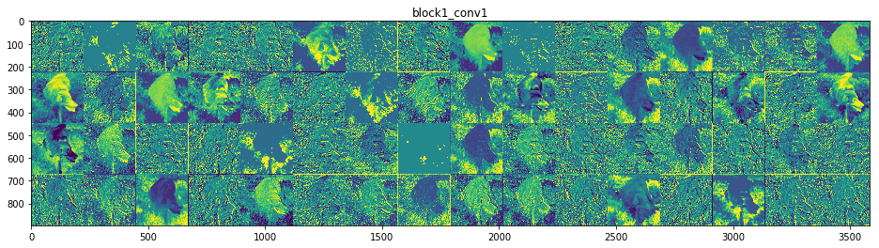
VGG16 Convnet Filter Visualization
Channel Number =18
Channel Number =8
block1_conv1 layer activation feature map
Channel Number =18 & Channel Number =8
Feature input is decomposed into different filters learned by the network.

Slide 7
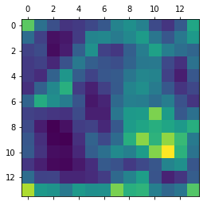
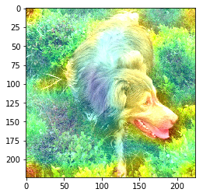
VGG16 CAM Visaulization
CAM illustrates how intense the input image activates different channels for every layer of the Convnet.
block4_pool layer activation heatmap
The output class is activated on the part where the head and mouth of the dog are located

Slide 8
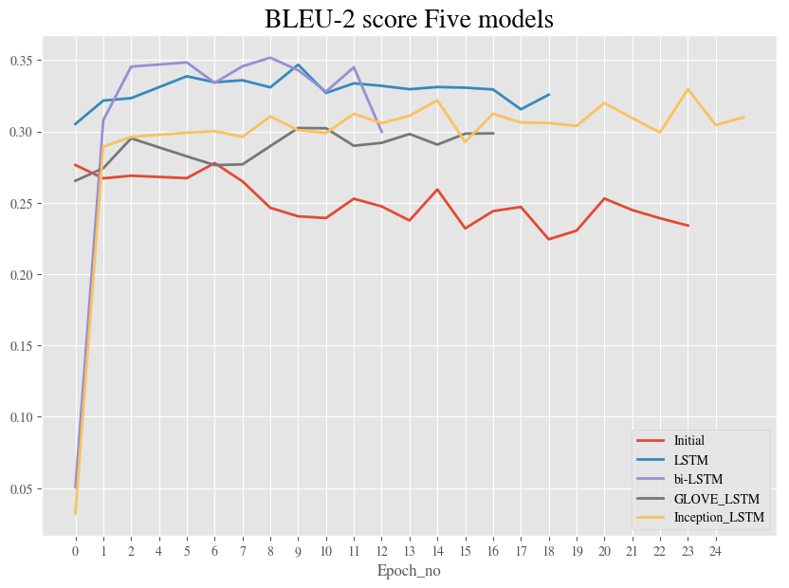
Model Performances on Dev Dataset
Model ‘GLOVE_LSTM’
Initial: features.pkl+dense in decoder
LSTM: features2.pkl +2 LSTM in decoder
GLOVE_LSTM: features2.pkl+glove
bi-LSTM: features2.pkl + bi-LSTM in decoder
Inception: Features_inception.pkl +LSTM in decoder
Embedding Encoding Layer:
L2 Regularization(lambda=0.01)
Decoding Layer:
Dropout (0.2)

Slide 9
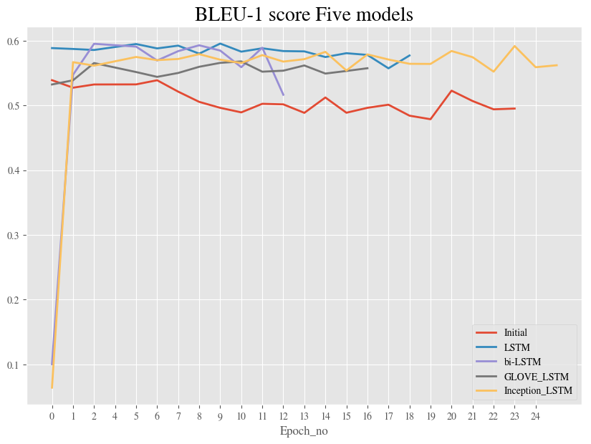
Model Performances on Dev Dataset
The best BLEU -1 score = 0.595553 (8th epoch of LSTM)
The best BLEU -2 score = 0.351678 (7th epoch of bi-LSTM)
Still overfit

Slide 10
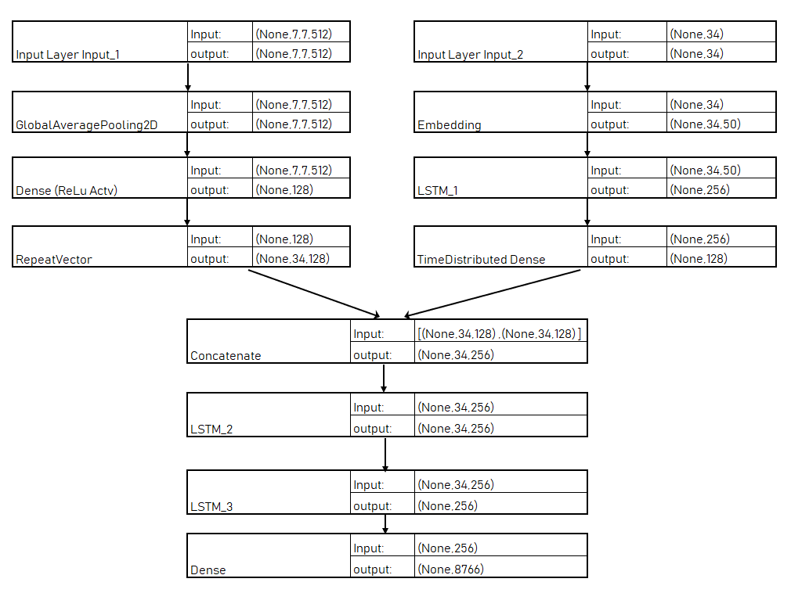
Model II (LSTM) Structure and Dimensions
The second model structure is inspired by Jason Browlee’s experiment on :
Add global average pooling in input1 decoder
Add another LSTM after emebedding layer in encoder
Add additional LSTM on the language decoder model

Slide 11
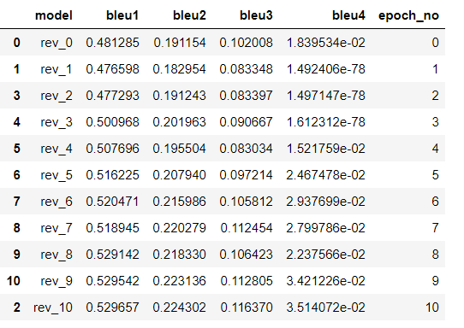
To Be Continued….
Increase to 256
Dropout Layer or L2 Reg
Dropout Layer or L2 Reg

Slide 12
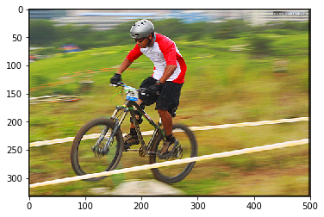
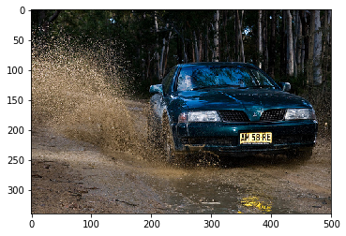
Beam Search
Beam Size | Predicted Line:
1 | Man in blue shirt is riding bike on the road
5 | Man in blue shirt is riding bike on the street
6 | Man is riding bike on the road
7 | Young boy is riding bike through the woods
Beam Size | Predicted Line:
1 | the car is driving on the track
2 | race car is driving on dirt road
3 | group of people on campground
7 | group of people on campground
The paper uses Beam size of 20, and found that beam size=1 degrades results by 2 BLEU points
[1] Vinyals, Oriol, Toshev, Alexander, Bengio, Samy, and Erhan, Dumitru. Show and tell: A neural image caption generator

Slide 13
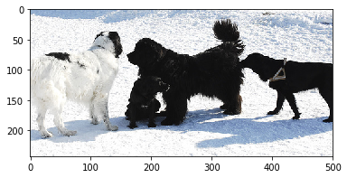
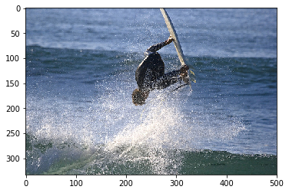
Composite BLEU Score Predictions
Beam size | Composite BLEU score | Predicted line
1 | 0.074303819978587 | ['two','dogs','are','walking','on','the','beach']
2 | 0.2949892420597484 | ['two', 'dogs', 'play', 'in', 'the', 'snow']
3 | 0.2949892420597484 | ['two', 'dogs', 'play', 'in', 'the', 'snow']
4 | 0.2949892420597484 | ['two', 'dogs', 'play', 'in', 'the', 'snow']
5 | 0.2949892420597484 | ['two', 'dogs', 'play', 'in', 'the', 'snow']
6 | 0.4423069034595409 | ['group','of','dogs', 'play','in', 'the','snow']
7 | 0.4423069034595409 | ['group', 'of', 'dogs', 'play', 'in','the','snow']
Beam size | Composite BLEU score | Predicted line
1 | 0.1311010247638203 | ['man','is','swimming','underwater','into','the','water']
2 | 0.1948232308322818 | ['surfer', 'is', 'swimming', 'underwater', 'into', 'the', 'water']
3 | 0.2554484575664864 | ['surfer', 'is', 'splashed', 'in', 'the', 'water']
4 | 0.2554484575664864 | ['surfer', 'is', 'splashing', 'in', 'the', 'water']
5 | 0.2554484575664864 | ['surfer', 'is', 'splashing', 'in', 'the', 'water']
6 | 0.1581256632951305 | ['young', 'boy', 'splashes', 'in', 'the', 'water']
7 | 0.1581256632951305 | ['young', 'boy', 'splashes', 'in', 'the', 'water']

Slide 14


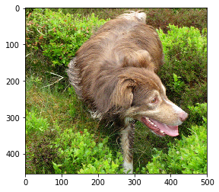
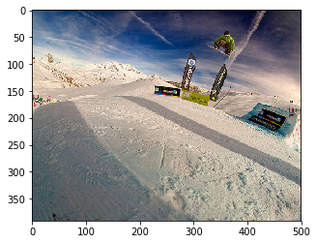
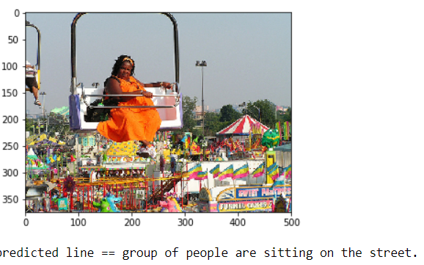
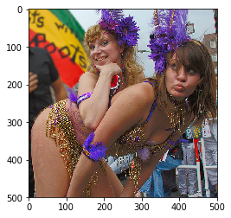
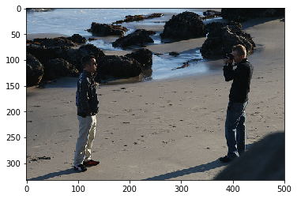
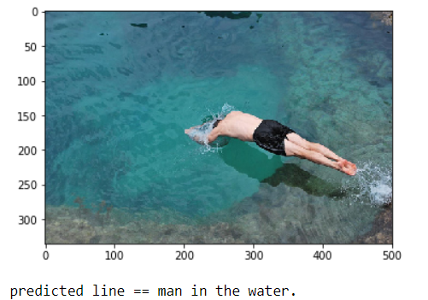
Example Predictions
brown dog is running through the grass
the skier is going through the air
Young girls pose for the camera
Two men are walking on the beach

Slide 15

Future Work
Create LSTM model with attention
Experiment more on regularization as the model tends to overfit early in the training process.
Create mini batch in the fit generator.
Experiment on larger corpus like Flickr30k and MS COCO with higher computing power.
Utilize inception_v3 network and explore more model structures.
We took a baby step towards..
The neural network architecture was inspired by my image captioning project.

Slide 16
YouTube URLs, Last Page
Two minute (short): https://youtu.be/15jtsoqUzhk
15 minutes (long): https://youtu.be/j5n95kx9W0g

