Slide 1
Visualizing Word Embeddings -- from word2vec to ELMO and BERT
Ting Sun
Ontario Teachers’ Pension Plan for HackerSix
Aug 21, 2020

Slide 2
Agenda
What is Word Embedding?
Word Embedding Algorithms:
word2vec
Elmo
Bert
Comparison of Algorithms

Slide 3
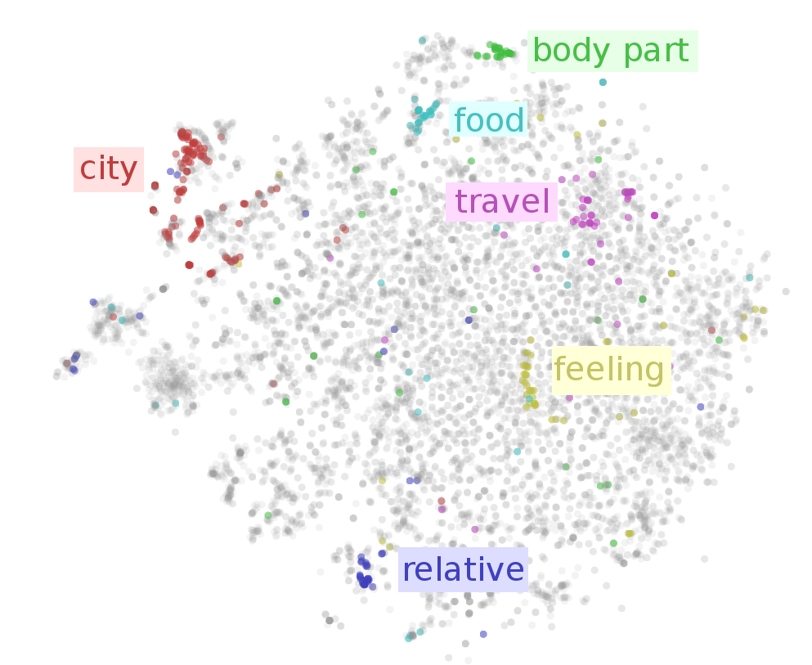
What is Word Embedding?
Natural language processing (NLP) looks at how computers and human languages interact, in particular how to program computers to process and analyze language data.
Word Embedding refers to the techniques in natural language processing (NLP) where words or phrases are mapped to numbers
It’s one of the biggest breakthroughs in NLP!
Illustration: dots represent number space, similar words are mapped in close proximity to each other. (From https://ruder.io/word-embeddings-1)

Slide 4
Types of Word Embedding Approaches
Frequency Based Embedding
Prediction Based Embedding
Static Embeddings
word2vec (Google)
Glove (Stanford)
FastText (Facebook)
Etc…
Dynamic Embeddings
Elmo (AllenNLP)
Bert (Google)
GPT-2 (OpenAI)
Etc...

Slide 5
Word2vec
Provides probabilities to the words and proved to be state of the art for tasks like word analogies and word similarities before Contextual Embeddings
A type of distributed word representation, allows words with similar meaning to have a similar representation
Unsupervised, built by reading huge corpus
Dimensions are basically projections along different axes (denser)
Efficient estimation of word representations in Vector space
Distributed representations of words or phrases
----- (Mikolov et al, 2013 )

Slide 6

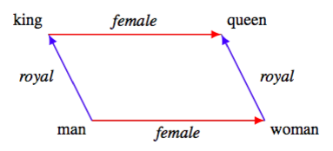
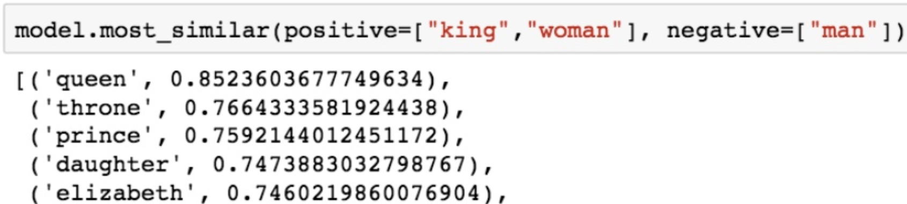
Word2vec Output
For example: “king” is to “man” as what to “woman” ?
Similarity terms output from python:
(numbers closer to 1 indicate higher similarity)

Slide 7
word2vec Training
Language models define probability distributions over strings or sentences.
Bigram Model:
prob(natural | language) or prob(language | processing), etc.
Let’s train this sentence:
natural language processing and machine learning is fun and exciting!

Slide 8

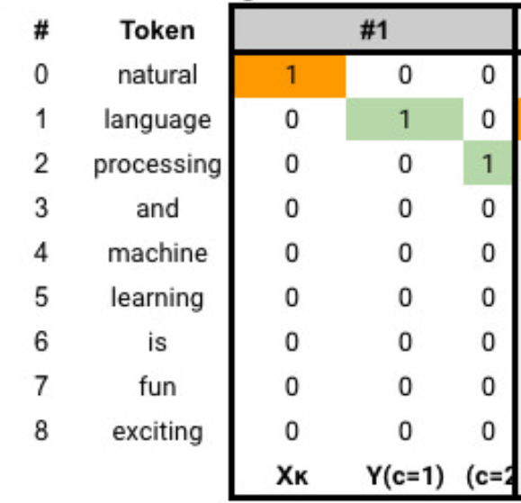
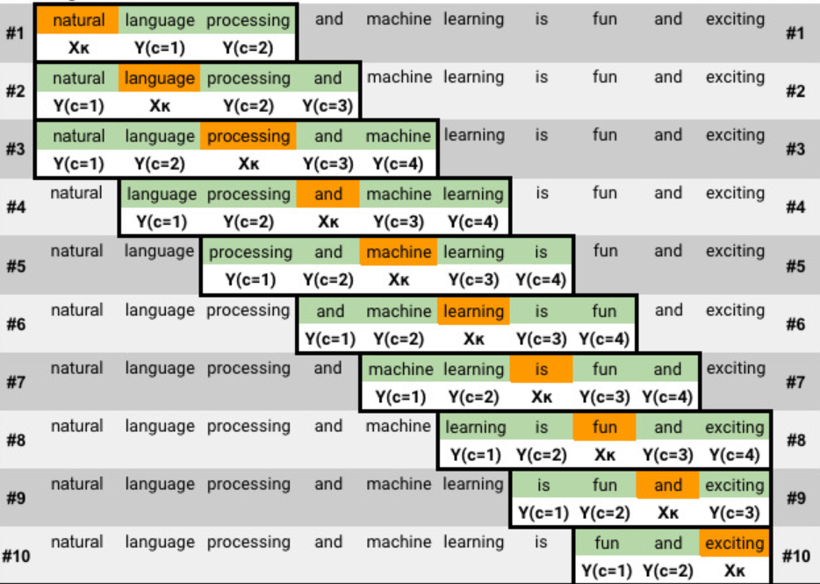
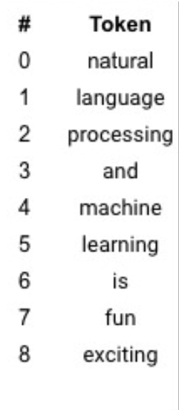
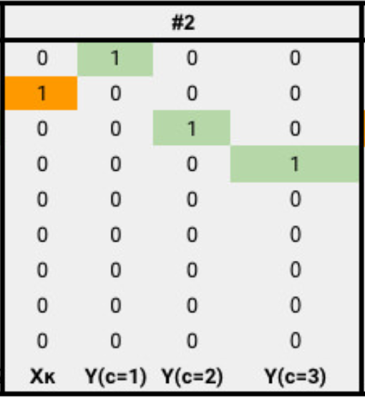
word2vec Training – Example 1
CBOW example
https://github.com/DerekChia/word2vec_numpy

Slide 9
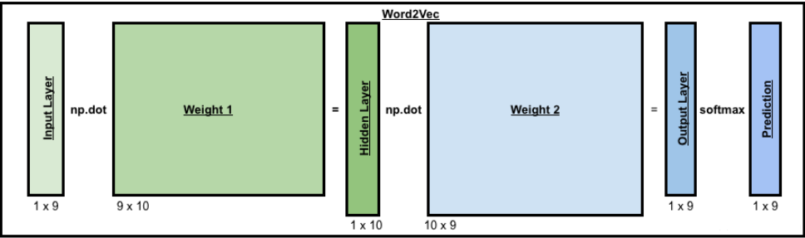
word2vec Training
A shallow two-layer neural network
Turn our sentence into a one-hot encoded representation
Randomly initialize the two weight matrices
Dot product for feedforward pass
Summing up the difference between y_pred (prob.) and actual Y
Use back propagation function to calculate the adjustment for the weights
Weight matrices → word2vec!
https://github.com/DerekChia/word2vec_numpy

Slide 10
word2vec Training – Another Example
Let’s try another example
Bloomberg News:
Business Wire Globe Newswire and New York Times
Topic: Brexit
Number of articles: 4700
Dictionary: 70K

Slide 11
word2vec Training – Example 2
Dense representation and placed in the same vector space
Smaller embedding dimensions (equal to the size of d (typically 100 or 300))
Similar words have similar embeddings
Cbow: continuous Bag of Words
Negative Sampling: Randomly sample a smaller number of negative samples
 | Hyper-Parameters
Algorithm | Cbow with negative sampling
Window size | 10
Learning rate | 0.025
min_count | 100
Batch size | 50
Iterations | 5

Slide 12
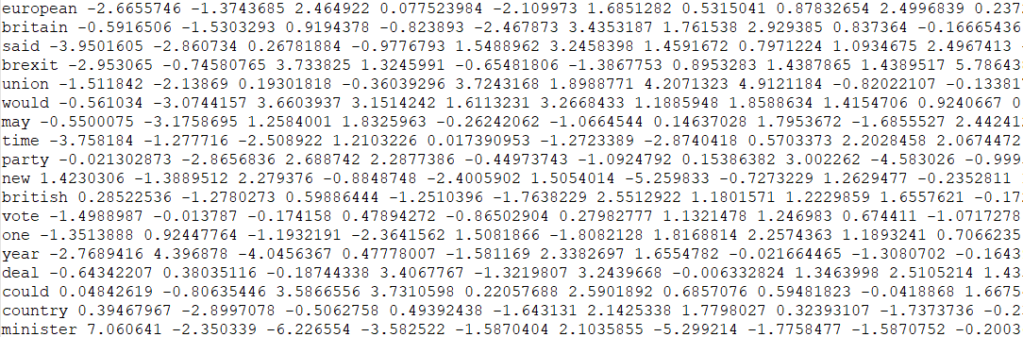
word2vec Training
Self Trained Word Vectors partial output
We’ll come back to the embedding of ‘May’ later!

Slide 13
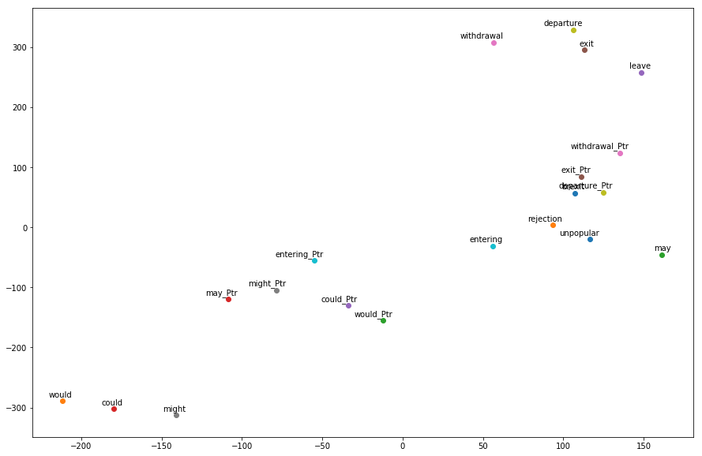
word2vec 2D Visualization with TSNE
Pretrained
‘may‘ is close to might, would, could.
‘exit‘ is close to withdrawal, departure.
Trained
‘may’ is close to unpopular, rejection. ☺
‘ exit ‘ is close to departure, leave.
*_Ptr: pretrained

Slide 14
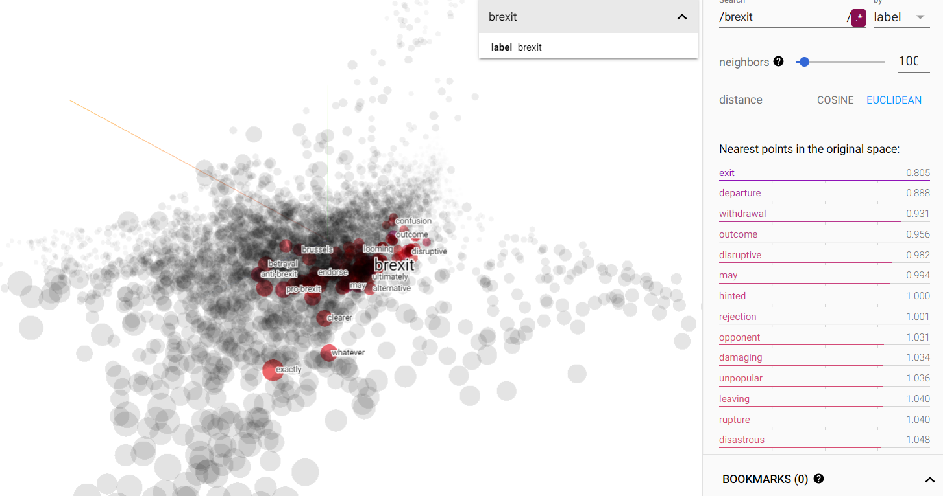

word2vec: 3D Visualization with TensorFlow
View live TB for trained (perplexity=18) and pretrained

Slide 15
Types of Word Embedding Approaches
Frequency Based Embedding
Prediction Based Embedding
Static Embeddings
word2vec (Google)
Glove (Stanford)
FastText (Facebook)
Etc…
Dynamic Embeddings
Elmo (AllenNLP)
Bert (Google)
GPT-2 (OpenAI)
Etc...
Elmo and Bert are
contextual word embeddings

Slide 16
Contextual Word Embeddings
Should we be using the same word embeddings for ‘may’?
cambridge analytics announced in may that it was ceasing most operations and filing for bankruptcy amid…… we may never know whether individuals were unknowingly influenced to vote a certain way in either the u.k. e.u. referendum or the u.s. election campaigns, the report said… … the may government has sent a range of signals indicating it will take a hard line in negotiations with european governments over the terms of Brexit……
Contextual Word Embeddings for Word Sense Disambiguation to the rescue!

Slide 17
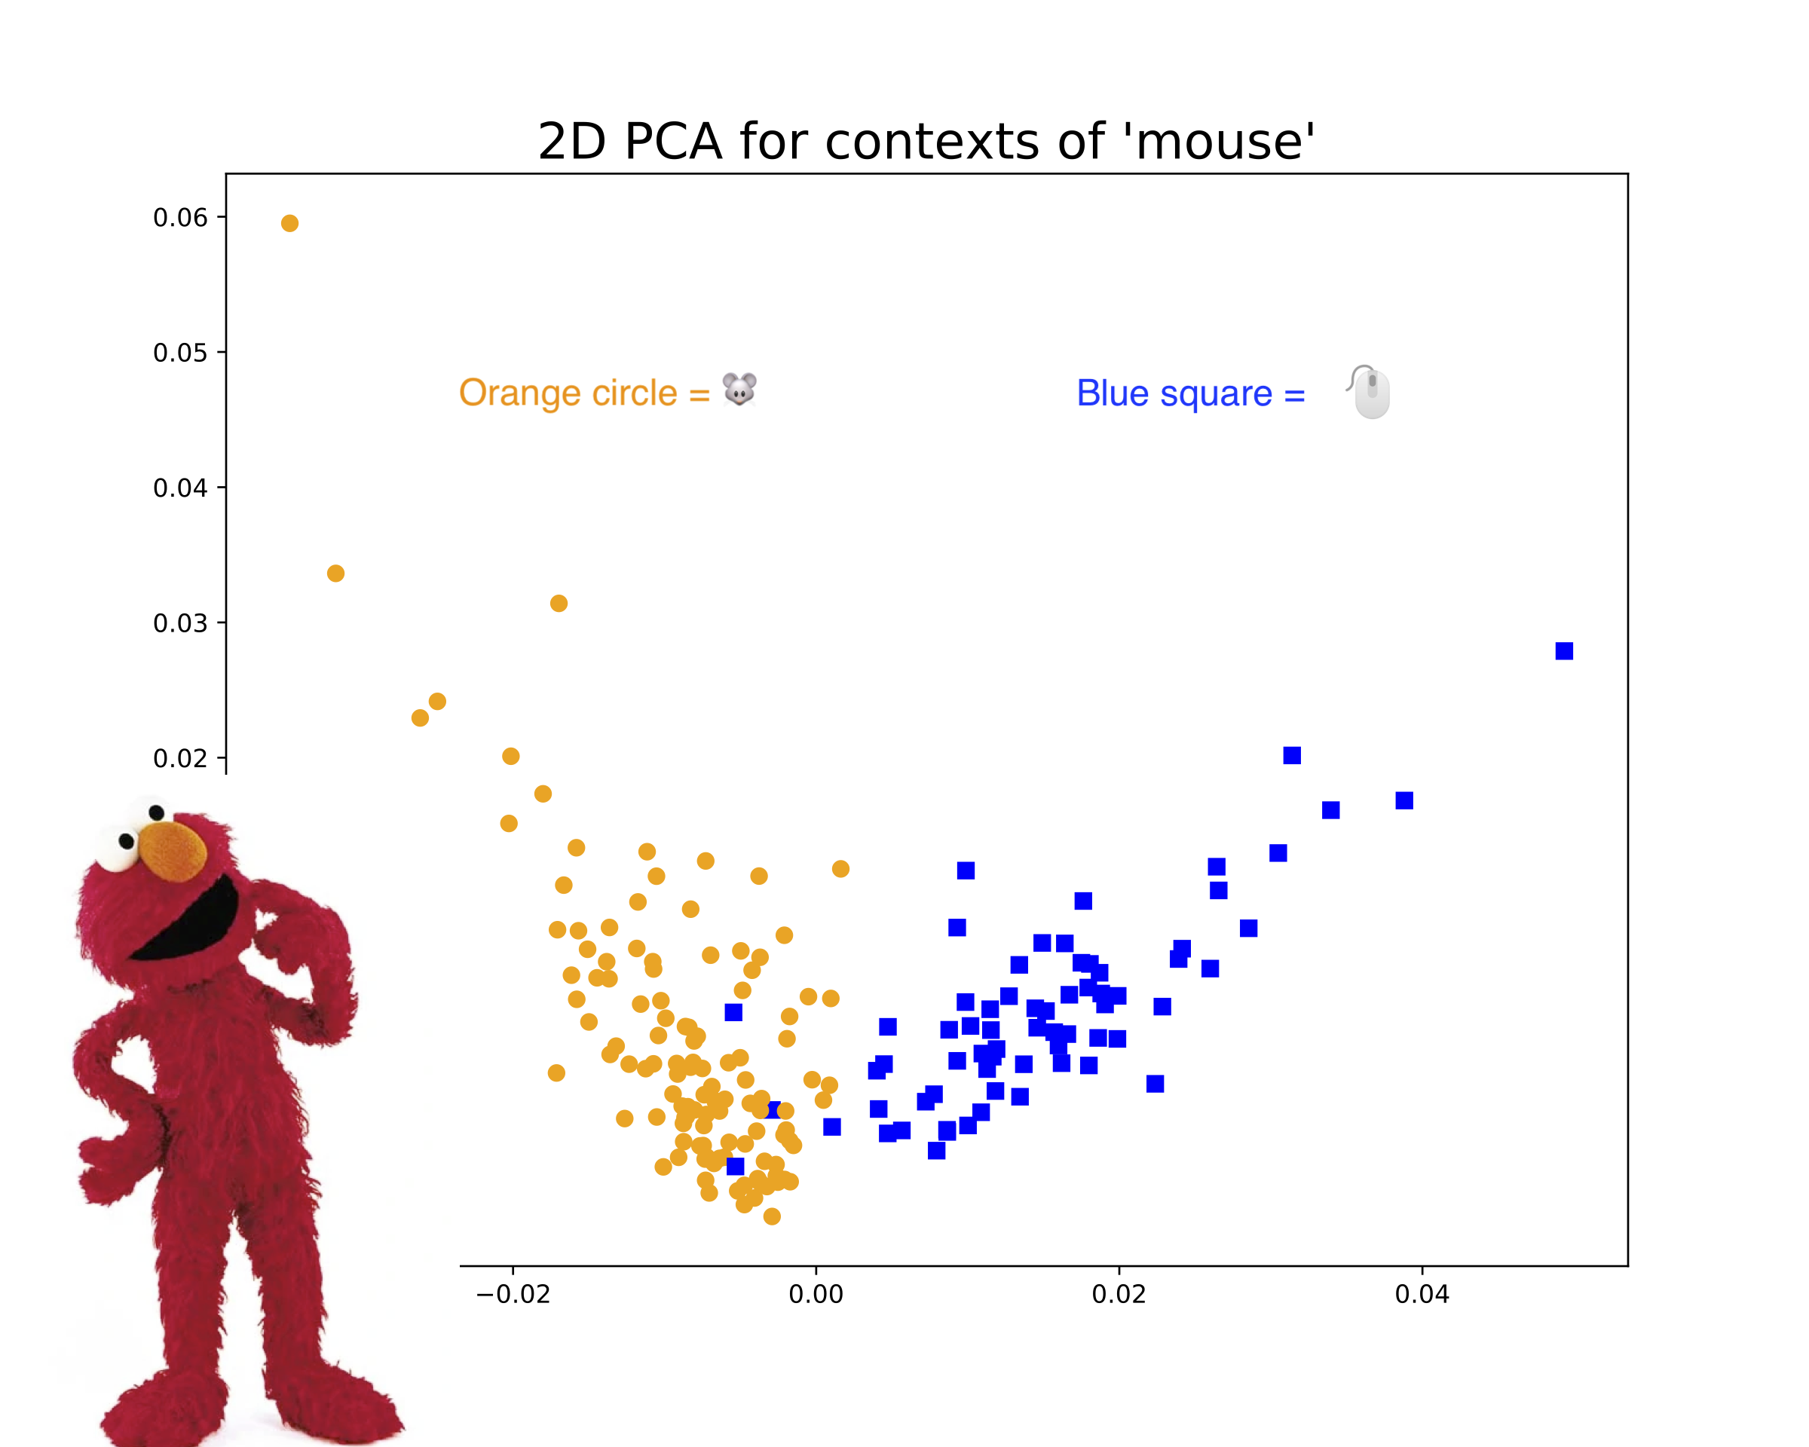
ELMO Word Embeddings – Bidirectional LSTM
Character based, deep bi-directional language (biLM) contextualized word representation that models syntax and semantics characteristics of word use.
*https://allennlp.org/elmo

Slide 18
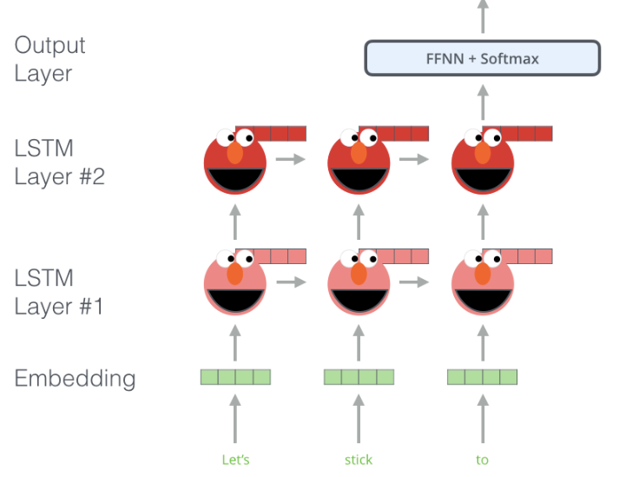
ELMO Model Structure
Layer | Tensor Shape
word_emb - character-based word representations | [batch_size, max_length, 512]
lstm_outputs1 | [batch_size, max_length, 1024]
lstm_outputs2 | [batch_size, max_length, 1024].
Elmo-weighted sum of the 3 layers, where the weights are trainable | [batch_size, max_length, 1024]
Final - fixed mean-pooling of all contextualized word | [batch_size, 1024]
This layer is the one we USE!

Slide 19
ELMO Embeddings from Bloomberg News
Data Preprocessing:
Cleaning: remove html tags, Remove some stop words, emails, weblink.. Lemmatization, ..etc
Spacy: sentence & word tokenizer
remove articles with 150 sentences
Remove sentences with length >50 or <10
Selected 800 sentences for visualization

Slide 20
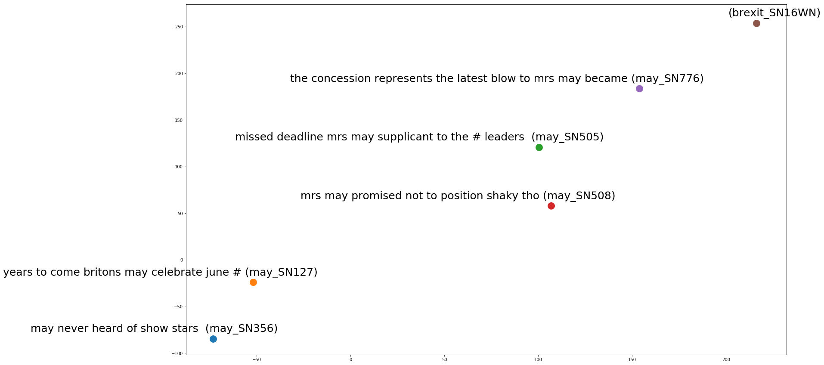
ELMO Embeddings from Bloomberg News

Slide 21
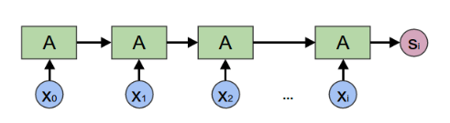
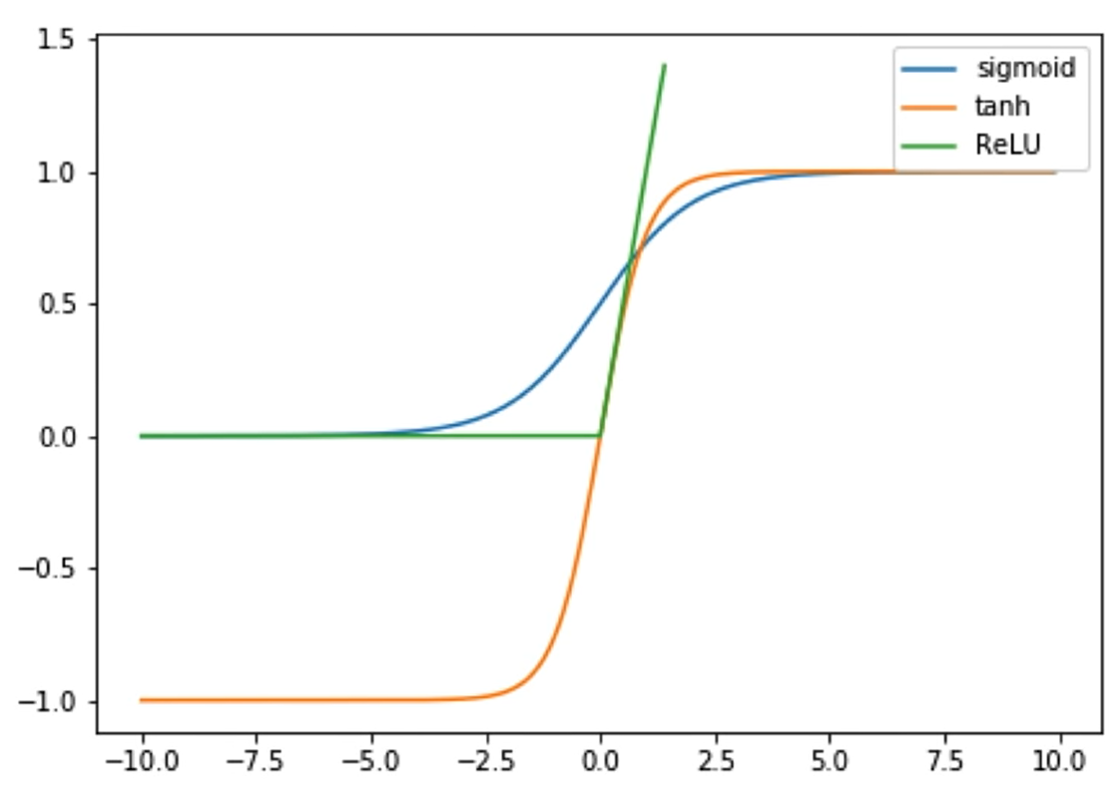
Limitations of LSTM (Long Short Term Memory)
Elmo is based on LSTM
Difficult to train
Very long gradient path -- LSTM on 100-word doc has gradients like 100-layer neural network
Must be computed in a series by token, can not execute in parallel
Transfer learning never really worked paralleled computation
RELU activation function works better than sigmoid and Tanh activations
Activation Functions

Slide 22
Types of Word Embedding Approaches
Frequency Based Embedding
Prediction Based Embedding
Static Embeddings
word2vec (Google)
Glove (Stanford)
FastText (Facebook)
Etc…
Dynamic Embeddings
Elmo (AllenNLP)
Bert (Google)
GPT-2 (OpenAI)
Etc...

Slide 23

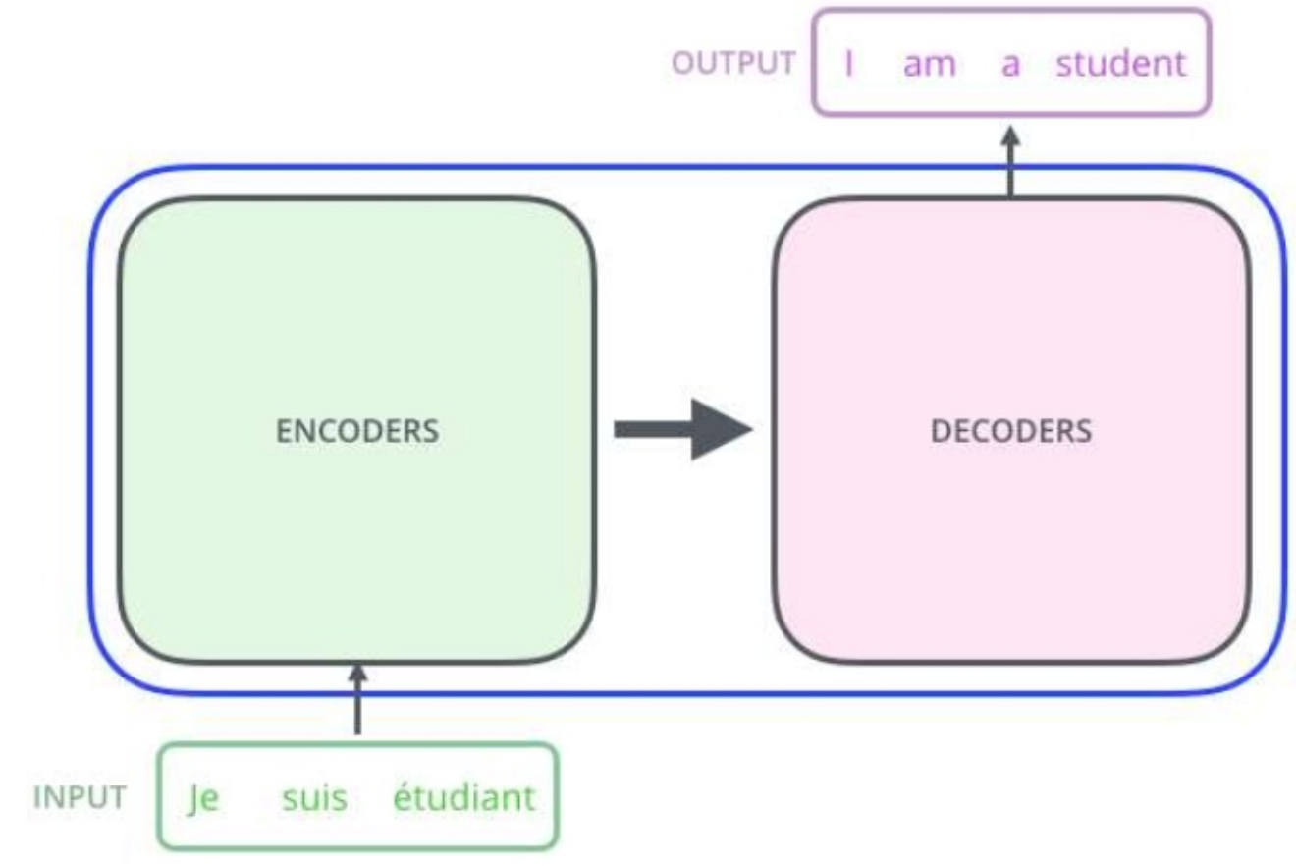
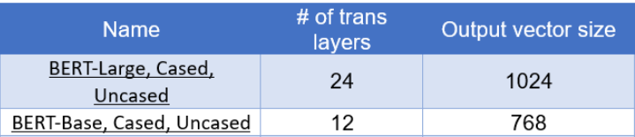
BERT – Encoder and Decoder Structure
Transformer is a network topology for implementing an encoder-decoder flow using fully connected networks based on attention.
Neural network Encoder and Decoder
Attention based model
Masked Language Model
Bidirectional/No-directional
* Total parameters are 110M and 240M. Pretrained 12-layer uncased BERT is used

Slide 24
BERT – Attention Explained
BERT aims to encode a word based on all other words in the sequence
Attention Mechanism:
Attention is all you need!
(Machine Translation)
Example from Geoffrey Hinton:
The gift can’t fit the box, because it is too large.
The gift can’t fit the box, because it is too small.

Slide 25
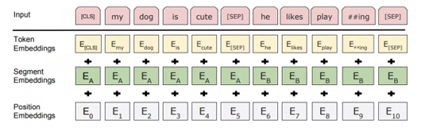
BERT – Masked Language Model
Tokenization is the task of chopping it up into pieces, called tokens
Using wordpieces (e.g. playing -> play + ##ing) instead of words
Token embedding is the task of get the embedding (i.e. a vector of real numbers) for each word in the sequence
Positional encoding: encode positions in the sequence
Segment embedding: segment ID. Original bert is trained on sentence pair.

Slide 26
BERT – Masked Language Model
Example of preprocessed tokens:
[CLS] mrs may promised not to position shaky thoughts turning to successor might behave particularly pro ##bre ##xi ##t hard ##liner like boris johnson the former foreign secretary [SEP]
['[CLS]', 'the', 'nik', '##kei', 'flu', '##ctuated', 'wildly', 'since', 'the', 'br', '##ex', '##it', 'vote', '–', 'plunging', 'almost', '#', 'percent', 'friday', 'and', 'rebound', '##ing', '#', 'percent', 'monday','[SEP]']

Slide 27
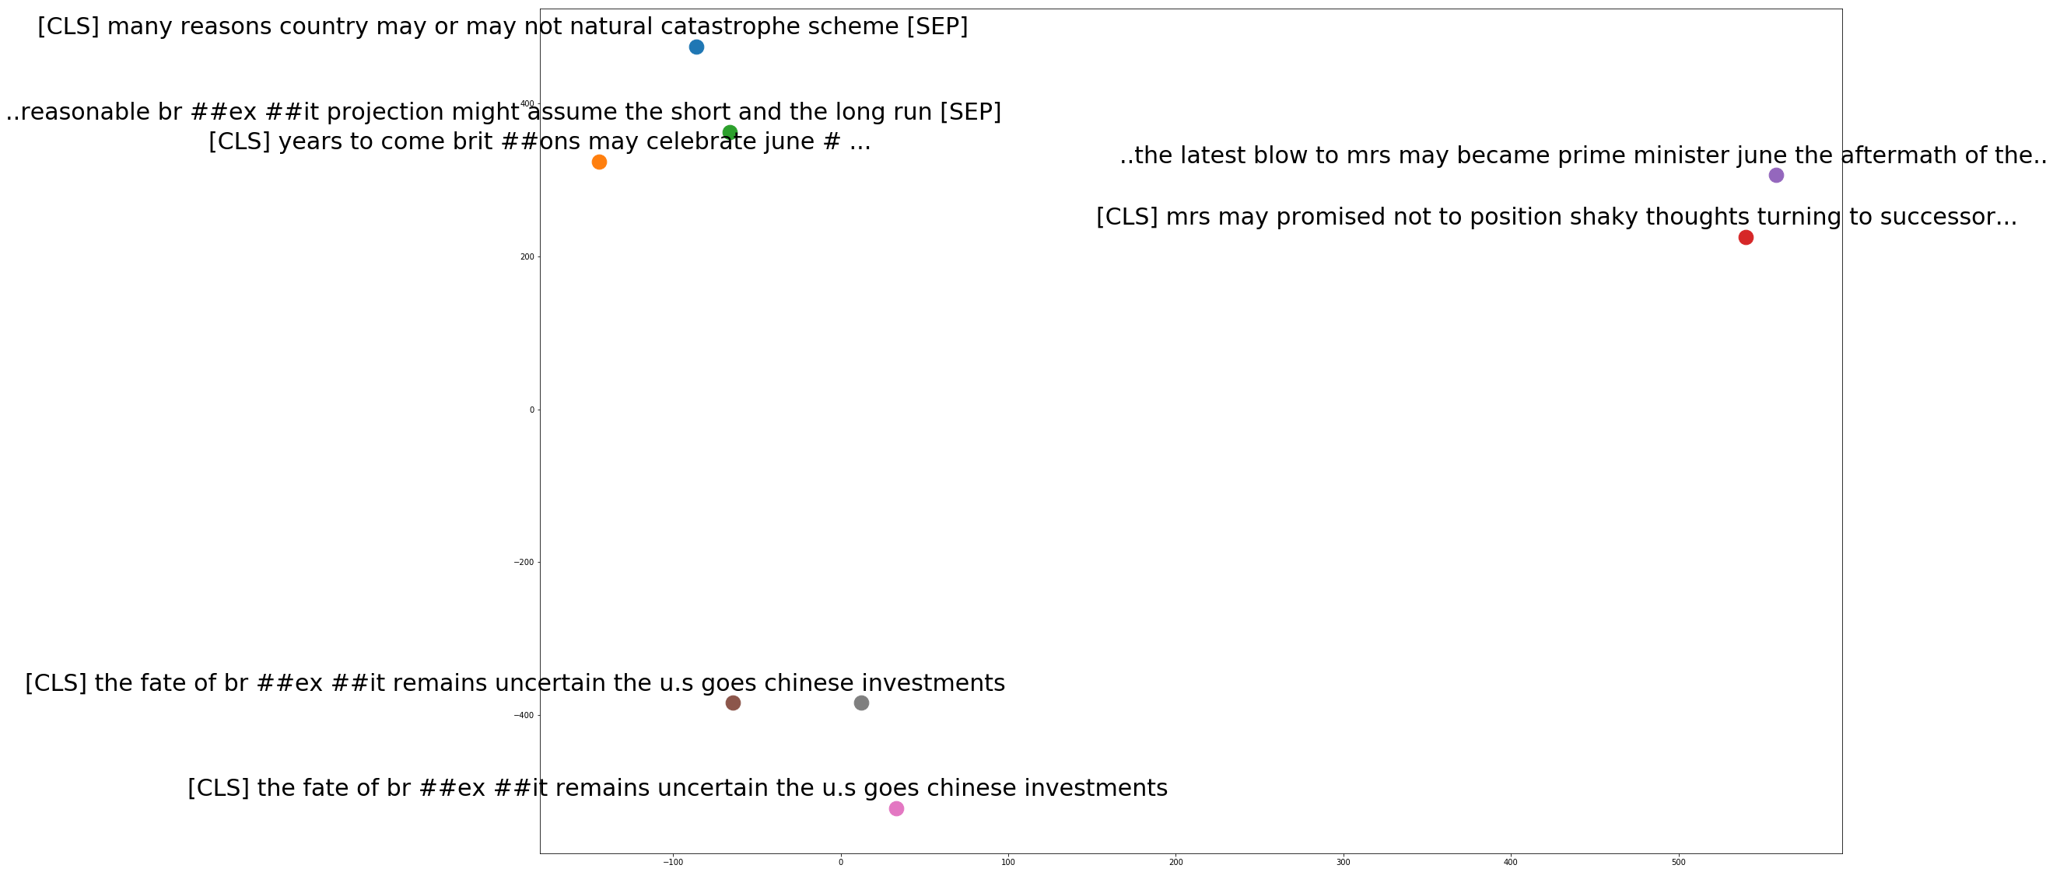
BERT Embeddings from Bloomberg News
*Tensorflow hub allows us to prototype NLP model using state of the art BERT embeddings in Keras.

Slide 28
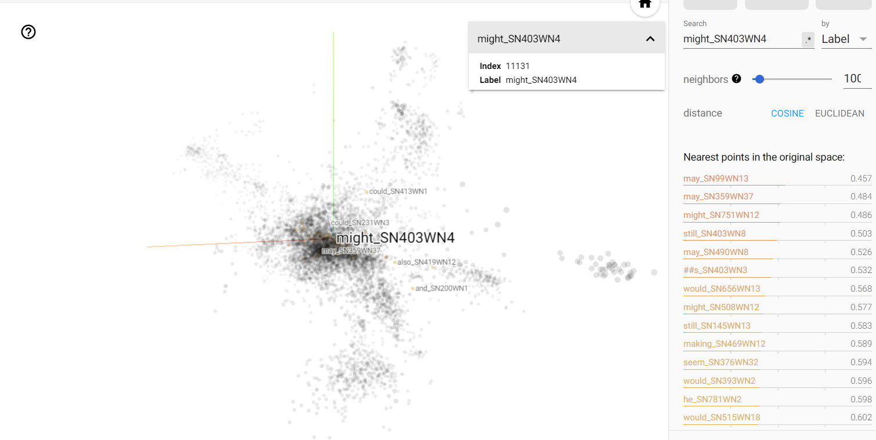
BERT: 3D Visualization
View live Bert Pretrained TSNE in 3D

Slide 29
Comparing word2vec, ELMO and BERT
Closer to 1 = more similar
Closer to 0 = less similar
Pretrained Word2Vec (1 X 300) | Cosine Similarity
may and might | 0.829957
May and could | 0.7262207
exit and departure | 0.50380
Word2vec assesses “may” and “might” as having high similarity
Sentence no 356: …. new drama british tv since downton abbey may never heard of show stars richard madden game of thrones.
Sentence no 15: …. the time next brexit it seems prime minister theresa may sacrificial promise to resign exchange support withdrawal plan...
Elmo compares the “may” in these two sentences as being dissimilar based on their contexts
Sentence No. | SN: 356 (encoding of may) | SN:15 (encoding of may) | Cosine Similarity
Elmo Embedding (1 X 1024) | [-0.5143662 , 0.17532113, 0.0359986 , ..., 0.38032413, 0.8787184 , -0.17165235] | [-3.92979324e-01, 2.50246882e-01, -3.57596874e-01, -3.89498353e-01,… | 0.110929
Bert Embedding (1 X 768) | [-0.06329039, -0.7610529 , 0.27190852, ..., -0.00549695, 0.9883583 , -0.38016868] | 4.85665165e-02, -1.86653316e-01, 6.02850914e-01, -2.74127066e-01,…] | 0.068779
Bert rates the “mays” as being even more dissimilar

Slide 30
Review
What is Word Embedding?
Word Embedding Algorithms:
word2vec
Elmo
Bert
Comparison of Algorithms

Slide 31


References
Paper:
Tomas Mikolov, Kai Chen, Greg Corrado, Jeffrey Dean: Efficient Estimation of Word Representations in Vector Space
Dzmitry Bahdanau, Kyunghyun Cho, Yoshua Bengio: Neural Machine Translation by Jointly Learning to Align and Translate
Jacob Devlin, Ming-Wei Chang, Kenton Lee, Kristina Toutanova: "BERT: Pre-training of Deep Bidirectional Transformers for Language Understanding", 2018
Matthew E. Peters, Mark Neumann, Mohit Iyyer, Matt Gardner, Christopher Clark, Kenton Lee, Luke Zettlemoyer. Deep contextualized word representations
Other References:
https://allennlp.org/elmo
http://jalammar.github.io/illustrated-bert/

