Slide 1
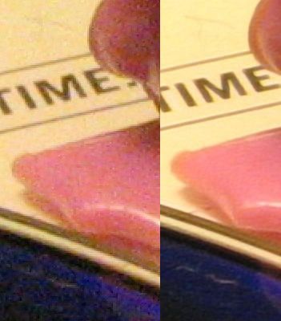
Learning Super Resolution
A short introduction
2019.09.20
Ting-Shuo Yo

Slide 2
Super Resolution
Super-resolution imaging (SR)
is a class of techniques that aims to obtain a high-resolution (HR) output from one of its low-resolution (LR) versions. In some SR techniques—termed optical SR—the diffraction limit of systems is transcended, while in others—geometrical SR—the resolution of digital imaging sensors is enhanced.
SR Is an Inverse Problem
It is ill-posed, one set of LR image may correspond to multiple HR
Some imaging methods use multiple LR (with different angle or time) to reconstruct HR.
Here we focus one Single Image Super Resolution (SISR)

Slide 3
Single Image Super Resolution
Classical methods
Prediction-based
Edge-based
Statistical methods
Patch-based
Sparse representation methods
Deep Learning

Slide 4
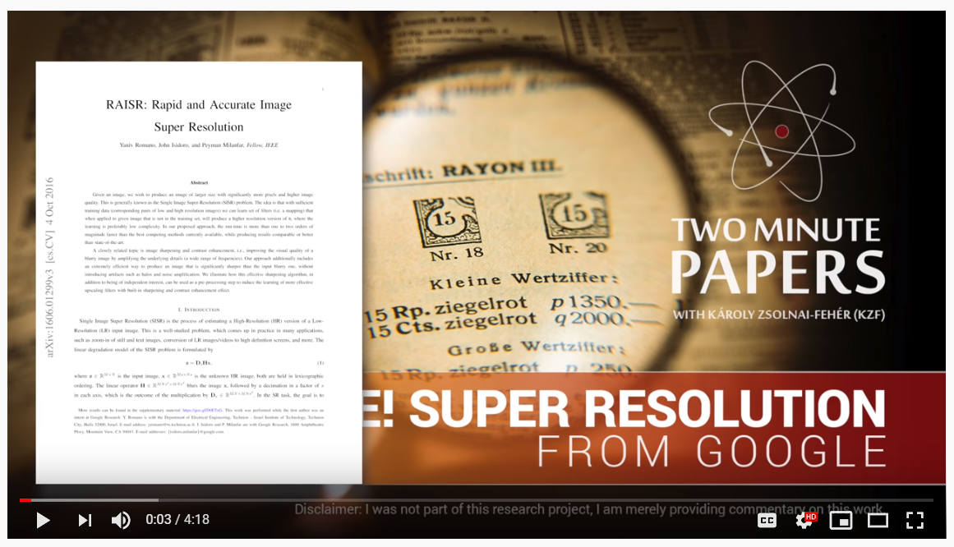
Two Minute Papers
RAISR: Rapid and Accurate Image Super Resolution
https://www.youtube.com/watch?v=WovbLx8C0yA
RAISR: Rapid and Accurate Image Super Resolution https://arxiv.org/abs/1606.01299

Slide 5
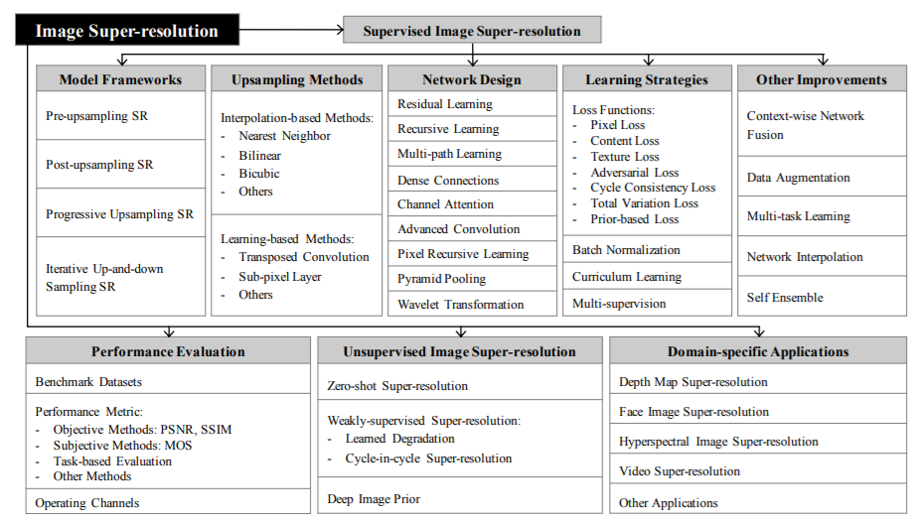
Single Image Super Resolution
Deep Learning for Image Super-resolution: A Surveyc https://arxiv.org/abs/1902.06068

Slide 6
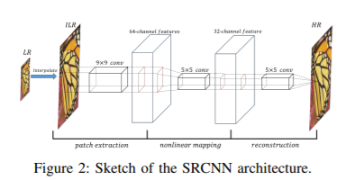
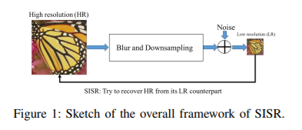
Overall SISR Framework
HR to LR
LR to HR
Deep Learning for Single Image Super-Resolution: A Brief Review https://arxiv.org/abs/1808.03344

Slide 7
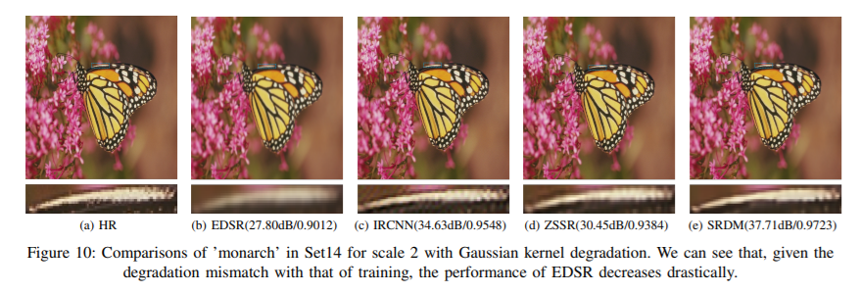
Comparison of a Few Algorithms
Deep Learning for Single Image Super-Resolution: A Brief Review https://arxiv.org/abs/1808.03344

Slide 8
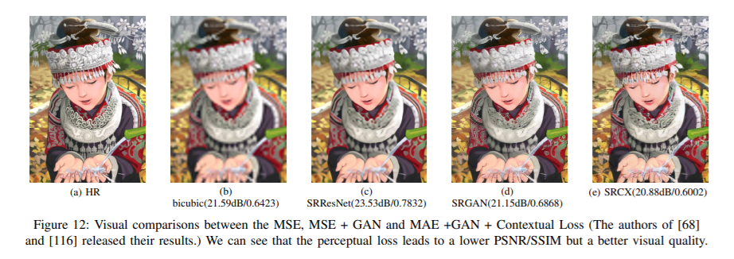
Comparison of a Few Algorithms with GAN
Deep Learning for Single Image Super-Resolution: A Brief Review https://arxiv.org/abs/1808.03344

Slide 9
Review Articles on SISR
Deep Learning for Single Image Super-Resolution: A Brief Review (127 reference entries)
https://arxiv.org/abs/1808.03344
Accepted by IEEE Transactions on Multimedia
Submitted on 9 Aug 2018 (accepted on 2019-07-12)
Deep Learning for Image Super-resolution: A Survey (202 reference entries)
https://arxiv.org/abs/1902.06068
Submitted on 16 Feb 2019
Papers with Code on SISR (https://paperswithcode.com/task/super-resolution)

Slide 10
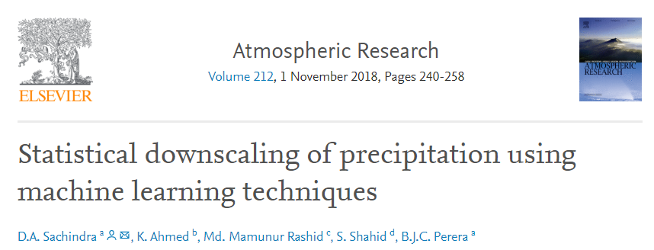
SR for Statistical Downscaling
Statistical downscaling of precipitation using machine learning techniques
https://www.sciencedirect.com/science/article/pii/S0169809517310141
Kernel-method-based approach

Slide 11
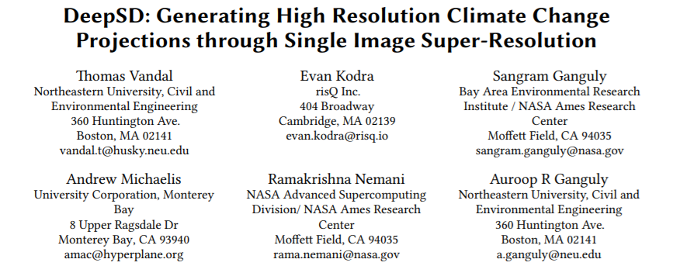
SR for Statistical Downscaling
DeepSD: Generating High Resolution Climate Change Projections through Single Image Super-Resolution
https://arxiv.org/abs/1703.03126
Proceedings of the Twenty-Seventh International Joint Conference on Artificial Intelligence (IJCAI-18)

Slide 12
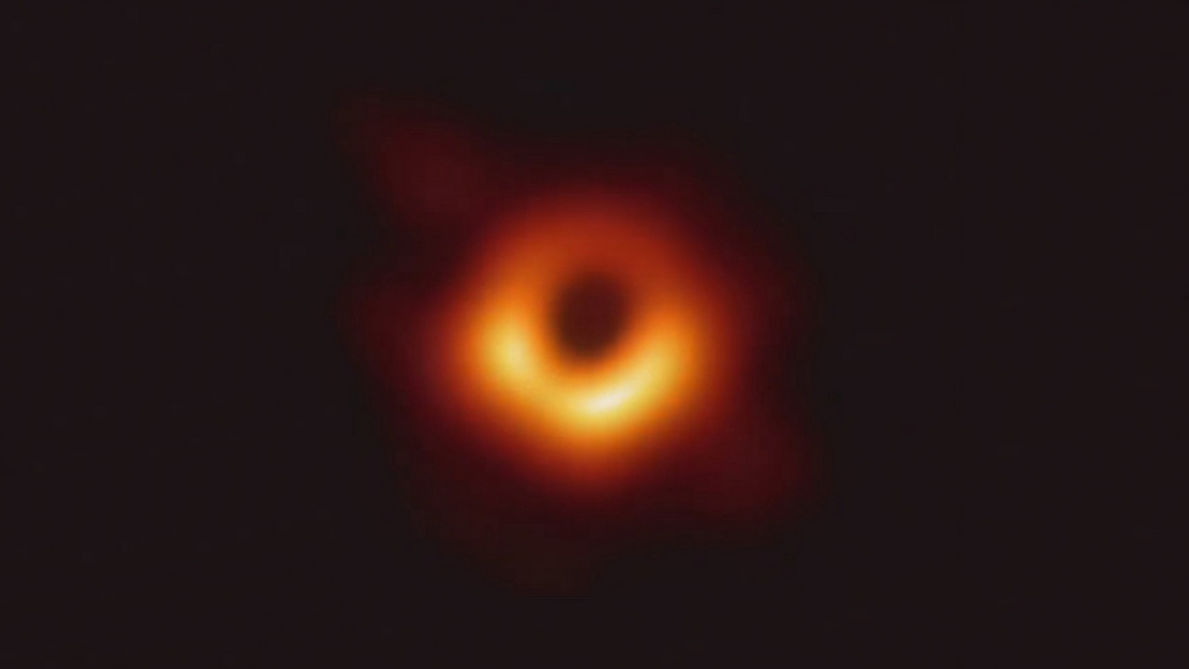
Notes:
I think everyone here should recognize this picture, don’t you?

Slide 13
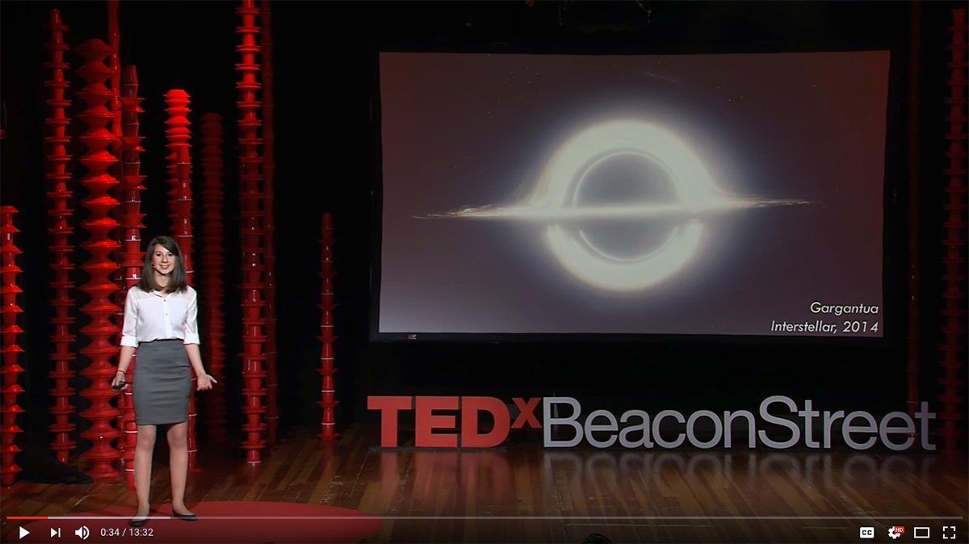
AI for Scientific Research
The Event Horizon Telescope Collaboration won the Breakthrough Prize in Fundamental Physics of 2020 for the first image of a supermassive black hole, taken by means of an Earth-sized alliance of telescopes.
Katie Bouman explained how to take a picture of a black hole in a Ted Talk.
https://www.ted.com/talks/katie_bouman_what_does_a_black_hole_look_like
AI techniques are particularly useful for data intensive problems.
Notes:
The first picture of black hole, which won the Breakthrough Prize in Fundamental Physics just recently, is actually achieved by using similar technology to “painting style transfer”. Here I don’t have enough time to explain the methodology thoroughly, and I just want to point out the computer first had to learn how to form the most likely image from many highly-noised partial dataset, and then create the final photo. If you are really interested in the methods, the computer vision scientist of the team, Katie Bouman, gave a talk in TED in 2017 which explained the technique in detail.

Slide 14
So, Your Plan with SISR?
Using it on VVM output?
For what? (precipitation, wind, MSLR,…etc.)
What do you want to measure as the performance? (RMSE, pattern correlation, …etc.)
How to compare with physical downscaling?
How to distinguish your work from the DeepSD?

