Slide 1
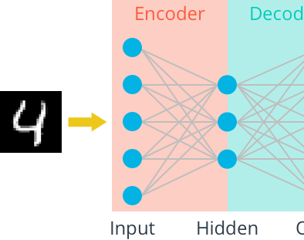
Autoencoder and Its Variations
2020.11.13

Slide 2
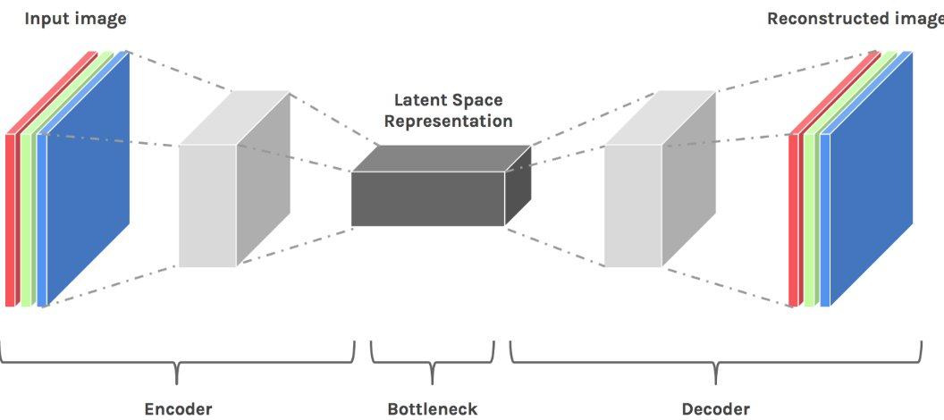
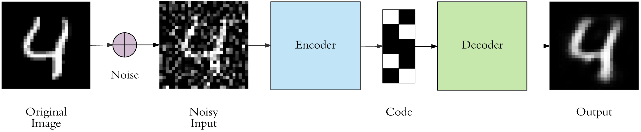
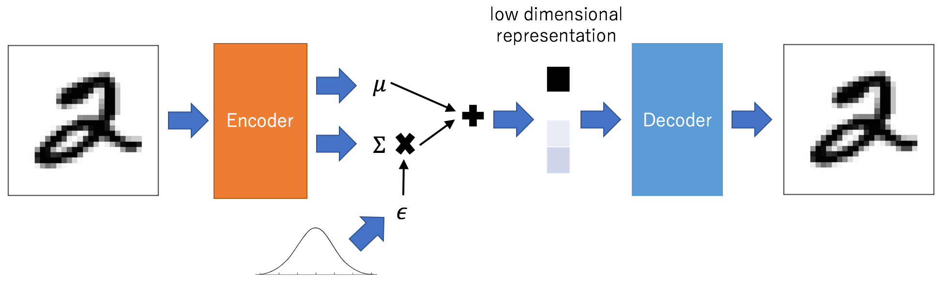
Outline
What is Autoencoder?
Simple Autoencoder
Deep Autoencoder
Convolutional Autoencoder
Denoising Autoencoder
Variational Autoencoder

Slide 3
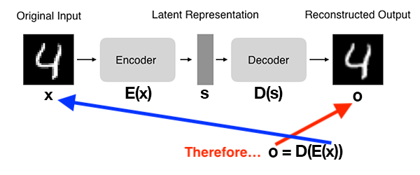
What are autoencoders?
AE is a neural network that:
Accept an input set of data (i.e., the input).
Internally compress the input data into a latent-space representation.
Reconstruct the input data from this latent representation (i.e., the output).

Slide 4
Two Components of Autoencoder
Encoder: Accepts the input data and compresses it into the latent-space. If we denote our input data as x and the encoder as E, then the output latent-space representation, s, would be s = E(x).
Decoder: The decoder is responsible for accepting the latent-space representation s and then reconstructing the original input. If we denote the decoder function as D and the output of the detector as o, then we can represent the decoder as o = D(s).

Slide 5
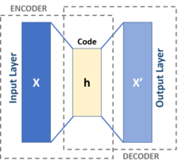
Autoencoder
An autoencoder is a type of artificial neural network used to learn efficient data codings in an unsupervised manner.
The aim of an autoencoder is to learn a representation (encoding) for a set of data, typically for dimensionality reduction, by training the network to ignore signal “noise”.
Along with the reduction side, a reconstructing side is learnt, where the autoencoder tries to generate from the reduced encoding a representation as close as possible to its original input, hence its name.

Slide 6
Why Autoencoder?

