Slide 1
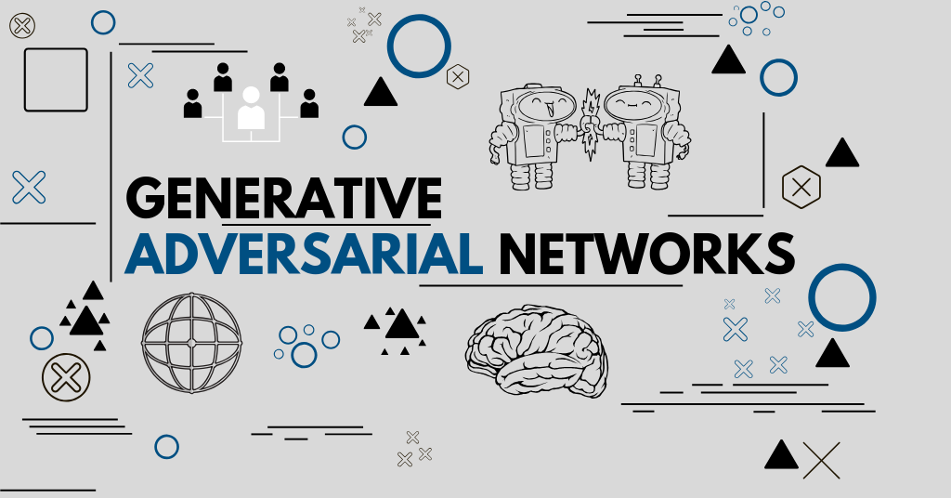
GAN and Generative Models
2020.12.18

Slide 2
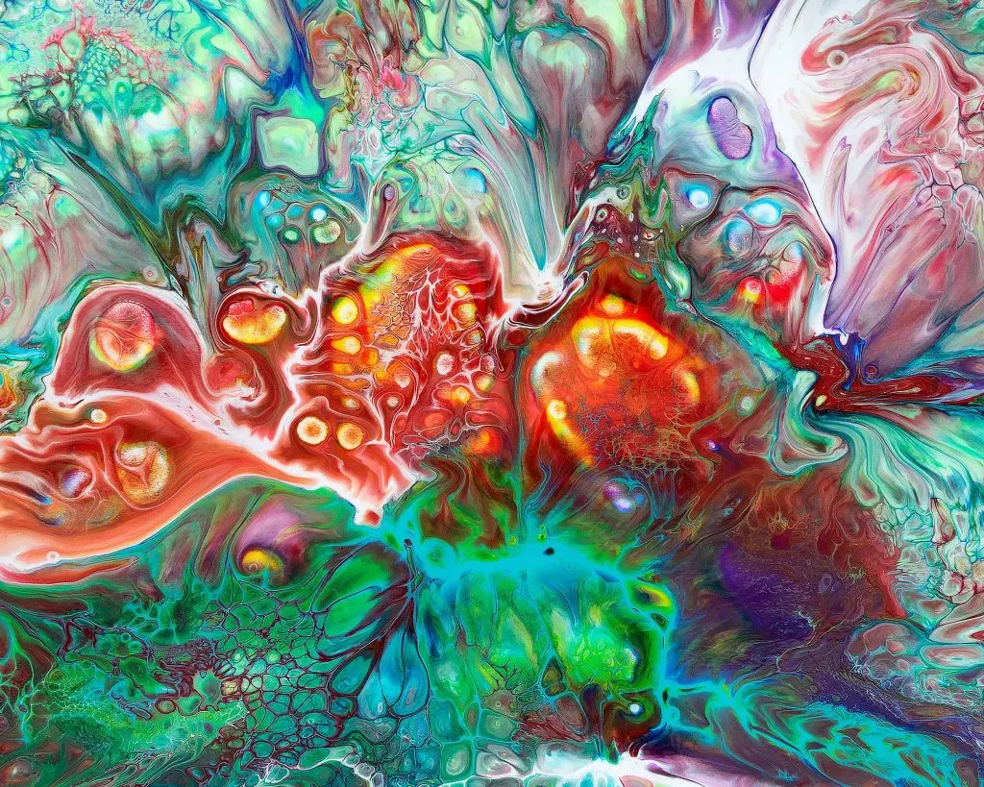
Outline
The Concept of GAN
Applications of GAN
Style Transfer
Deep Dream
Representation Learning
More on Generative Models

Slide 3
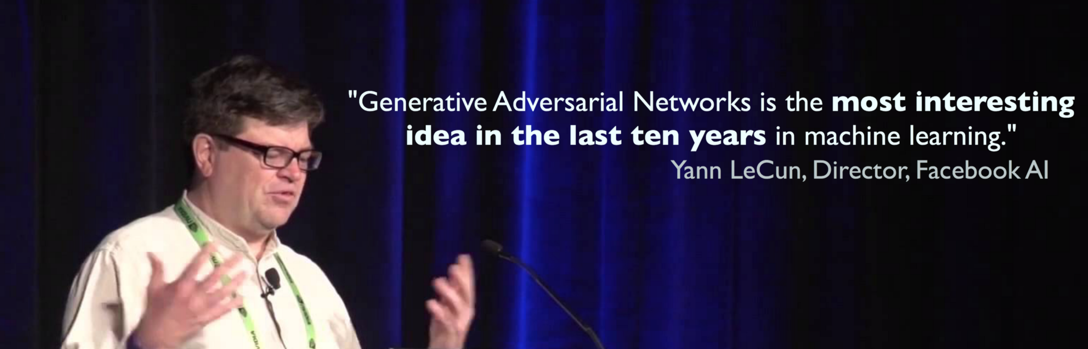
Generative Adversarial Networks
Goodfellow, Ian; Pouget-Abadie, Jean; Mirza, Mehdi; Xu, Bing; Warde-Farley, David; Ozair, Sherjil; Courville, Aaron; Bengio, Yoshua (2014). Generative Adversarial Networks. Proceedings of the International Conference on Neural Information Processing Systems (NIPS 2014). pp. 2672–2680.

Slide 4
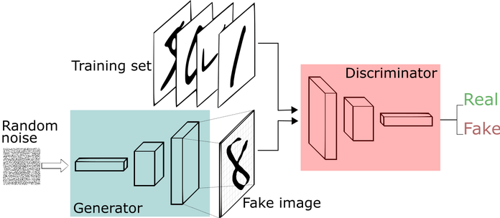
GAN: Concept
Two learning models compete to each other

Slide 5
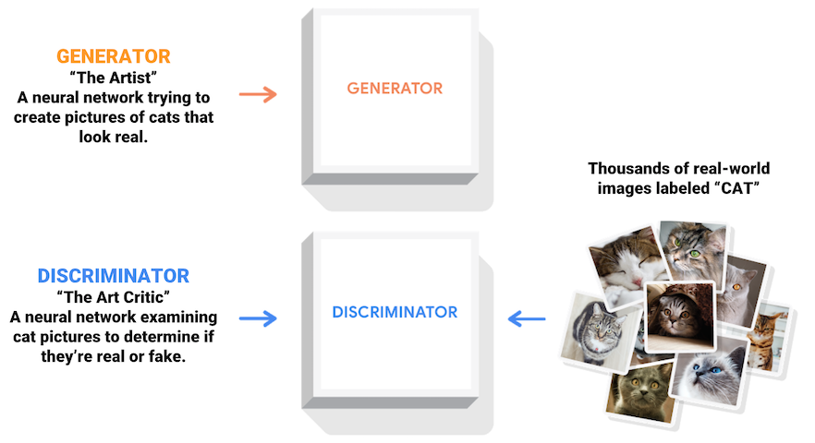
GAN: Artist vs Critics

Slide 6
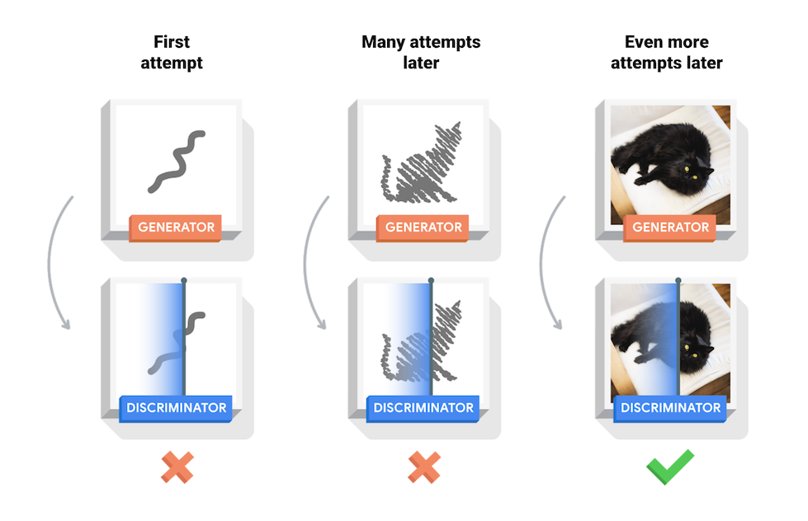
GAN: The Learning Process

Slide 7
GAN: The Algorithm

Slide 8
GAN: Generated Examples
Rightmost column shows the nearest training example of
the neighboring sample, in order to demonstrate that the model has not memorized the training set.

Slide 9
GAN: in the Original Paper
A clearly described algorithm and theorem
A derivation of (theoretical) global optimality
A proof of convergence of the algorithm
Well designed experiments
Comparison with other generative models
Goodfellow, Ian; Pouget-Abadie, Jean; Mirza, Mehdi; Xu, Bing; Warde-Farley, David; Ozair, Sherjil; Courville, Aaron; Bengio, Yoshua (2014). Generative Adversarial Networks. Proceedings of the International Conference on Neural Information Processing Systems (NIPS 2014). pp. 2672–2680.

Slide 10
GAN: Representation Learning

Slide 11
GAN: Other Applications

Slide 12
Generative Models

