Slide 1
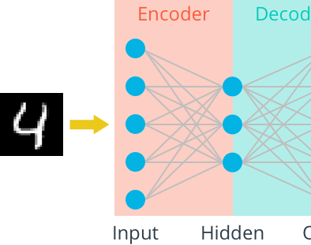
Autoencoder and Its Variations
2020.11.13

Slide 2
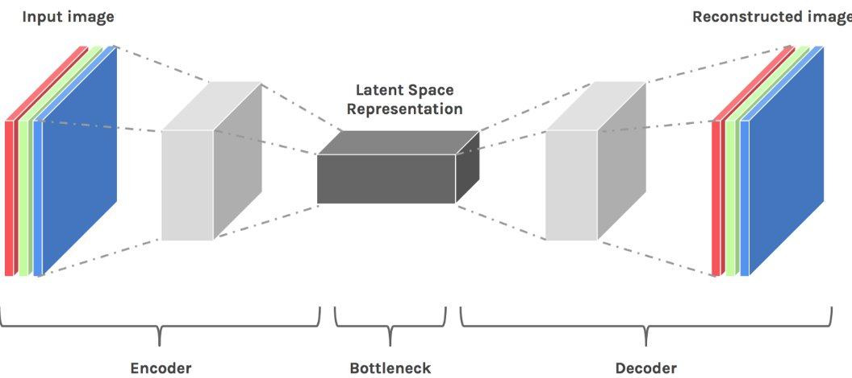
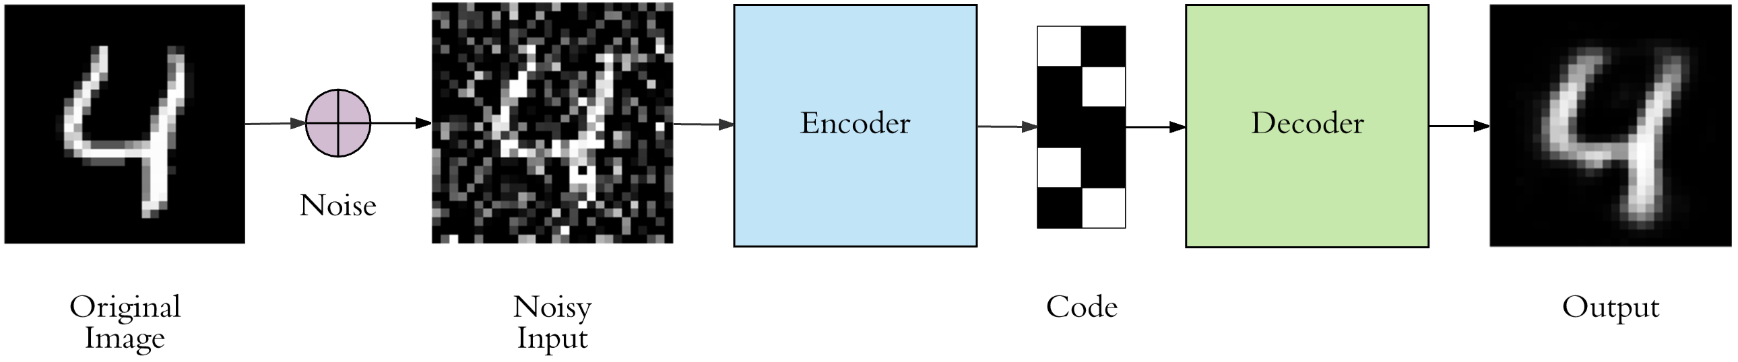
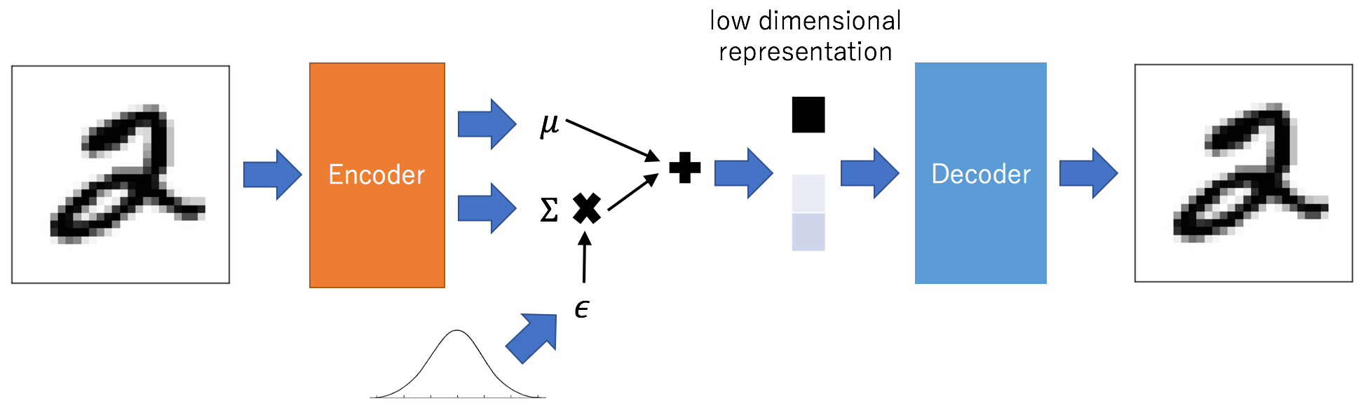
Outline
What is Autoencoder?
Simple Autoencoder
Deep Autoencoder
Convolutional Autoencoder
Denoising Autoencoder
Variational Autoencoder

Slide 3
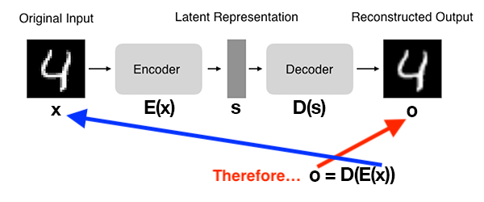
What are autoencoders?
AE is a neural network that:
Accept an input set of data (i.e., the input).
Internally compress the input data into a latent-space representation.
Reconstruct the input data from this latent representation (i.e., the output).

Slide 4
Two Components of Autoencoder
Encoder: Accepts the input data and compresses it into the latent-space. If we denote our input data as x and the encoder as E, then the output latent-space representation, s, would be s = E(x).
Decoder: The decoder is responsible for accepting the latent-space representation s and then reconstructing the original input. If we denote the decoder function as D and the output of the detector as o, then we can represent the decoder as o = D(s).

Slide 5
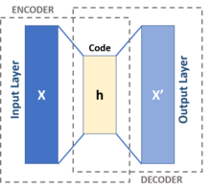
Autoencoder
An autoencoder is a type of artificial neural network used to learn efficient data codings in an unsupervised manner.
The aim of an autoencoder is to learn a representation (encoding) for a set of data, typically for dimensionality reduction, by training the network to ignore signal “noise”.
Along with the reduction side, a reconstructing side is learnt, where the autoencoder tries to generate from the reduced encoding a representation as close as possible to its original input, hence its name.

Slide 6
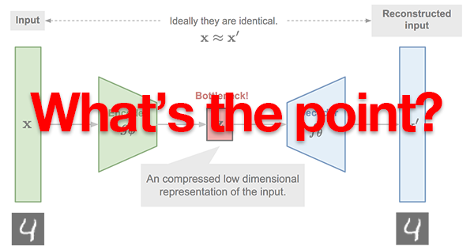
Why Autoencoder?
It’s a self-supervised learning algorithm.
The true value of the autoencoder lives inside that latent-space representation.

Slide 7
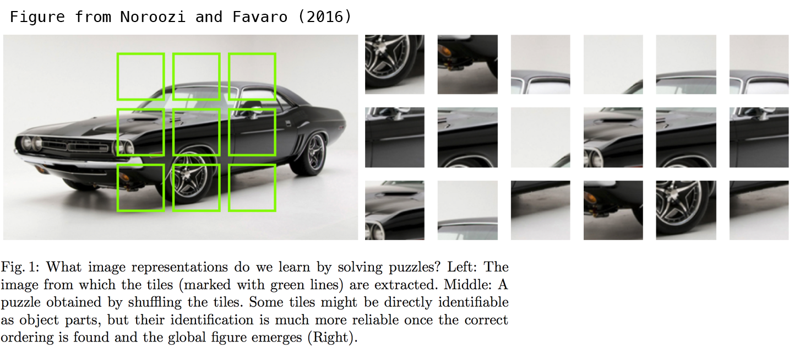
What is Representation?
Take Jigsaw puzzle reassembly as examples: you need to have background knowledge of cars, to recognize each piece as part of the car, and put them into the correct order.
https://arxiv.org/abs/1603.09246

Slide 8
From Simple to Deep Autoencoders

Slide 9

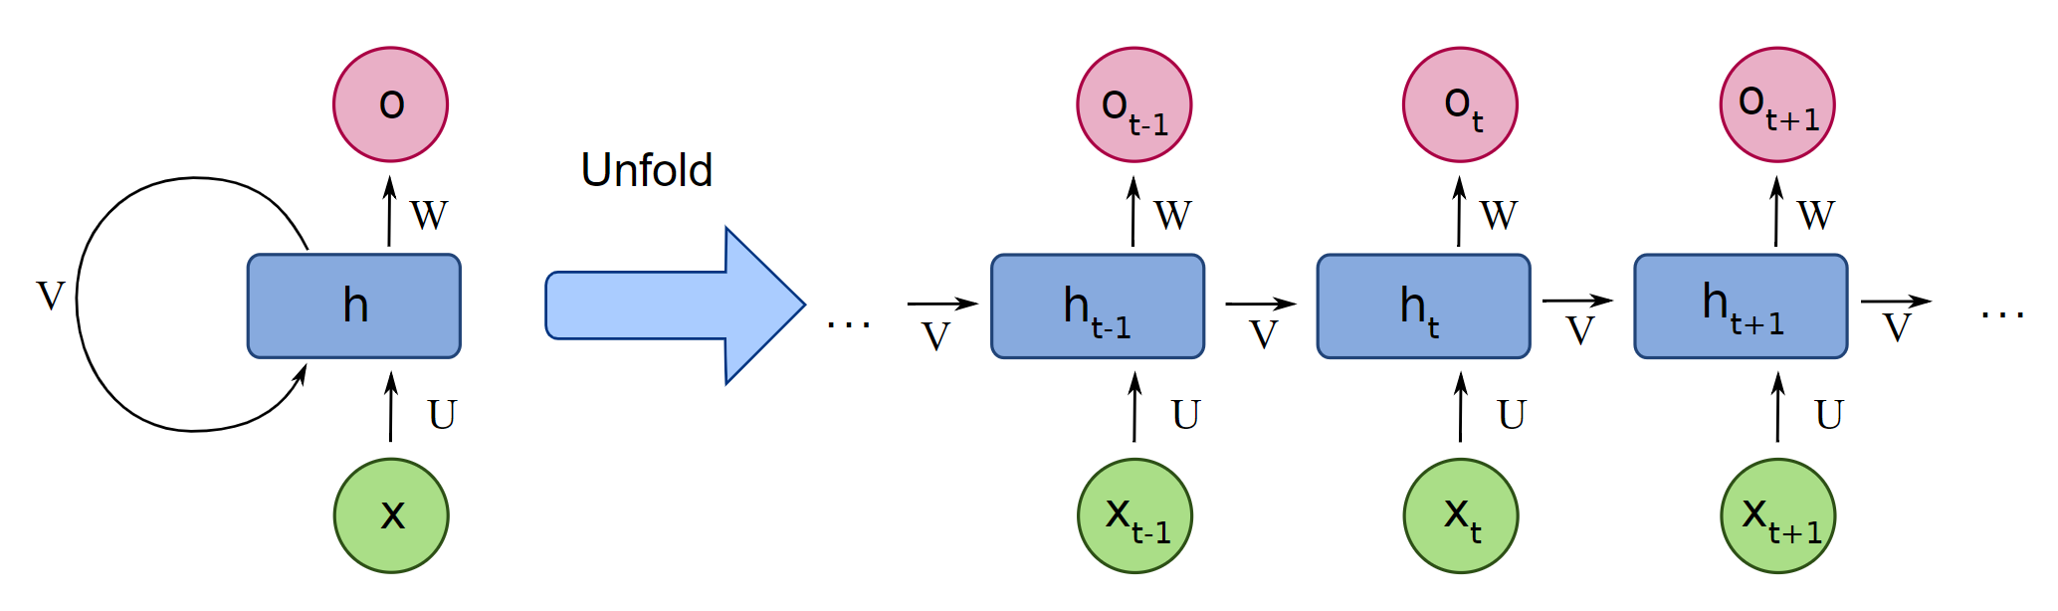
Convolutional and Sequential Autoencoders

Slide 10
Denoising Autoencoders
Add white noise to the raw input data.
Train the autoencoder to reconstruct the raw data (without noise).

Slide 11
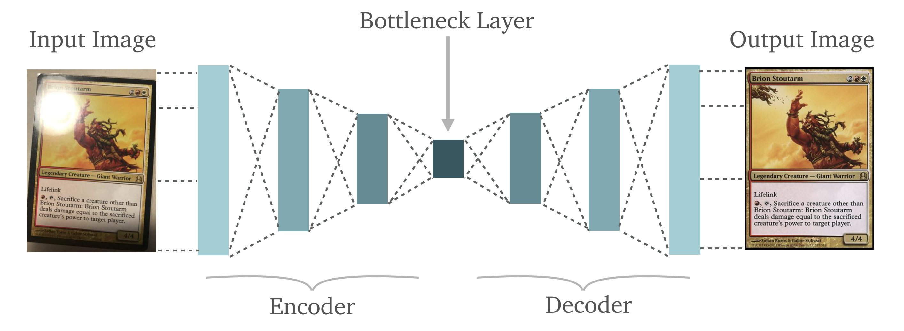
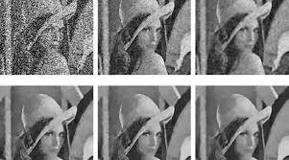
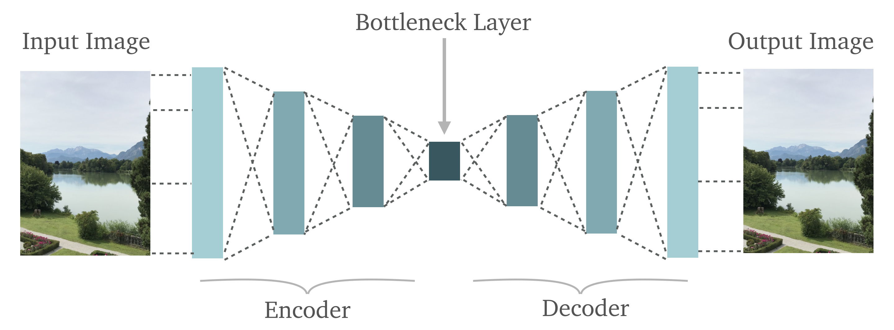
What Denoising Autoencoders can Do?
To fix and enhance photos

Slide 12
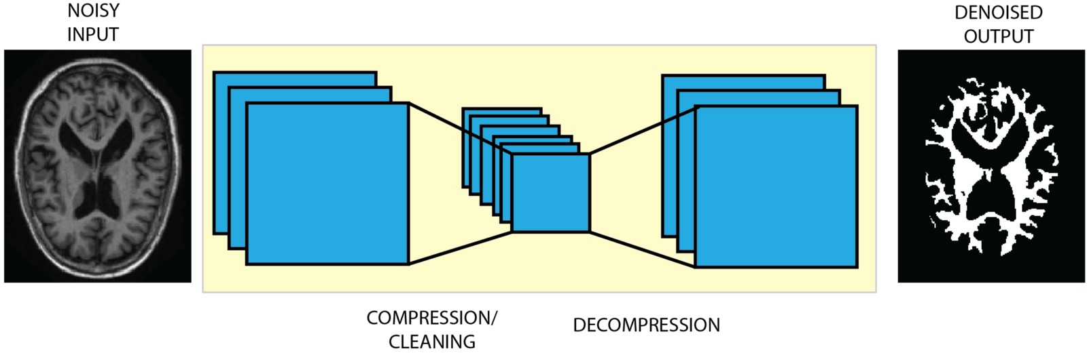
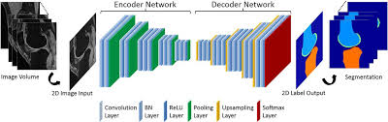
What Denoising Autoencoders can Do?
To enhance medical imaging
To remove unwanted background
To perform motion corrections
To remove noises
To perform automatic segmentation

Slide 13
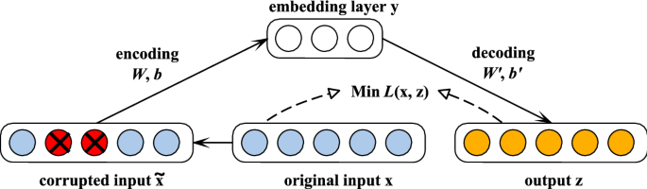
What Denoising Autoencoders can Do?
Missing data imputation
https://curiousily.com/posts/data-imputation-using-autoencoders/

Slide 14
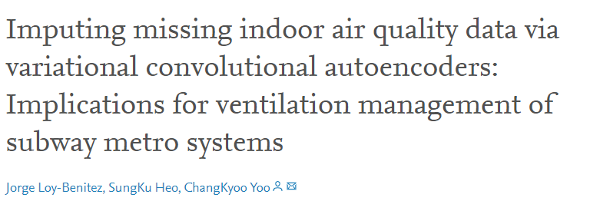
Missing Data Imputation with Autoencoders

Slide 15
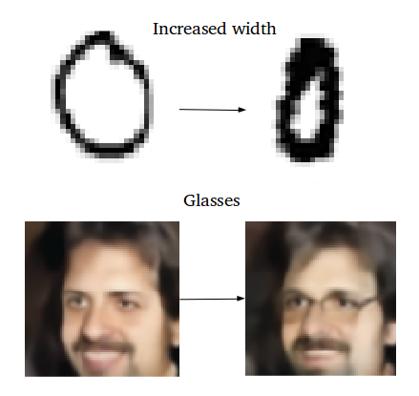
Variational Autoencoders
Most generative models (including GAN) can generate random output.
Ideally, we want to have a few factors to control when generating new samples.
https://towardsdatascience.com/intuitively-understanding-variational-autoencoders-1bfe67eb5daf
https://towardsdatascience.com/understanding-variational-autoencoders-vaes-f70510919f73

Slide 16
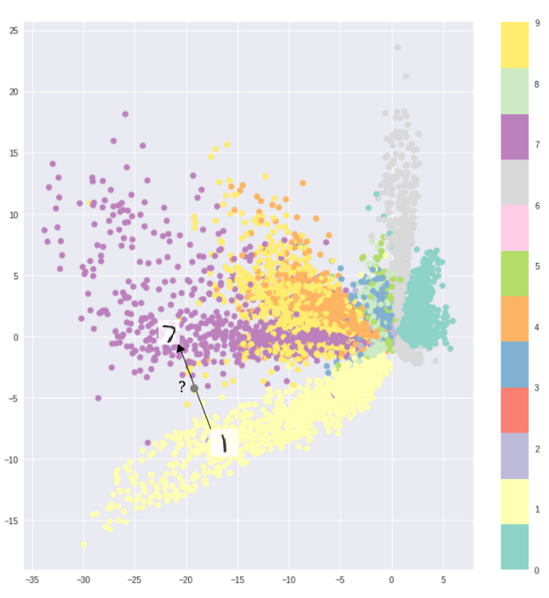
Problems of Generating with Autoencoders
The fundamental problem with autoencoders, for generation, is that the latent space they convert their inputs to and where their encoded vectors lie, may not be continuous, or allow easy interpolation.
The encoded space is fine for reproducing raw data, but not comprehensive for generating new data.
Optimizing purely for reconstruction loss

Slide 17
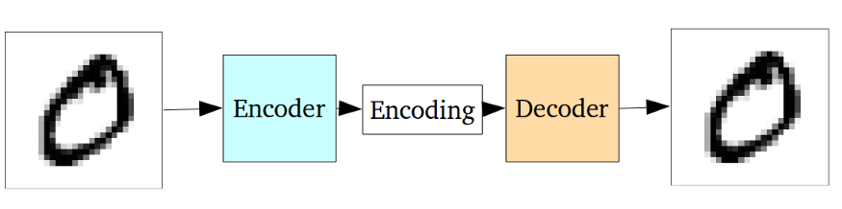
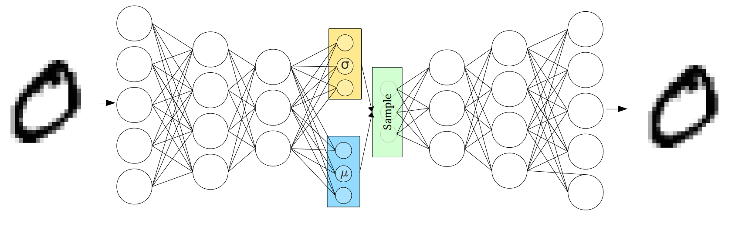
Variational Autoencoders (VAE)
VAE provide a latent space that are continuous by-design and allowing easy random sampling and interpretation.
Instead of outputting an encoding vector of size n, outputting two vectors of size n: a vector of means, μ, and another vector of standard deviations, σ.
https://towardsdatascience.com/intuitively-understanding-variational-autoencoders-1bfe67eb5daf
https://towardsdatascience.com/understanding-variational-autoencoders-vaes-f70510919f73

