Slide 1

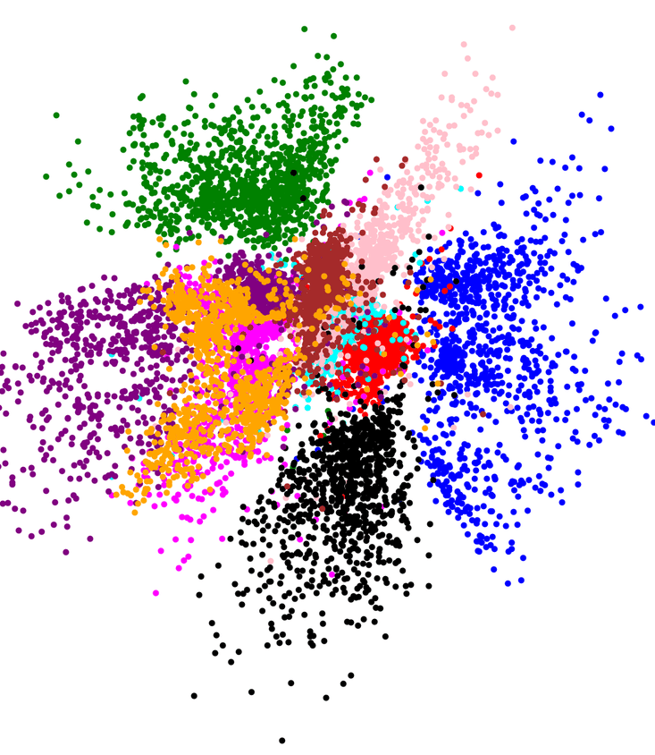
Latent Variable
Introduction to

Slide 2
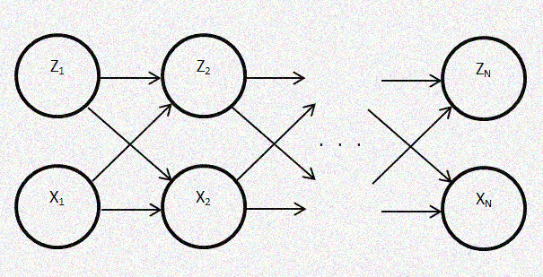
Outline
Latent variable
FA vs PCA
Examples
Personality traits
Quality of life
Geochemistry
Language representation

Slide 3
Latent Variable
In statistics, latent variables are variables that are not directly observed but are rather inferred (through a mathematical model) from other variables that are observed (directly measured).
Mathematical models that aim to explain observed variables in terms of latent variables are called latent variable models.
https://en.wikipedia.org/wiki/Latent_variable

Slide 4
Different Types of Latent Variables
Latent variables may correspond to aspects of physical reality that could in principle be measured but may not be for practical reasons. In this situation, the term hidden variables is commonly used (reflecting the fact that the variables are meaningful, but not observable).
Other latent variables correspond to abstract concepts, like categories, behavioral or mental states, or data structures. The terms hypothetical variables or hypothetical constructs may be used in these situations.

Slide 5
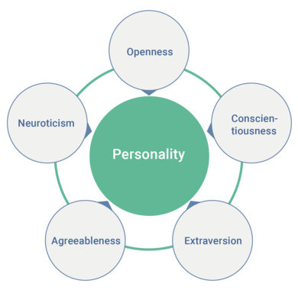
Example: Personality Traits
In psychological trait theory, the famous Big Five personality traits also known as the five-factor model (FFM) and the OCEAN model, is a suggested taxonomy, or grouping, for personality traits, developed from the 1980s onwards.
Openness to experience (inventive/curious vs. consistent/cautious)
Conscientiousness (efficient/organized vs. extravagant/careless)
Extraversion (outgoing/energetic vs. solitary/reserved)
Agreeableness (friendly/compassionate vs. challenging/callous)
Neuroticism (sensitive/nervous vs. resilient/confident)
開放性
盡責性
外向性
親和性
情緒不穩定性

Slide 6
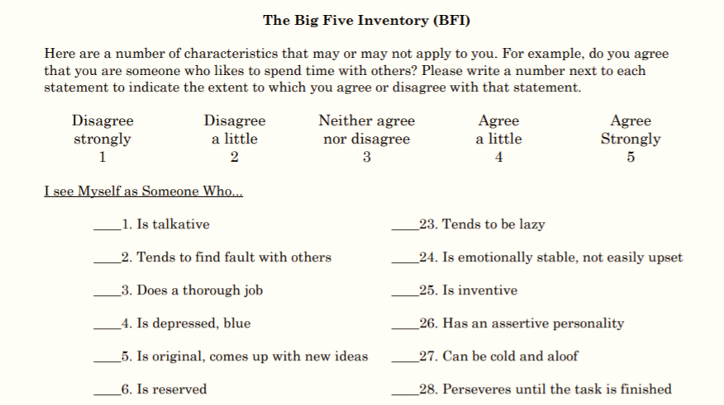
Big Five Questionaires

Slide 7
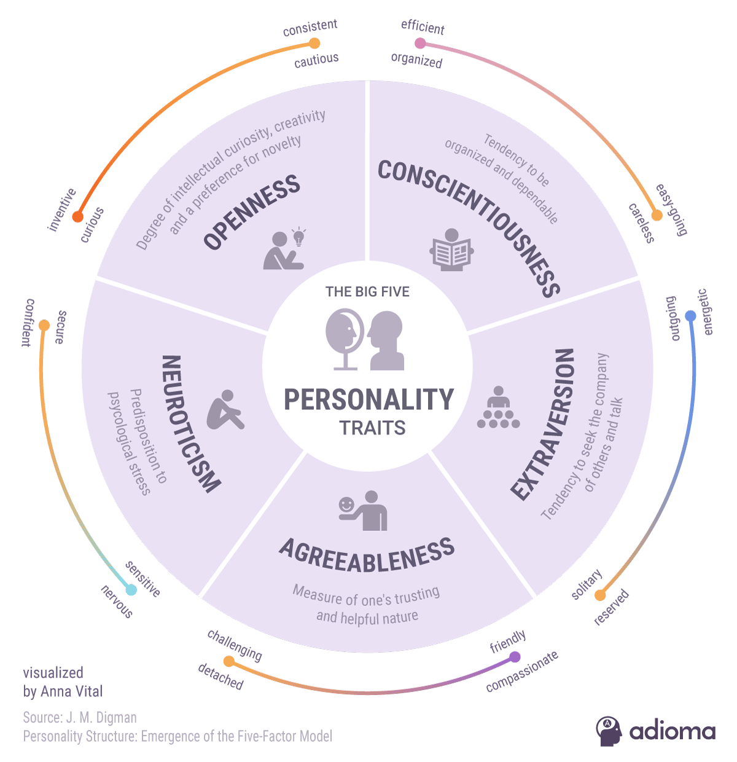
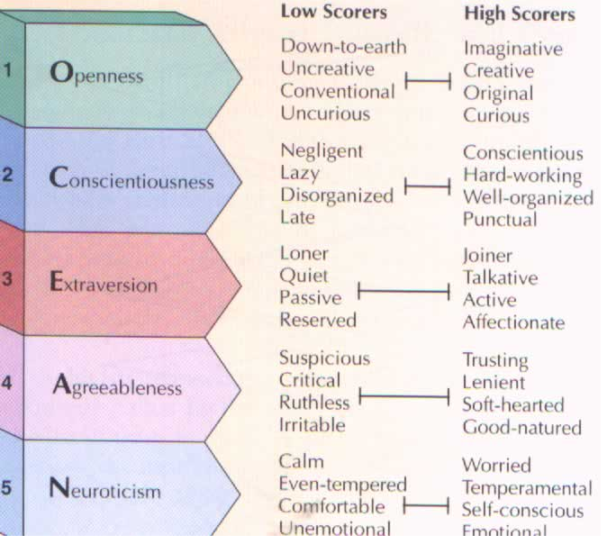
The OCEAN

Slide 8

Example: Quality of Life
Quality of life (QOL) is the general well-being of individuals and societies, outlining negative and positive features of life.
QOL is a latent variable which cannot be measured directly so observable variables are used to infer quality of life. Observable variables to measure quality of life include wealth, employment, environment, physical and mental health, education, recreation and leisure time, and social belonging.

Slide 9

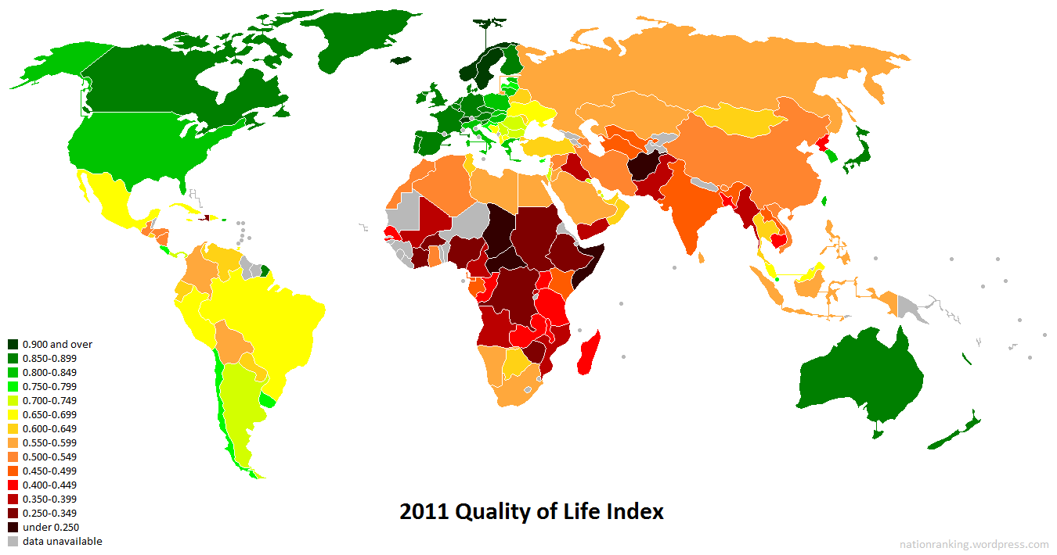

Slide 10
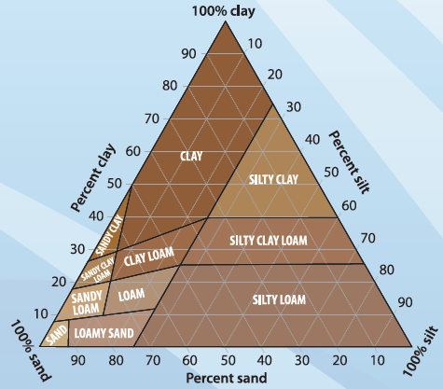
Example: Geochemical Exploration
Vijay S.Tripathi (1979) applied factor analysis on the chemical compositions of soil samples (10 chemical elements) and derived 4 factors. Hunt and Gilkes (1992) used similar approach and resulted in a soil textural triangle. (further details in Measuring Soil Texture in the Laboratory)

Slide 11
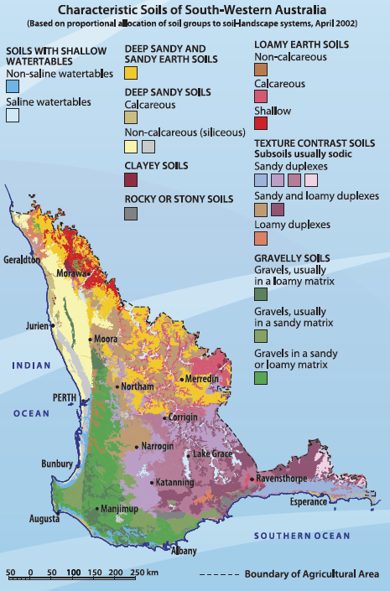

Slide 12
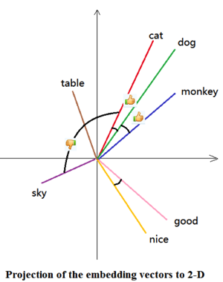
Example: Word Embeddings
In one sentence: a framework to convert a word into a vector.
Word embedding is the collective name for a set of language modeling and feature learning techniques in natural language processing (NLP) where words or phrases from the vocabulary are mapped to vectors of real numbers.
https://en.wikipedia.org/wiki/Word_embedding

Slide 13
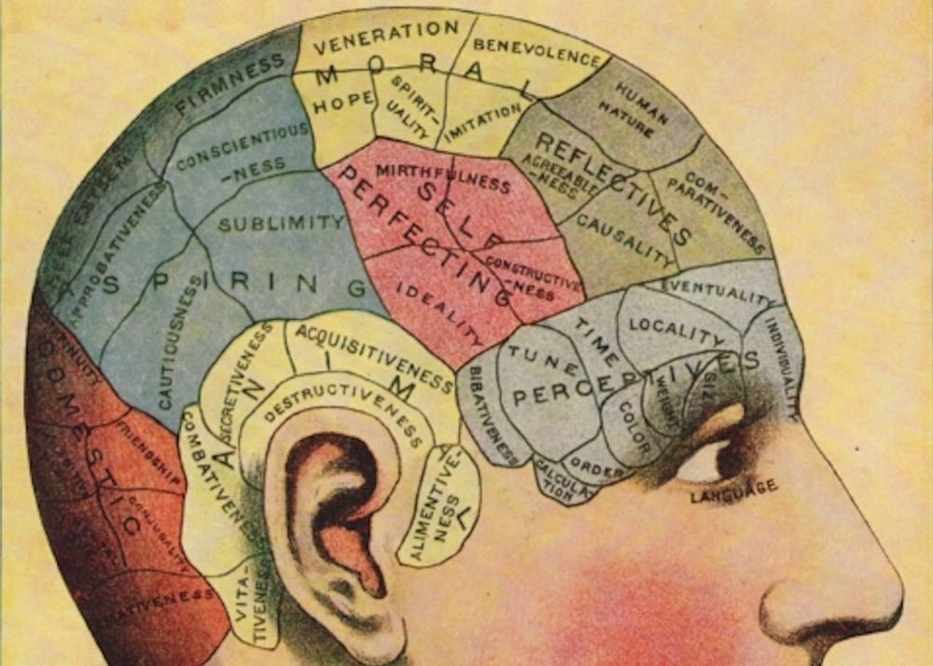
How do human process language?
We don’t really process “words” according to their dictionary definitions.
We map a word onto a space of semantics (or meaning).
We reason and infer the meaning in this space.
How do we mimic this process?
https://en.wikipedia.org/wiki/Word_embedding

Slide 14
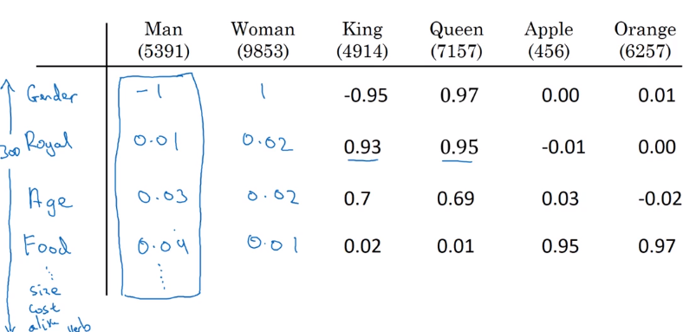
Word Embeddings
Instead of dictionary definition, we can image that each word has its own attributes in this “space of meaning”.
For example:

Slide 15
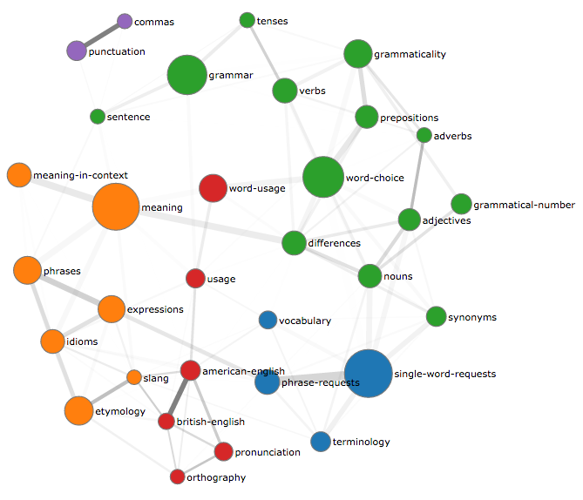
Creating Word Embeddings
We can ask human experts to derive word embedding, but this task is exhausting for human and the process can be highly subjective.
Alternatively, we can do it with algorithm and a large corpus
Bag-of-Words (BOW)
word2vec
GloVe
fastText
…

Slide 16
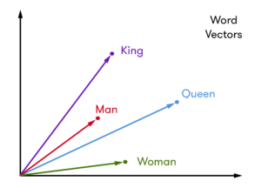
Why Do We Quantify Words?
Once words become vectors, we can easily derive:
Similarity between words, phrases, sentences, and paragraphs
Latent variables behind a corpus
Other quantitative analysis
And based on these analysis, we can do:
Machine translation
Text classification
Document summarization
And eventually, natural language understanding

Slide 17
Another Purpose of Latent Variables
The use of latent variables can serve to reduce the dimensionality of data. Many observable variables can be aggregated in a model to represent an underlying concept, making it easier to understand the data. In this sense, they serve a function similar to that of scientific theories. At the same time, latent variables link observable ("sub-symbolic") data in the real world to symbolic data in the modeled world.
To reduce data dimension into symbolic space

Slide 18
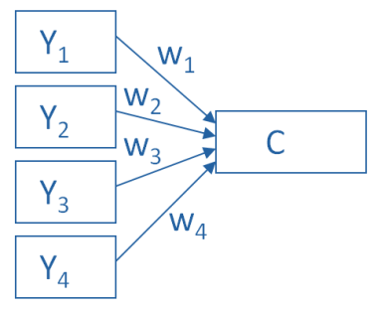
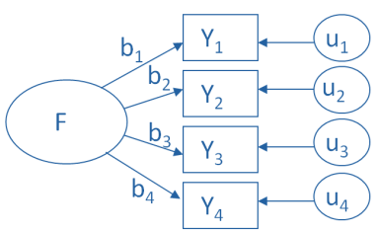
Example: FA vs PCA
PCA
FA
Y₁ = b₁*F + u₁ Y₂ = b₂*F + u₂ Y₃ = b₃*F + u₃ Y₄ = b₄*F + u₄
C = w₁(Y₁) + w₂(Y₂) + w₃(Y₃) + w₄(Y₄)
https://www.theanalysisfactor.com/the-fundamental-difference-between-principal-component-analysis-and-factor-analysis/

