Slide 1
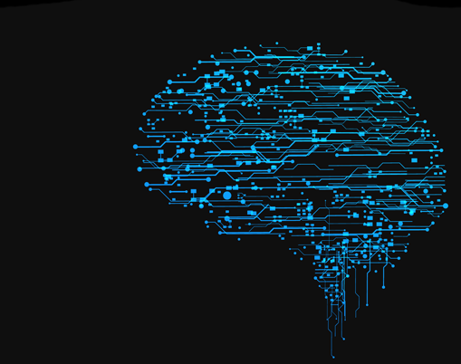
Introduction to Neural Networks

Slide 2
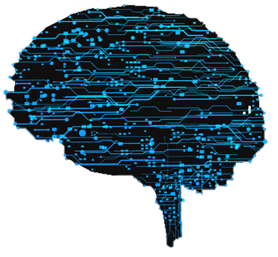
Outline
Introduction to neural network
Implementation of a simple neural network (reference)
Autoencoder
Breaking the limitation of the number of layers

Slide 3
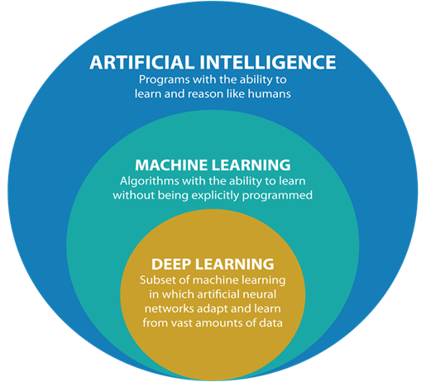
Neural Networks
The recent hype of AI is originated in the breakthrough of deep neural networks, which is a sub-domain of machine learning.
For the rest of this course, the algorithms we are going to talk about are all deep-neural-network-related. Hence, before we go any further, we would first learn some foundations of the neural networks.

Slide 4
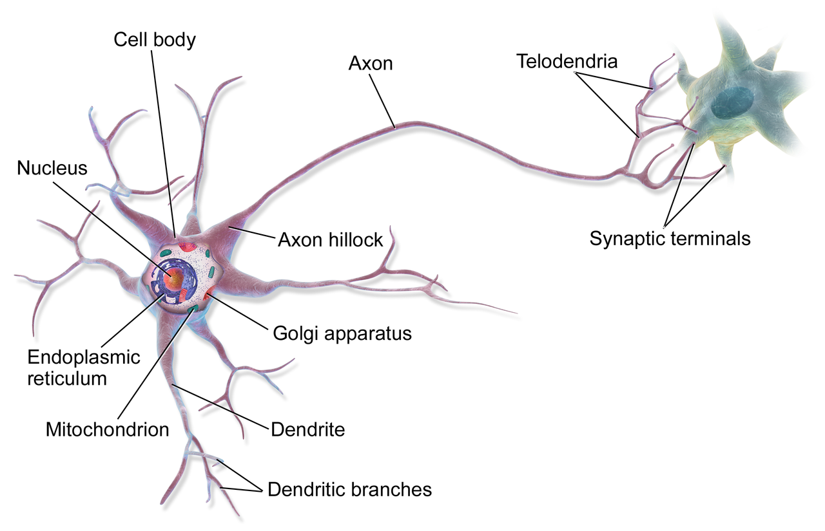
Neural Networks
A neural network is a network or circuit of neurons, it can refer to a biological neural network made up of real biological neurons, or an artificial neural network that mathematically represents its biological counterpart.

Slide 5
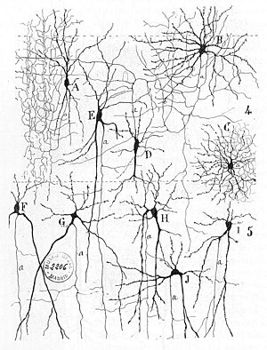
Biological Neural Networks
Herbert Spencer's Principles of Psychology, 3rd edition (1872)
Theodor Meynert's Psychiatry (1884)
William James' Principles of Psychology (1890)
Sigmund Freud's Project for a Scientific Psychology (composed 1895)
The first rule of neuronal learning was described by Hebb in 1949, in the Hebbian theory

Slide 6
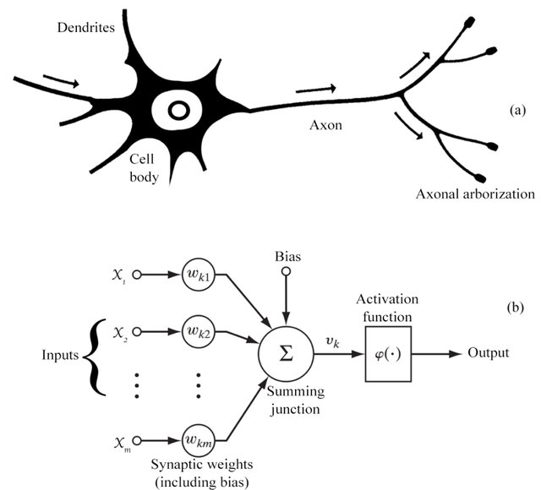
Mathematics of a Neuron
In 1943, McCulloch and Pitts created a computational model for neural networks based on mathematics and algorithms.
Farley and Clark (1954)
Rochester, Holland, Habit, and Duda (1956)
Rosenblatt (1958): perceptron
Werbos (1975) : backpropagation

Slide 7
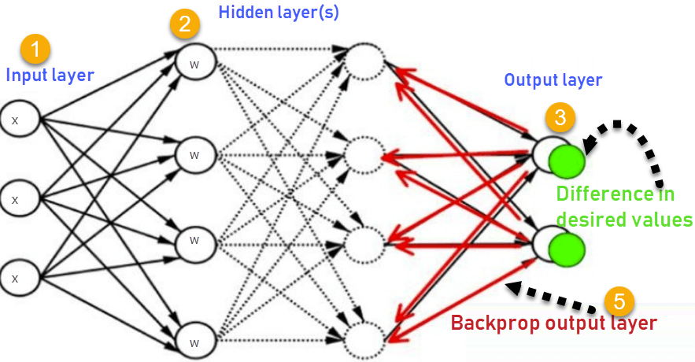
Backwardpropagation

Slide 8
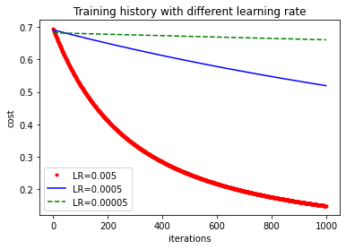
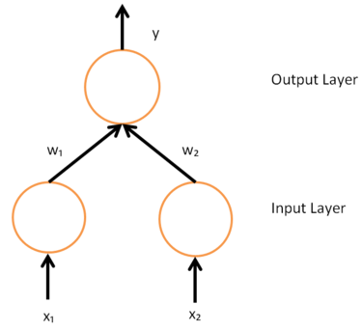
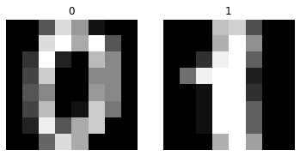
Implementation
https://github.com/tingsyo/course_2020Q3_representation_learning/blob/master/notebooks/04_neural_network_and_autoencoder.ipynb

Slide 9
Limitations of BP
Gradient descent with backpropagation is not guaranteed to find the global minimum of the error function, but only a local minimum; also, it has trouble crossing plateaus in the error function landscape. This issue, caused by the non-convexity of error functions in neural networks, was long thought to be a major drawback.
Backpropagation learning does not require normalization of input vectors; however, normalization could improve performance.
Backpropagation requires the derivatives of activation functions to be known at network design time.

Slide 10
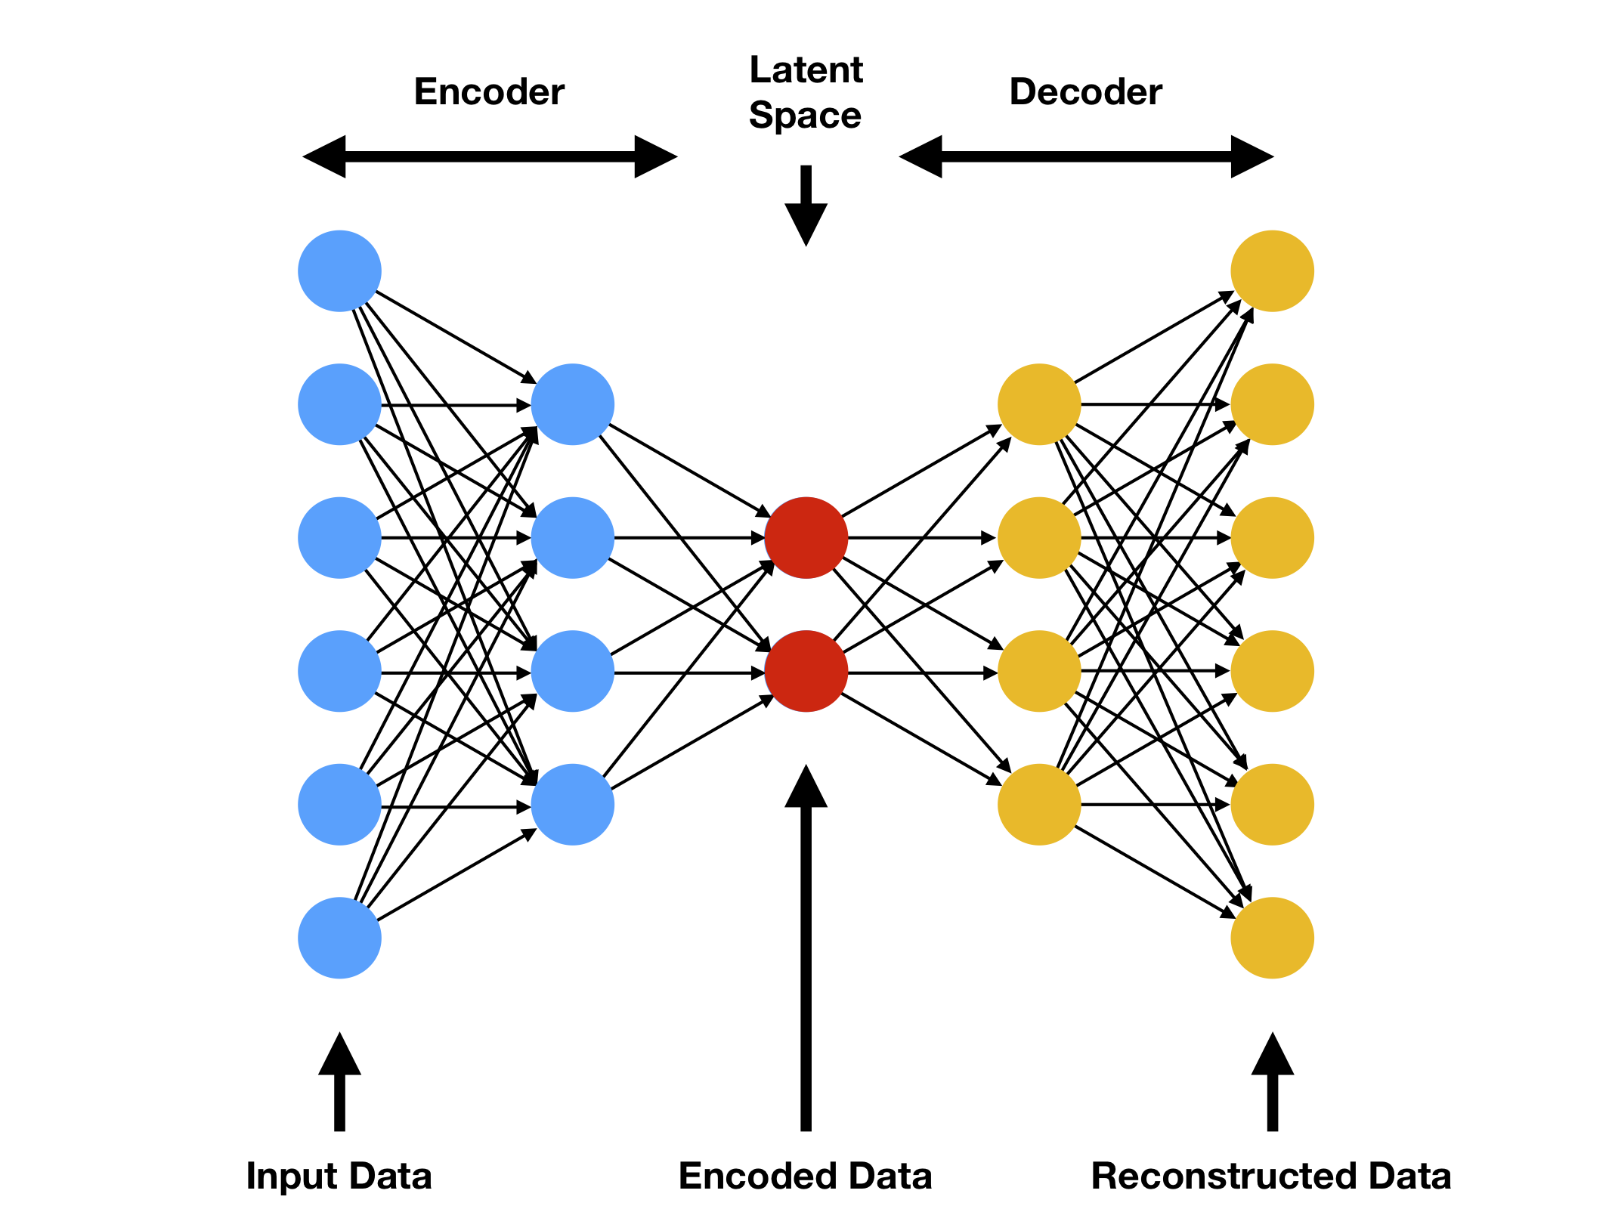
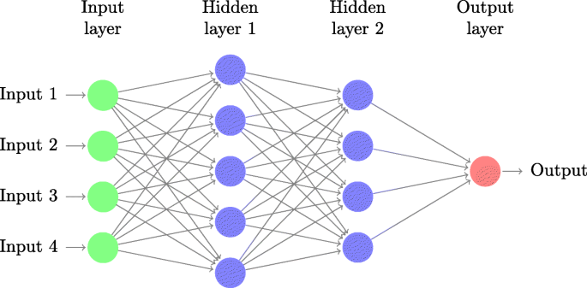
The Flexible ANN
Any form of input/output
Any network structures
Any activation function (differentiable)
Any loss function

