Slide 1
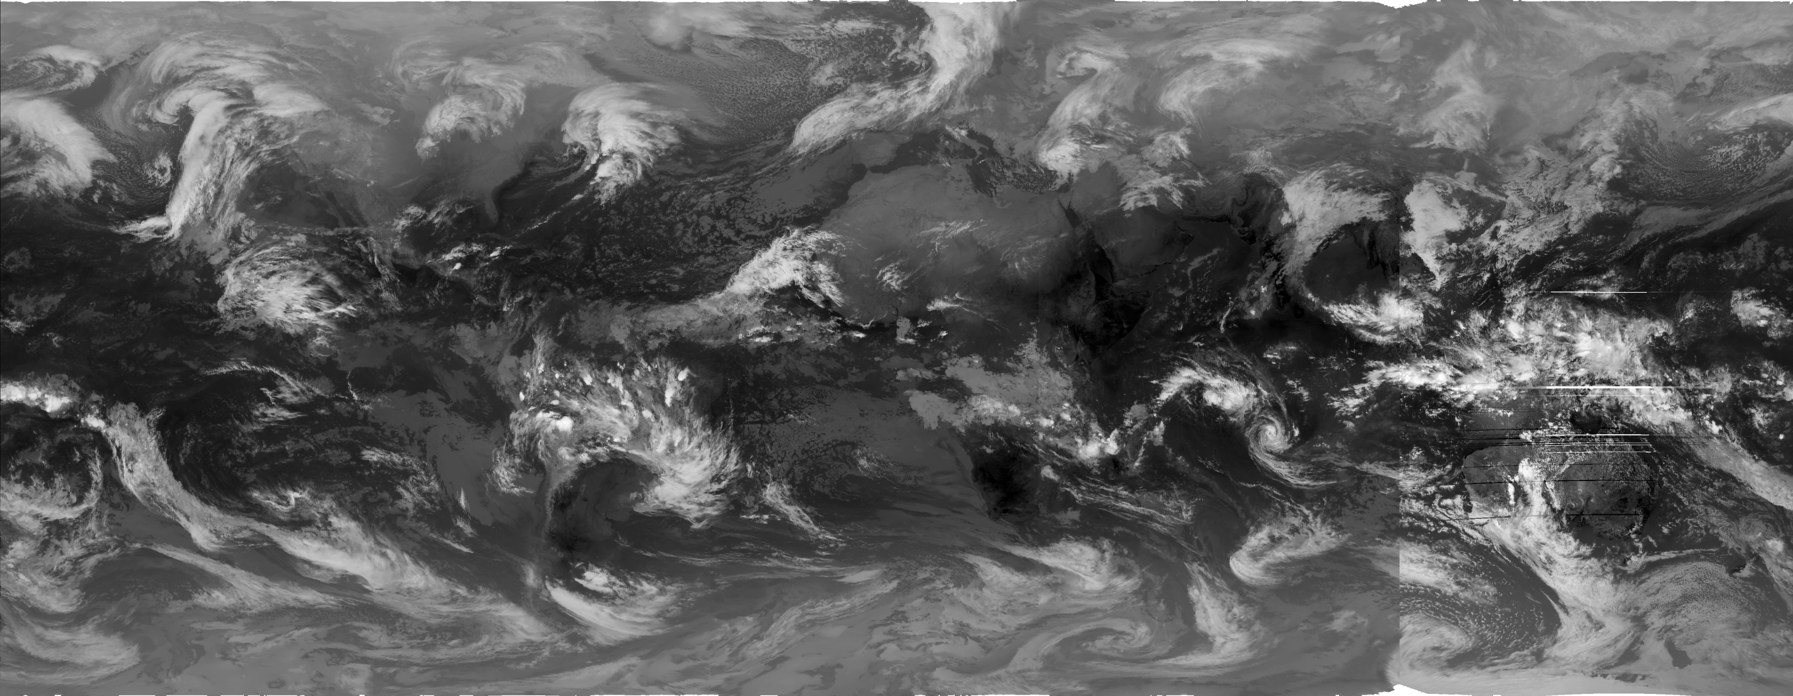
Learning the Representations of Satellite Images
NOAA GridSat-B1 Dataset
and
Weather Events in Taiwan

Slide 2
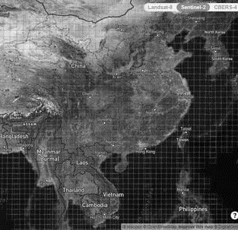
Outline
Representation Learning
What is representation learning?
How to evaluate the learned representations?
Dataset
NOAA GridSat-B1
TAD
Experiment Design
A Note on Transfer Learning
Some Results

Slide 3
What is Representation Learning?
In machine learning, feature learning or representation learning is a set of techniques that allows a system to automatically discover the representations needed for feature detection or classification from raw data.
The process is automatic.
The learned features/representations should be evaluated against some downstream tasks.
https://en.wikipedia.org/wiki/Feature_learning

Slide 4
A Short Review of Representation Learning
Dimension reduction:
the input data is too large to be processed efficiently, and hence we need a way to reduce its size.
Feature engineering:
Manually designed filters or functions to reduce the input data size for further analysis.
Problems
Requires significant human interference
Derived features are task-dependent

Slide 5
Toward automatic discovery representations
Nonlinear mapping techniques
Sammon mapping (Sammon, 1969)
self-organizing map (SOM, Kohonen, 1982)
Manifold Learning
kernel-PCA (Schölkopf, 1998)
spectral graph theory (Lawrence, 2012)
Sammon, J. W. (1969). "A nonlinear mapping for data structure analysis". IEEE Transactions on Computers. 18 (5): 401, 402, 403–409. doi:10.1109/t-c.1969.222678.
Kohonen, Teuvo (1982). "Self-Organized Formation of Topologically Correct Feature Maps". Biological Cybernetics. 43 (1): 59–69. doi:10.1007/bf00337288. S2CID 206775459.
Schölkopf, Bernhard (1998). "Nonlinear Component Analysis as a Kernel Eigenvalue Problem". Neural Computation. 10 (5): 1299–1319. CiteSeerX 10.1.1.100.3636. doi:10.1162/089976698300017467. S2CID 6674407.
Lawrence, Neil D (2012). "A unifying probabilistic perspective for spectral dimensionality reduction: insights and new models". Journal of Machine Learning Research. 13 (May): 1609–1638. arXiv:1010.4830.

Slide 6
Here Come the Deep Neural Networks
(adapted from Bengio et al., 2013)

Slide 7
Evaluation of Learned Representations
For self-supervised methods
Reconstruction errors (RMSE, pattern correlation, …etc.)
For supervised methods
Design various downstream tasks
Evaluate the overall performance of the tasks
What are proper tasks for evaluating satellite images?
Object detection?
Meteorological events on the surface?

Slide 8
Datasets
NOAA GridSat-B1 CDR
1998 – 2018, Global coverage (70N to 70S)
Data included from most meteorological geostationary satellites.
Variable used: brightness temperature
Cropped domain: 100-160E, 0-60N
Precipitation
Hourly precipitation records of 45 CWB stations in Taipei basin
TAD
Daily weather events in Taiwan area (1980-2019)

Slide 9
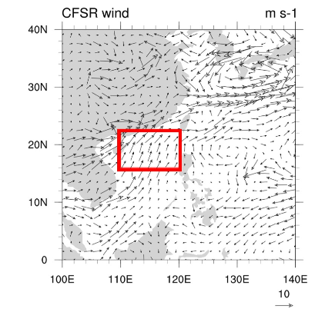
Define Weather Events
Precipitation
To predict the mean daily precipitation in Taipei basin
To detect rainfall events (>=10mm/hr) in Taipei basin
TAD defined events:
NWPTC: there exist tropical cyclones in the North-Western Pacific.
FT: there exist a front over Taiwan in the weather map issued by CWB.
NE: defined by the wind profile of Pengjiayu Weather Station (彭佳嶼測站): daily mean wind speed >=4m/s, and wind direction within (15, 75) degree.
SWF: define by CFSR 850hPa reanalysis: within the red rectangle, u>0 and v>0, and average wind-speed >=3m/s (or 30% of grids with wind-speed >=6m/s)
16°𝐍 to 22.5°N &𝟏𝟎𝟎°𝐄 to 𝟏𝟐𝟎°𝐄

Slide 10
Experiment Design
Representation Learning Methods
Principle Component Analysis (PCA)
Convolutional Auto-Encode
Variational Auto-Encoder
ResNet50 Pre-trained with ImageNet
ResNet50 Pre-trained with ImageNet/BigEarth
Downstream Tasks
Precipitation in Taipei Basin
Tropical Cyclones on NWP
Southeasterlies / Northeasterlies
Front

Slide 11
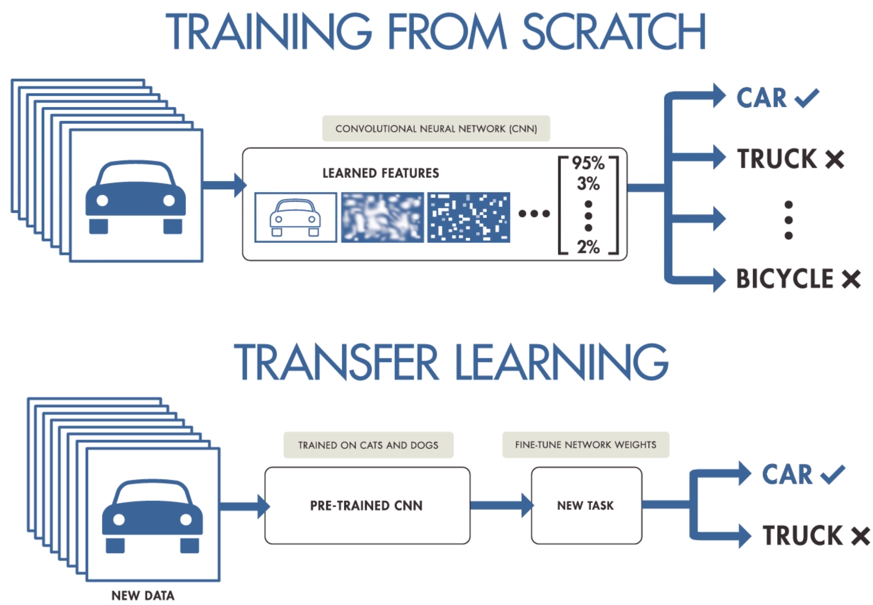
Transfer Learning and Pre-trained Models
What are pretrained models?
Deep neural networks can learn its weights from provided data.
A pretrained model is a deep neural network model with weights learned from certain datasets.
Using a pretrained model for our own dataset and tasks is called Transfer Learning or fine-tuning.

Slide 12
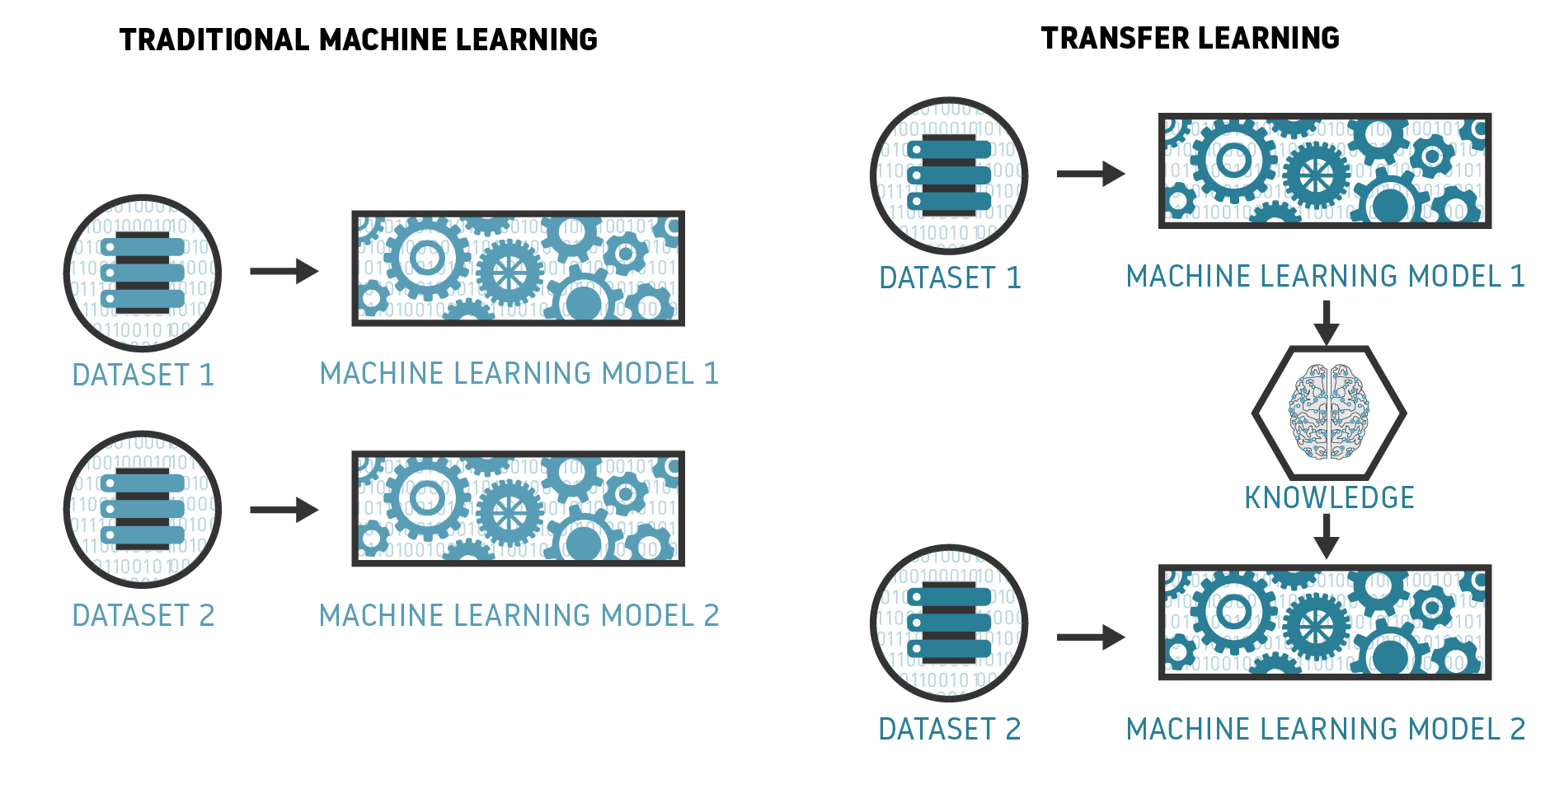
Transferring the Learned Knowledge

Slide 13
Why do we need pretrained models?
To leverage the knowledge learned from similar data/tasks.
It is very common that we don’t have sufficient data to train our own deep neural network.
Especially for classifying rare events or anomaly detection tasks.
Model training is expensive
ML models are in general expensive at training and cheap at predicting.
The computations of deep learning heavily rely on GPUs.
GPUs are not only expensive, but also hard to get (due to the hype of cryptocurrency mining).
Fine-tuning a pretrained model can be a practical choice.

Slide 14
Experiment Flow
NOAA-GridSat-B1 CDR data
Projections on the learned representations (feature vector)
Generalized Liner Model
Precipitation
NWPTC
FT
NE
SWF

Slide 15
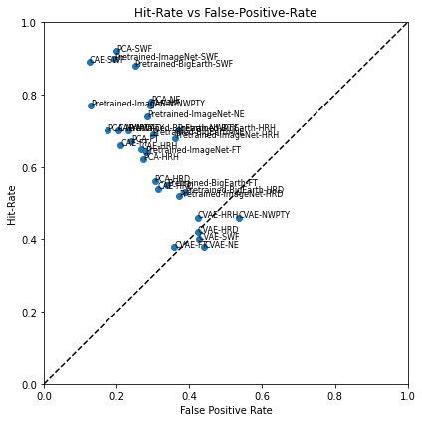
Experimental Results
-SWF:
- PCA: hit-rate:0.92/fpr:0.20
- Pretrained-ImageNet: hit-rate:0.90/fpr:0.19
- NE:
- PCA: hit-rate:0.78/fpr:0.30
- CAE: hit-rate:0.77/fpr:0.29
- Pretrained-ImageNet:0.74/fpr:0.29
- NWPTY
- Pretrained-ImageNet: hit-rate:0.77/fpr:0.13
- PCA: hit-rate:0.70/fpr:0.17
- HRH:
- Pretrained-BigEarth:0.7/fpr:0.37
- Pretrained-ImageNet:0.68/fpr:0.36
- CAE: hit-rate:0.65/fpr:0.27
- PCA: hit-rate:0.62/fpr:0.27
- FT:
- PCA: hit-rate:0.67/fpr:0.24
- CAE: hit-rate:0.66/fpr:0.21
- Pretrained-ImageNet:0.64/fpr:0.28

Slide 16
Takeaways
The pretrained models perform very well. And pretrained with only ImageNet performs even better.
The good old friend, PCA, is a decent method. The performance of PCA is similar to CAE, and the algorithm is solid and robust.
SWF can be detected with a high hit-rate (0.92). NE is not as good as SWF but is still not bad. This suggests that the satellite image can provide information about synoptic scale wind patterns.

