Slide 1
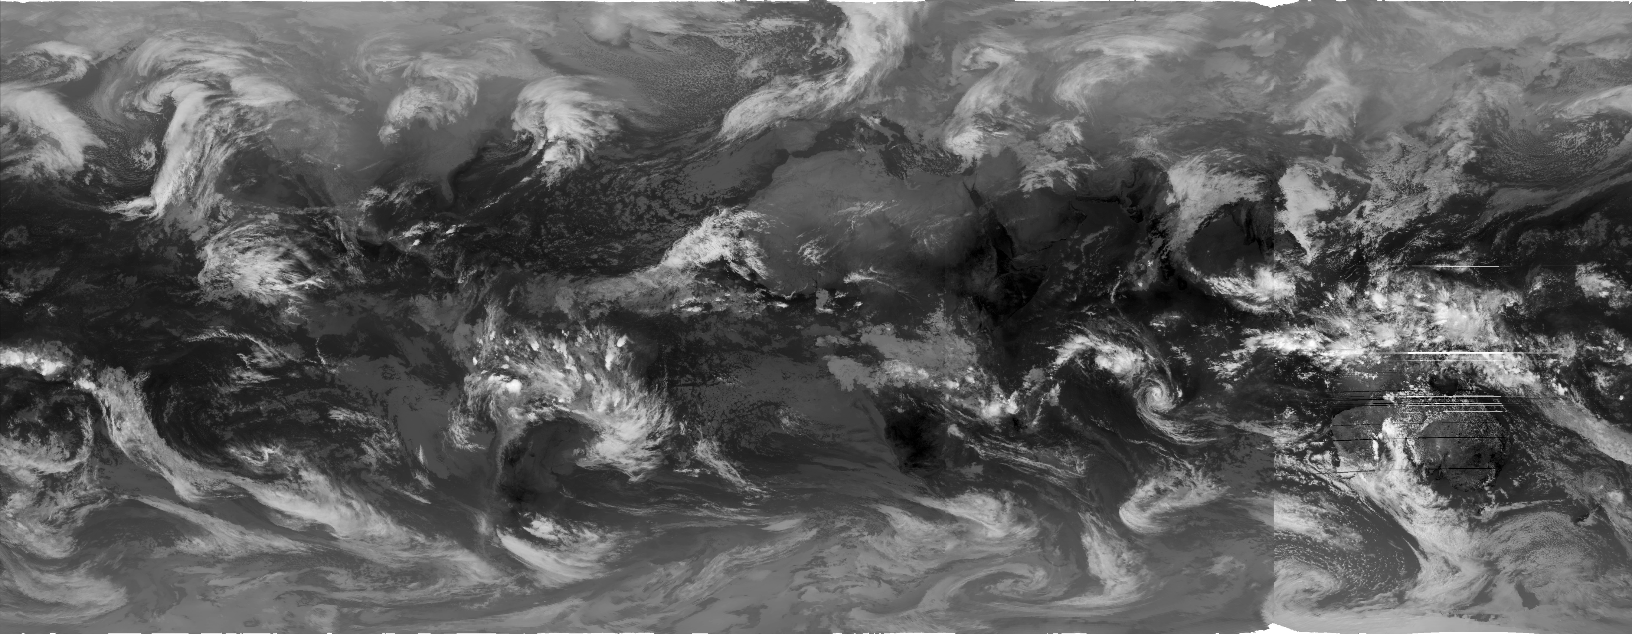
Learning the Representations of Satellite Images
NOAA GridSat-B1 Dataset
and
Weather Events in Taiwan

Slide 2
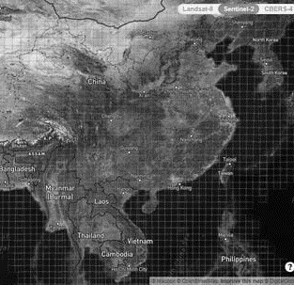
Outline
Representation Learning
  What is representation learning?
  How to evaluate the learned representations?
Dataset
  NOAA GridSat-B1
  TAD
Experiment Design
A Note on Transfer Learning
Some Results

Slide 3
What is Representation Learning?
In machine learning, feature learning or representation learning is a set of techniques that allows a system to automatically discover the representations needed for feature detection or classification from raw data.
The process is automatic.
The learned features/representations should be evaluated against some downstream tasks.
https://en.wikipedia.org/wiki/Feature_learning

Slide 4
A Short Review of Representation Learning
Dimension reduction:
  the input data is too large to be processed efficiently, and hence we need a way to reduce its size.
Feature engineering:
  Manually designed filters or functions to reduce the input data size for further analysis.
Problems
  Requires significant human interference
  Derived features are task-dependent

Slide 5
Toward automatic discovery representations
Nonlinear mapping techniques
  Sammon mapping (Sammon, 1969)
  self-organizing map (SOM, Kohonen, 1982)
Manifold Learning
  kernel-PCA (Schölkopf, 1998)
  spectral graph theory (Lawrence, 2012)
Sammon, J. W. (1969). "A nonlinear mapping for data structure analysis". IEEE Transactions on Computers. 18 (5): 401, 402, 403–409. doi:10.1109/t-c.1969.222678.
Kohonen, Teuvo (1982). "Self-Organized Formation of Topologically Correct Feature Maps". Biological Cybernetics. 43 (1): 59–69. doi:10.1007/bf00337288. S2CID 206775459.
Schölkopf, Bernhard (1998). "Nonlinear Component Analysis as a Kernel Eigenvalue Problem". Neural Computation. 10 (5): 1299–1319. CiteSeerX 10.1.1.100.3636. doi:10.1162/089976698300017467. S2CID 6674407.
Lawrence, Neil D (2012). "A unifying probabilistic perspective for spectral dimensionality reduction: insights and new models". Journal of Machine Learning Research. 13 (May): 1609–1638. arXiv:1010.4830.

Slide 6
Here Come the Deep Neural Networks
(adapted from Bengio et al., 2013)

Slide 7
Evaluation of Learned Representations
For self-supervised methods
  Reconstruction errors (RMSE, pattern correlation, …etc.)
For supervised methods
  Design various downstream tasks
  Evaluate the overall performance of the tasks
What are proper tasks for evaluating satellite images?
  Object detection?
  Meteorological events on the surface?

Slide 8
Datasets
NOAA GridSat-B1 CDR
  1998 – 2018, Global coverage (70N to 70S)
  Data included from most meteorological geostationary satellites.
  Variable used: brightness temperature
  Cropped domain: 100-160E, 0-60N
Precipitation
  Hourly precipitation records of 45 CWB stations in Taipei basin
TAD
  Daily weather events in Taiwan area (1980-2019)

Slide 9
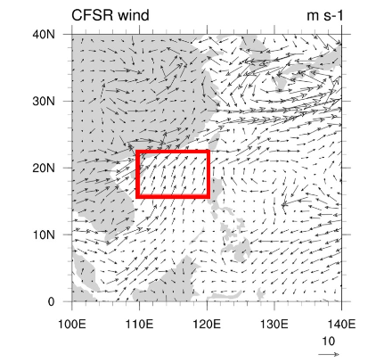
Define Weather Events
Precipitation
  To predict the mean daily precipitation in Taipei basin
  To detect rainfall events (>=10mm/hr) in Taipei basin
TAD defined events:
  NWPTC: there exist tropical cyclones in the North-Western Pacific.
  FT: there exist a front over Taiwan in the weather map issued by CWB.
  NE: defined by the wind profile of Pengjiayu Weather Station (彭佳嶼測站): daily mean wind speed >=4m/s, and wind direction within (15, 75) degree.
  SWF: define by CFSR 850hPa reanalysis: within the red rectangle, u>0 and v>0, and average wind-speed >=3m/s (or 30% of grids with wind-speed >=6m/s)
16°𝐍 to 22.5°N &𝟏𝟎𝟎°𝐄 to 𝟏𝟐𝟎°𝐄

Slide 10
Experiment Design
Representation Learning Methods
  Principle Component Analysis (PCA)
  Convolutional Auto-Encode
  Variational Auto-Encoder
  ResNet50 Pre-trained with ImageNet
  ResNet50 Pre-trained with ImageNet/BigEarth
Downstream Tasks
  Precipitation in Taipei Basin
  Tropical Cyclones on NWP
  Southeasterlies / Northeasterlies
  Front

Slide 11
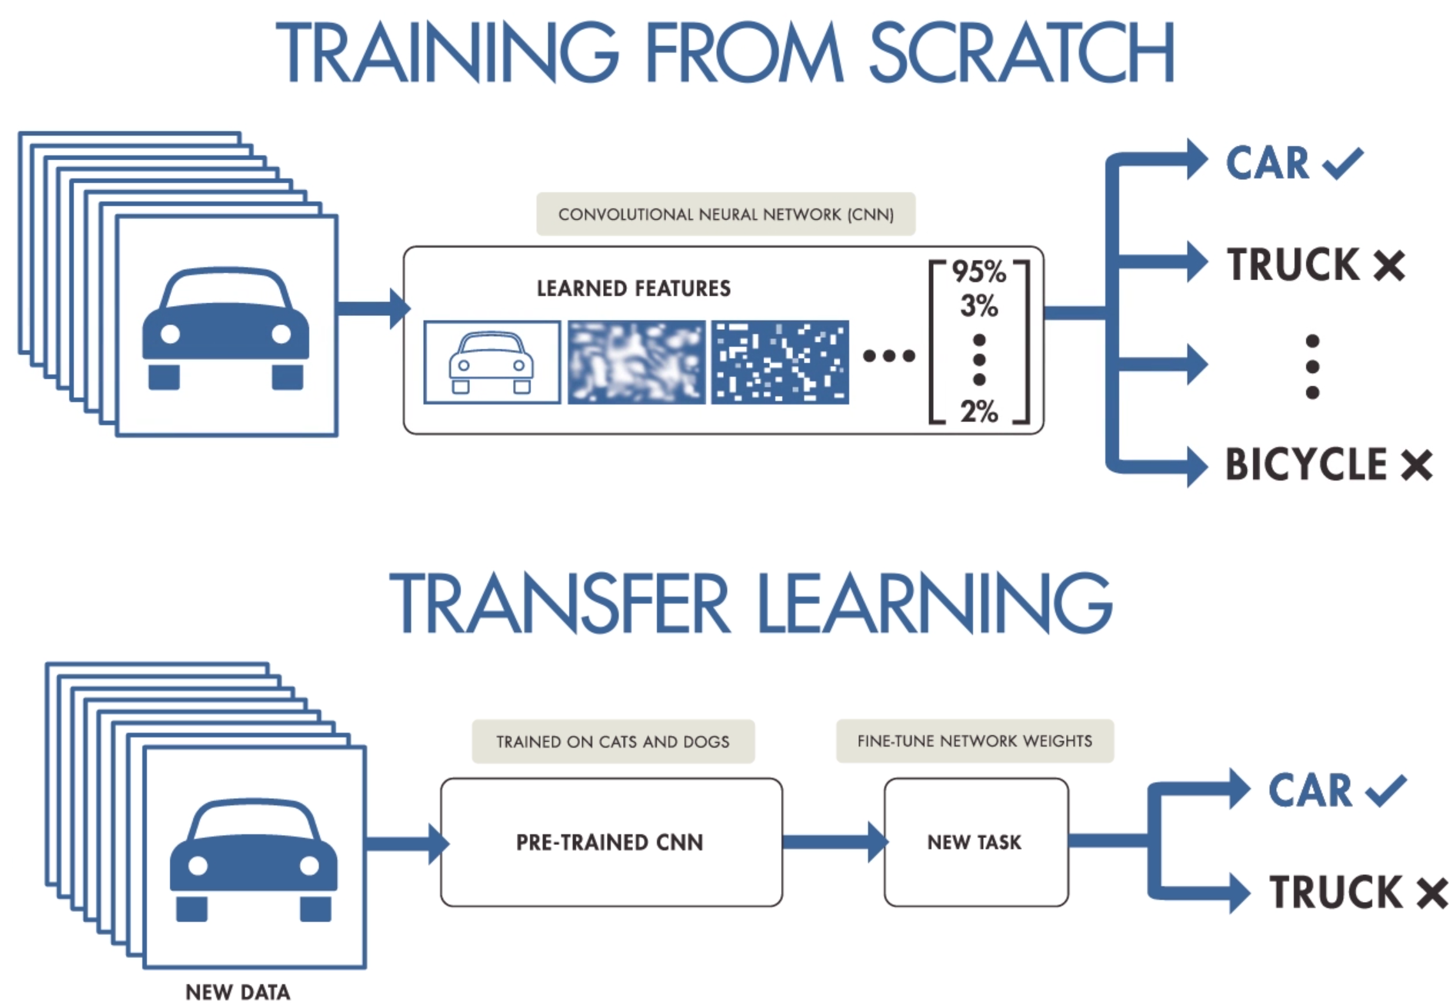
Transfer Learning and Pre-trained Models
What are pretrained models?
  Deep neural networks can learn its weights from provided data.
  A pretrained model is a deep neural network model with weights learned from certain datasets.
  Using a pretrained model for our own dataset and tasks is called Transfer Learning or fine-tuning.

Slide 12
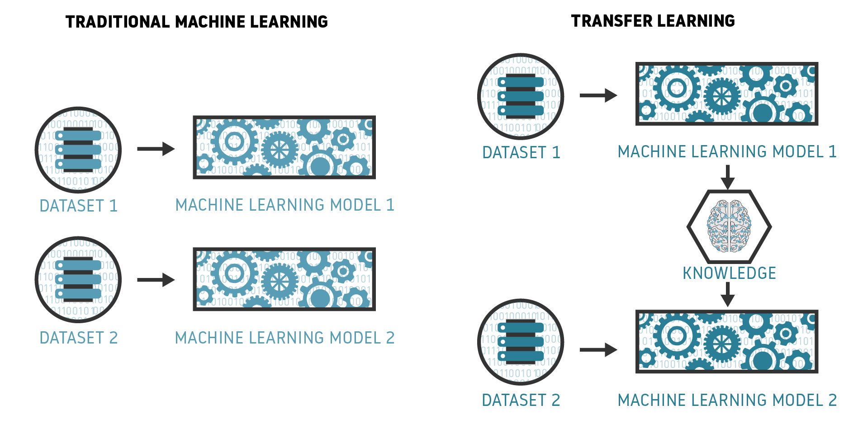
Transferring the Learned Knowledge

Slide 13
Why do we need pretrained models?
To leverage the knowledge learned from similar data/tasks.
  It is very common that we don’t have sufficient data to train our own deep neural network.
  Especially for classifying rare events or anomaly detection tasks.
Model training is expensive
  ML models are in general expensive at training and cheap at predicting.
  The computations of deep learning heavily rely on GPUs.
  GPUs are not only expensive, but also hard to get (due to the hype of cryptocurrency mining).
Fine-tuning a pretrained model can be a practical choice.

Slide 14
Experiment Flow
NOAA-GridSat-B1 CDR data
Projections on the learned representations (feature vector)
Generalized Liner Model
Precipitation
NWPTC
FT
NE
SWF

Slide 15
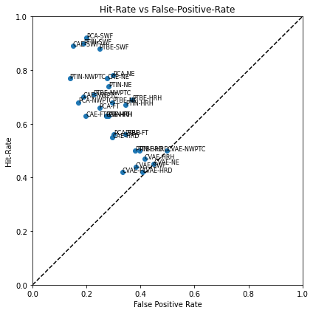
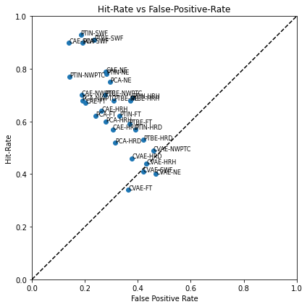
Experimental Results
256x256
512x512

Slide 16
Precipitation
Definition: any station in Taipei Basin recorded a precipitation >= 10mm/hour within the day.
256x256
id event feature sensitivity fpr threat_score
0 PCA-HRH HRH PCA 0.63 0.2722 0.4187
1 CAE-HRH HRH CAE 0.63 0.2722 0.4200
2 CVAE-HRH HRH CVAE 0.47 0.4148 0.2661
3 PTBE-HRH HRH PTBE 0.69 0.3698 0.4151
4 PTIN-HRH HRH PTIN 0.67 0.3451 0.4146
512x512
id event feature sensitivity fpr threat_score
0 PCA-HRH HRH PCA 0.60 0.2787 0.3974
1 CAE-HRH HRH CAE 0.64 0.2626 0.4329
2 CVAE-HRH HRH CVAE 0.44 0.4319 0.2462
3 PTBE-HRH HRH PTBE 0.68 0.3719 0.4060
4 PTIN-HRH HRH PTIN 0.69 0.3805 0.4057

Slide 17
NWPTC
Definition: JTWC best track
256x256
id event feature sensitivity fpr threat_score
0 PCA-NWPTC NWPTC PCA 0.68 0.1700 0.5746
1 CAE-NWPTC NWPTC CAE 0.70 0.1871 0.5824
2 CVAE-NWPTC NWPTC CVAE 0.50 0.4980 0.3252
3 PTBE-NWPTC NWPTC PTBE 0.71 0.2253 0.5651
4 PTIN-NWPTC NWPTC PTIN 0.77 0.1383 0.6650
512x512
id event feature sensitivity fpr threat_score
0 PCA-NWPTC NWPTC PCA 0.68 0.1897 0.5642
1 CAE-NWPTC NWPTC CAE 0.70 0.1871 0.5788
2 CVAE-NWPTC NWPTC CVAE 0.49 0.4585 0.3259
3 PTBE-NWPTC NWPTC PTBE 0.70 0.2767 0.5362
4 PTIN-NWPTC NWPTC PTIN 0.77 0.1423 0.6675

Slide 18
FT
Definition: CWB weather map (00Z) showed a front over Taiwan area.
256x256
id event feature sensitivity fpr threat_score
0 PCA-FT FT PCA 0.66 0.2473 0.2937
1 CAE-FT FT CAE 0.63 0.1969 0.3145
2 CVAE-FT FT CVAE 0.42 0.3325 0.1576
3 PTBE-FT FT PTBE 0.56 0.3433 0.2034
4 PTIN-FT FT PTIN 0.63 0.2804 0.2595
512x512
id event feature sensitivity fpr threat_score
0 PCA-FT FT PCA 0.62 0.2407 0.2792
1 CAE-FT FT CAE 0.67 0.2026 0.3285
2 CVAE-FT FT CVAE 0.34 0.3648 0.1206
3 PTBE-FT FT PTBE 0.59 0.3681 0.2061
4 PTIN-FT FT PTIN 0.62 0.3317 0.2312

Slide 19
NE
Definition: the wind profile of Pengjiayu Weather Station (彭佳嶼測站) showed north-easterlies.
256x256
id event feature sensitivity fpr threat_score
0 PCA-NE NE PCA 0.78 0.2972 0.4816
1 CAE-NE NE CAE 0.77 0.2768 0.4878
2 CVAE-NE NE CVAE 0.45 0.4484 0.2313
3 PTBE-NE NE PTBE 0.68 0.2962 0.4177
4 PTIN-NE NE PTIN 0.74 0.2809 0.4677
512x512
id event feature sensitivity fpr threat_score
0 PCA-NE NE PCA 0.75 0.2952 0.4670
1 CAE-NE NE CAE 0.79 0.2789 0.4973
2 CVAE-NE NE CVAE 0.40 0.4688 0.2004
3 PTBE-NE NE PTBE 0.68 0.3095 0.4145
4 PTIN-NE NE PTIN 0.78 0.2809 0.4906

Slide 20
SWF
Definition: the wind field of CFSR 850hPa reanalysis showed South-Westerlies.
256x256
id event feature sensitivity fpr threat_score
0 PCA-SWF SWF PCA 0.92 0.2000 0.5977
1 CAE-SWF SWF CAE 0.89 0.1498 0.6370
2 CVAE-SWF SWF CVAE 0.44 0.3820 0.2186
3 PTBE-SWF SWF PTBE 0.88 0.2474 0.5260
4 PTIN-SWF SWF PTIN 0.90 0.1877 0.6007
512x512
id event feature sensitivity fpr threat_score
0 PCA-SWF SWF PCA 0.90 0.1915 0.5966
1 CAE-SWF SWF CAE 0.90 0.1403 0.6506
2 CVAE-SWF SWF CVAE 0.41 0.4209 0.1912
3 PTBE-SWF SWF PTBE 0.91 0.2351 0.5585
4 PTIN-SWF SWF PTIN 0.93 0.1848 0.6224

Slide 21
Takeaways
The pretrained models perform very well. And pretrained with only ImageNet performs even better.
The good old friend, PCA, is a decent method. The performance of PCA is similar to CAE, and the algorithm is solid and robust.
SWF can be detected with a high hit-rate (0.92). NE is not as good as SWF but is still not bad. This suggests that the satellite image can provide information about synoptic scale wind patterns.

