Slide 1
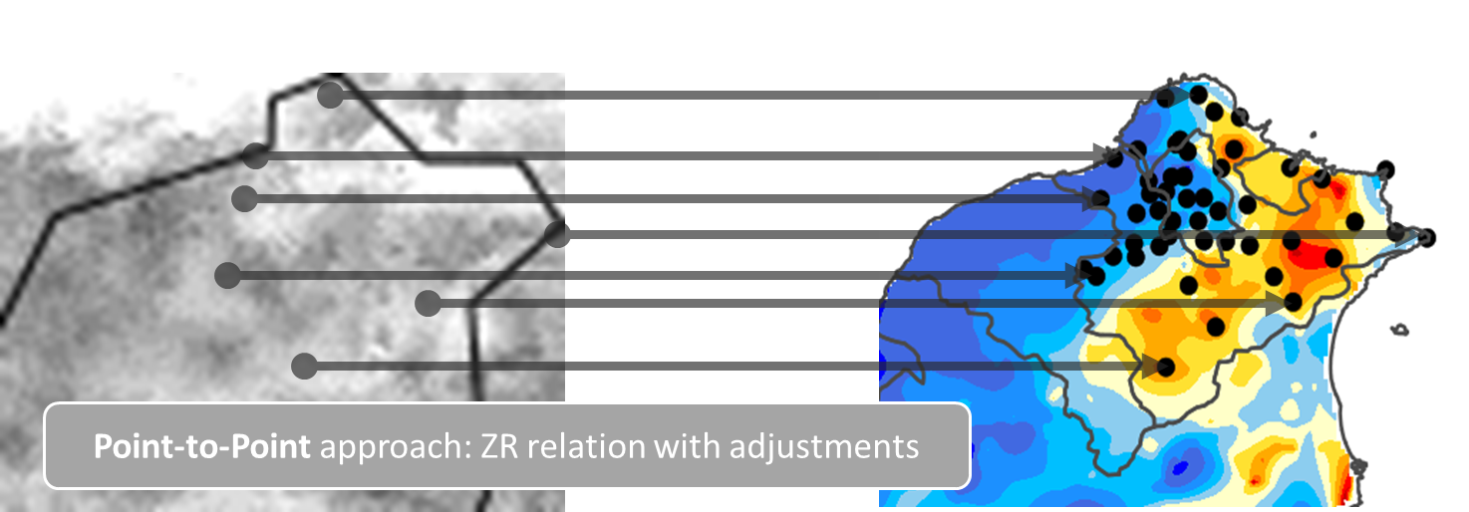
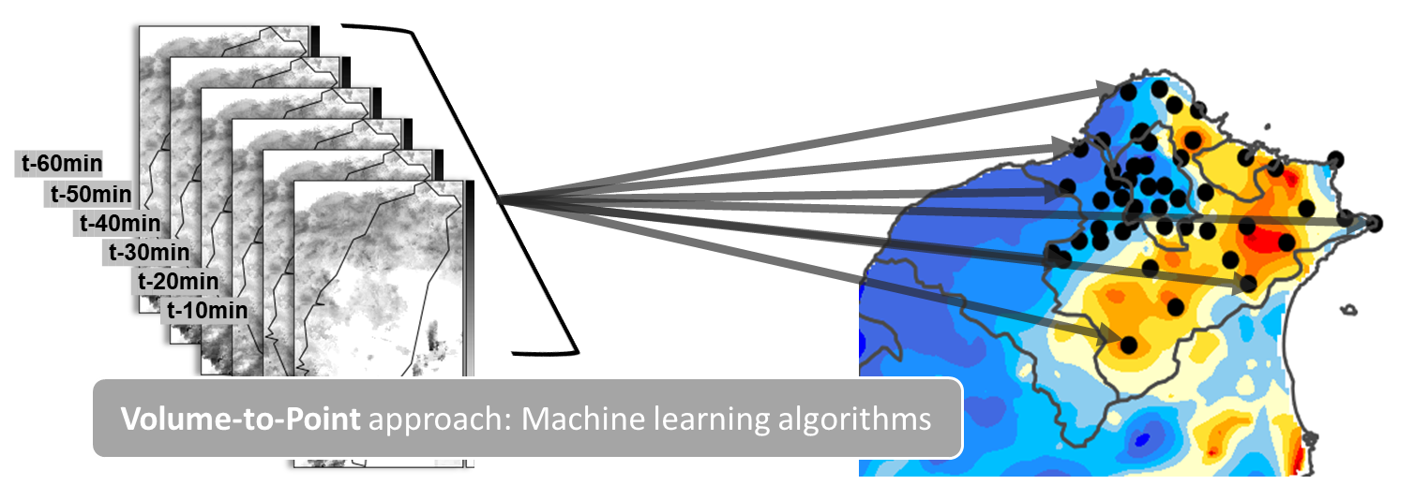
Fig. 1. A conceptual illustration of point-to-point and volume-to-point quantitative precipitation estimation.

Slide 2
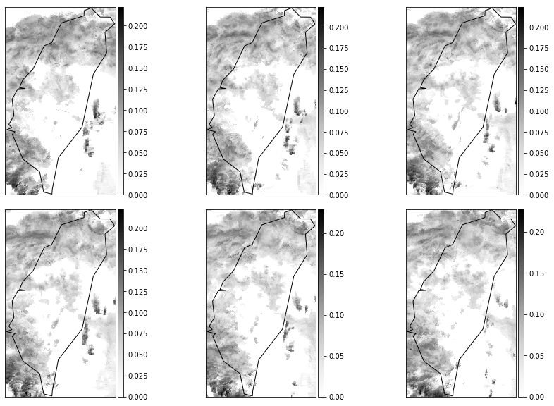
Fig. 2 The QPESUMS Mosaic data of 2014-06-14 11:10 ~ 12:00. (Typhoon HAGIBI.)

Slide 3
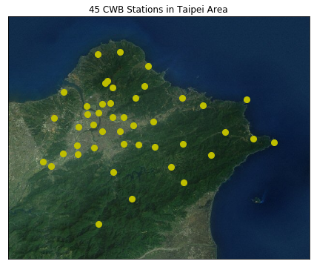
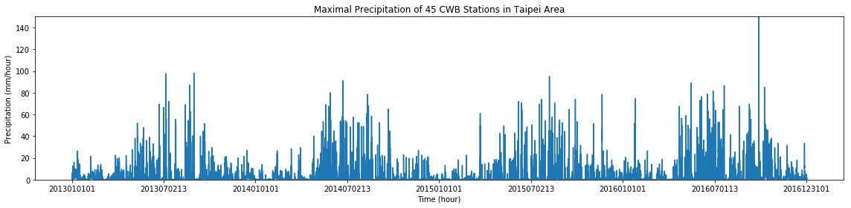
(a)
(b)
Fig. 3 (a) The locations of 45 CWB weather stations over Taipei area; (b) The time series of maximal precipitation of the 45 stations during 2013-01-01-00:00 ~ 2016-12-31-23:00 (LST).

Slide 4
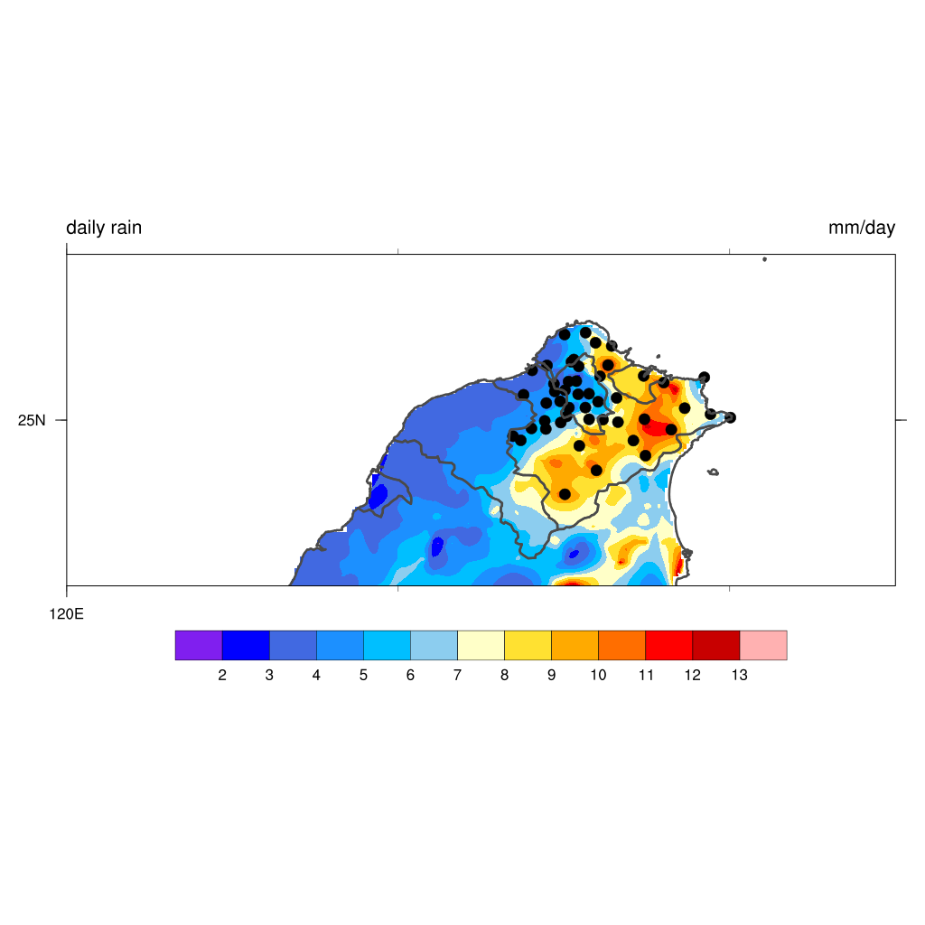
Feature Extraction
Volume-to-Point
Feature-N
t-60min
Machine Learning Model
t-50min
t-40min
t-30min
t-20min
t-10min
Feature2
Feature1
X: Features of radar reflectivity every 60 mins
Y: 1hr accumulated Rainfall
Fig 4. The architecture of the volume-to-point framework used in this study. The data volume, X, consists of successive QPESUMS images within the hour; the target point, Y, is represented by the rain gauge records of the weather station. Machine learning algorithms is then applied to learn the mapping from data.

Slide 5
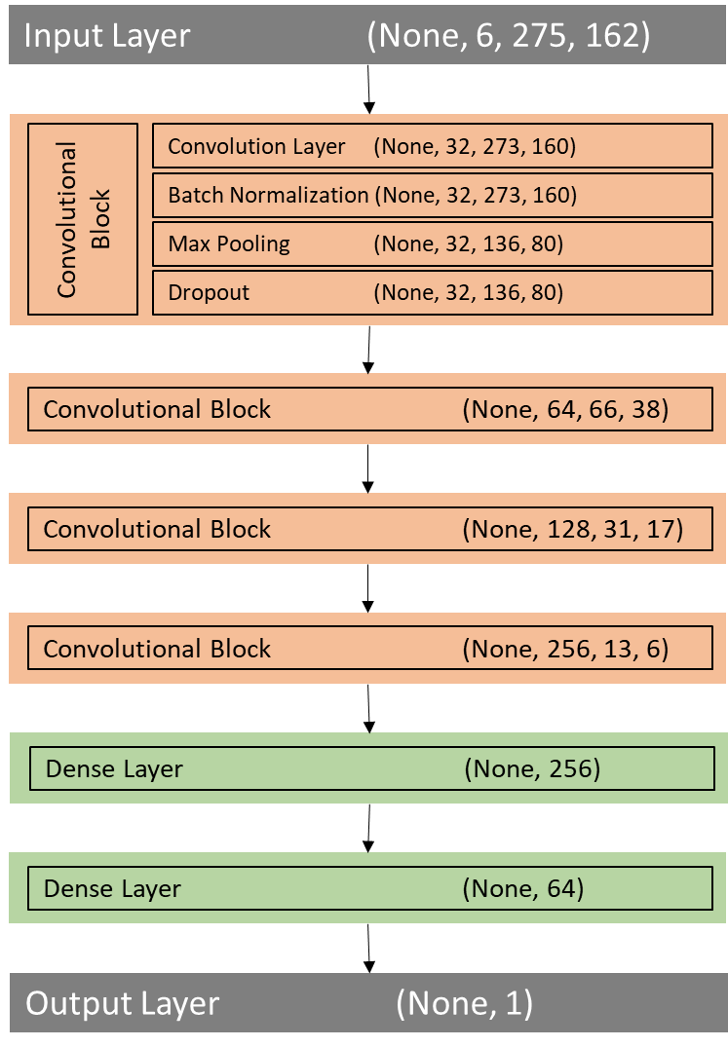
Input Layer (None, 6, 275, 162)
Convolutional Block
Convolution Layer (None, 32, 273, 160)
Batch Normalization (None, 32, 273, 160)
Max Pooling (None, 32, 136, 80)
Dropout (None, 32, 136, 80)
Convolutional Block (None, 64, 66, 38)
Convolutional Block (None, 128, 31, 17)
Convolutional Block (None, 256, 13, 6)
Fig. 5. The structure of the Convolutional Neural Network (CNN) model used in this study. Four convolutional blocks are stacked to extract spatial-temporal features from the 6x275x162 data volume. The bottom layers further reduce the feature dimension to 64 and then output the estimated precipitation (regression) or whether the rainfall will exceed a threshold (classification).
Dense Layer (None, 256)
Dense Layer (None, 64)
Output Layer (None, 1)

Slide 6
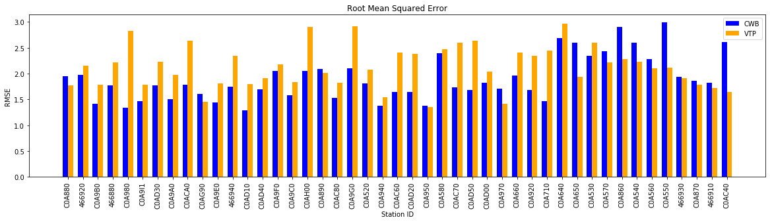
Fig. 6 The RMSE between QPE schemes and the weather station records. The operational QPE scheme used by CWB is shown in blue, and the proposed VTP approach is shown in orange. Stations are arranged in ascending altitude.

Slide 7
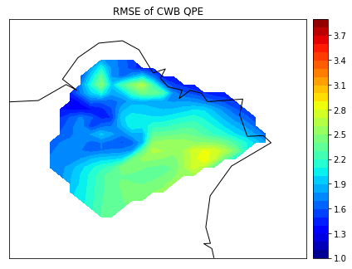
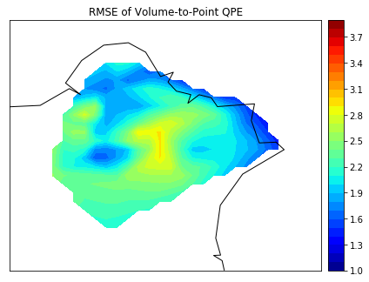
CWB mean RMSE: 1.90
VTP mean RMSE: 1.92
Fig. 7 The RMSE between QPE schemes and the weather station records. The operational QPE scheme used by CWB is shown in the left panel, and the proposed VTP approach is shown in the right side.

Slide 8
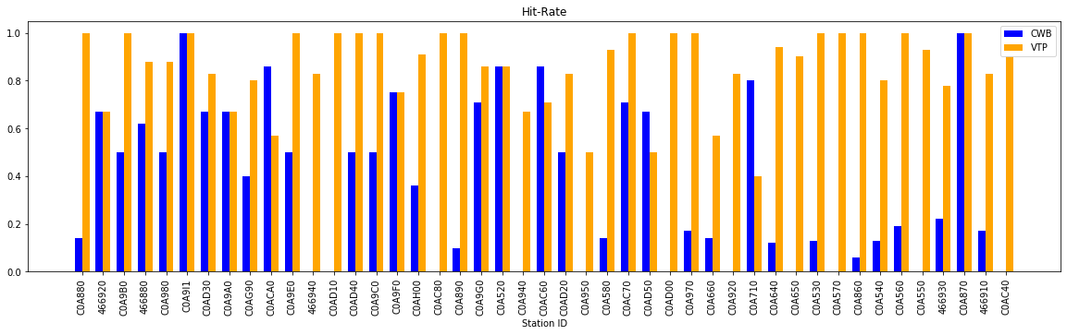
Fig. 8 The hit-rate of detecting events of 30mm/hr rainfall. The operational QPE scheme used by CWB is shown in blue, and the proposed VTP approach is shown in orange. Stations are arranged in ascending altitude.

Slide 9
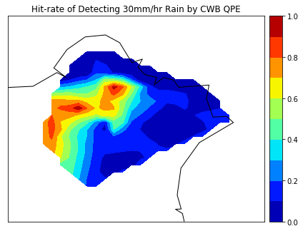
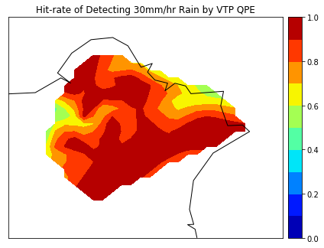
CWB mean hit-rate: 0.36
VTP mean hit-rate: 0.85
Fig. 9 The hit-rate of detecting events of 30mm/hr rainfall. The operational QPE scheme used by CWB is shown in the left panel, and the proposed VTP approach is shown in the right side.

Slide 10
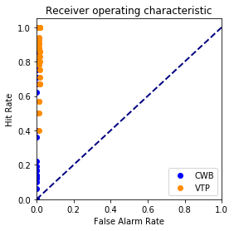
Fig 10. shows the receiver operating characteristics of two QPE schemes (blue for the operational scheme and orange for the proposed method).

