Slide 1
Chapter 1
Introduction to web development

Slide 2
Objectives
Applied
Load a web page from the Internet or an intranet into a web browser.
View the source code for a web page in a web browser.
Knowledge
Describe the components of a web application.
Distinguish between the Internet and an intranet.
Describe HTTP requests and responses.
Distinguish between the way a web server processes static web pages and dynamic web pages.
Name the five major web browsers.
Describe the use of JavaScript.
Distinguish between HTML and CSS.

Slide 3
Objectives (cont.)
Explain how you deploy a website on the Internet.
Describe the components of an HTTP URL.
Describe these five web development issues: usability, cross-browser compatibility, user accessibility, search engine optimization, and Responsive Web Design.

Slide 4
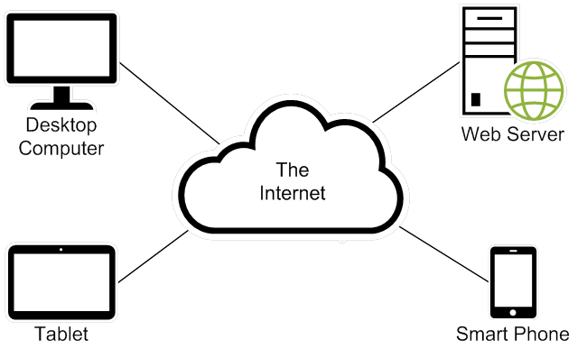
The components of a web application

Slide 5
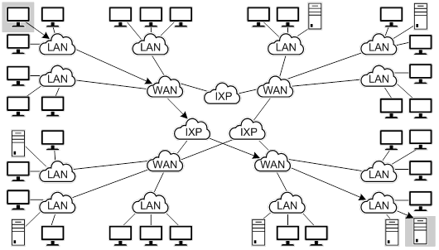
The architecture of the Internet

Slide 6
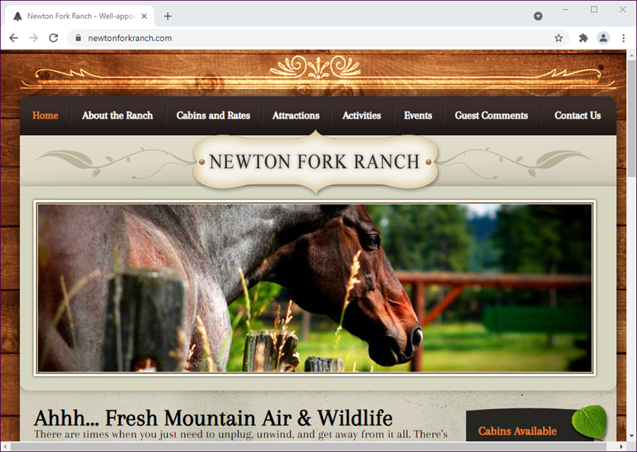
A static web page

Slide 7
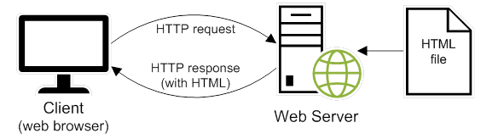
How a web server processes a static web page

Slide 8
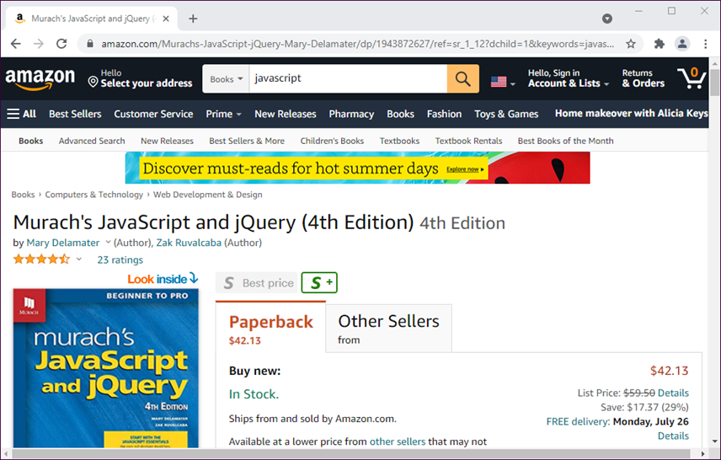
A dynamic web page at amazon.com

Slide 9
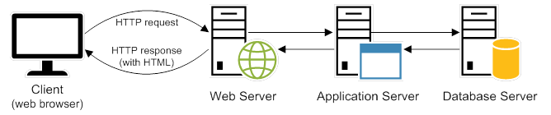
How a web server processes a dynamic web page

