Slide 1

Data Visualization CA1
Shi TingXiao (P2033444)
Ang Kah Shin (P2004176), Devyn Chew(P2026578), Ryan Tan (P2026312),

Slide 2
Topic: Environment
Business Objectives:
How can solar energy light up Africa
How effective are mangroves at Carbon Sequestrating

Slide 3
Carbon Dioxide accounts for more than
75%
Of the Global Annual Climate Pollution

Slide 4
Dataset (Solar energy)
Data Header | Description
System Size(kWp) | Current installed Photovoltaic capacity
Household Consumptions (GWh) | Amount of electricity consumed per Hour
Industrial Consumptions (GWh) | Amount of electricity consumed per Hour
Average Practical Potential (PVOUT, kWh/kWp/day) | Approximate Photovoltaic panel power output per day
System Type | Category that implemented the system
Singapore Total Solar Generation (GWh) | Total Solar Energy Generated in Singapore
Size:
The dataset includes Photovoltaic values, panel installation from Singapore and globally.

Slide 5
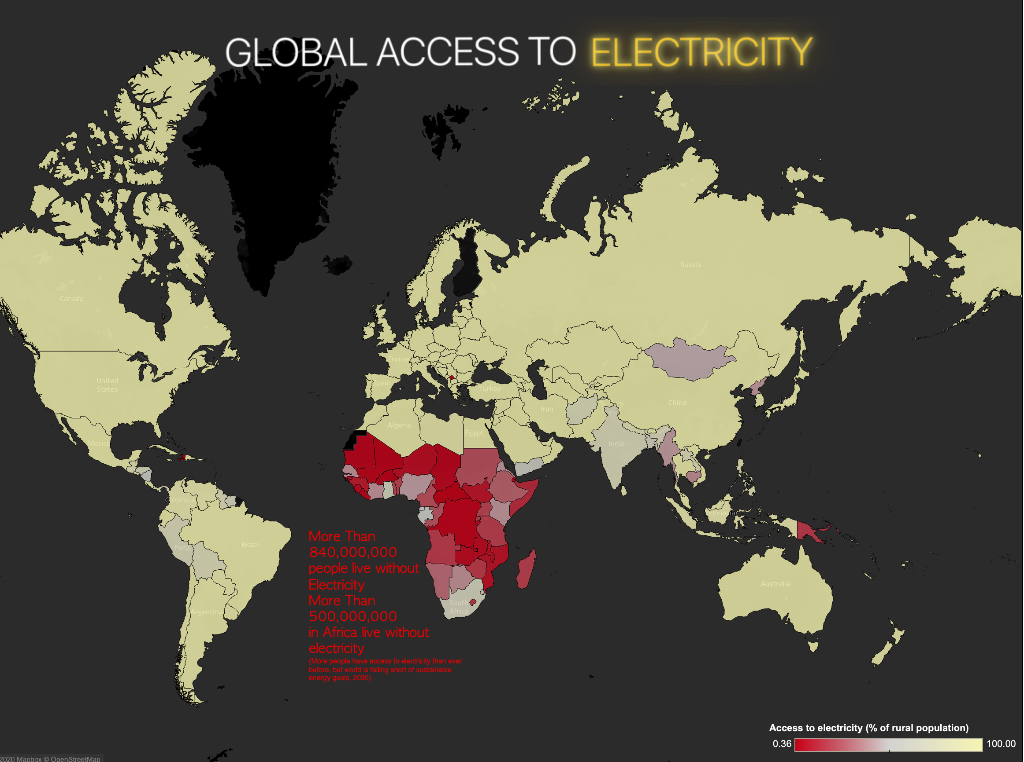
Data Insights
There are large amount of countries that don’t have proper access to power, concentrated on the Africa continent, countries like Liberia only have 1.3 % of rural population have access to power in 2016
The photovoltaic practical potential index on the Africa continent is amongst the highest globally

Slide 6
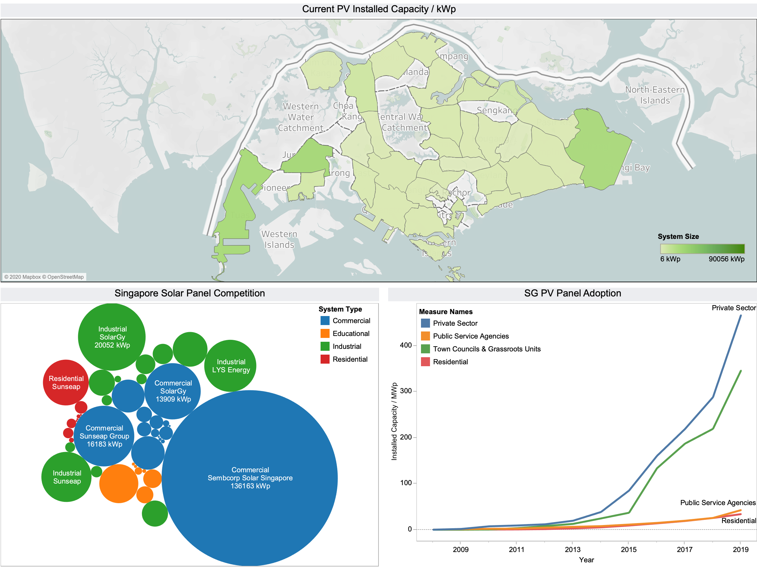
Data Insights
The amount of adoption for Solar Panels in Singapore is increasing exponentially as more and more private and government sectors are installing these panels to save cost on their energy consumption.
There are healthy competitions of solar panel contractor, which encourages the development of solar panel, also reduce the price as demand raises.

Slide 7
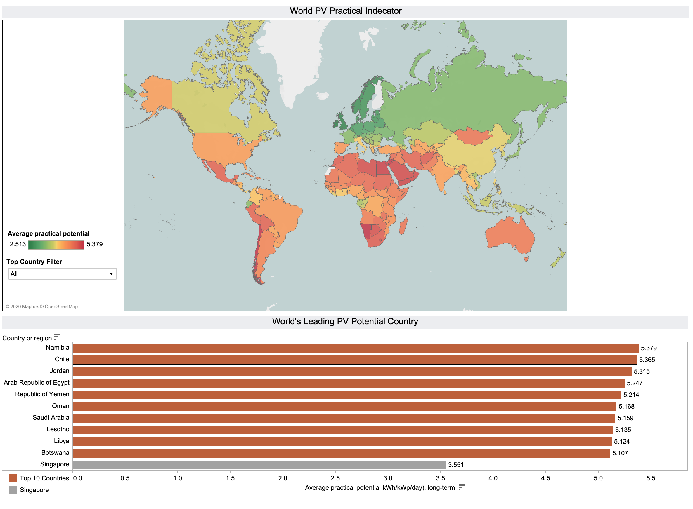
Is Solar Energy a viable alternative Source of Power Globally?
The countries around Africa and South America yields higher PV values as opposed to Singapore’s PV value.
This shows that the Solar Panels that are installed at these locations will yield better results as compared to Singapore.
The photovoltaic practical potential index on the Africa continent is amongst the highest globally.

Slide 8
Dataset (Mangrove Sequestration)
Data Header | Data Description
1 m SOC (Mg C) | Amount of carbon stored in the top 1m of mangrove soil
Area (ha) | Area of mangrove in 2000
Deforested area (ha) | Area of mangrove that was deforested between 2000 and 2015
High deforested SOC (Mg C) | Sum of all carbon loss due to deforested Mangrove
Land cover category | Different types of terrestrial ecosystems
Cntry_name | Names of countries
Co2 | Annual production-based emissions of carbon dioxide (CO2), measured in million tonnes per year.
The dataset includes mangrove carbon stocks from 107 countries for the year 2000
Size

Slide 9
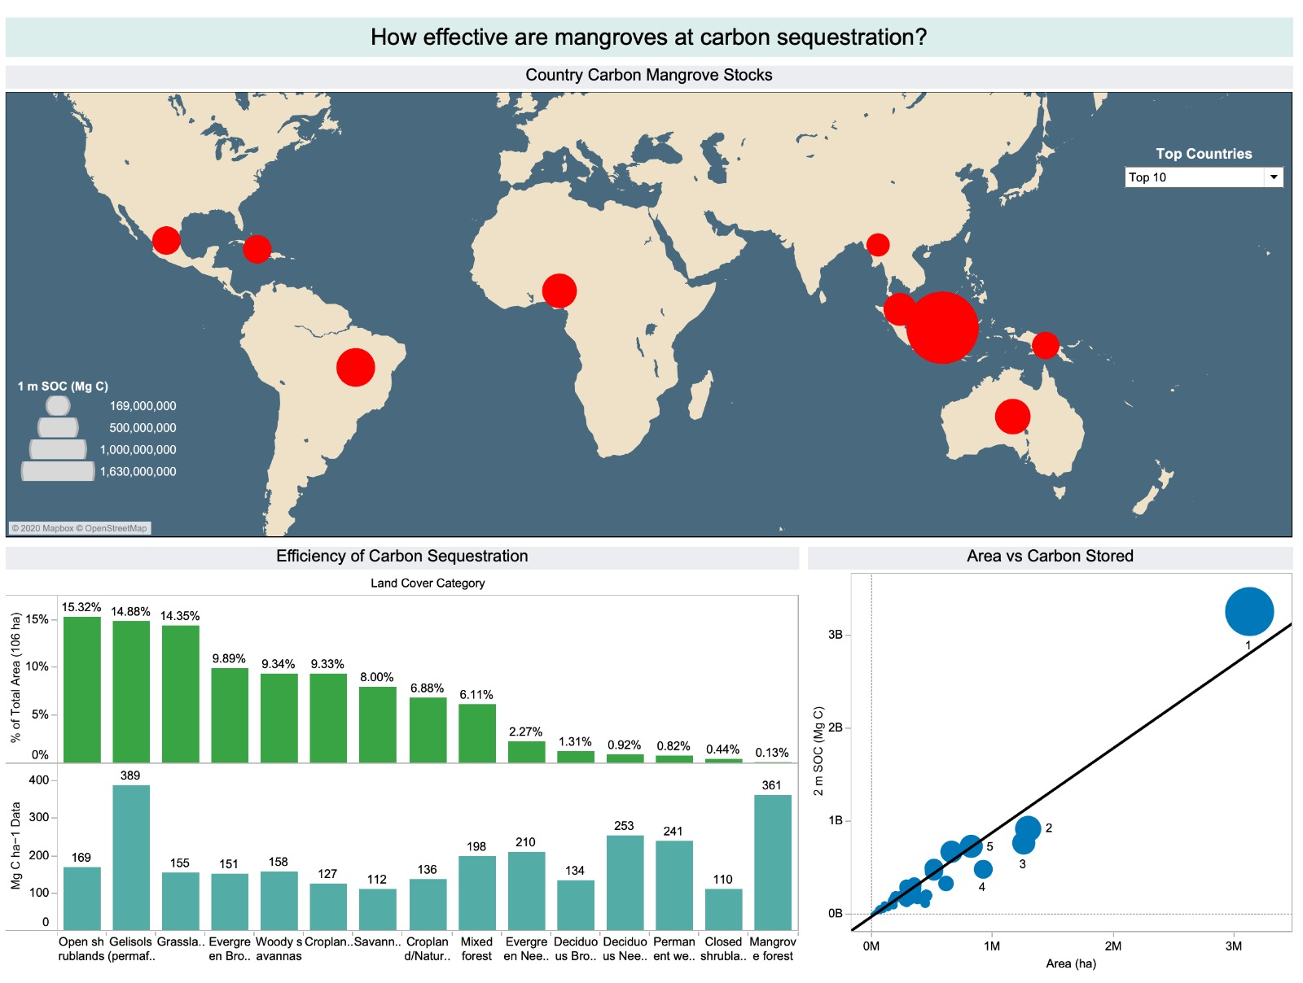
Data Insights
Indonesia holds the largest mangrove carbon stock in the world. This is
consistent with the area of mangrove in Indonesia.
Despite mangroves taking up only 0.1% of Earth’s surface, they store the
second-highest amount of carbon per hectare.
There is a positive correlation between the area of mangroves and
amount of carbon stored in the soil.

Slide 10
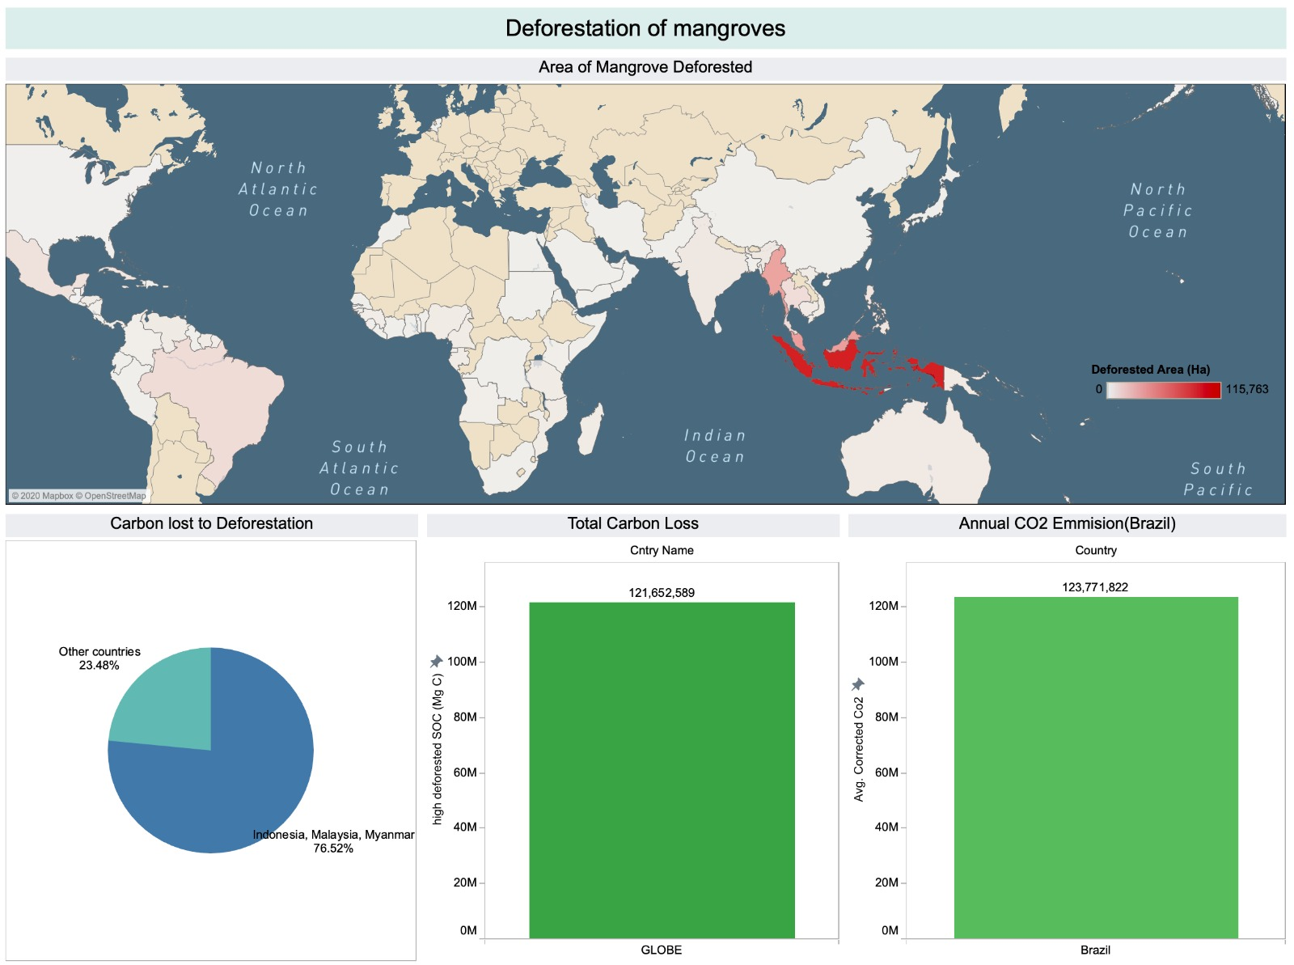
Data Insights
Indonesia, Myanmar and Malaysia are experiencing the greatest amount of mangrove deforestation, and account for more than 75% of all carbon loss.
The total amount of carbon loss due to mangrove deforestation between 2000 and 2015 is roughly equivalent to Brazil’s average annual CO2 emissions.

Slide 11
Our Solution/Suggestions
Support local mangrove conservation efforts
Mass adoption of solar panels
Protect mangroves

Slide 12
Our Solution/Suggestions
Solar panels have the potential to light up Africa, just as they have the potential to power up Singapore’s 350,000 household by 2030 (Singapore to deploy 2GW of solar power by 2030, 2020), and provide 43% of Singapore’s Power demand during mid-day (Han, 2020). With much higher PV practical potential index in Africa, there is potential to generate substantially more power. Donate to our foundation and help bring light to the night.
We have concluded that mangroves are the one of the most carbon-dense ecosystems in the world. We recommend prioritizing the protection of mangroves especially in countries like Indonesia which holds a large part of the world’s mangrove carbon stock. As for us, we ask for the support of local conservation efforts such as NParks and make mangrove protection a priority of our climate mitigation plans.
This will reduce the carbon emissions produced from burning lesser fossil fuels while also reducing the carbon dioxide in the atmosphere.

Slide 13
Thanks!
]]

Slide 14
Citations & References
Mangrove carbon sequestration.xlsx
Original dataset name: ERL_5__055002_SD_mangroveSOC_country_stats_121917.xlsx
Used in sheet:
﻿V2 - 1 - Efficiency of carbon sequestration
﻿V2 - 1 - Country Carbon Mangrove Stocks
﻿V2 - 1 - Area vs Carbon stored
﻿V2 - 2 - Carbon lost to deforestation
﻿V2 - 2 - Area of mangrove deforested
﻿V2 - 2 - Total Carbon Loss
Source: Iopscience.iop.org. 2018. Shieldsquare Captcha. [online] Available at: <https://iopscience.iop.org/article/10.1088/1748-9326/aabe1c/meta#erlaabe1cs7> [Accessed 27 November 2020].
Remark: The downloading towards the file is at the supplementary file of the article
Global co2 emissions.xlsx
Original dataset name: owid-co2-data.xlsx
Used in sheet:
﻿ ﻿V2 - 2 - Annual CO2 Emissions Brazil
Source: GitHub. 2020. Owid/Co2-Data. [online] Available at: <https://github.com/owid/co2-data> [Accessed 27 November 2020].
Asian Power. 2020. Singapore To Deploy 2GW Of Solar Power By 2030. [online] Available at: https://asian-power.com/power-utility/news/singapore-deploy-2gw-solar-power-2030 [Accessed 29 November 2020].
Datacatalog.worldbank.org. 2020. Global Photovoltaic Power Potential By Country | Data Catalog. [online] Available at: <https://datacatalog.worldbank.org/dataset/global-photovoltaic-power-potential-country> [Accessed 27 November 2020]
Ema.gov.sg. 2020. EMA : Singapore Energy Statistics. [online] Available at: <https://www.ema.gov.sg/Singapore_Energy_Statistics.aspx> [Accessed 27 November 2020]
GitHub. 2020. Owid/Co2-Data. [online] Available at: <https://github.com/owid/co2-data> [Accessed 27 November 2020]
Han, T., 2020. Solar Could Meet 43% Of Singapore's Power Demand During Mid-Day By 2050: Study. [online] Eco-Business. Available at: <https://www.eco-business.com/news/solar-could-meet-43-of-singapores-power-demand-during-mid-day-by-2050-study/> [Accessed 29 November 2020].
Iopscience.iop.org. 2018. Shieldsquare Captcha. [online] Available at: <https://iopscience.iop.org/article/10.1088/1748-9326/aabe1c/meta#erlaabe1cs7> [Accessed 27 November 2020]
Solar-repository.sg. 2020. NSR | National Solar Repository Of Singapore. [online] Available at: <https://www.solar-repository.sg/database/index.cfm?id_sort_by=nm_contact&page=2&maxRowsSelect=500> [Accessed 27 November 2020]

