Slide 1
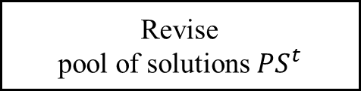
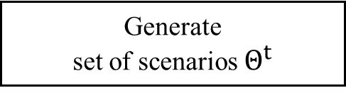

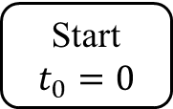
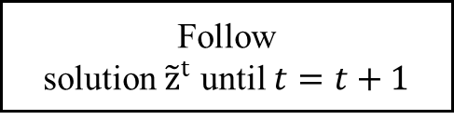
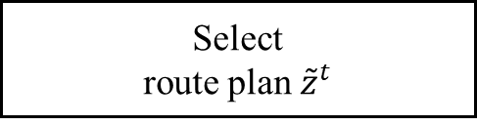
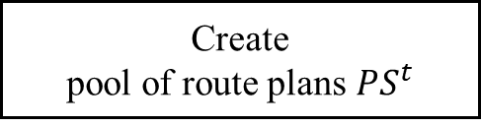
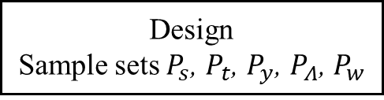
Start$t_{0}=0$
Design
Sample sets $P_{s}$, $P_{t}$, $P_{y}$, $P_{Λ}$, $P_{w}$
Generate
set of scenarios $Θ^{t}$
Greedy
heuristics
Create
pool of route plans${PS}^{t}$
Variable neighbourhood search
Select
route plan ${\tilde{z}}^{t}$
Follow
solution ${\tilde{z}}^{t}$ until $t=t+1$
$$t=t_{f}$$
Y
End
N
Event occurs
Y
Revise
pool of solutions${PS}^{t}$
N

