Slide 1
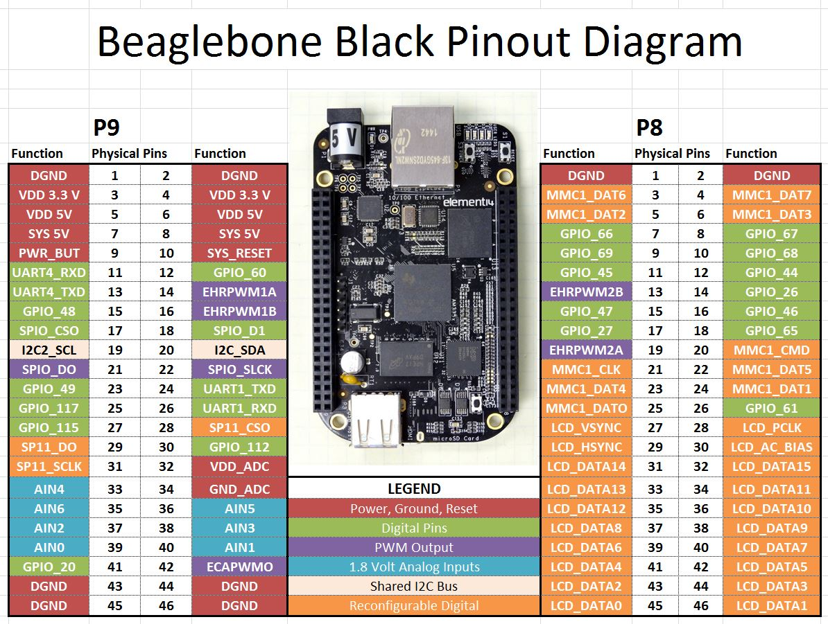
GPIO Controller

Slide 2
Agenda
Hardware gpio module
Instance of GPIO controller in Linux Kernel
Instance of Interrupt controller in Linux Kernel
User Interface with GPIO controller – Sysfs

Slide 3
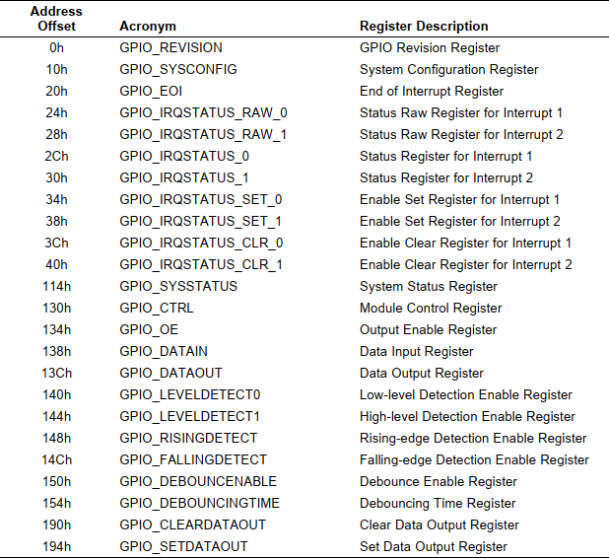
Hardware GPIO
What's GPIO
Functional Description
Input
Output
Registers of GPIO module

Slide 4
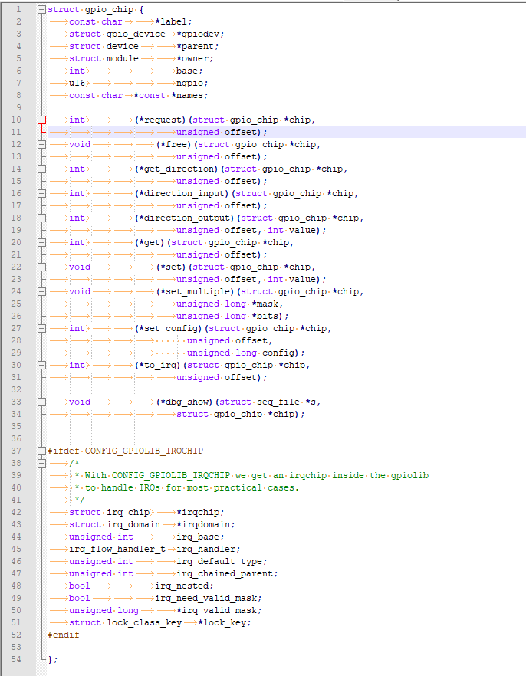
Instance of GPIO controller
Struct gpio_chip

Slide 5
API for struct gpio_chip
static inline int gpiochip_irqchip_add (struct gpio_chip *gpiochip,
struct irq_chip *irqchip, unsigned int first_irq,
irq_flow_handler_t handler, unsigned int type);
int gpiochip_add_data(struct gpio_chip *chip, void *data);
void *gpiochip_get_data(struct gpio_chip *chip);

Slide 6
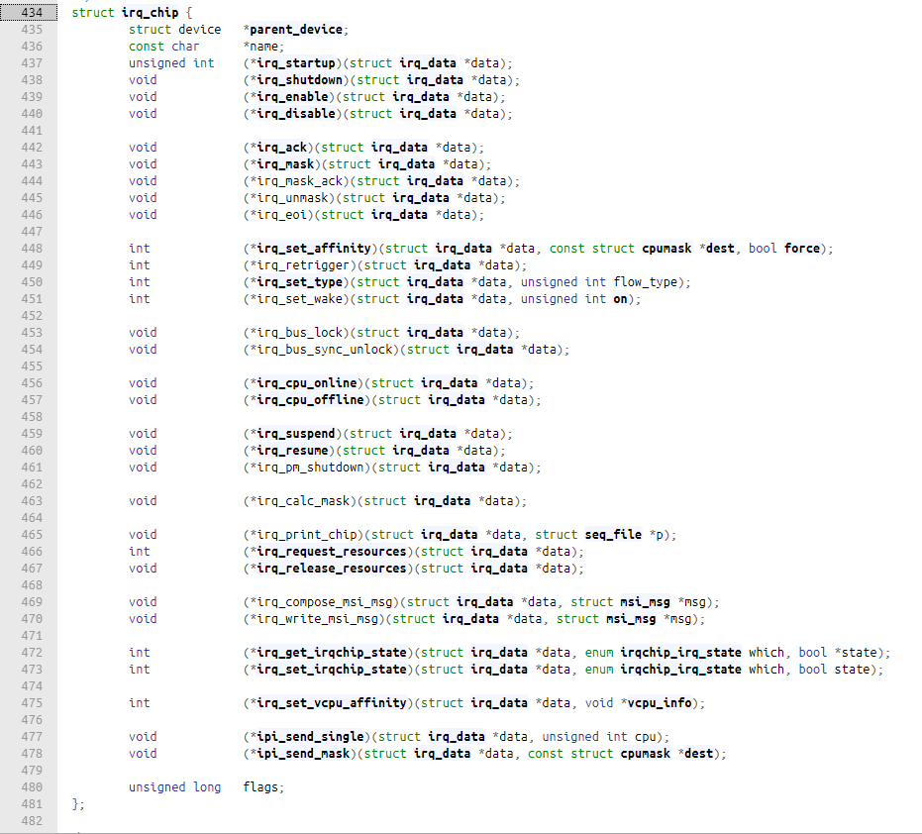
Instance of Interrupt controller

Slide 7
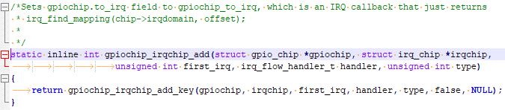
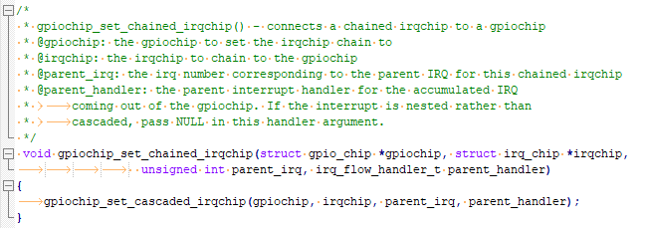
API for struct irq_chip

Slide 8
Sysfs Interface
export
my_gpio_request
Unexport
omap_gpio_free
value
SyS_read -> omap_gpio_get
SyS_write -> omap_gpio_set
edge
gpio_sysfs_request_irq
gpio_sysfs_free_irq
direction
omap_gpio_set_config
omap_gpio_output
omap_gpio_input

Slide 9
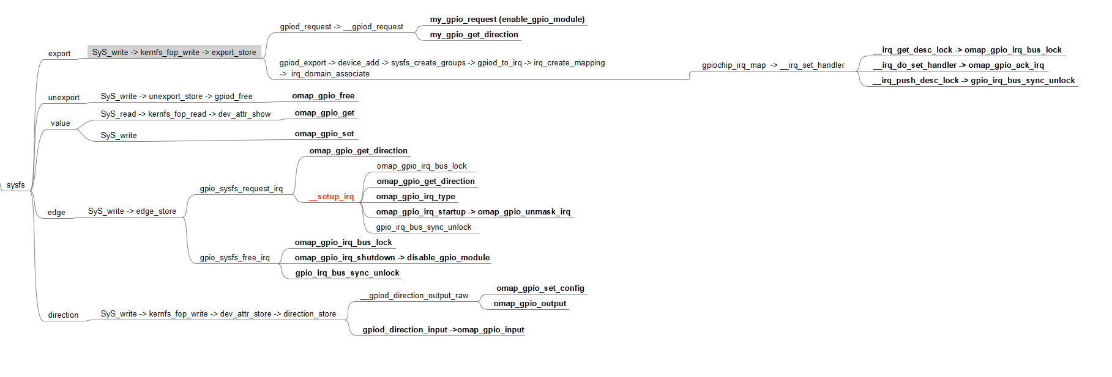
Sysfs Interface

Slide 10

Questions and Answers

Slide 11

Thanks

