Slide 1
Driver communicate ZynQ 7000 to TMS320C5509A

Slide 2
Agenda
Analysis of the problem
Solution

Slide 3

Analysis of the problem
Requirement ?
Objects ?

Slide 4
Requirement
Driver communicate ZynQ 7000 to DSP TMS320C5509A.
Use McBSP port.

Slide 5
Objects
How about ZynQ 7000 ?
How about DSP TMS320C5509A ?
What's McBSP ?

Slide 6
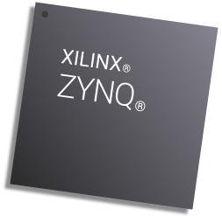
How about ZynQ 7000 ?
Is the SoC integrate of ARM and FPGA
Can use with Linux and Free RTOS
2 x UART
2 x CAN 2.0B
2 x I2C
2 x SPI
4 x GPIO

Slide 7
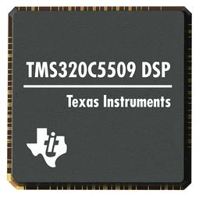
How about DSP TMS320C5509A?
Is the DSP
Manufactured by TI
Up to 3 Multichannel Buffered Serial Ports (McBSPs)

Slide 8
What's McBSP?
Mulitichannel Buffered Serial Port.
Is a standard protocol.
The primary use for the McBSP is for audio interface purposes.
Separate pins for transmission and reception communicate data to external devices.

Slide 9
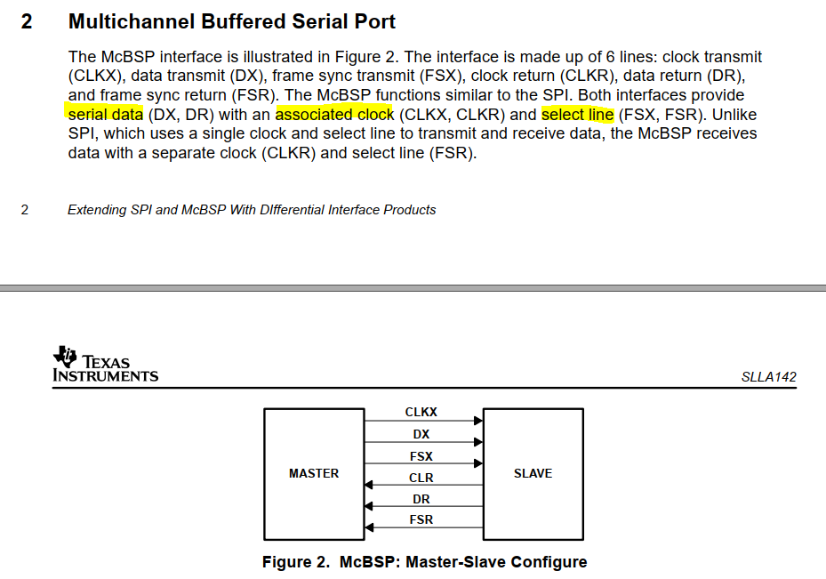
McBSP signals
clock transmit - CLKX
clock receive- CLKR
frame sync transmit - FSX
frame sync receive - FSR
Data transmit - DX
Data receive - DR

Slide 10

How to comminicate between both devices?

Slide 11
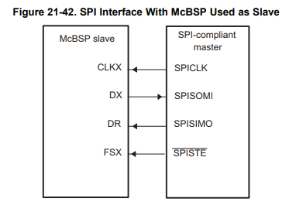
McBSP as SPI Slave

Slide 12
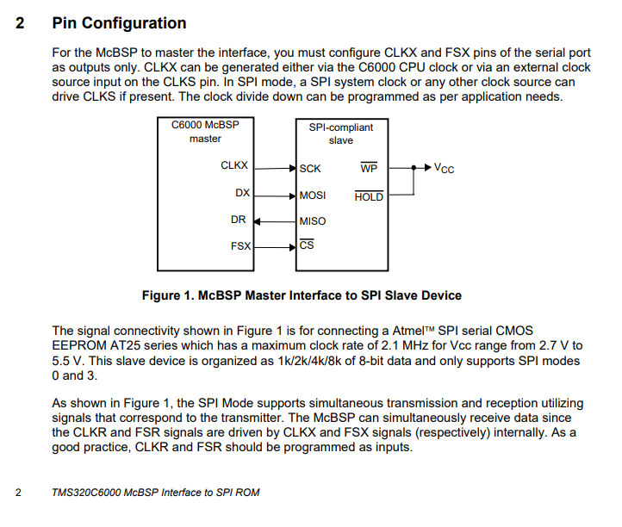
McBSP as SPI Master

Slide 13

Solution
McBSP as SPI Slave
Target: Write SPI driver on ZynQ to communicate with DSP

