Slide 1
Transactions across microservices

Slide 2
Context
Distributed System and Distributed Transaction
Handling transaction across multiple microservices
Implement approach with Go

Slide 3
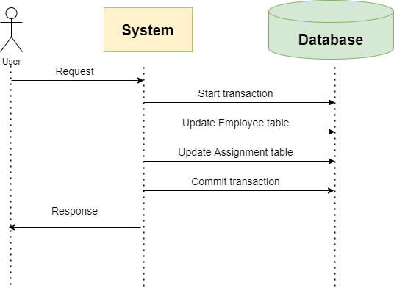
Distributed System and Distributed Transaction
1
Notes:
Distributed System: a computing environment, also known as distributed computing in which various components are spread across devices on a network

Slide 4
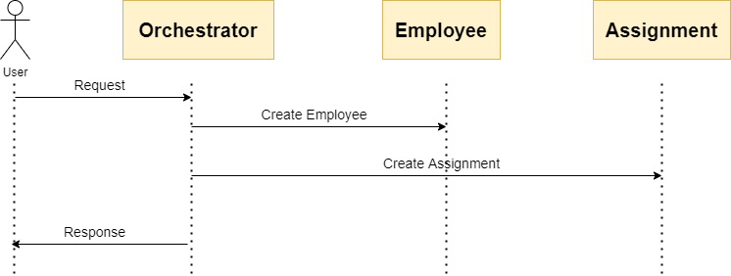
Notes:
Distributed Transaction: a set of operations on data that is performed, span over multiple physical systems/computers over the network. => In microservices system: a transaction is distributed to multiple services

Slide 5
ACID
Atomicity
Consistency
Isolation
Durability

Slide 6
Handling transactions
2
Two-phase commit (2pc) pattern
Eventual Consistency and Compensation/Saga pattern
Notes:
There are many distributed transaction patterns: Modular Monolith, Two-phase commit, Orchestration, Choreography, Parallel Pipeline

Slide 7
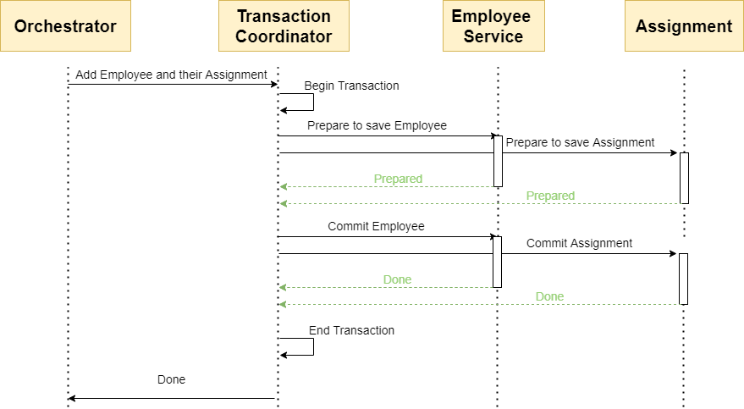
2PC
Notes:
The two-phase commit protocol (2PC) is a widely used pattern to implement distributed transactions (Prepare phase and Commit Phase)
The transaction is atomic
2pc allows read-write isolation

Slide 8
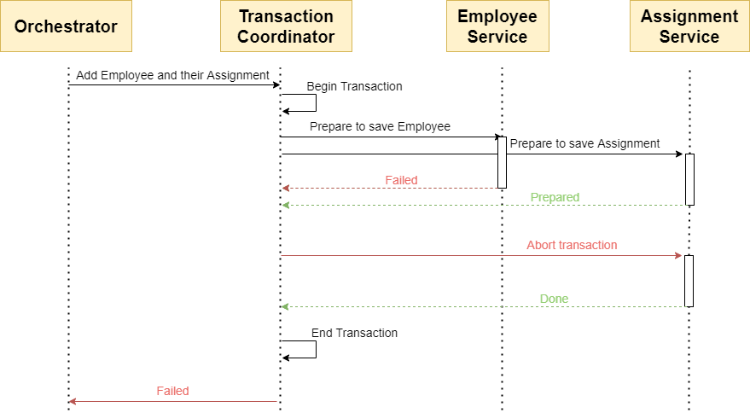
2PC
Notes:
The onus of the transaction is on the coordinator node, and it can become the single point of failure
All other services need to wait until the slowest service finishes its confirmation. Thus, the overall performance of the transaction is bound by the slowest service
The two-phase commit protocol is slow by design due to the chattiness and dependency on the coordinator. Thus, it can lead to scalability and performance issues in a microservice-based architecture involving multiple services
Two-phase commit protocol is not supported in NoSQL databases. Thus, in a microservice architecture where one or more services use NoSQL databases, a two-phase commit cannot be applied

Slide 9
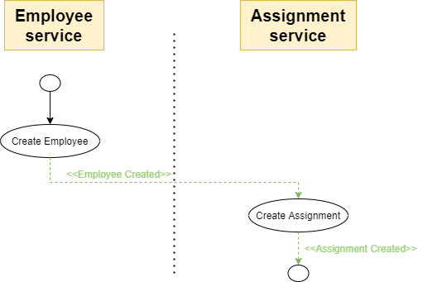
SAGA
Notes:
The Saga architecture pattern provides transaction management using a sequence of local transactions

Slide 10
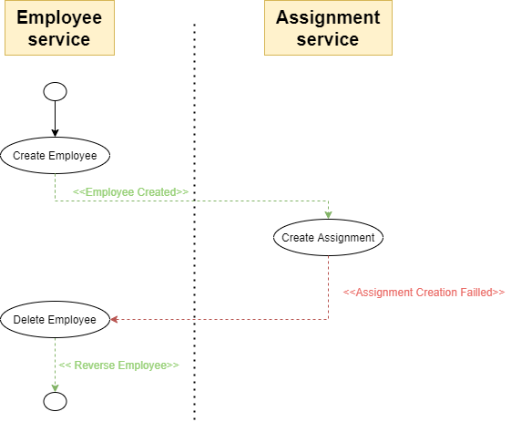
SAGA
Notes:
Transactions to continue waiting for user input.
Support for long-lived transactions
Difficult to debug
Does not have read isolation

Slide 11
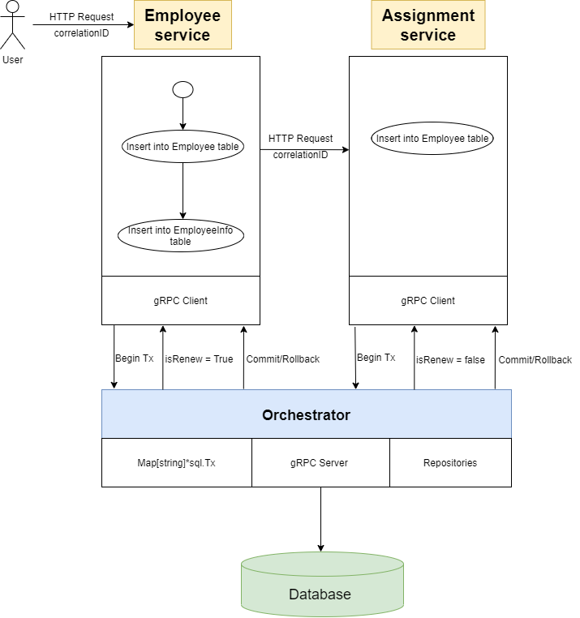
Approach 1
3.1
Notes:
Service communicate via HTTP request
Orchestrator help to communicate with DB

Slide 12
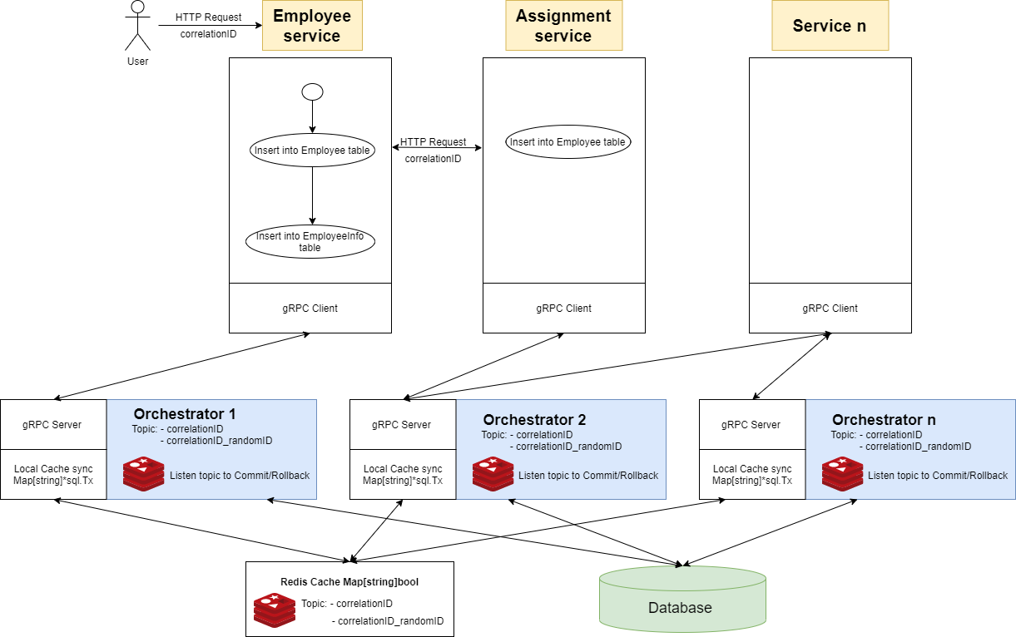
Approach 2
3.2
Notes:
Horizontal Scaling

Slide 13
Reference
https://developers.redhat.com/articles/2021/09/21/distributed-transaction-patterns-microservices-compared
https://www.baeldung.com/cs/saga-pattern-microservices
https://developers.google.com/protocol-buffers/docs/gotutorial

Slide 14
Thanks!
Any questions ?
You can find me at
@phucpa1
phucpa1@fsoft.com.vn

