Slide 1
Augmented Reality (AR) application for Room Design and Decoration
Mentors:
Tony
Mike
Members:
Quinto
Darick
Tina

Slide 2
AGenDa
Introduction
Project Overview
Implementation and Demonstration
Conclusion

Slide 3
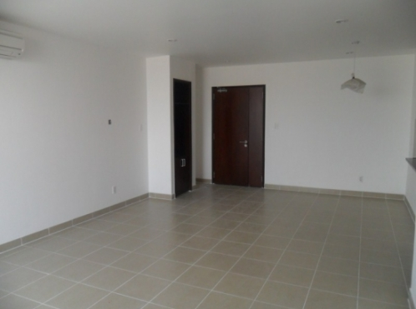
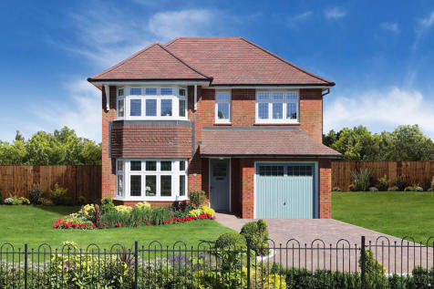

Introduction
Where is this idea from?
What should I do with my new house?
without anything inside
When the people have a new house
Notes:
When the people have a new house without anything inside.

Slide 4
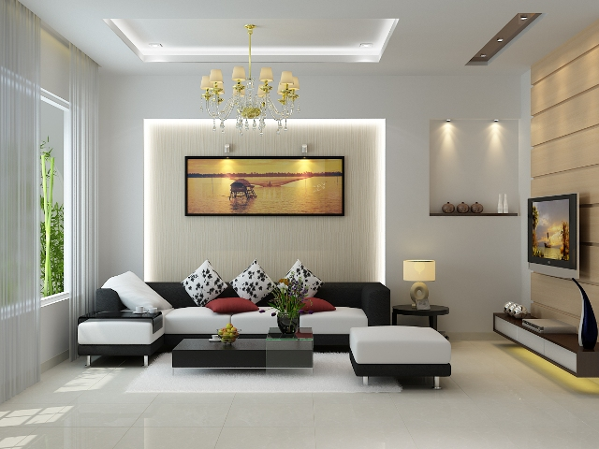

Introduction
My room will be like that
Notes:
But how to do

Slide 5
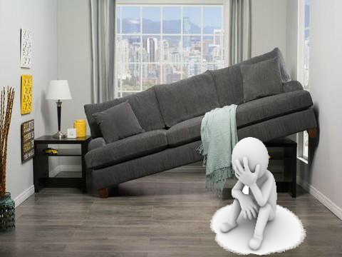

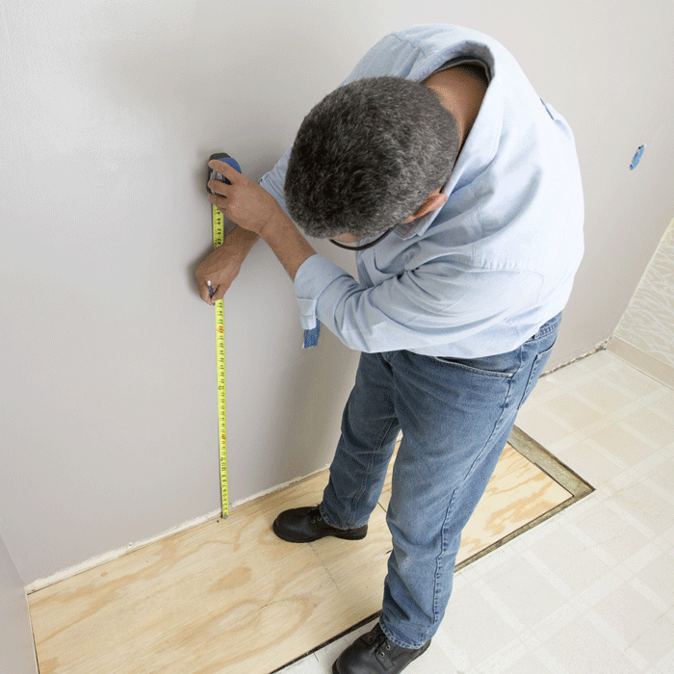
Introduction
Good idea???
Notes:
Waste of time to think about what will we buy?: Types, Colors, Dimension?
Waste of time to measure the dimension of the room.
What about if the furniture is too big in your room? Is it not your expected?
Too heavy to bring it to your homes.
Nowadays, the more technology is developed, the human life is more convenient. Once step into the era of technology, requirements for quality of life is increased.

Slide 6
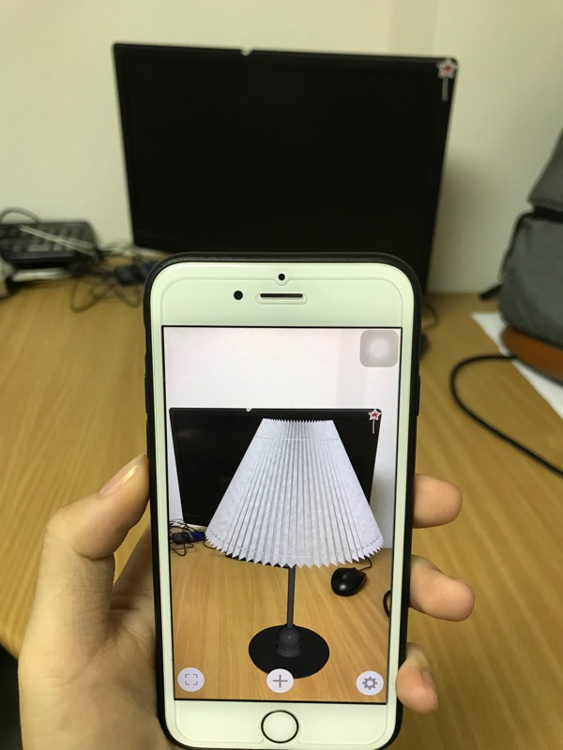
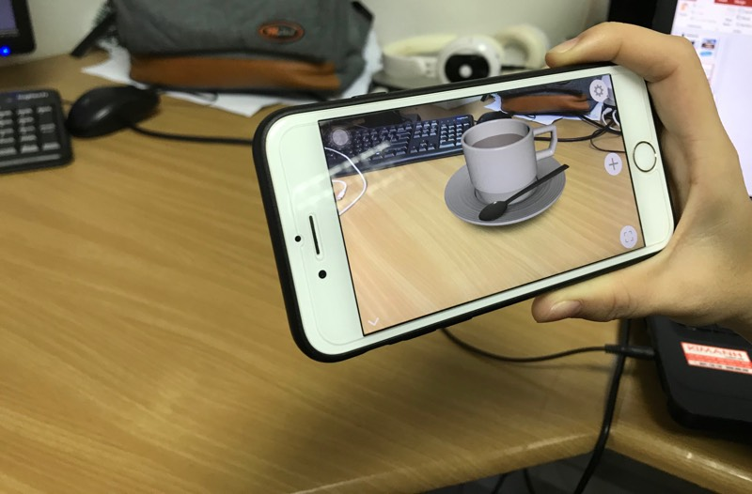
Project overview
Users
Plane
Real world
Interact
Camera
Phone
Open
Detect
Choose 3D models

Slide 7




Technologies
Swift 4.0
AR - ARKit library 1.5
Xcode 9.3
iOS 11.3 with A9 processor.
Realm database.
Blender 2.7

Slide 8
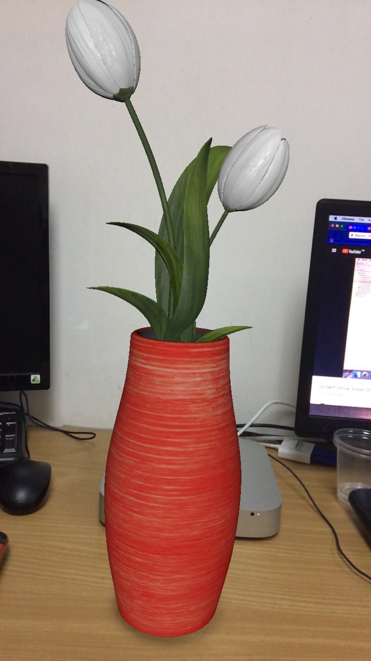
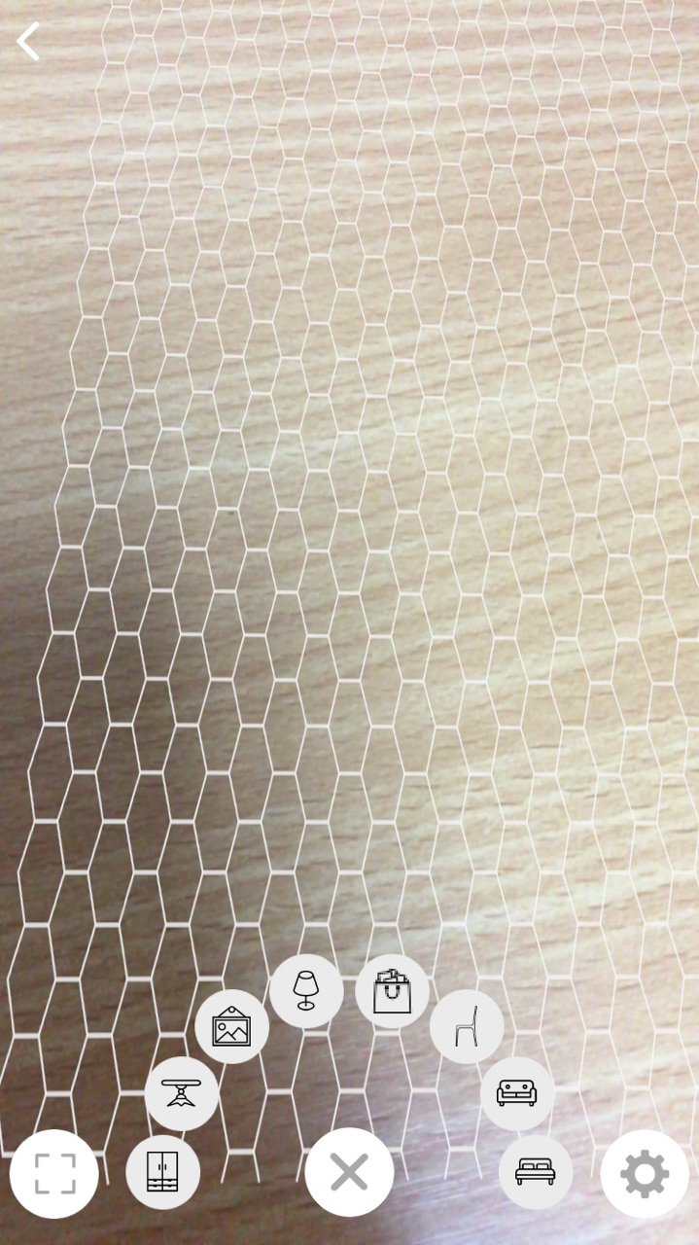
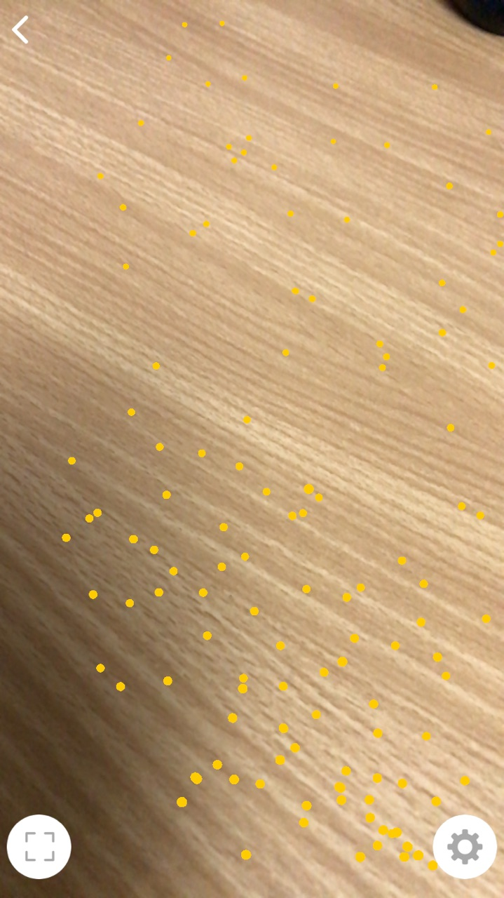
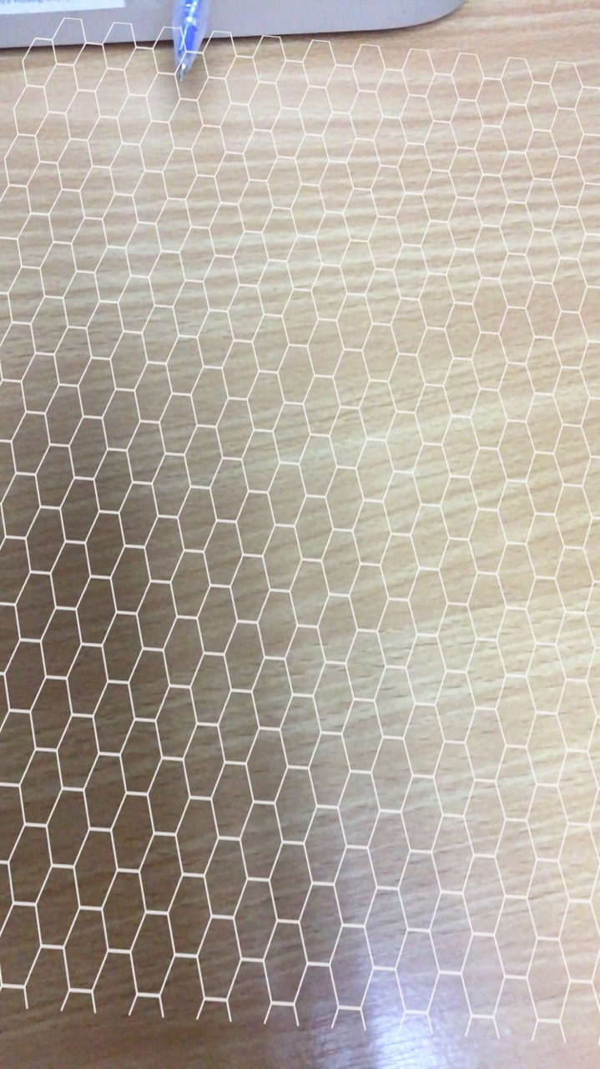
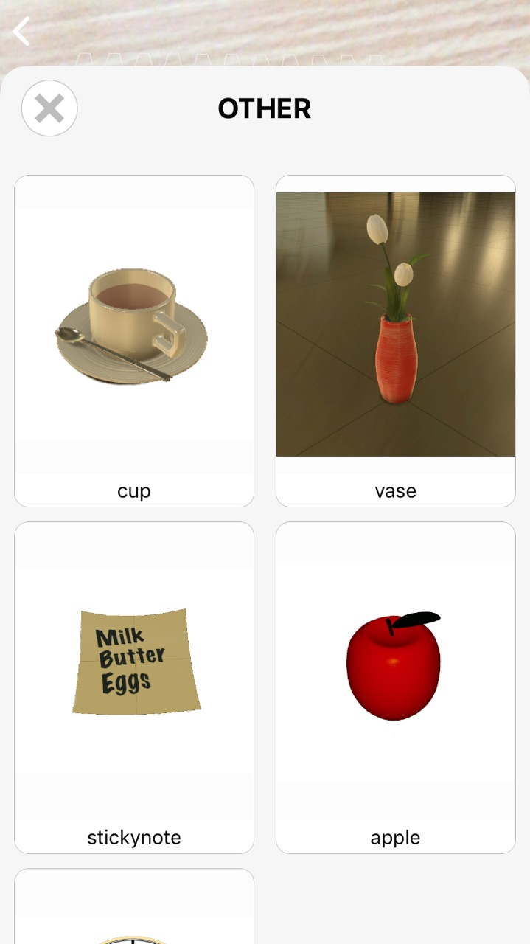
Implementation
Functionality:
- Detecting Plane
- Put 3D models -> Manipulate
- Take a picture/ record video -> Share
- Build 3D models.

Slide 9
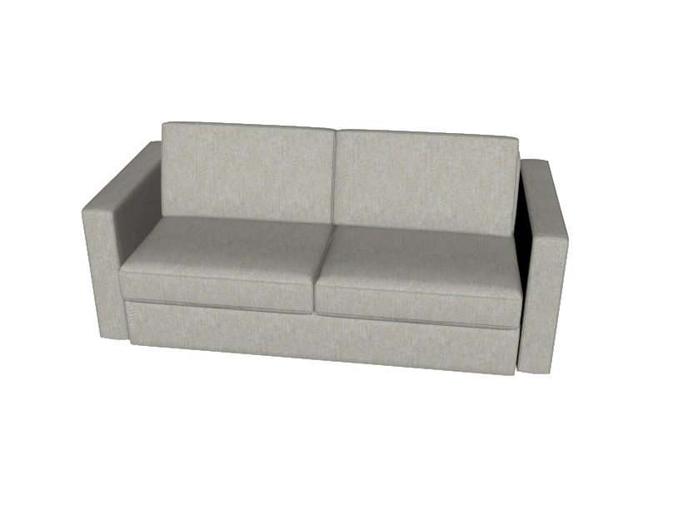

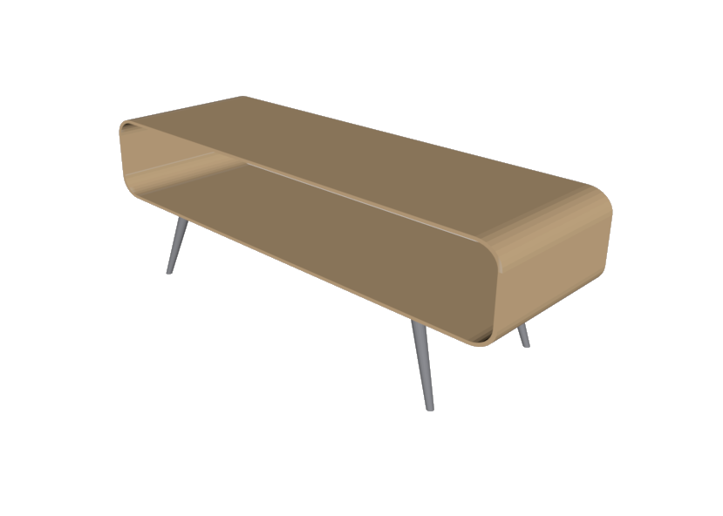

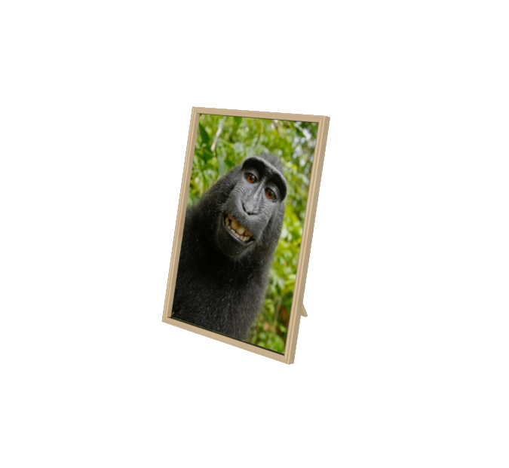
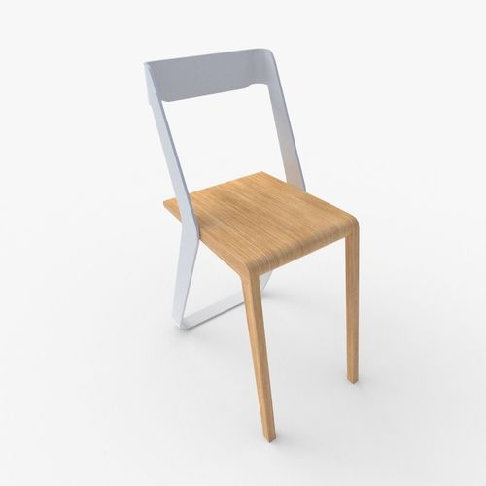
demonstration

Slide 10
demonstration

Slide 11
conclusion
Achieve results:
Create an application meets requirements.
New technologies: Swift 4.0, ARKit library
English.
Soft skill.

Slide 12
conclusion
Disadvantages:
Not work well on smooth surface such as shining wall, the mirror, …
Import new 3D models.

Slide 13
QUESTION & ANSWER

Slide 14
THANK YOU

