Slide 1
Hashes and Message Digest
Hash is also called message digest
One-way function: d=h(m) but no h’(d)=m
  Cannot find the message given a digest
Cannot find m₁, m₂, where d₁=d₂
Arbitrary-length message to fixed-length digest
Randomness
  any bit in the outputs ‘1’ half the time
  each output: 50% ‘1’ bits

Slide 2
Birthday Problem
How many people do you need so that the probability of having two of them share the same birthday is > 50% ?
Random sample of n birthdays (input) taken from k (365, output)
k^{n} total number of possibilities
(k)_{n}=k(k-1)…(k-n+1) possibilities without duplicate birthday
Probability of no repetition:
  p = (k)_{n}/k^{n} ≈ 1 - n(n-1)/2k
For k=366, minimum n = 23
n(n-1)/2 pairs, each pair has a probability 1/k of having the same output
n(n-1)/2k > 50% ➔ n>k^{1/2}

Slide 3
How Many Bits for Hash?
m bits, takes 2^{m/2} to find two with the same hash
64 bits, takes 2³² messages to search (doable)
Need at least 128 bits

Slide 4
Using Hash for Authentication
Alice to Bob: challenge r_{A}
Bob to Alice: MD(K_{AB}|r_{A})
Bob to Alice: r_{B}
Alice to Bob: MD(K_{AB}|r_{B})
Only need to compare MD results

Slide 5
Using Hash to Encrypt
One-time pad with K_{AB}
  Compute bit streams using MD, and K
    b₁=MD(K_{AB}), b_{i}=MD(K_{AB}|b_{i-1}), …
  ⊕ with message blocks
  Add a random 64 bit number (aka IV) b₁=MD(K_{AB}|IV), b_{i}=MD(K_{AB}|b_{i-1}), …

Slide 6
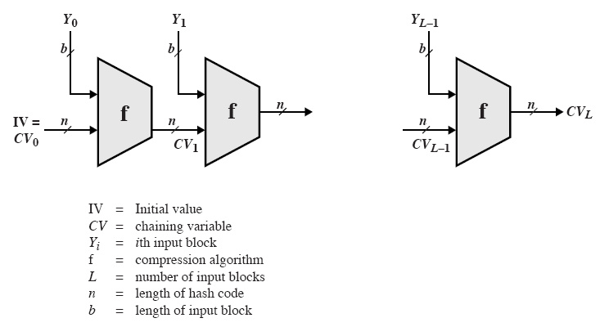
General Structure of Secure Hash Code
Iterative compression function
  Each f is collision-resistant, so is the resulting hashing

Slide 7

MD5: Message Digest Version 5
input Message
Output 128 bits Digest
Until recently the most widely used hash algorithm
  in recent times have both brute-force & cryptanalytic concerns
Specified as Internet standard RFC1321

Slide 8
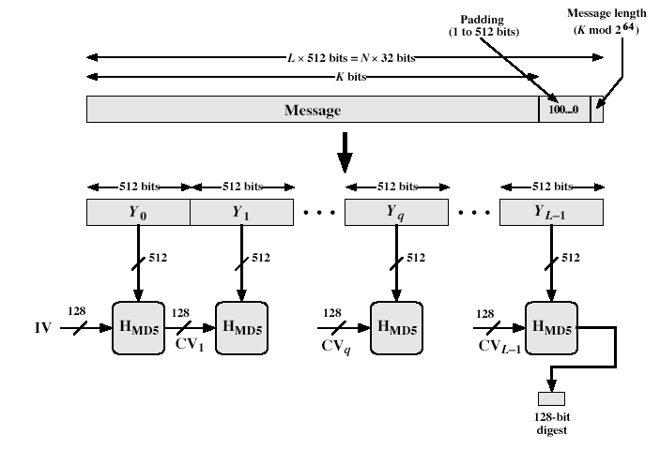
MD5 Overview
Notes:
Stallings Fig 12.1

Slide 9
MD5 Overview
Pad message so its length is 448 mod 512
Append a 64-bit original length value to message
Initialise 4-word (128-bit) MD buffer (A,B,C,D)
Process message in 16-word (512-bit) blocks:
  Using 4 rounds of 16 bit operations on message block & buffer
  Add output to buffer input to form new buffer value
Output hash value is the final buffer value
Notes:
The padded message is broken into 512-bit blocks, processed along with the buffer value using 4 rounds, and the result added to the input buffer to make the new buffer value. Repeat till run out of message, and use final buffer value as hash. nb. due to padding always have a full final block (with length in it).

Slide 10
Padding Twist
Given original message M, add padding bits “10*” such that resulting length is 64 bits less than a multiple of 512 bits.
Append (original length in bits mod 2⁶⁴), represented in 64 bits to the padded message
Final message is chopped 512 bits a block

Slide 11
MD5 Process
As many stages as the number of 512-bit blocks in the final padded message
Digest: 4 32-bit words: MD=A|B|C|D
Every message block contains 16 32-bit words: m₀|m₁|m₂…|m₁₅
  Digest MD₀ initialized to: A=01234567,B=89abcdef,C=fedcba98, D=76543210
  Every stage consists of 4 passes over the message block, each modifying MD
Each block 4 rounds, each round 16 steps

Slide 12
Processing of Block m_{i} - 4 Passes
m_{i}
MD_{i}
ABCD=f_{F}(ABCD,m_{i},T[1..16])
A
B
C
D
ABCD=f_{G}(ABCD,m_{i},T[17..32])
ABCD=f_{H}(ABCD,m_{i},T[33..48])
ABCD=f_{I}(ABCD,m_{i},T[49..64])
+
+
+
+
MD _{i+1}

Slide 13
Different Passes...
Each step t (0 <= t <= 79):
Input:
  m_{t} – a 32-bit word from the message
  With different shift every round
  T_{t} – int(2³² * abs(sin(i))), 0<i<65
  Provided a randomized set of 32-bit patterns, which eliminate any regularities in the input data
  ABCD: current MD
Output:
  ABCD: new MD

Slide 14
MD5 Compression Function
Each round has 16 steps of the form:
  a = b+((a+g(b,c,d)+X[k]+T[i])<<<s)
a,b,c,d refer to the 4 words of the buffer, but used in varying permutations
  note this updates 1 word only of the buffer
  after 16 steps each word is updated 4 times
where g(b,c,d) is a different nonlinear function in each round (F,G,H,I)
Notes:
Each round mixes the buffer input with the next "word" of the message in a complex, non-linear manner. A different non-linear function is used in each of the 4 rounds (but the same function for all 16 steps in a round). The 4 buffer words (a,b,c,d) are rotated from step to step so all are used and updated. g is one of the primitive functions F,G,H,I for the 4 rounds respectively. X[k] is the kth 32-bit word in the current message block. T[i] is the ith entry in the matrix of constants T. The addition of varying constants T and the use of different shifts helps ensure it is extremely difficult to compute collisions.

Slide 15
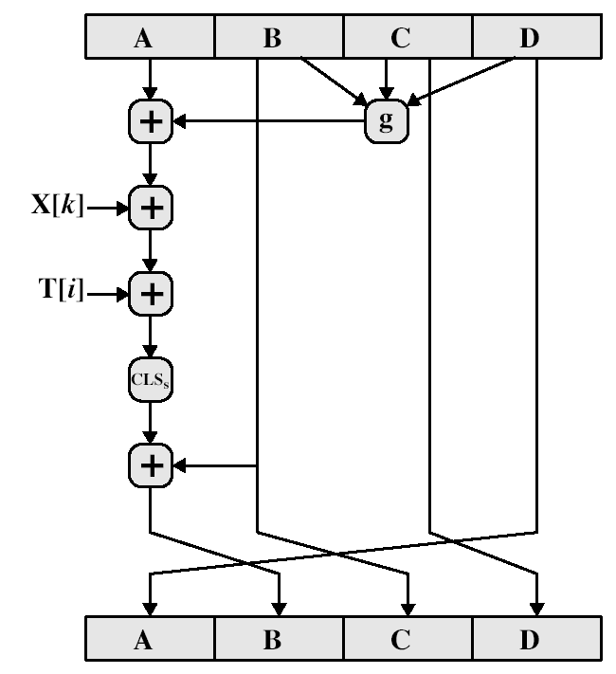
MD5 Compression Function

Slide 16
Functions and Random Numbers
F(x,y,z) == (x∧y)∨(~x ∧ z)
  selection function
G(x,y,z) == (x ∧ z) ∨(y ∧~ z)
H(x,y,z) == x⊕y⊕ z
I(x,y,z) == y⊕(x ∧ ~z)

Slide 17
Secure Hash Algorithm
Developed by NIST, specified in the Secure Hash Standard (SHS, FIPS Pub 180), 1993
SHA is specified as the hash algorithm in the Digital Signature Standard (DSS), NIST

Slide 18
General Logic
Input message must be < 2⁶⁴ bits
  not really a problem
Message is processed in 512-bit blocks sequentially
Message digest is 160 bits
SHA design is similar to MD5, but a lot stronger

Slide 19
Basic Steps
Step1: Padding
Step2: Appending length as 64 bit unsigned
Step3: Initialize MD buffer 5 32-bit words
Store in big endian format, most significant bit in low address
  A|B|C|D|E
  A = 67452301
  B = efcdab89
  C = 98badcfe
  D = 10325476
  E = c3d2e1f0

Slide 20
Basic Steps...
Step 4: the 80-step processing of 512-bit blocks – 4 rounds, 20 steps each.
Each step t (0 <= t <= 79):
  Input:
    W_{t} – a 32-bit word from the message
    K_{t} – a constant.
    ABCDE: current MD.
  Output:
    ABCDE: new MD.

Slide 21
Basic Steps...
Only 4 per-round distinctive additive constants
  0 <=t<= 19 K_{t} = 5A827999
  20<=t<=39 K_{t} = 6ED9EBA1
  40<=t<=59 K_{t} = 8F1BBCDC
  60<=t<=79 K_{t} = CA62C1D6

Slide 22
SHA-1 verses MD5
Brute force attack is harder (160 vs 128 bits for MD5)
Not vulnerable to any known cryptanalytic attacks (compared to MD4/5)
A little slower than MD5 (80 vs 64 steps)
  Both work well on a 32-bit architecture
Both designed as simple and compact for implementation
Notes:
Compare using the design goals listed earlier.
SHA-1 is probbaly the preferred hash function for new applications. Currently no problems are known with it.

Slide 23
Revised Secure Hash Standard
NIST have issued a revision FIPS 180-2
adds 3 additional hash algorithms
SHA-256, SHA-384, SHA-512
designed for compatibility with increased security provided by the AES cipher
structure & detail is similar to SHA-1
hence analysis should be similar
Notes:
See Stallings Tables 12.3 and 12.4 for details.

