Slide 1
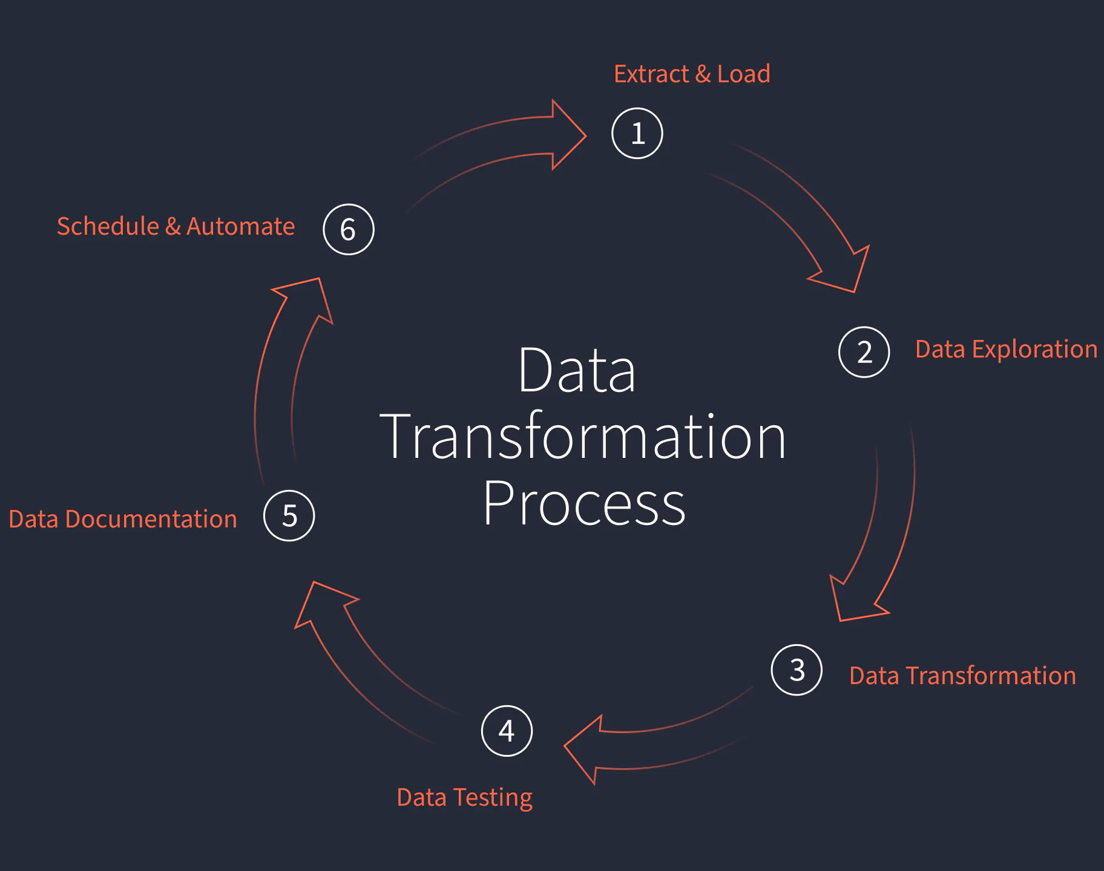

SSIS vs AWS Glue: Powering Your Data Transformation
As the digital landscape continues to evolve, the need for robust and efficient data transformation tools has become increasingly crucial. In this comprehensive comparison, we will explore the capabilities of SSIS (SQL Server Integration Services) and AWS Glue, two powerful players in the data integration arena, to help you make an informed decision on the best solution for your data transformation needs.
Tinitiate Technologies Pvt Ltd

Slide 2
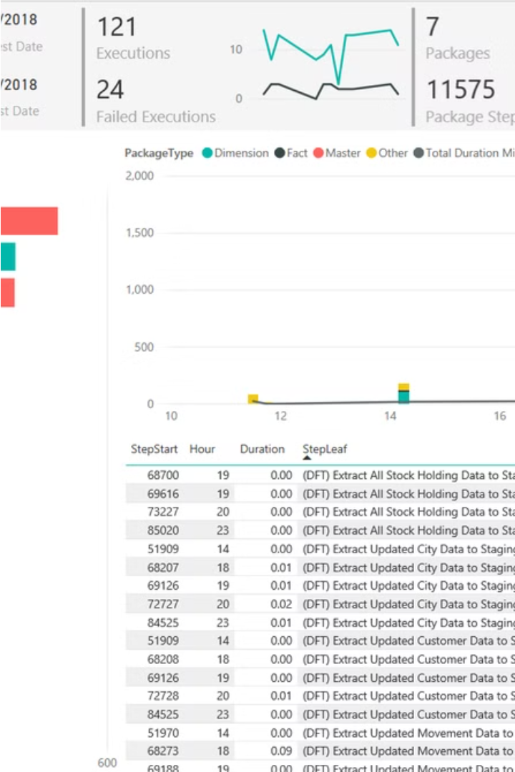
SSIS: Harnessing the Power of Microsoft's Ecosystem
SSIS is a comprehensive data integration platform developed by Microsoft, designed to seamlessly integrate with the broader Microsoft technology stack. It offers a user-friendly, visual interface that enables data engineers and ETL developers to design, build, and manage complex data transformation workflows. SSIS excels in its ability to connect to a wide range of data sources, including on-premises databases, cloud-based services, and a variety of file formats.

Slide 3
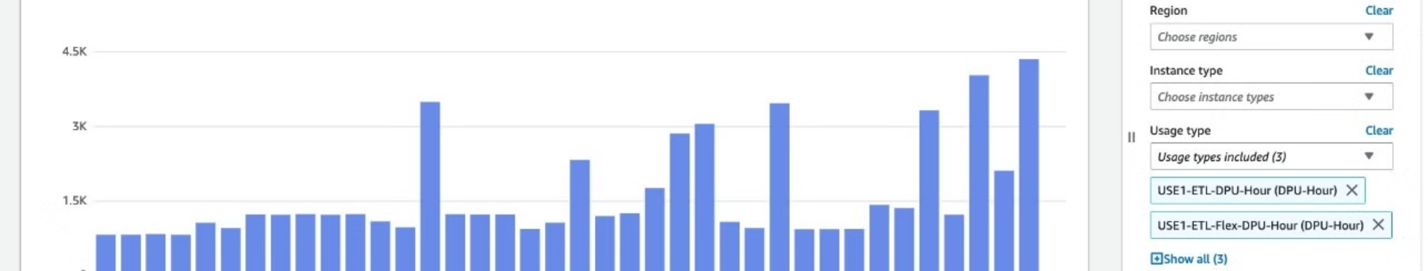
AWS Glue: Serverless Data Integration in the Cloud
AWS Glue, a fully managed, serverless data integration service from Amazon Web Services (AWS), provides a powerful and scalable platform for data transformation. Unlike SSIS, which is primarily tied to the Microsoft ecosystem, AWS Glue is cloud-native and can easily integrate with various AWS services, making it a compelling choice for organizations that have embraced the AWS cloud infrastructure.

Slide 4
Comparing SSIS and AWS Glue: Key Differences
Deployment and Maintenance
Scalability and Performance
Connectivity and Integration
SSIS is typically deployed on-premises, requiring infrastructure management and maintenance, while AWS Glue is a fully managed, serverless service, reducing the operational overhead for data engineers.
AWS Glue can automatically scale to handle large volumes of data and complex transformations, making it a more scalable solution compared to the on-premises nature of SSIS.
SSIS offers a wide range of built-in connectors for on-premises data sources, while AWS Glue seamlessly integrates with various AWS services and cloud-based data sources.

Slide 5
Pros and Cons: SSIS vs. AWS Glue
1
SSIS Pros
2
SSIS Cons
Extensive Microsoft ecosystem integration, robust data transformation capabilities, user-friendly visual interface, and familiarity for Microsoft-centric organizations.
On-premises deployment, limited scalability, and higher maintenance overhead compared to cloud-based solutions.
3
AWS Glue Pros
4
AWS Glue Cons
Serverless and scalable architecture, seamless integration with AWS services, reduced operational overhead, and increased flexibility for cloud-based deployments.
Learning curve for organizations unfamiliar with AWS, potential vendor lock-in for AWS-centric businesses, and limited on-premises data source integration compared to SSIS.

Slide 6
Why AWS Glue Shines in Data Transformation
Scalability and Performance
Cloud-native Integration
Reduced Operational Overhead
AWS Glue's serverless architecture allows it to automatically scale to handle large volumes of data and complex transformations, ensuring optimal performance and reliability.
As a fully managed AWS service, Glue seamlessly integrates with a wide range of AWS services, such as Amazon S3, Amazon Athena, and Amazon Redshift, simplifying the data transformation pipeline.
With AWS Glue, data engineers and ETL developers can focus on the core data transformation tasks, as the service handles the underlying infrastructure management and scaling, reducing the operational burden.

Slide 7
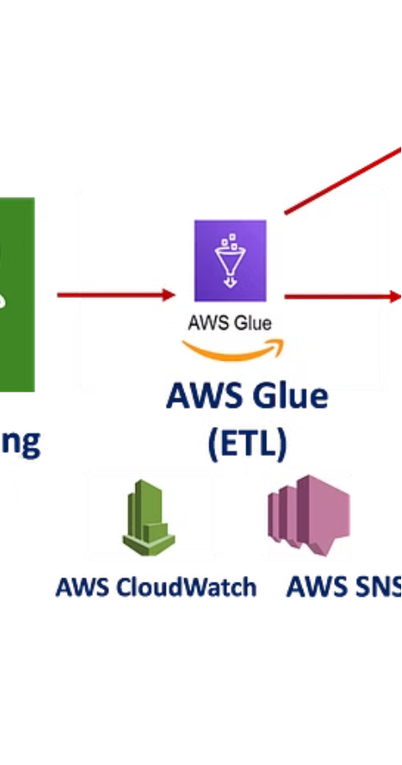
Optimizing Data Pipelines with AWS Glue
1
Data Discovery
AWS Glue's data catalog provides a centralized repository for cataloging and discovering data assets across your organization, simplifying the process of understanding and preparing data for transformation.
2
Data Transformation
The AWS Glue ETL engine allows you to build and run complex data transformation workflows using a familiar SQL-based syntax, ensuring consistent and reliable data transformations.
3
Data Orchestration
AWS Glue's scheduling and job management capabilities enable you to orchestrate and automate your data transformation pipelines, ensuring timely and consistent data delivery to downstream consumers.

Slide 8




Elevating Data Transformation with AWS Glue
Cloud-native
Scalable
Cost-effective
User-friendly
As a fully managed AWS service, Glue seamlessly integrates with the broader AWS ecosystem, reducing the need for on-premises infrastructure and simplifying the data transformation process.
AWS Glue's serverless architecture automatically scales to handle large volumes of data and complex transformations, ensuring high performance and reliability.
By eliminating the need for infrastructure management and scaling, AWS Glue can provide a more cost-effective solution for data transformation compared to traditional on-premises tools like SSIS.
AWS Glue's intuitive console and code-based approach to data transformation make it accessible to a wide range of data engineers and ETL developers, regardless of their technical expertise.

Slide 9




Unleashing the Power of AWS Glue
Comprehensive Data Catalog
Serverless ETL Workflows
Automated Orchestration
AWS Glue's data catalog provides a central repository for discovering and understanding your organization's data assets, simplifying the data transformation process.
The AWS Glue ETL engine enables you to build and run complex data transformation pipelines using a familiar SQL-based syntax, ensuring reliable and consistent data transformations.
AWS Glue's scheduling and job management capabilities allow you to automate and orchestrate your data transformation pipelines, ensuring timely and efficient data delivery to downstream consumers.

Slide 10

Embracing the Future of Data Transformation with AWS Glue
Cloud-native Advantage
Empowered Data Teams
As a fully managed, serverless service, AWS Glue provides a compelling alternative to on-premises data integration tools like SSIS, offering increased scalability, reduced operational overhead, and seamless integration with the broader AWS ecosystem.
By leveraging AWS Glue, data engineers and ETL developers can focus on building and optimizing data transformation pipelines, rather than managing the underlying infrastructure, enabling them to be more productive and impactful.
Competitive Edge
Adopting AWS Glue for your data transformation needs can provide your organization with a competitive edge, enabling faster time-to-insight, improved data quality, and the ability to scale data processing as your business demands evolve.

