Slide 1
Comparison of thermal resistance for different packaging and cooling concepts
Ueli Wendelspiess
Notes:
\\ZEUS\Projects\01_generic\Halbleiter-Module\Mold-Modul_Danfoss\Mold-Modul_A-Phase\Mechanik\CAD_30032015\104302_module_formed_asm.stp

Slide 2
Investigated configurations
TO-247 with Tgard TNC-4 cooled with extruded profile heatsink
TO-247 with Keratherm U90 cooled with extruded profile heatsink
Super-247 with Tgard TNC-4 cooled with extruded profile heatsink
Super-247 with Keratherm U90 cooled with extruded profile heatsink
IGBT Module with thermal paste and liquidPin or pinFin cooling
IGBT Module directly mounted (sintered, soldered, …) to pinFin cooler

Slide 3

Module stack
A_chip
chip
solder
A_copper1
copper
A_contact
ceramic
copper
paste
heatsink
T_junction
T_sink
T_case

Slide 4
Assumptions and simplifications
Heat transfer coefficient of the heat sink for IGBT-modules is assumed to be 20000 W/(m^2*K), estimated based on literature and simplified model comparisons with simulation results
For IGBT-modules, heat spreading in the sink is assumed to be equivalent to the heat spreading in a 3 mm aluminum layer.
Heat transfer coefficient of extruded profile heat sink (TO247 cooling) is estimated at 17000 W/(m^2*K), based on analytical model and comparison with simulation results
For the TO247, heat spreading in the sink is considered within the sink model
For the module calculations with different chip sizes, it was assumed that the area available for heat dissipation is unchanged (meaning lower fraction of area is covered by chip for small chips)
Analytical model assumes symmetric heat spreading

Slide 5
Data used for calculations
 | Solder | Copper | Ceramic | Aluminum | paste
Thermal conductivity [W/(m*K)] | 65 | 385 | 23 | 180 | 2.5
 | Chip area [mm^2] estimated | Area contact [mm^2] | Area heatsink [mm^2] | RthJC [K/W] | Thermal insulance foil [mm^2*K/W] | h heatsink [W/(m^2*K)]
TO-247 with Tgard TNC-4 | 39 | 140 | 350 | 0.35 | 193.6 | 17000
TO-247 with Keratherm U90 | 39 | 140 | 350 | 0.35 | 32.9 | 17000
Super-247 with Tgard TNC-4 | 66 | 190 | 350 | 0.2 | 193.6 | 17000
Super-247 with Keratherm U90 | 66 | 190 | 350 | 0.2 | 32.9 | 17000
Contact areas for TO247 and TO247Plus from https://www.infineon.com/dgdl/Infineon-Presentation+1200+V+discrete+IGBT+in+TO-247PLUS-PPT-v01_00-EN.pdf?fileId=5546d4625bd71aa0015bf5f3d6123c5c
TO-247: AIKW75N60CT
Super-247: AUIRGPS4070D0
Chip areas estimated
 | Chip area [mm^2] | Area first copper layer [mm^2] | Area second copper layer [mm^2] | Area heatsink [mm^2] | Thickness Solder [mm] | Thickness copper 1 [mm] | Thickness ceramic [mm] | Thickness copper 2 [mm] | Thickness paste [mm] | h heatsink [W/(m^2*K)]
Module with paste | 100 | 150 | 200 | 250 | 0.1 | 0.3 | 0.37 | 3 | 0.05 | 20000
Module directly bonded to heatsink | 100 | 150 | 200 | 250 | 0.1 | 0.3 | 0.37 | 0.3 | 0 | 20000

Slide 6
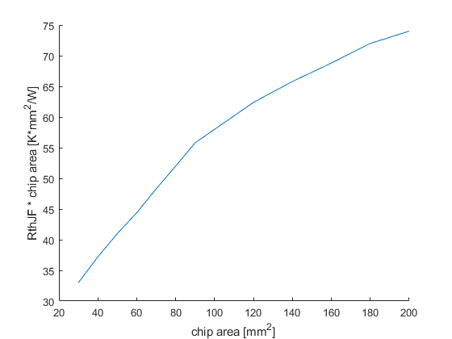
Results
 | Chip area [mm^2] | RthJF [K/W] | RthCF [K/W] | RthJF x chip area [K*mm^2/W]
TO-247 with Tgard TNC-4 | 39 | 2.01 | 1.66 | 78
TO-247 with Keratherm U90 | 39 | 0.86 | 0.51 | 34
Super247 with Tgard TNC-4 | 66 | 1.48 | 1.28 | 98
Super247 with Keratherm U90 | 66 | 0.63 | 0.43 | 42
Module with paste | 100 | 0.59 | NA | 59
Module with paste | 66 | 0.71 | NA | 47
Module with paste | 39 | 0.95 | NA | 37
Module directly bonded to heatsink | 100 | 0.46 | NA | 46
Module directly bonded to heatsink | 66 | 0.59 | NA | 39
Module directly bonded to heatsink | 39 | 0.81 | NA | 32
Dependency of thermal insulance of chip from chip size, calculated for module with paste (thermal insulance increases for large chips, because of smaller influence of heat spreading for large chips)
For the modules, the available area in the first copper layer is set to 150 mm^2, in the second copper layer to 200 mm^2 and on the heatsink to 250 mm^2 for all chip sizes

Slide 7
Results
Results if the ratio between the chip area and the available area on the heat sink is kept constant
(first copper layer 1.5 times the chip area, second copper layer 2 times chip area, heatsink 2.5 times chip area)
 | Chip area [mm^2] | RthJF [K/W] | RthJF x chip area [K*mm^2/W]
Module with paste | 100 | 0.59 | 59
Module with paste | 66 | 0.86 | 56
Module with paste | 39 | 1.43 | 55
Module directly bonded to heatsink | 100 | 0.46 | 46
Module directly bonded to heatsink | 66 | 0.67 | 44
Module directly bonded to heatsink | 39 | 1.08 | 42

Slide 8
observations
Smaller chips allow for higher power loss per area because of better heat spreading
For small chips, heat spreading has a strong influence, which means a thicker copper layer for spreading is beneficial to decrease the overall thermal resistance
For small chips the through plane thermal resistance is less important than for larger chips because of the strong heat spreading
For very large chips, heat spreading has little influence, therefore a thicker copper layer for spreading is not beneficial to decrease the overall thermal resistance
For large chips, the through plane thermal resistance is very important
With small chips, the total chip area needed to keep the chips at a given temperature for a given amount of power loss is smaller, which allows for higher ratios of chip area to dissipation area for a limited amount of space, which further decreases their thermal resistance

