Slide 1
Optimization cooling with extruded profile
Ueli Wendelspiess

Slide 2
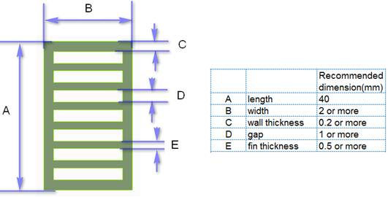
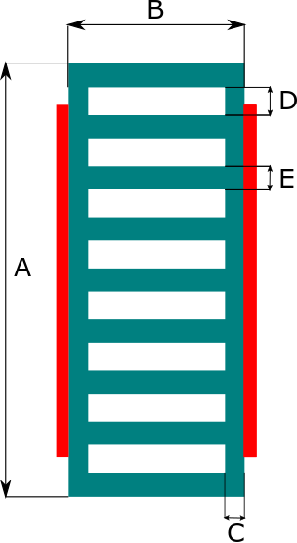
Goal
Optimization of cooling performance with an extruded profile heatsink
Geometrical limits:
Minimal channel dimension: «D» 1.05 mm (clearance for pollution particle VDA19/TECSA/ISO 16232 as well as manufacturing)
Aluminum wall thickness: «C» 0.2-1.5 mm (manufacturing)
Wall thickness «C» equal to fin thickness «E» (manufacturing)
Flow condition range
Cooling fluid: water ethylene 50-50%
Flowrate total minimal 3l/min
Flowrate total nominal 6l/min
Flowrate total maximal 10l/min
Four profiles in parallel → per profile 1/4 of total flowrate
Optimization Parameters
Wall thickness «C»
Profile thickness «B»
Channel thickness «D» as small as possible → 1.05mm
Height of entire profile «A» set at ~ 21 - 22 mm
Objective
Rth between contact area and fluid as small as possible
Thickness «B» of profile small
Manufacturing limits
Source: mail from inovance

Slide 3
Assumptions and simplifications
Assumed constant heat flux through contact surface
Spreading in the profile is considered in the outer wall, symmetric heatspreading is assumed
An analytical model of the heat sink is used for optimization

Slide 4
Validation of analytical model
Comparison with simulation \\zeus\Projects\Porsche_MissionE_BVD1_CSC1\BVD1\BVD138\BVD138-B01\06_Mechanics\03_Simulation\02_Thermisch\_Alternativ_Kühlkonzept_Strangpressprofil
depthChannel | widthChannel | thickWall | numChannel | flowrate per profile | Temperature fluid in | Contact resistance | Contact area
8.4 mm | 1.05 mm | 0.8 mm | 10 | 3.5 l/min | 72 °C | 2e-4 K*m/W | 200 mm^2
Power loss per chip | Temperature chip case [°C]; FEM-simulation | Temperature chip case [°C]; analytical model | error
30 W | 108.36 | 109.66 | 3.6 %
50 W | 130.70 | 134.77 | 6.9 %
Notes:
in the simulation the chip on one side of the profile is heated with 30W, the one on the opposite side with 50W. In the analytical model symmetric heating is assumed. Since the middle of the profile does not contribute much to the heat transfer, the error introduced by this can be assumed to be small.

Slide 5
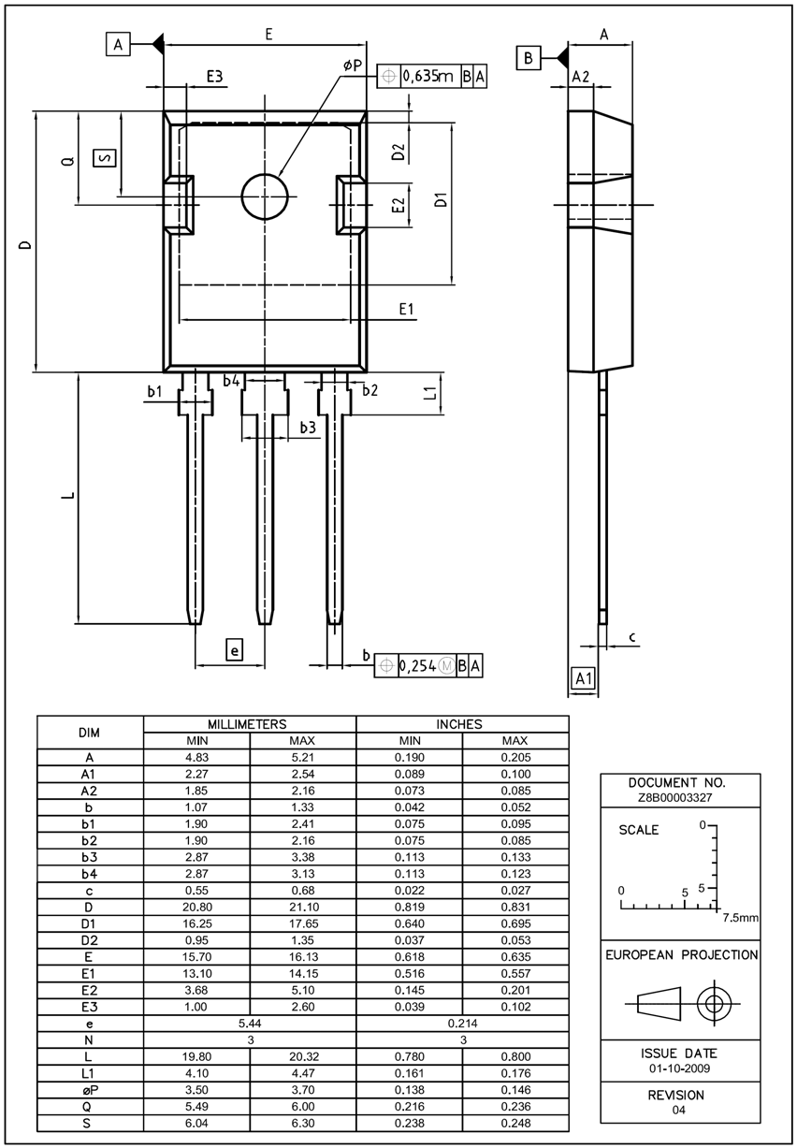

Heating arrangement
TO-247 geometry
E = 16mm
E1 = 13.7mm
D = 21mm
D1 = 16.9mm
9 TO-247 in series, 16.5 mm from center to center
Symmetrical arrangement, TO-247 on both sides of profile

Slide 6
Results of optimization, considerations
Thermal resistances are given with regard to the fluid inlet for all TO-247 (temperature increase of fluid already included in the Rth)
Thermal resistance values are from the aluminum surface in contact with the thermal pad to the fluid inlet temperature
The contact area is chosen to be 13.7mm x 16.9 mm as specified in the datasheet in the previous slides. The area of the hole is considered to be active for the heat dissipation into the water, due to the relatively small dimensions it can be assumed that the heat is spread over most of its area without too much loss.
For the thermal resistance through the pad however, the area reduced by the hole needs to be considered.
The resistances are calculated for the fluid properties resulting from 72°C inlet temperature and 40W loss per TO-247, for different operating conditions, different thermal resistances will result due to the changed fluid characteristics, however the differences can be assumed to be small, if the inlet temperature and the power losses stay in the same order of magnitude
For small flowrates below 1 L/min and high power losses, it might happen, that the wall temperature locally exceeds the boiling point of the water/glycol coolant. In that case the model is no longer valid and drastic changes in the heat transfer properties might occur.

Slide 7
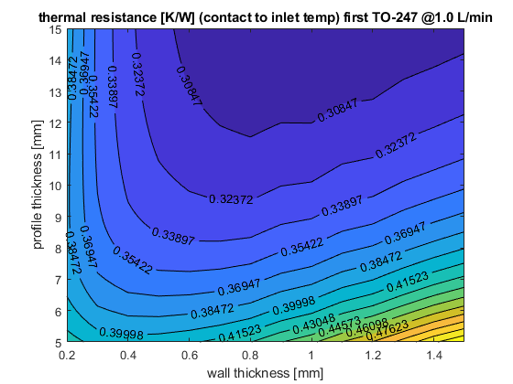
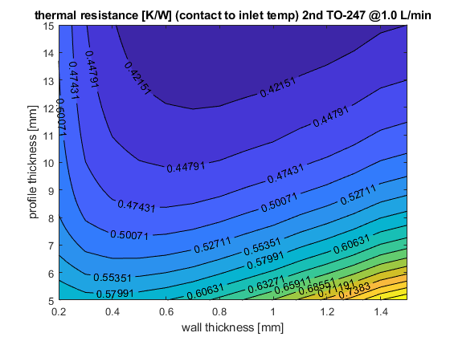
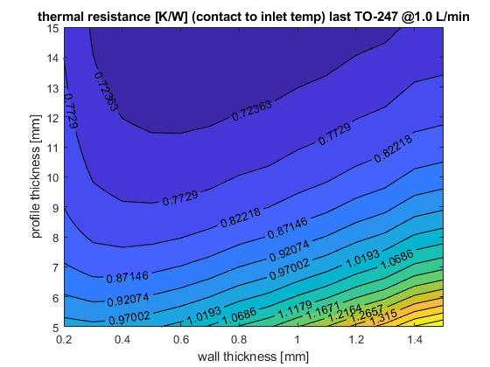

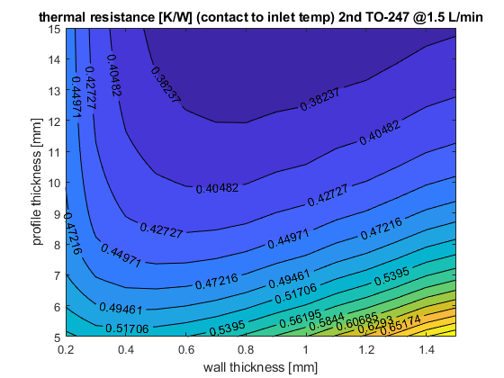
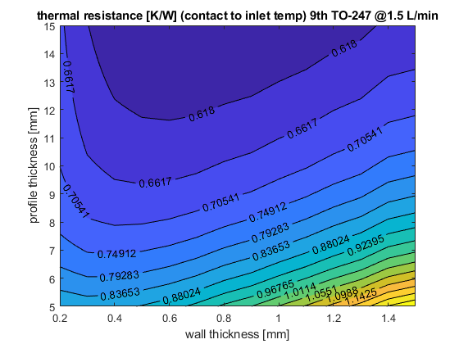
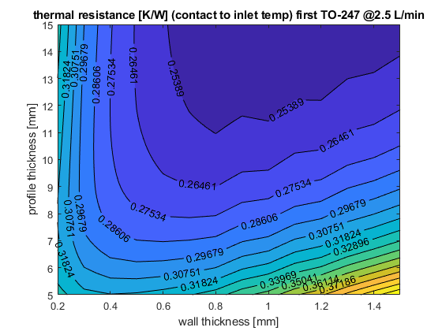

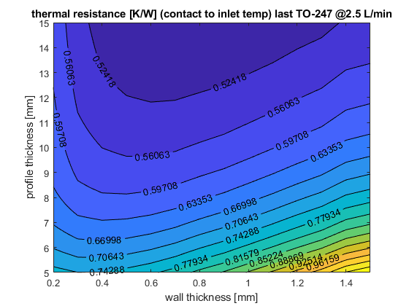
Results of optimization for different conditions
 | First TO-247 | 2nd TO-247 | 9th TO-247
1.0 L/min
1.5 L/min
2.5 L/min

Slide 8
Results
As expected, the most critical is the last TO-247 at lowest flowrate
At 1 L/min a profile thickness of 10mm seems to be a good compromise between thermal resistance and required space, further increase of the thickness has little influence
With decreasing flowrate the ideal wall thickness decreases as well
With increasing profile thickness, the ideal wall thickness increases as well
For the later TO-247, the ideal wall thickness decreases compared to the previous TO-247
These effects are due to reduced heat transfer rate into the fluid, which increases the fin efficiency
Since the last TO-247’s are the most critical, the wall thickness should be chosen to be ideal for them rather then the earlier ones
For a profile thickness of 10 mm the ideal wall thickness is at approximately 0.5mm, but since the thermal resistance is much more sensitive to too thin walls then to too thick walls, it is suggested to choose asomewhat thicker wall in the range of 0.6 to 0.7 mm

Slide 9
Results for chosen profile at different conditions
Thickness wall | Thickness profile | Width of channel | Number of channels | Height of profile | Contact area
0.6 mm | 10 mm | 1.05 mm | 13 | 22.05 mm | 13.7*16.9
 | Rth_fluid_loc_to_inlet @1L/min | Rth_contact_to_loc_fluid @1L/min | h_contact_to_Loc_fluid [W/^(m^2*K)] | Rth_contact_to_inlet @1L/min | Rth_fluid_loc_to_inlet @2L/min | Rth_contact_to_loc_fluid @2L/min | h_contact_to_Loc_fluid [W/^(m^2*K)] | Rth_contact_to_inlet @2L/min | Rth_fluid_loc_to_inlet @3L/min | Rth_contact_to_loc_fluid @3L/min | h_contact_to_Loc_fluid [W/^(m^2*K)] | Rth_contact_to_inlet @3L/min
TO-247 1 | 0.0164 | 0.306 | 14115 | 0.3224 | 0.0082 | 0.2675 | 16146 | 0.2757 | 0.0055 | 0.2472 | 17472 | 0.2527
TO-247 2 | 0.0493 | 0.3963 | 10899 | 0.4455 | 0.0246 | 0.3518 | 12277 | 0.3765 | 0.0164 | 0.3259 | 13253 | 0.3423
TO-247 3 | 0.0821 | 0.4265 | 10127 | 0.5087 | 0.0411 | 0.3853 | 11210 | 0.4263 | 0.0274 | 0.3591 | 12028 | 0.3864
TO-247 4 | 0.1151 | 0.4433 | 9743 | 0.5584 | 0.0575 | 0.4062 | 10633 | 0.4636 | 0.0383 | 0.3808 | 11342 | 0.4191
TO-247 5 | 0.1482 | 0.4539 | 9516 | 0.6021 | 0.0739 | 0.4207 | 10266 | 0.4947 | 0.0493 | 0.3967 | 10888 | 0.4459
TO-247 6 | 0.1813 | 0.4611 | 9367 | 0.6425 | 0.0904 | 0.4315 | 10009 | 0.5219 | 0.0602 | 0.4088 | 10565 | 0.4691
TO-247 7 | 0.2146 | 0.4663 | 9262 | 0.6808 | 0.1069 | 0.4398 | 9821 | 0.5467 | 0.0712 | 0.4185 | 10320 | 0.4897
TO-247 8 | 0.2479 | 0.47 | 9190 | 0.718 | 0.1235 | 0.4463 | 9678 | 0.5697 | 0.0822 | 0.4264 | 10129 | 0.5086
TO-247 9 | 0.2814 | 0.4728 | 9135 | 0.7543 | 0.14 | 0.4516 | 9564 | 0.5916 | 0.0932 | 0.4329 | 9977 | 0.5261

Slide 10
Results for chosen profile at different conditions
Thickness wall | Thickness profile | Width of channel | Number of channels | Height of profile | Contact area
0.6 mm | 10 mm | 1.05 mm | 13 | 22.05 mm | 13.7*16.9
The added increase in thermal resistance for the subsequent TO-247’s is due to the developing thermal boundary layer, that is not developed to the same extent at the first TO-247)

Slide 11
Results for chosen profile at different conditions
Thickness wall | Thickness profile | Width of channel | Number of channels | Height of profile | Contact area
0.5 mm | 8 mm | 1.05 mm | 14 | 22.2 mm | 13.7*16.9
 | Rth_fluid_loc_to_inlet @1L/min | Rth_contact_to_loc_fluid @1L/min | h_contact_to_Loc_fluid [W/^(m^2*K)] | Rth_contact_to_inlet @1L/min | Rth_fluid_loc_to_inlet @2L/min | Rth_contact_to_loc_fluid @2L/min | h_contact_to_Loc_fluid [W/^(m^2*K)] | Rth_contact_to_inlet @2L/min | Rth_fluid_loc_to_inlet @3L/min | Rth_contact_to_loc_fluid @3L/min | h_contact_to_Loc_fluid [W/^(m^2*K)] | Rth_contact_to_inlet @3L/min
TO-247 1 | 0.0164 | 0.3275 | 13188 | 0.344 | 0.0082 | 0.2832 | 15251 | 0.2914 | 0.0055 | 0.26 | 16612 | 0.2655
TO-247 2 | 0.0493 | 0.4335 | 9963 | 0.4828 | 0.0246 | 0.3806 | 11348 | 0.4053 | 0.0164 | 0.3503 | 12330 | 0.3667
TO-247 3 | 0.0821 | 0.4705 | 9180 | 0.5526 | 0.0411 | 0.4202 | 10279 | 0.4613 | 0.0274 | 0.3891 | 11100 | 0.4165
TO-247 4 | 0.1151 | 0.4915 | 8788 | 0.6066 | 0.0575 | 0.4454 | 9697 | 0.5029 | 0.0383 | 0.4149 | 10410 | 0.4532
TO-247 5 | 0.1482 | 0.5051 | 8551 | 0.6533 | 0.0739 | 0.4633 | 9322 | 0.5372 | 0.0493 | 0.4339 | 9954 | 0.4832
TO-247 6 | 0.1813 | 0.5144 | 8396 | 0.6958 | 0.0904 | 0.4767 | 9060 | 0.5671 | 0.0602 | 0.4487 | 9626 | 0.5089
TO-247 7 | 0.2146 | 0.5212 | 8287 | 0.7358 | 0.1069 | 0.487 | 8869 | 0.594 | 0.0712 | 0.4606 | 9377 | 0.5318
TO-247 8 | 0.2479 | 0.5262 | 8208 | 0.7741 | 0.1235 | 0.4953 | 8720 | 0.6188 | 0.0822 | 0.4703 | 9184 | 0.5525
TO-247 9 | 0.2814 | 0.53 | 8149 | 0.8114 | 0.14 | 0.502 | 8604 | 0.6421 | 0.0932 | 0.4784 | 9028 | 0.5716

Slide 12
Results for chosen profile at different conditions
Thickness wall | Thickness profile | Width of channel | Number of channels | Height of profile | Contact area
0.5 mm | 8 mm | 1.05 mm | 14 | 22.2 mm | 13.7*16.9
The added increase in thermal resistance for the subsequent TO-247’s is due to the developing thermal boundary layer, that is not developed to the same extent at the first TO-247)

Slide 13
Results for chosen profile at different conditions
Thickness wall | Thickness profile | Width of channel | Number of channels | Height of profile | Contact area
0.8 mm | 8 mm | 1.05 mm | 12 | 23 mm | 13.7*16.9
 | Rth_fluid_loc_to_inlet @1L/min | Rth_contact_to_loc_fluid @1L/min | h_contact_to_Loc_fluid [W/^(m^2*K)] | Rth_contact_to_inlet @1L/min | Rth_fluid_loc_to_inlet @2L/min | Rth_contact_to_loc_fluid @2L/min | h_contact_to_Loc_fluid [W/^(m^2*K)] | Rth_contact_to_inlet @2L/min | Rth_fluid_loc_to_inlet @3L/min | Rth_contact_to_loc_fluid @3L/min | h_contact_to_Loc_fluid [W/^(m^2*K)] | Rth_contact_to_inlet @3L/min
TO-247 1 | 0.0164 | 0.3330 | 12972 | 0.3494 | 0.0082 | 0.2861 | 15095 | 0.2943 | 0.0055 | 0.2620 | 16483 | 0.2675
TO-247 2 | 0.0493 | 0.4499 | 9599 | 0.4992 | 0.0246 | 0.3901 | 11073 | 0.4147 | 0.0164 | 0.3570 | 12098 | 0.3734
TO-247 3 | 0.0821 | 0.4941 | 8741 | 0.5763 | 0.0411 | 0.4345 | 9939 | 0.4756 | 0.0274 | 0.3994 | 10813 | 0.4268
TO-247 4 | 0.1151 | 0.5205 | 8298 | 0.6356 | 0.0575 | 0.4639 | 9311 | 0.5214 | 0.0383 | 0.4285 | 10081 | 0.4668
TO-247 5 | 0.1482 | 0.5382 | 8026 | 0.6863 | 0.0739 | 0.4853 | 8900 | 0.5592 | 0.0493 | 0.4504 | 9590 | 0.4996
TO-247 6 | 0.1813 | 0.5507 | 7843 | 0.7320 | 0.0904 | 0.5017 | 8609 | 0.5921 | 0.0602 | 0.4677 | 9234 | 0.5280
TO-247 7 | 0.2146 | 0.5599 | 7714 | 0.7745 | 0.1069 | 0.5148 | 8390 | 0.6217 | 0.0712 | 0.4820 | 8961 | 0.5532
TO-247 8 | 0.2479 | 0.5669 | 7618 | 0.8149 | 0.1235 | 0.5254 | 8221 | 0.6488 | 0.0822 | 0.4939 | 8746 | 0.5760
TO-247 9 | 0.2814 | 0.5723 | 7546 | 0.8538 | 0.1400 | 0.5341 | 8086 | 0.6741 | 0.0932 | 0.5040 | 8570 | 0.5971

Slide 14
Results for chosen profile at different conditions
Thickness wall | Thickness profile | Width of channel | Number of channels | Height of profile | Contact area
0.8 mm | 8 mm | 1.05 mm | 12 | 23 mm | 13.7*16.9

Slide 15
Results for chosen profile at different conditions
Thickness wall | Thickness profile | Width of channel | Number of channels | Height of profile | Contact area | Number of Bridges
0.5 mm | 8 mm | 1.05 mm | 14 | 22.2 mm | 13.7*16.9 | 4
 | Rth_fluid_loc_to_inlet @1L/min | Rth_contact_to_loc_fluid @1L/min | h_contact_to_Loc_fluid [W/^(m^2*K)] | Rth_contact_to_inlet @1L/min | Rth_fluid_loc_to_inlet @2L/min | Rth_contact_to_loc_fluid @2L/min | h_contact_to_Loc_fluid [W/^(m^2*K)] | Rth_contact_to_inlet @2L/min | Rth_fluid_loc_to_inlet @3L/min | Rth_contact_to_loc_fluid @3L/min | h_contact_to_Loc_fluid [W/^(m^2*K)] | Rth_contact_to_inlet @3L/min
TO-247 1 | 0.0164 | 0.2858 | 15112 | 0.3022 | 0.0082 | 0.2475 | 17449 | 0.2557 | 0.0055 | 0.2276 | 18977 | 0.2331
TO-247 2 | 0.0493 | 0.3776 | 11438 | 0.4269 | 0.0246 | 0.3323 | 12997 | 0.3569 | 0.0164 | 0.3059 | 14118 | 0.3224
TO-247 3 | 0.0821 | 0.4080 | 10585 | 0.4902 | 0.0411 | 0.3664 | 11787 | 0.4075 | 0.0274 | 0.3397 | 12714 | 0.3671
TO-247 4 | 0.1151 | 0.4244 | 10178 | 0.5395 | 0.0575 | 0.3877 | 11141 | 0.4451 | 0.0383 | 0.3619 | 11934 | 0.4002
TO-247 5 | 0.1482 | 0.4343 | 9944 | 0.5825 | 0.0739 | 0.4023 | 10737 | 0.4762 | 0.0493 | 0.3781 | 11425 | 0.4273
TO-247 6 | 0.1813 | 0.4409 | 9797 | 0.6222 | 0.0904 | 0.4129 | 10460 | 0.5033 | 0.0602 | 0.3904 | 11064 | 0.4506
TO-247 7 | 0.2146 | 0.4454 | 9698 | 0.6599 | 0.1069 | 0.4210 | 10260 | 0.5279 | 0.0712 | 0.4001 | 10796 | 0.4713
TO-247 8 | 0.2479 | 0.4485 | 9630 | 0.6965 | 0.1235 | 0.4272 | 10110 | 0.5507 | 0.0822 | 0.4079 | 10589 | 0.4901
TO-247 9 | 0.2814 | 0.4508 | 9581 | 0.7322 | 0.1400 | 0.4322 | 9994 | 0.5722 | 0.0932 | 0.4143 | 10424 | 0.5075
Modified profile with 4 additional bridged dividing the channels into 5 sub-channels
Bridges are modeled with ideal fin efficiency (non-conservative assumption)
Different increase in mean temperature for the individual sub-channel is not considered (non-conservative assumption)
→ thermal resistance will be somewhat higher than calculated

Slide 16
Results for chosen profile at different conditions
Thickness wall | Thickness profile | Width of channel | Number of channels | Height of profile | Contact area | Number of Bridges
0.5 mm | 8 mm | 1.05 mm | 14 | 22.2 mm | 13.7*16.9 | 4
Modified profile with 4 additional bridged dividing the channels into 5 sub-channels
Bridges are modeled with ideal fin efficiency (non-conservative assumption)
Different increase in mean temperature for the individual sub-channel is not considered (non-conservative assumption)
→ thermal resistance will be somewhat higher than calculated

