Slide 1
Examination of the influence of heat spreading effect for the example of «Mold Modul 104302»
Ueli Wendelspiess – 09.11.2017
Notes:
\\ZEUS\Projects\01_generic\Halbleiter-Module\Mold-Modul_Danfoss\Mold-Modul_A-Phase\Mechanik\CAD_30032015\104302_module_formed_asm.stp

Slide 2
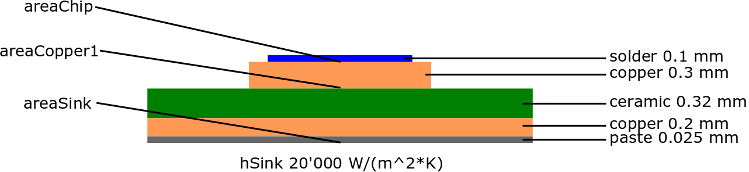
Geometry definition and data for examined modul
 | solder | copper | ceramic | paste
Thermal conductivity [W/(m*K)] | 65 | 385 | 23 | 2.5
areaChip | areaCopper1
38.9 mm^2 | 62 mm^2
Geometry data from step file
\\ZEUS\Projects\01_generic\Halbleiter-Module\Mold-Modul_Danfoss\Mold-Modul_A-Phase\Mechanik\CAD_30032015\104302_module_formed_asm.stp

Slide 3
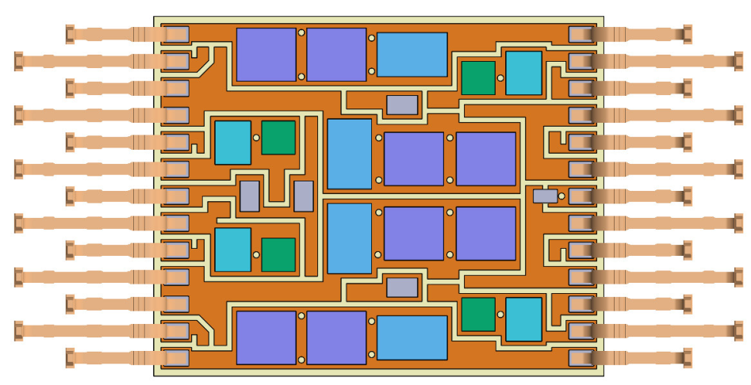
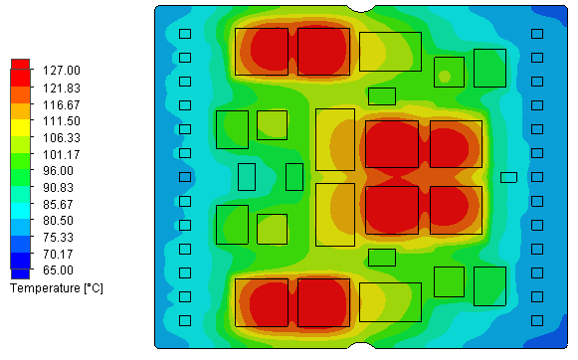
Considered areas for spreading
areaCopper1
areaChip
2 x areaChip (estimated area effective for heat
dissipation to fluid, limited by neighboring heat sources)

Slide 4
Assumptions and simplifications
Spreading effects in heat sink are neglected (spreading primarily occurs in layers with good thermal conductivity early on in the heat path)
Uniform heat generation on chip area
Heat transfer coefficient of heat sink estimated at 20’000 W/(m^2*K) from looking at different simulation / measurement documents
The thickness of the heat transfer paste is calculated to match the contact resistance of 1.00E-05 K*m^2/W used in the simulation
The formulas used assume axisymmetric heat spreading:
Lee et al: "Constriction/Spreading Resistance Model for Electronic Packaging“
Simons: "Simple Formulas for Estimating Thermal Spreading Resistance“
Ying et al: "A HEAT SPREADING RESISTANCE MODEL FOR ANISOTROPIC THERMAL CONDUCTIVITY MATERIALS IN ELECTRONIC PACKAGING"

Slide 5
Results from simulation for comparison
\\ZEUS\Projects\01_generic\Halbleiter-Module\Mold-Modul_Danfoss\Mold-Modul_A-Phase\Simulation_und_Messung_thermisch\thermisch_104302.pdf
Power loss of IGBT: 40W
Temperature difference of IGBT to fluid: 118C – 65C = 53K
Resulting Rth: 53K / 40W = 1.325 K/W

Slide 6
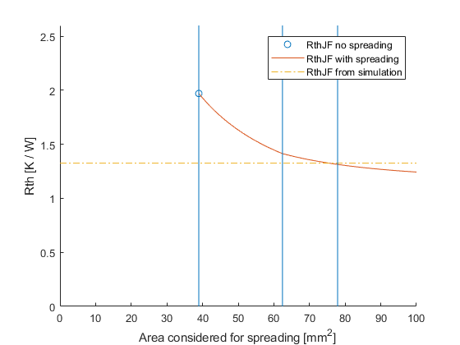
Results
areaCopper1
areaChip
2x areaChip
 | simulation | calculated without spreading | calculated with spreading over 2 times the chip area
RthJF [K / W] | 1.325 | 1.971 | 1.313
error compared to simulation | - | 48.8 % | 0.8%

Slide 7
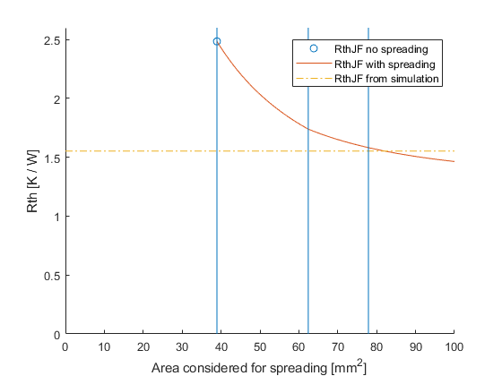
Results
TIM-layer increased from 0.025mm to 0.075mm (3.00E-05 K*m^2/W)
An increased thermal insulance after the spreading layer increases the effect of heat spreading
The error from neglecting the heat spreading increases considerably
The heat effectively spreads over a larger area (thus the increased error when considering 2 times chip area)
A lower performing heat sink has the same effect
areaCopper1
areaChip
2x areaChip
 | simulation | calculated without spreading | calculated with spreading over 2 times the chip area
RthJF [K / W] | 1.5525 | 2.484 | 1.5912
error compared to simulation | - | 60.0 % | 2.5%

Slide 8
Things to consider
The influence of heat spreading becomes higher with decreasing chip area
The influence of heat spreading becomes higher with decreasing heat transfer coefficient of the heat sink
Heat spreading is most effective early on in the heat path (spreading layer as close to heat source as possible), this is particularly pronounced if insulating layers are present (eg. Isofoil or fr4 layers in pcbs)

Slide 9
Conlcusions
Heat spreading has a significant influence for components with small chip areas, as well as for low performing heatsinks
Effect has to be taken into account if meaurements or simulations are used to derive the heat transfer coefficient of heat sinks, otherwise the performance of a heat sink will get overestimated for larger chips and denser arrangements of components on the heat sink
If the heat transfer coefficient of the sink is known (with regards to an infinite area), neglecting the heat spreading influence in calculations can lead to a significant overestimation of the junction temperature

