Slide 1
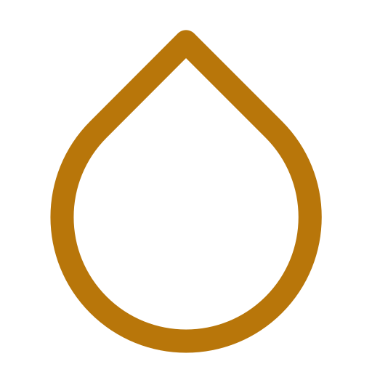
HYDROWARM
Warm the person. Not the room.
A vision for where HydroWarm goes next — for my co-developer and TU Delft Industrial Design partner.
LEKKERKERK, NETHERLANDS · JULY 2026 · CONFIDENTIAL

Slide 2


THE ORIGIN
Winter 2022. Cold feet, working alone at a desk in Lekkerkerk.
The moment
That gap became HydroWarm
A hot water bottle under cold feet, a blanket over the lap. It worked perfectly — natural warmth, no electricity, no noise.
Two co-inventors: me, and a TU Delft Industrial Design graduate friend who joined as co-developer — branding and commercialisation expertise, and access to TU Delft's student project network for CAD and prototyping.
A search for a product built specifically for this turned up nothing — not one hot water foot warmer designed for the home office, anywhere in the EU market.
The mission hasn't moved since:
Warm the person. Not the room.
HydroWarm · Warm the person. Not the room.
02

Slide 3



THE PROBLEM
Every existing option fails a different way.
Electric foot warmers
Cherry-pit warmers
Heated smart shoes
Corded, resistive-wire heat — an overheat risk, and you're tethered to the wall.
20–40 minutes of warmth, then cold — up to 16 microwave trips across an 8-hour working day.
USD 200+ for embedded electronics most desk workers don't need — a gadget, not a comfort product.
Not one of them is designed to sit at a desk all day. HydroWarm is.
HydroWarm · Warm the person. Not the room.
03

Slide 4

THE MISSION
Warm the person. Not the room.
Heating an entire room to warm one pair of feet is wasteful — of energy, and of money. HydroWarm puts the warmth exactly where the body needs it, so the room doesn't have to work at all. That's the sustainability story, and it's also just a better product.
HydroWarm · Warm the person. Not the room.
04

Slide 5
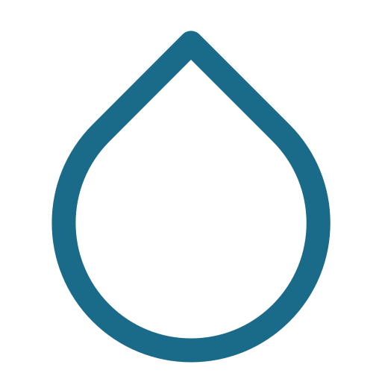



THE PRODUCT FAMILY
Three tiers, one deliberate launch order.
Comfort proves the core technology first. Charge adds precision once the foundation holds. Boot — the original idea — arrives last, once its hot-water certification is worked out.
01
02
03
Comfort
Charge
Boot
LAUNCHING FIRST
YEAR 1–2
YEAR 2–3
Single-zone PCM cartridge + induction plate. Simplest build, proves the core tech.
Dual-zone, magnetic-click cartridges, aluminium frame. The premium tier.
Hot water + the original Arch-Hex Grid sole. The flagship, engineered properly.
€34–39
€59 / €69
€39 / €54
HydroWarm · Warm the person. Not the room.
05

Slide 6
PRODUCT 1 OF 3
HydroWarm Comfort
HW-COMFORT-SYS · LAUNCHING FIRST
A single-zone PCM gel cartridge sits in a ribbed polypropylene tray, recharged by an induction plate under the desk. No cords to the foot, no resistive element — the phase-change gel self-limits its own temperature.
Cartridge
Single zone, heel to toe
€34–39
Access
Velcro flap, grey minky fabric
retail price
Temperature
38–40°C, self-regulating
Refill
2-pack, €9
Month 5–7
launch window
HydroWarm · Warm the person. Not the room.
06

Slide 7
PRODUCT 2 OF 3
HydroWarm Charge
HW-CHARGE-SGL/DBL-SYS · YEAR 1–2
Dual-zone cartridges click into an aluminium frame by neodymium magnet — tool-free, satisfying, precise. A translucent brand window lets the warm amber gel show through as it heats.
Zones
Independent heel + toe
€59 / €69
Frame
Aluminium 6061, load + heat path
retail price
Retention
Magnetic click, 3–5N engage
Refill
4-pack, €19
Single / Double
launch window
HydroWarm · Warm the person. Not the room.
07

Slide 8
PRODUCT 3 OF 3
HydroWarm Boot
HW-BOOT-001/002 · YEAR 2–3
The idea that started HydroWarm, engineered properly: hot water held over an original Arch-Hex Grid sole that keeps the channel open under standing load. Pro adds a side zip for mobility-limited users.
Sole
Arch-Hex Grid, food-grade PP
€39 / €54
Load rating
Tested to 150kg standing
retail price
Lining
Sherpa fleece + TPR bladder
Patent
Patent 1 — filing in progress
Standard / Pro
launch window
HydroWarm · Warm the person. Not the room.
08

Slide 9

WHY NOW
The desk-warming market, honestly compared.
PRODUCT
THE CATCH
Beurer FW20
Corded, overheat risk
€35–45
12–16
Medisana FWS
Reviewers: barely warm enough
€30–40
microwave trips a cherry-pit warmer needs across one 8-hour working day.
Decathlon Bouillotte
12–16 microwave trips / day
€29.99
HydroWarm eliminates every one of them.
Digitsole heated shoe
Complex tech, wrong product
$200+
HydroWarm · Warm the person. Not the room.
09

Slide 10
ROADMAP
Month 1 to Year 3, in five moves.
M1
M2
M5–7
Y1–2
Y2–3
File both patents, register KVK, apply for the Qredits loan.
First Comfort prototype ordered, DEKRA CE quote requested.
Comfort launches — direct channels: Bol.com, Amazon, own site.
Charge launches. Retail partner outreach begins (ConnaBride, Action).
Boot launches — the flagship, once hot-water certification clears.
HydroWarm · Warm the person. Not the room.
10

Slide 11
THE BUSINESS CASE
Year 2, 40,000 units — the channel decision.
57%
net margin — recommended mix
Direct channels for margin. Retail partners for volume and brand exposure. The mix trades some revenue for a margin partners alone can't deliver.
Break-even at just 228 Comfort units.
HydroWarm · Warm the person. Not the room.
11

Slide 12



THE ASK
What I need from you, as we move to prototype.
TU Delft network
Branding & commercialisation
Shared conviction on sequencing
Continued access to the student project network for CAD drawings and first prototyping — the same relationship that's already opened the door to Yes!Delft.
Your lead on how HydroWarm looks and sounds as it goes to market — the expertise the NDA and Collaboration Agreement already recognise.
Comfort first, then Charge, then Boot. It's a longer road to the original idea, but the right order to actually get there.
This is a longer conversation, not a slide — happy to go through the terms in the Collaboration Agreement in as much detail as you want.
HydroWarm · Warm the person. Not the room.
12

Slide 13

NEXT STEPS
This week, together.
File Patent 1 & 2
Register KVK
Apply for Qredits
Arch-Hex Grid + PCM Cartridge, at mijn.rvo.nl. The single most urgent item — everything else is blocked on it.
Free, at kvk.nl. Unlocks the Qredits loan, Bol.com selling, and every supplier contract.
€10,000 microloan — covers the first prototype and CE certification.
Warm the person. Not the room.
HydroWarm · hello@hydrowarm.nl · Lekkerkerk, Netherlands
13

