Slide 1
Prediction of cement concrete compressive strength using Machine Learning
For the course : CSN-526
Tinkal Kumar 22553008

Slide 2
Introduction:
The quality of cement concrete is determined by its compressive strength, which is measured using a conventional crushing test on a concrete cube sample using a Universal testing machine.
The concrete compressive strength is a highly nonlinear function of age and ingredients. These ingredients include cement, blast furnace slag, fly ash, water, superplasticizer, coarse aggregate, and fine aggregate, etc.
Machine learning (ML) offers an attractive option to develop data-driven models by “learning from example” based on existing data sets to predict the compressive strength of cement concrete.

Slide 3
Objective
Objective The concrete compressive strength is a highly nonlinear function of age and ingredients. These ingredients include cement, blast furnace slag, fly ash, water, superplasticizer, coarse aggregate, and fine aggregate. Machine learning (ML) offers an attractive option to develop data-driven models by “learning from example” based on existing data sets to predict the compressive strength of cement concrete.

Slide 4
Flow Chart :
Data Pre-processing
Feature Engineering
Start
Dataset for training
Training & Testing of Model
Model creation
Feature Scaling
Determination of Accuracy
Prediction

Slide 5
Dataset:
We have used a concrete compressive strength dataset which was retrieved from the Kaggle
Data Used:
Cement
Blast Furnace slag
Fly Ash
Water
Superplasticizer
Coarse Aggregate
Fine Aggregate
Age
Concrete Compressive Strength

Slide 6
Imported Libraries:
pandas
NumPy
Matplotlib
Seaborn
sklearn
We imported pandas to read data csv file, NumPy for calculating logarithm of values, seaborn, and matplotlib to visualize the data, sklearn for regression and splitting the training & validation data.

Slide 7
Feature Engineering:
Checking missing values
One way of handling missing values is the deletion of the rows or columns having null values. If any columns have more than half of the values as null then you can drop the entire column. In the same way, rows can also be dropped If having one or more columns values as null.
So the command we used to see the null values: dataframe.isnull().sum()

Slide 8
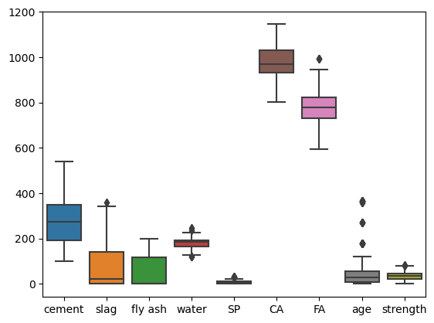
Checking outliers in data:
We used boxplot to find the outliers in our data

Slide 9
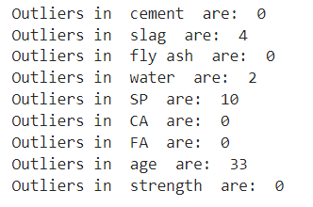
Checking outliers in data:
So these many outliers are present in respective features

Slide 10
Removing Outliers:
We considered the 3 standard deviation criteria to find the upper and lower limit of distribution of each feature.
That is if any point is below (-3σ + µ) or if any point is above (+3σ + µ) then those are considered as outliers.
Instead of replacing the outlier value from particular feature by mean value of the feature we removed the entire row from the dataset.

Slide 11
Classifying data into dependent and independent features
Before starting model building we have to divide the dataset into two parts:
Independent variables contain a list of those variables in which concrete quality is dependent.
The dependent variable is that variable that is dependent on other variables’ values.
We found that:
Independent variables are cement, fly ash, water, superplasticizer, coarse aggregate, fine aggregate, age.
Dependent variable is the only Compressive Strength

Slide 12
Features correlation:
We used heatmap and pairplot from seaborn library to find the correlation among the independent features
The Heatmap values shows the correlation values, which measure the degree of linear relationship between each pair of variables.
The correlation values can fall between -1 and +1. If the two variables tend to increase and decrease together, the correlation value is positive.

Slide 13
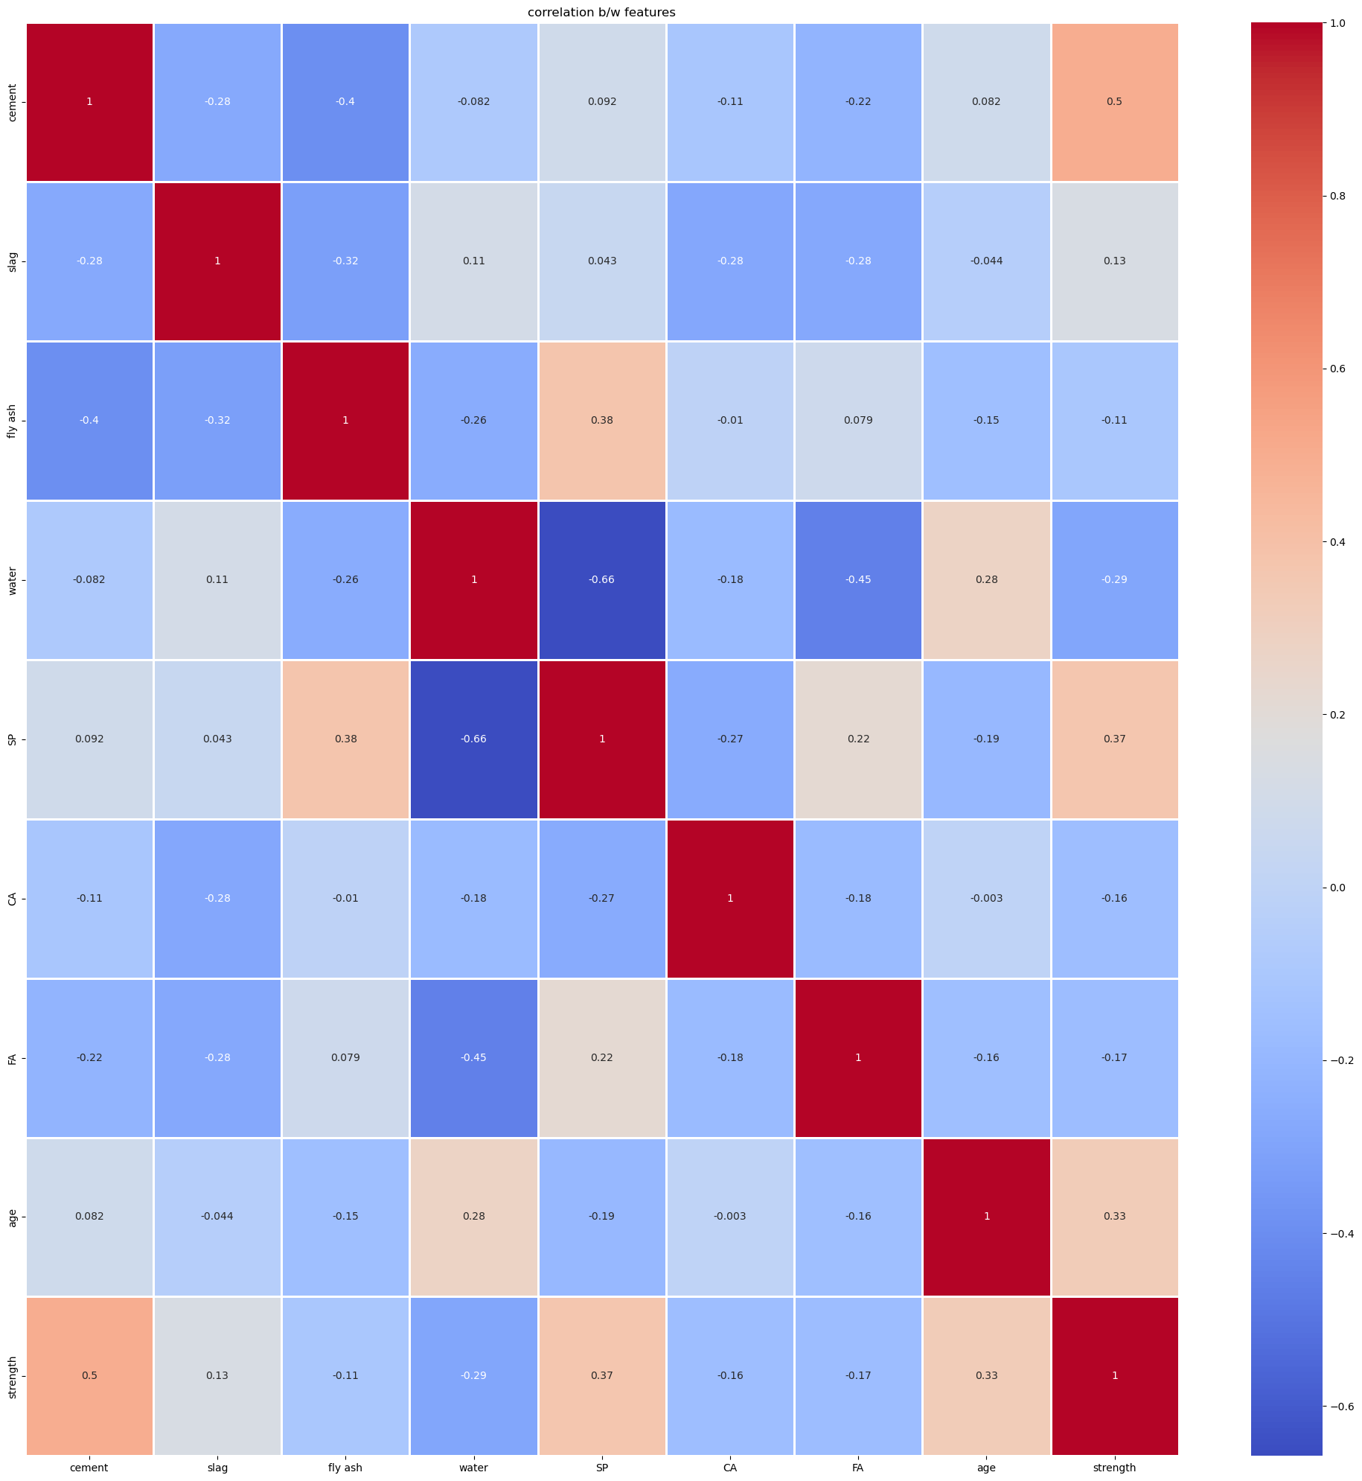
Features correlation:
Correlation heatmap

Slide 14
Features correlation:
Maximum correlation between independent and dependent feature is 50% and that is between cement and strength.
Maximum correlation between independent features is 38% which is between super plasticizer and fly ash.
So in this case as our correlation between independent features is not enough therefore we will not drop any of the independent feature.

Slide 15
Feature scaling and Splitting of the Data:
We did feature scaling by importing StandardScaler from sklearn library.
StandardScaler makes the mean of distribution equal to zero and makes the variance unit.
we used the train_test_split module from scikit-learn library, for splitting the training and testing parts.
80% of the dataset we considered for training and rest 20% for testing.

Slide 16
Building different Models:
Multiple linear regression:
After importing linear regression model and training it we found following results
Mean squared error = 93.69
accuracy = 66.04%

Slide 17
Random Forest
After importing Random Forest Regressor model and training it we found following results
Mean squared error = 27.08
accuracy = 90.18%

Slide 18
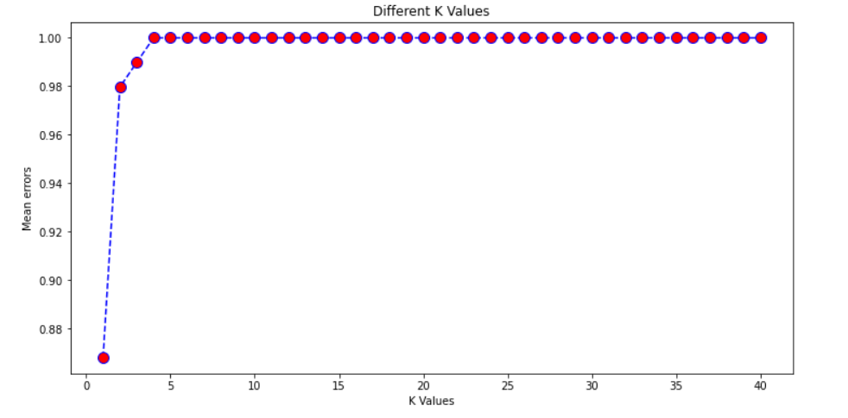
KNN Regressor
We found the optimum value of k using the elbow method
We selected k = 3 from above plot

Slide 19
KNN Regressor
After importing KNN Regressor model and training it with k= 3 we found following results
Mean squared error = 63.26
accuracy = 77.07%

Slide 20
Support Vector Machine
After importing Support Vector Regressor model and training it we found following results
Mean squared error = 89.97
accuracy = 67.39%

Slide 21
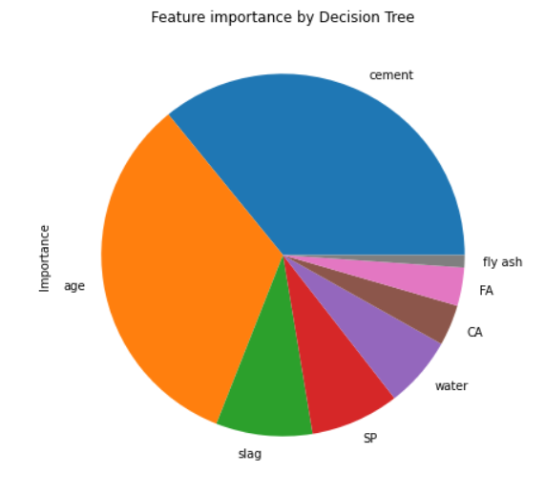
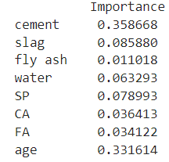
Decision Tree Regressor
After importing Support Vector Regressor model and training it we found following results
Mean squared error = 59.82
accuracy = 78.31%

Slide 22
Decision Tree with important features
From previous decision tree model we dropped less important features i.e. fly ash, coarse aggregate, fine aggregate and again trained decision tree.
We found the following results
Mean squared error = 39.18
accuracy = 85.79%

Slide 23
Pruned Decision Tree
Though our decision tree is not overfitted, still we have checked the pruned model’s accuracy so that we can conclude that its accuracy will decrease.
We found the following results for pruned model
Mean squared error = 97.82
accuracy = 64.54%

Slide 24
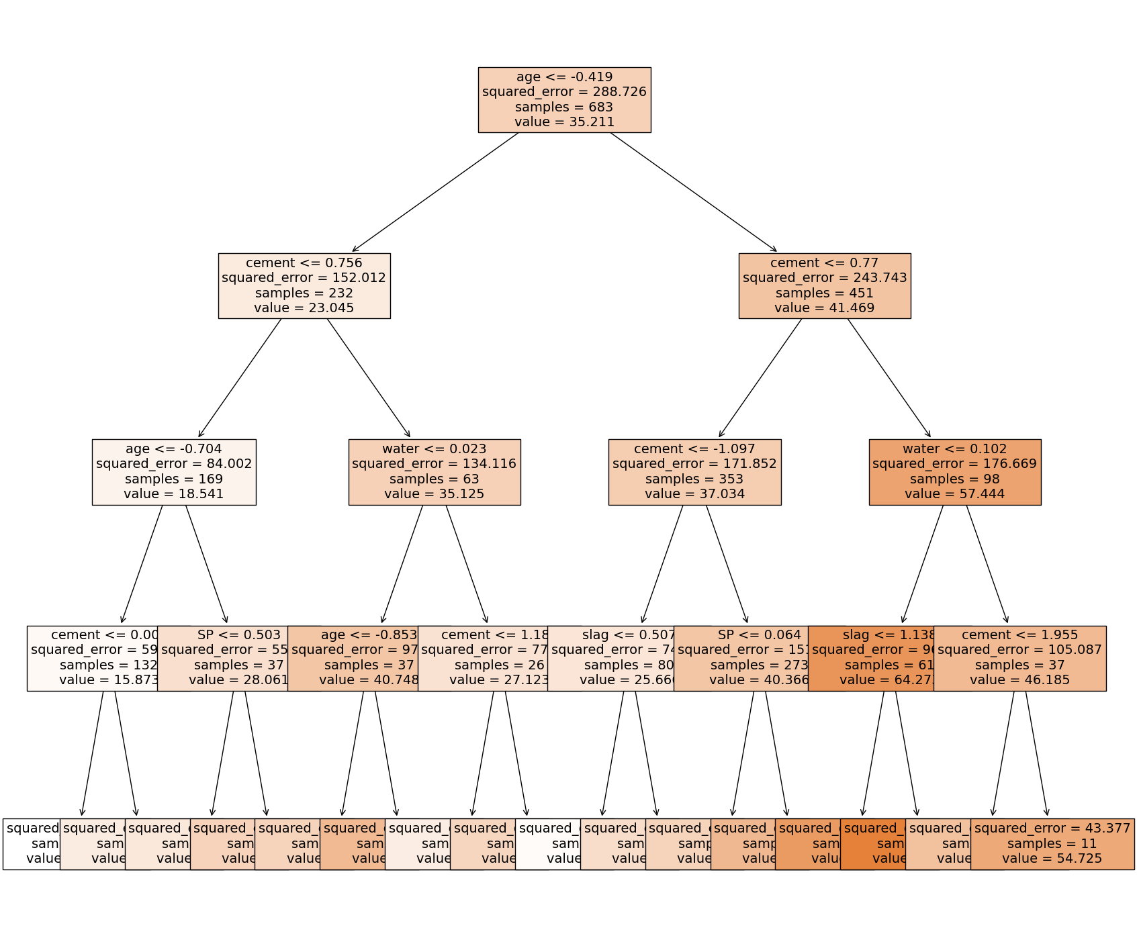
Pruned decision Tree Plot:

Slide 25
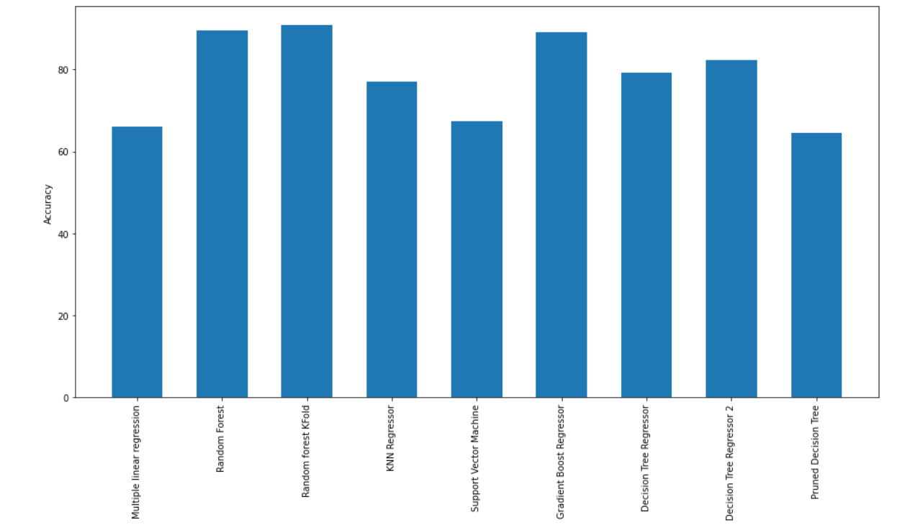
Accuracy Plot of All Model:

