Slide 1

DK181
Team Night Hunters

Slide 2
Day 3 - Improvements
Login
Login feature has been implemented. Each user has own library of it's books.
Batch_Size
Searching has been Improved by using the batch size parameter
Sliding window
To solve continuity problem , sliding window is used by overlapping documents up to 50% .
Cosine Similarity
Sentence embedding is done and cosine similarity is performed for maintaining semantics

Slide 3
Test cases

Slide 4
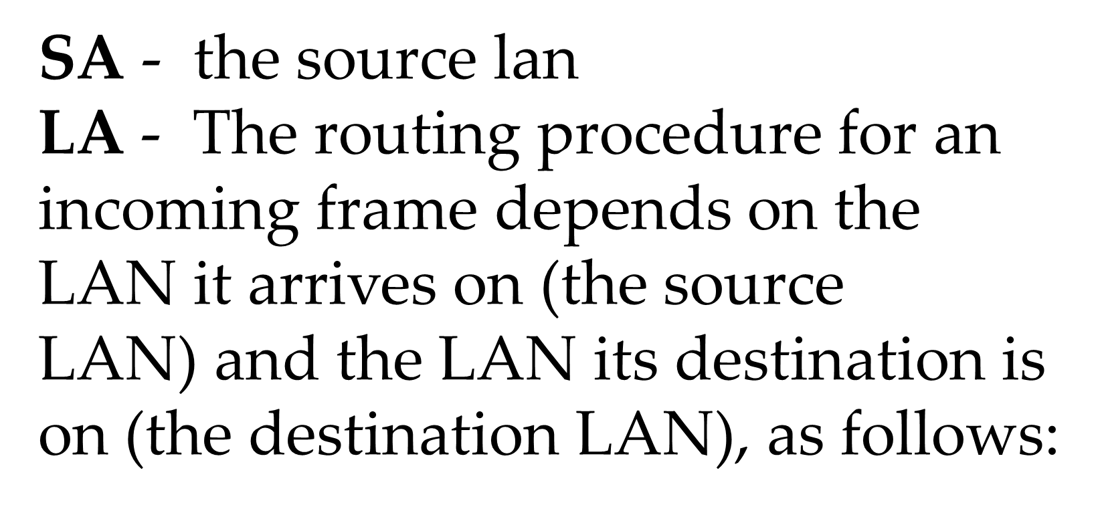
1.What is LAN?
Expected
Outcome
Local area networks, generally called LANs, are privately-owned networks within a single building or campus of up to a few kilometers in size. They are widely used to connect personal computers and workstations in company offices and factories to share resources (e.g., printers) and exchange information.
MORE INFORMATION
MORE INFORMATION

Slide 5
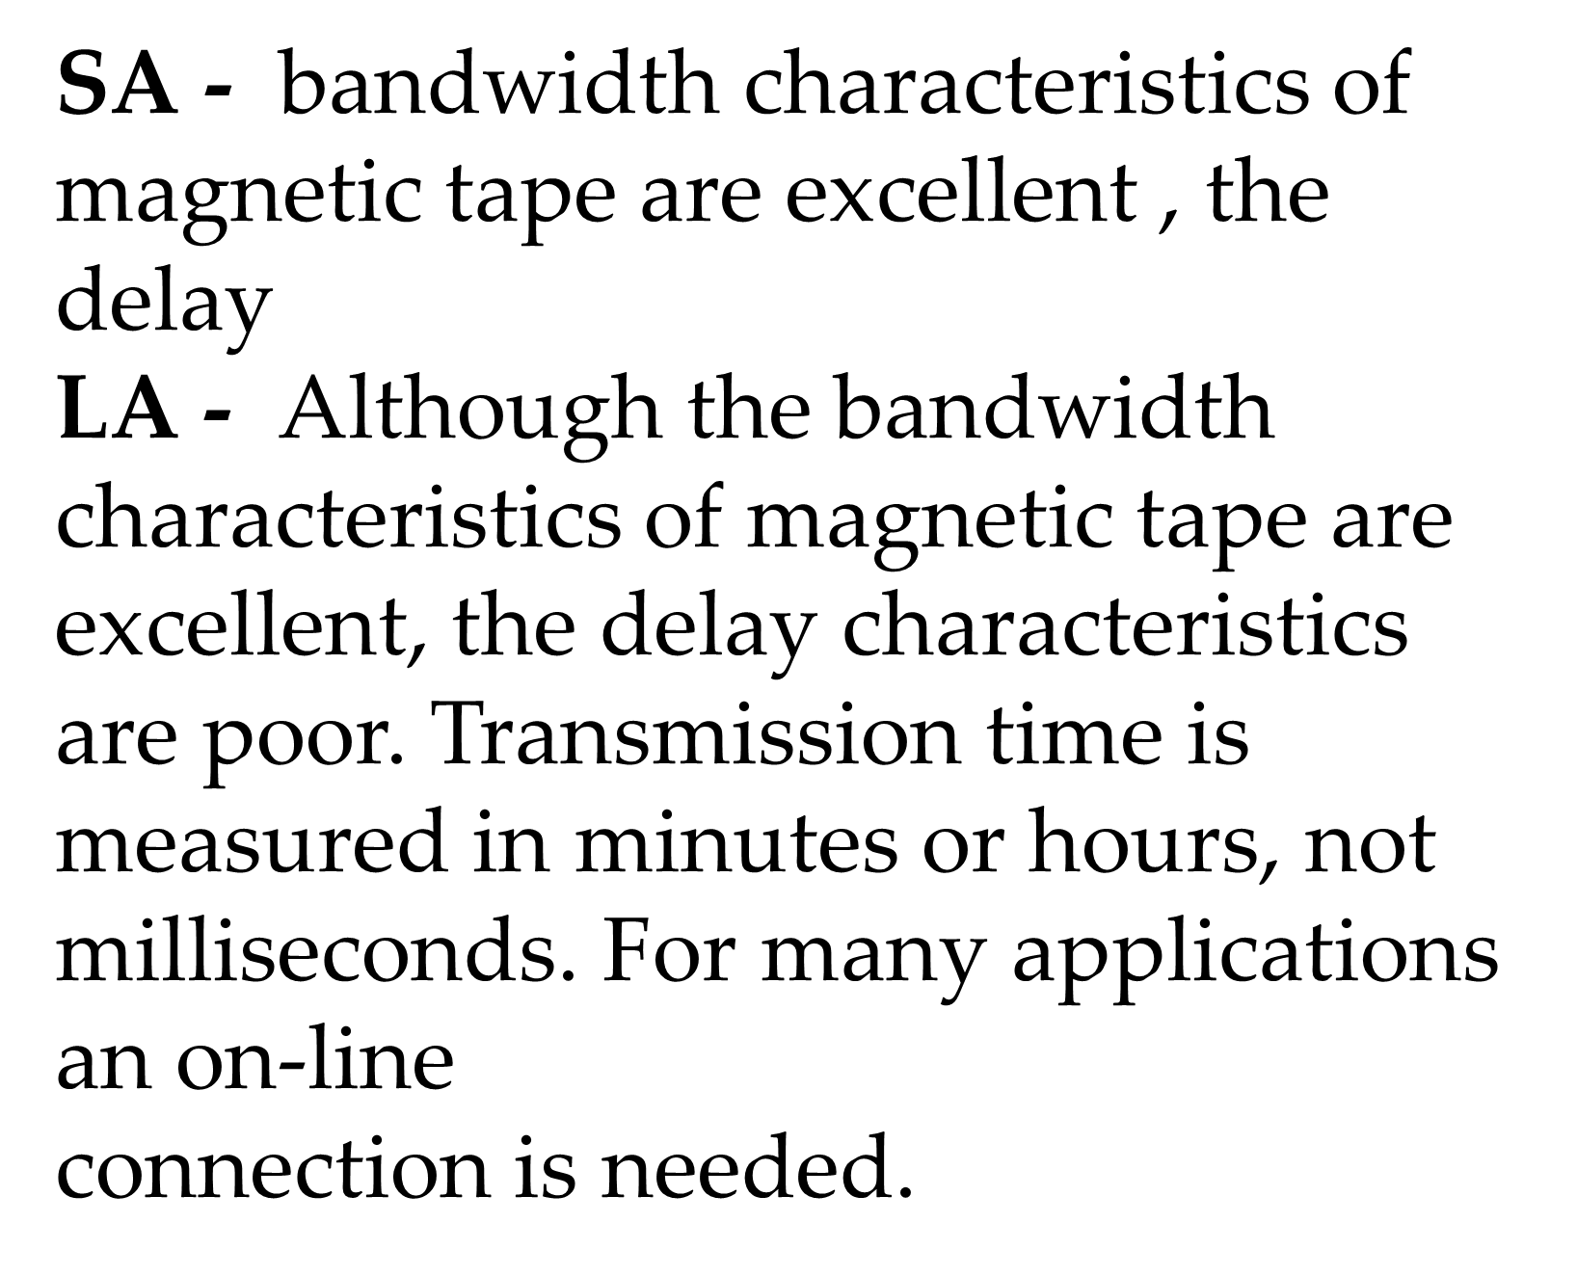
2.What are characteristics of LAN?
Expected
Outcome
LANs are distinguished from other kinds of networks by three characteristics: (1) their size, (2) their transmission technology, and (3) their topology.
MORE INFORMATION
MORE INFORMATION

Slide 6
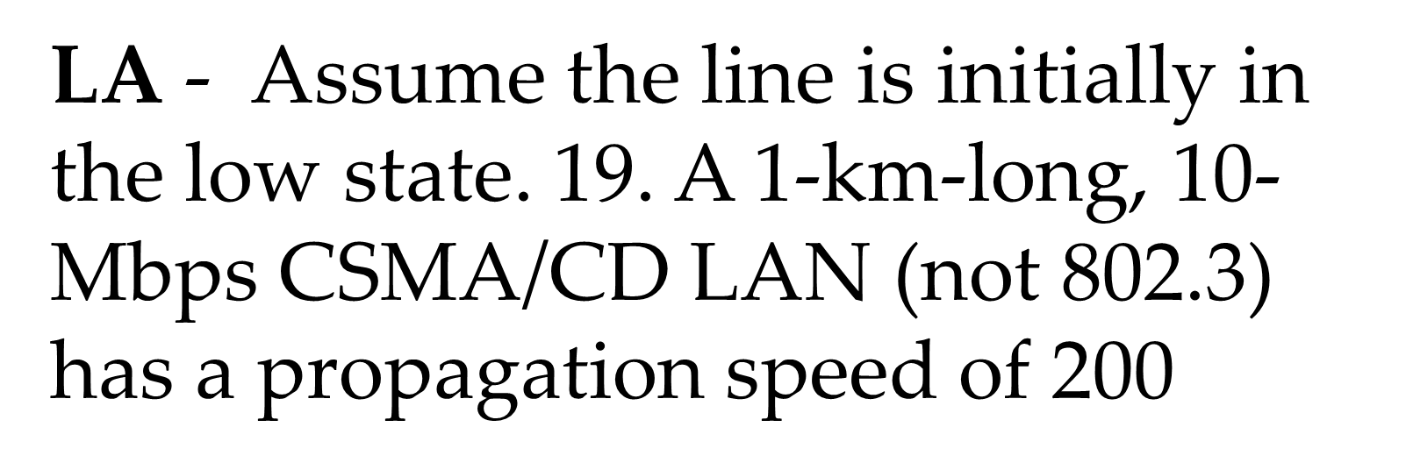
3.what is the speed of LAN?
Expected
Outcome
Traditional LANs run at speeds of 10 Mbps to 100 Mbps, have low delay (microseconds or nanoseconds), and make very few errors.
MORE INFORMATION
MORE INFORMATION

Slide 7
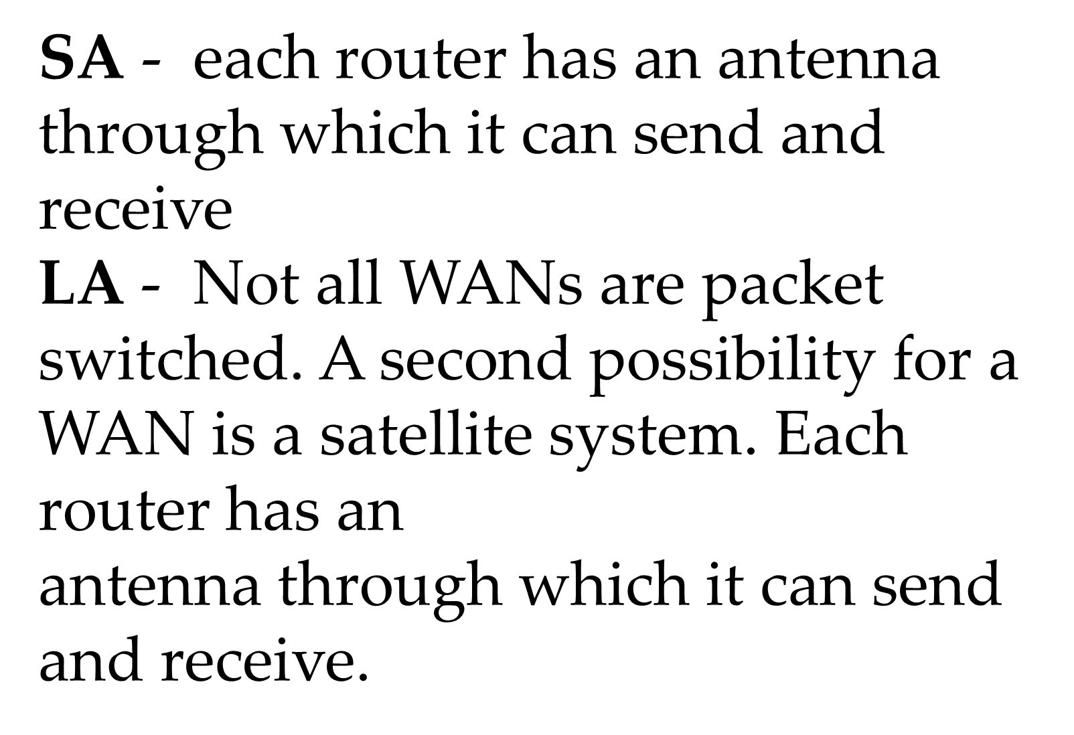
4. Describe principle of a packet-switched WAN?
Expected
Outcome
Each router has an antenna through which it can send and receive. Generally, when a process on some host has a message to be sent to a process on some other host, the sending host first cuts the message into packets, each one bearing its number in the sequence. Not all WANs are packet switched. A second possibility for a WAN is a satellite system. Each router has antenna through which it can send and receive.
MORE INFORMATION
MORE INFORMATION

Slide 8
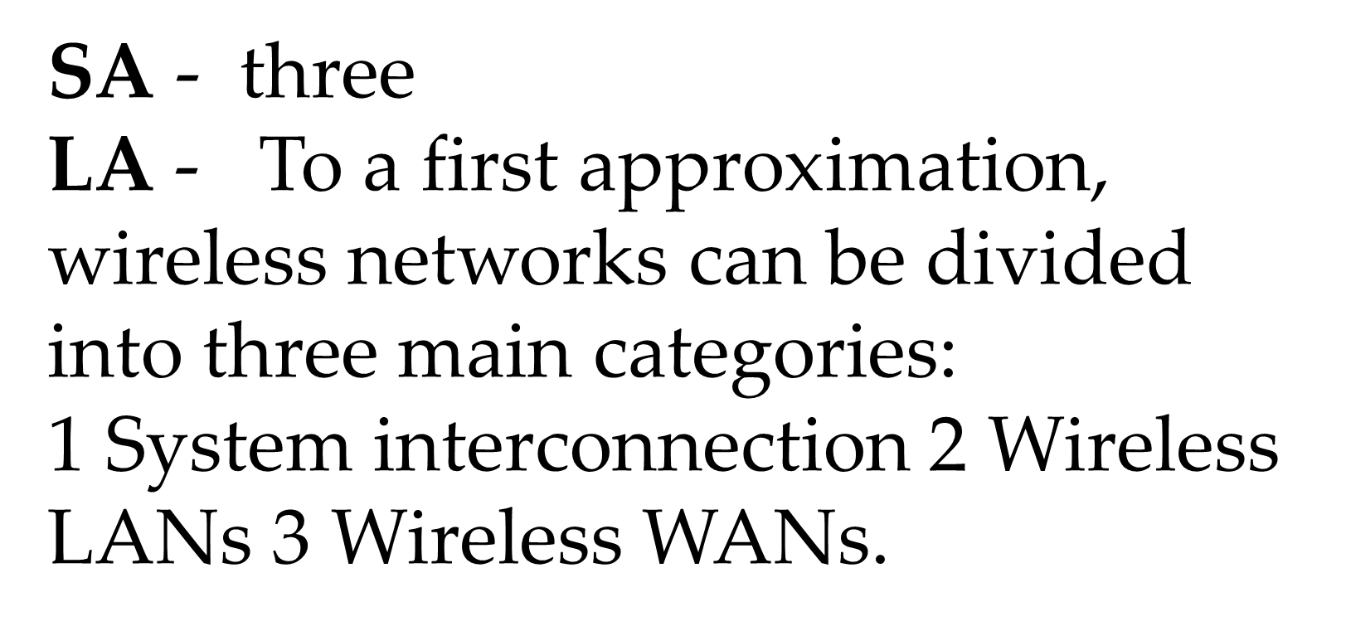
5. Into how many categories the wireless networks are divided?
Expected
Outcome
To a first approximation, wireless networks can be divided into three main categories: 1. System interconnection. 2. Wireless LANs. 3. Wireless WANs.
MORE INFORMATION
MORE INFORMATION

Slide 9
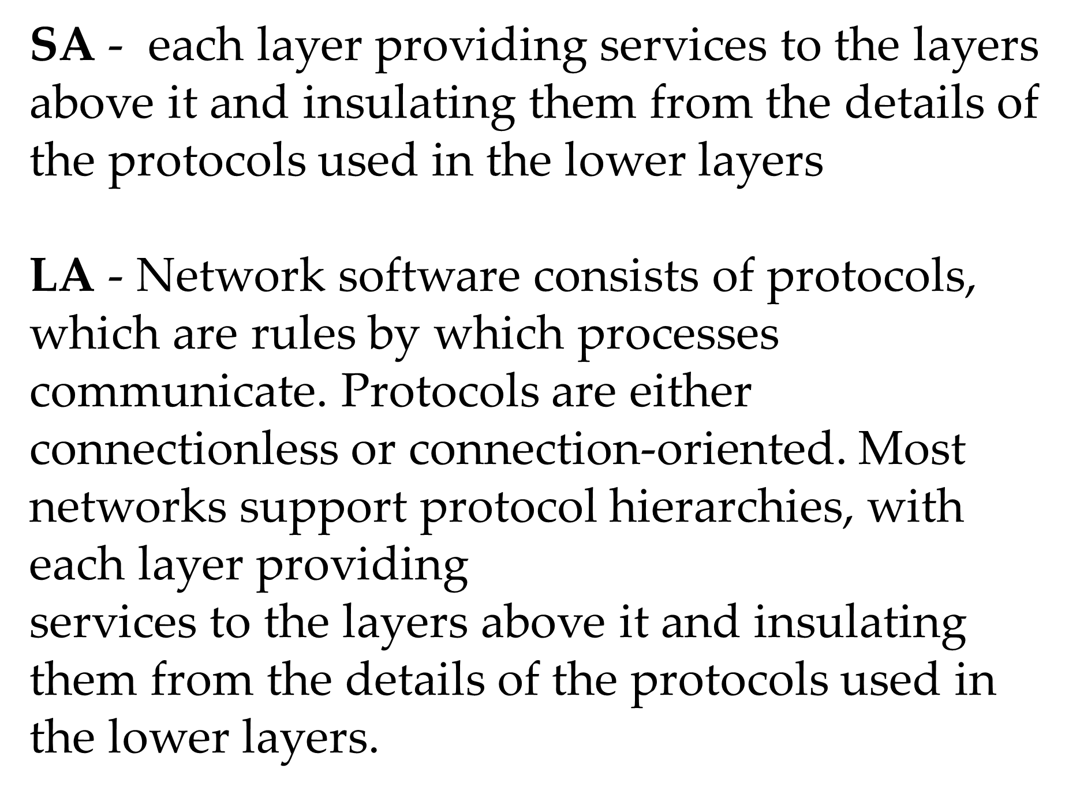
6. why are protocol hierarchies required?
Expected
Outcome
To reduce their design complexity, most networks are organized as a stack of layers or levels, each one built upon the one below it. The number of layers, the name of each layer, the contents of each layer, and the function of each layer differ from network to network. The purpose of each layer is to offer certain services to the higher layers, shielding those layers from the details of how the offered services are actually implemented.
MORE INFORMATION
MORE INFORMATION

Slide 10
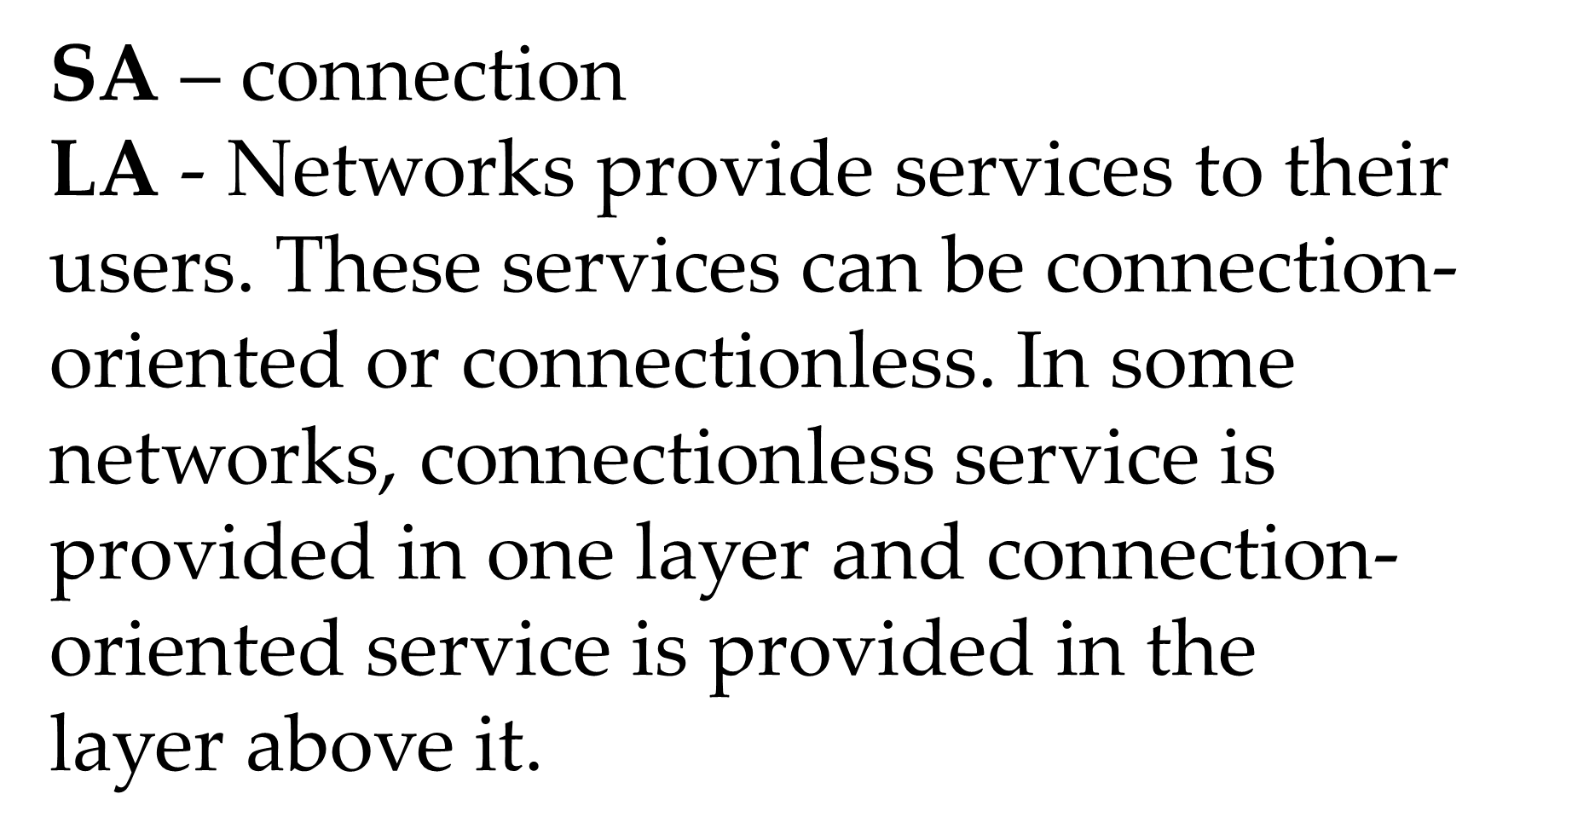
7. Contrast between Connection-Oriented and Connectionless
Services
Expected
Outcome
Connection-oriented service is modeled after the telephone system. To talk to someone, you pick up the phone, dial the number, talk, and then hang up. In contrast, connectionless service is modeled after the postal system. Each message (letter) carries the full destination address, and each one is routed through the system independent of all the others.
MORE INFORMATION
MORE INFORMATION

Slide 11
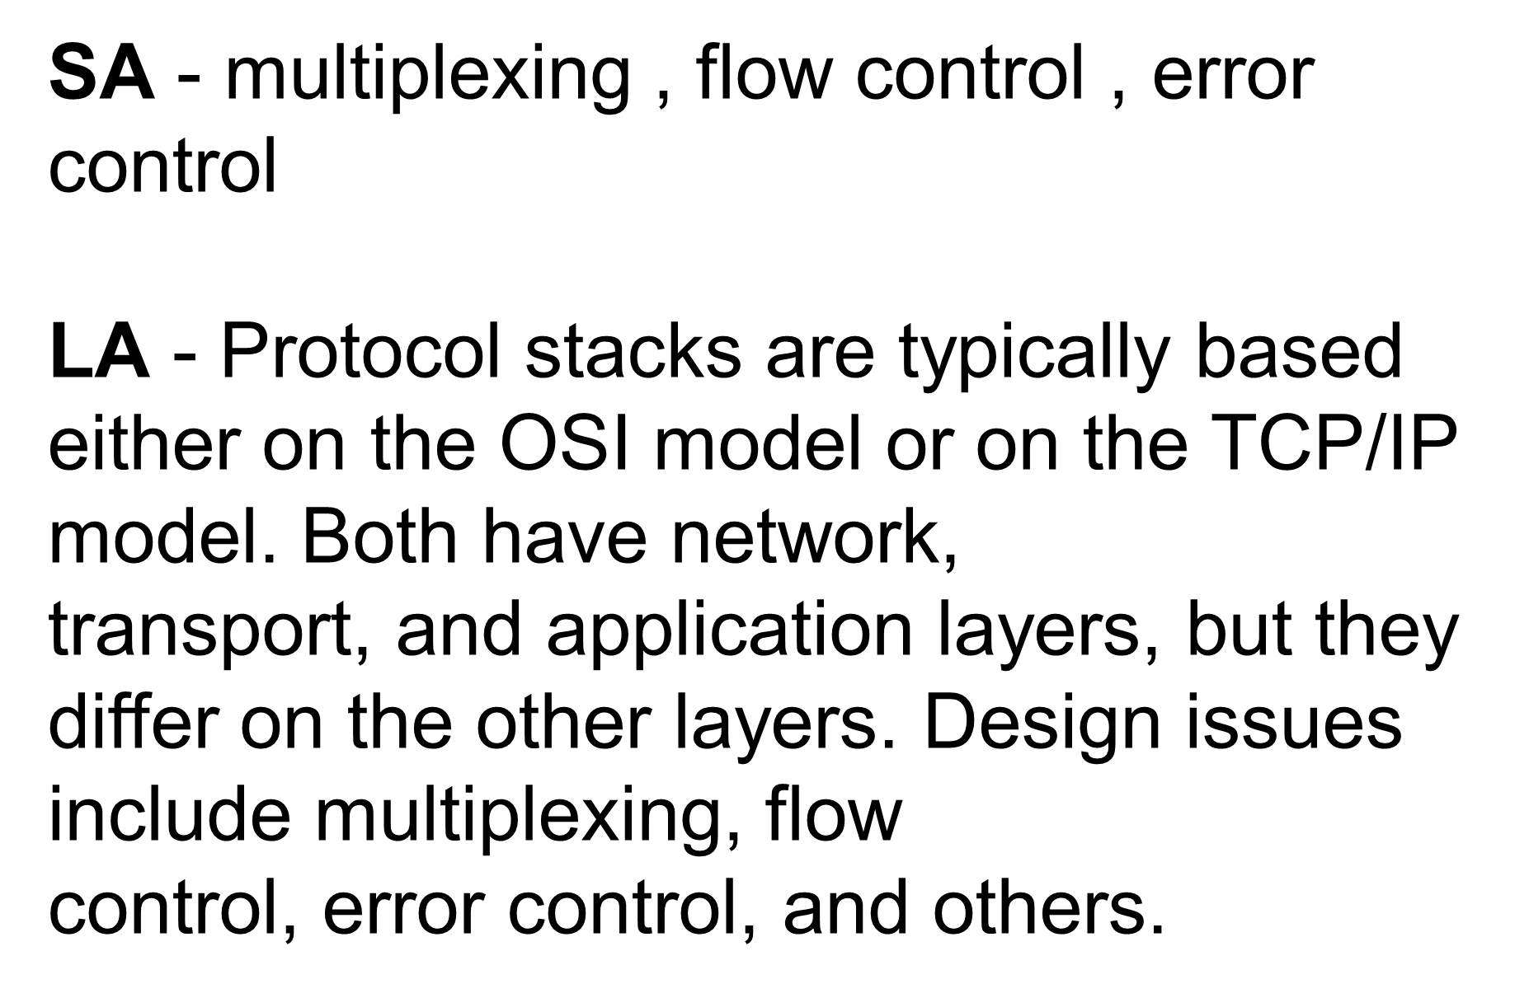
8. Explain design issues for the layers.
Expected
Outcome
Connection-oriented service is modeled after the telephone system. To talk to someone, you pick up the phone, dial the number, talk, and then hang up. In contrast, connectionless service is modeled after the postal system. Each message (letter) carries the full destination address, and each one is routed through the system independent of all the others.
MORE INFORMATION
MORE INFORMATION

Slide 12
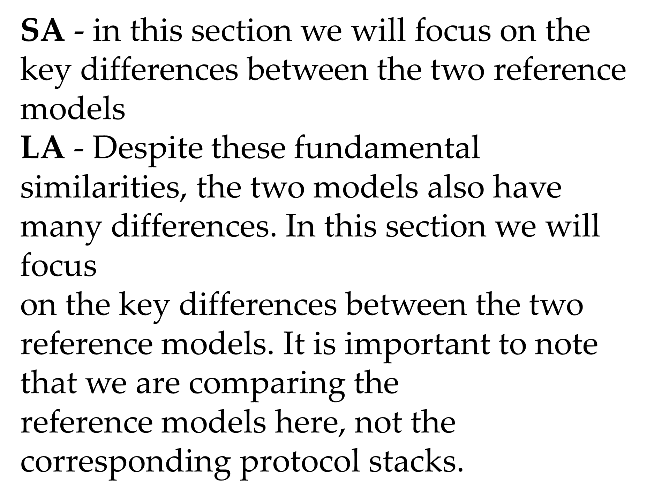
9. List out reference models
Expected
Outcome
two important network architectures, the OSI reference model and the TCP/IP reference model.
MORE INFORMATION
MORE INFORMATION

Slide 13
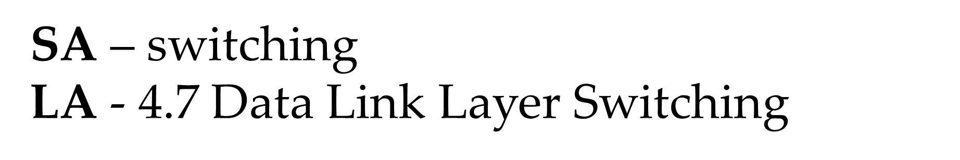
10. Briefly explain data link layer
Expected
Outcome
The main task of the data link layer is to transform a raw transmission facility into a line that appears free of undetected transmission errors to the network layer. It accomplishes this task by having the sender break up the input data into data frames and transmit the frames sequentially.
MORE INFORMATION
MORE INFORMATION

Slide 14
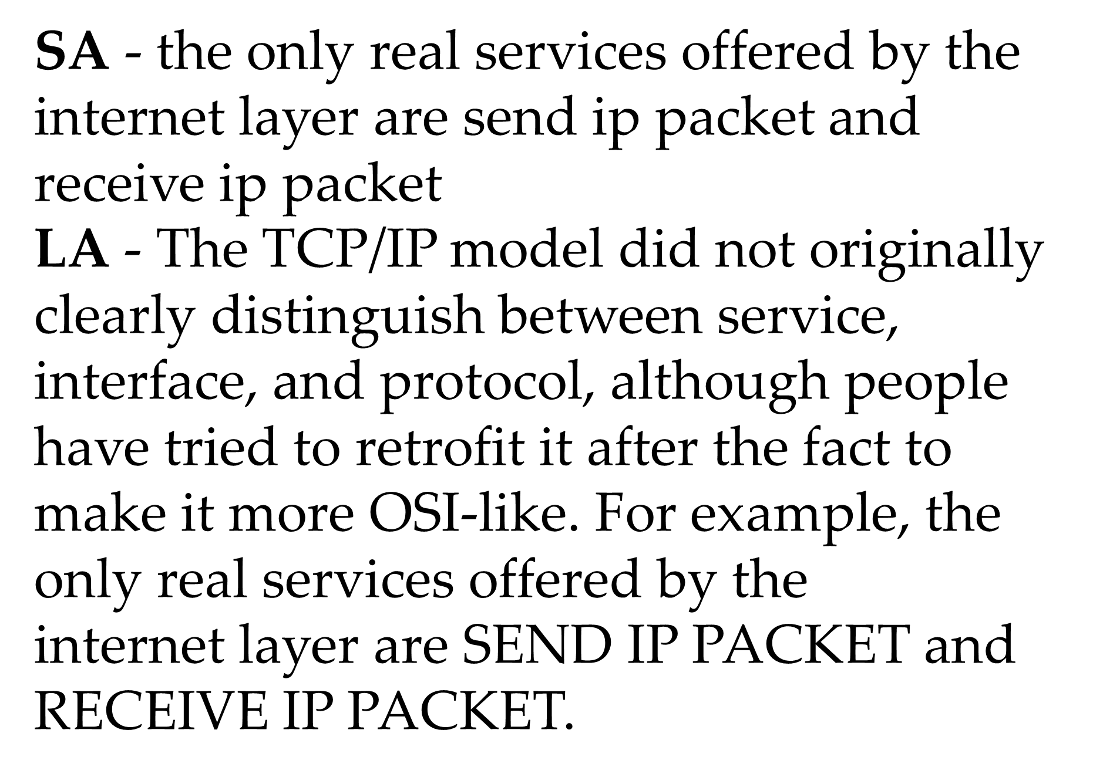
11. Write a short note on Internet layer of TCP/IP model
Expected
Outcome
All these requirements led to the choice of a packet-switching network based on a connectionless internetwork layer. This layer, called the internet layer, is the linchpin that holds the whole architecture together. Its job is to permit hosts to inject packets into any network and have them travel independently to the destination (potentially on a different network).
MORE INFORMATION
MORE INFORMATION

