Slide 1




Problem Statement: CREATING A PLATEFORM FOR HEALTHCARE MONITORING AND CONSULTATION
Team Name: CODEJAMMERS
Team Leader Name: TINKU MONI KAUSHIK
Institute Name: GAUHATI UNIVERSITY INSTITUTE OF SCIENCE AND TECHNOLOGY

Slide 2
IDEA APPROACH DETAILS:
Digital Patient Platform for Healthcare Access Develop a digital patient platform (website) to revolutionize healthcare access, streamline services, and empower patients.
Key Features:
Personalized Profiles: Securely store medical data for tailored care.
Teleconsultation: Enable remote consultations for convenience and accessibility.
Health Education: Provide curated resources for informed decision-making
Review system : patient can review and give feedback so that others people get the best doctors
Digital Prescriptions: Streamline medication management for patients and providers.
Intuitive Appointment Management: Simplify scheduling, reducing wait times.
7.Provide Persionalised Health Plan: We understand that each individual’s health needs are unique. That’s why Health Pro offers persionalised health plans .

Slide 3
Opportunities
We are different from others
We provide customisable health plans for people of different needs
User Friendly Interfacee
Allowing patients to access healthcare professionals from anywhere

Slide 4
FEATURES
Persionalised health plans
Get experts opinion
Get consultation
Appointment of a physician

Slide 5
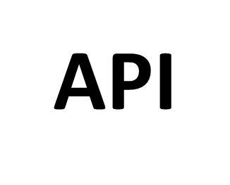
ARTITECHTURE /FLOWCHART
web interface
Frontend
HTML ,CSS,JS
Backend
Node.js , Express.js , MongoDB
UI
API
Data Storage
External Services

Slide 6






TECH STACK
Frontend
Backend
Authentication endpoints for user registration, login, and token generation using JSON web tokens (JWT).
Secure storage of user credentials with password hashing .
API endpoints for crud operations.
Data validation and sanitization using libraries like joi to prevent malicious inputs and ensure data integrity.
Logging of API requests and responses for audit trails and troubleshooting purposes.
Registration and login form
Patient-facing dashboard displaying appointments, medical records, prescriptions, and educational resources.
Provider-facing dashboard for managing appointments, accessing patient data, and communicating with patients.
Dropdowns, modals, and sliders for enhanced user engagement.
Database
Storage of patient medical information
Recording of appointment details, including dates, times, healthcare providers.
Secure storage of digital prescriptions, treatment plans,

Slide 7
BUSINESS mODEL
Allow healthcare related professionals to publish sponsored ariticles
Offer premium services behind a paywall

