Slide 1

Computer Networking: A Top Down Approach
Seventh Edition
Chapter 9
Multimedia Networking
Slides in this presentation contain hyperlinks. JAWS users should be able to get a list of links by using INSERT+F7
Copyright © 2017, 2013, 2010 Pearson Education, Inc. All Rights Reserved
Notes:
If this PowerPoint presentation contains mathematical equations, you may need to check that your computer has the following installed:
1) MathType Plugin
2) Math Player (free versions available)
3) NVDA Reader (free versions available)

Slide 2
Learning Objectives (1 of 6)
9.1 multimedia networking applications
9.2 streaming stored video
9.3 voice-over-I P
9.4 protocols for real-time conversational applications
9.5 network support for multimedia

Slide 3
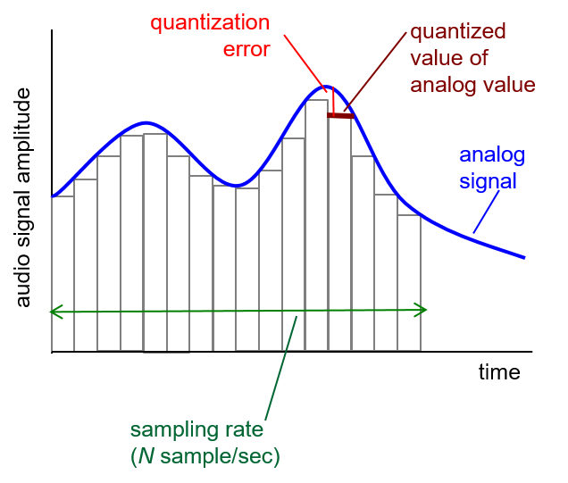
Multimedia: Audio (1 of 2)
analog audio signal sampled at constant rate
telephone: 8,000 samples/second
C D music: 44,100 samples/second
each sample quantized, i.e., rounded
e.g.,
possible quantized values
each quantized value represented by bits, e.g., 8 bits for 256 values

Slide 4
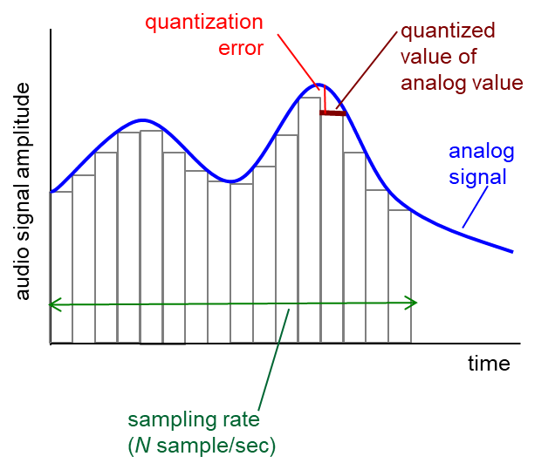
Multimedia: Audio (2 of 2)
example: 8,000 samples/sec, 256 quantized values: 64,000 b p s
receiver converts bits back to analog signal:
some quality reduction
example rates
C D: 1.411 M b p s
M P 3: 96, 128, 160 k b p s
Internet telephony: 5.3 k b p s and up

Slide 5
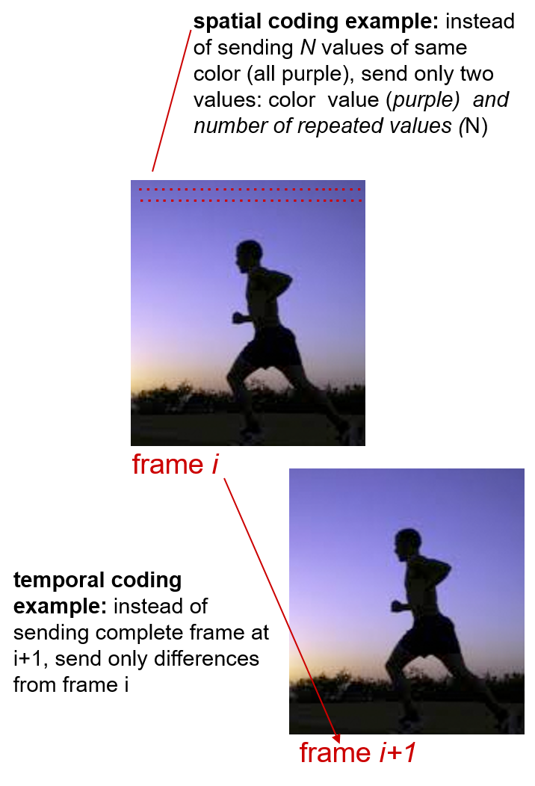
Multimedia: Video (1 of 2)
video: sequence of images displayed at constant rate
e.g., 24 images/second
digital image: array of pixels
each pixel represented by bits
coding: use redundancy within and between images to decrease # bits used to encode image
spatial (within image)
temporal (from one image to next)

Slide 6
Multimedia: Video (2 of 2)
C B R: (constant bit rate): video encoding rate fixed
V B R: (variable bit rate): video encoding rate changes as amount of spatial, temporal coding changes
examples:
M P E G 1 (C D-R O M) 1.5 M b p s
M P E G 2 (D V D) 3-6 M b p s
M P E G 4 (often used in Internet, < 1 M b p s)

Slide 7
Multimedia Networking: 3 Application Types
streaming, stored audio, video
streaming: can begin playout before downloading entire file
stored (at server): can transmit faster than audio/video will be rendered (implies storing/buffering at client)
e.g., YouTube, Netflix, Hulu
conversational voice/video over I P
interactive nature of human-to-human conversation limits delay tolerance
e.g., Skype
streaming live audio, video
e.g., live sporting event (futbol)

Slide 8
Learning Objectives (2 of 6)
9.1 multimedia networking applications
9.2 streaming stored video
9.3 voice-over-I P
9.4 protocols for real-time conversational applications
9.5 network support for multimedia

Slide 9
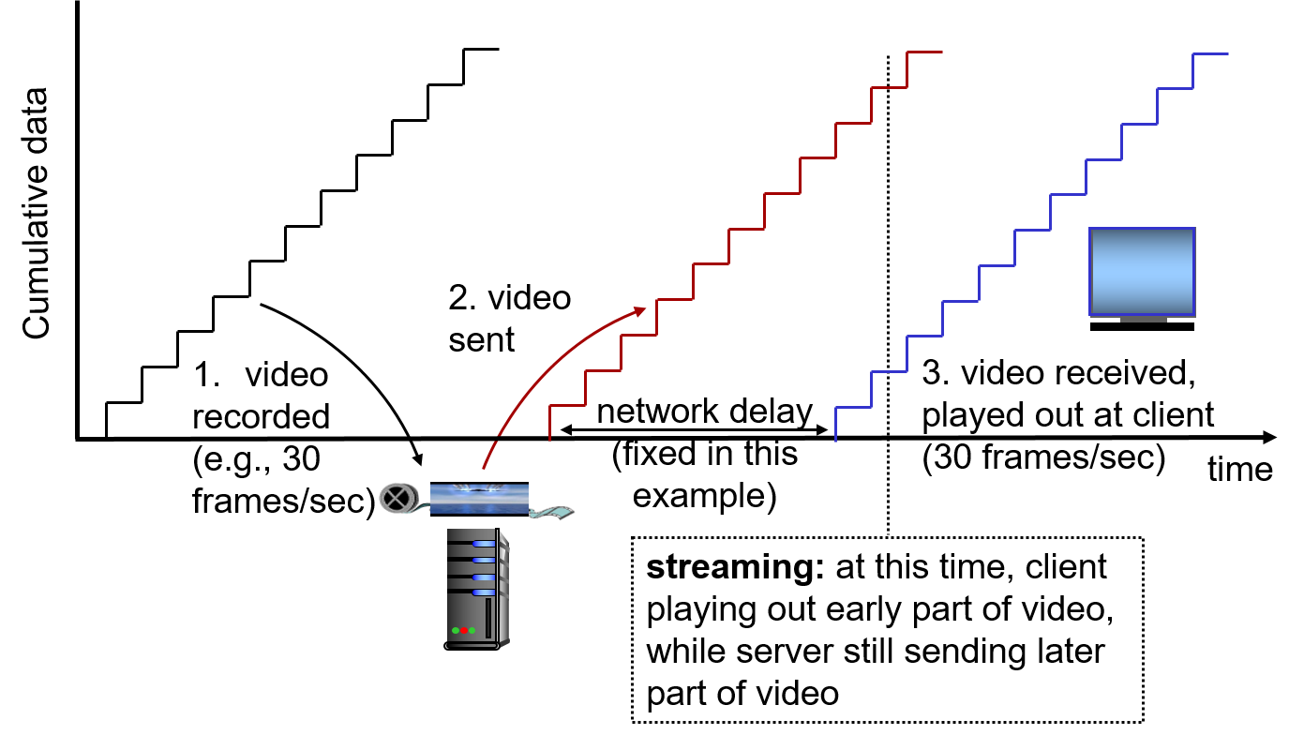
Streaming Stored Video

Slide 10
Streaming Stored Video: Challenges
continuous playout constraint: once client playout begins, playback must match original timing
… but network delays are variable (jitter), so will need client-side buffer to match playout requirements
other challenges:
client interactivity: pause, fast-forward, rewind, jump through video
video packets may be lost, retransmitted

Slide 11
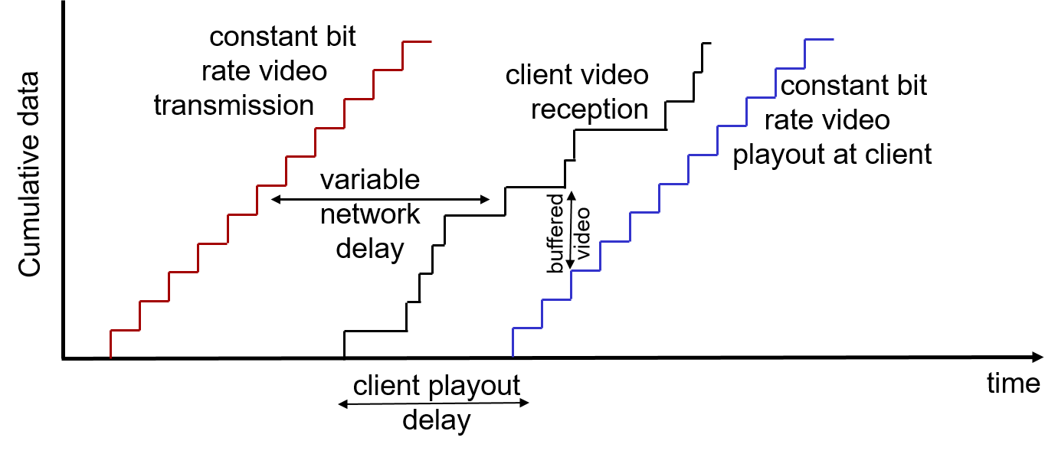
Streaming Stored Video: Revisited
client-side buffering and playout delay: compensate for network-added delay, delay jitter

Slide 12
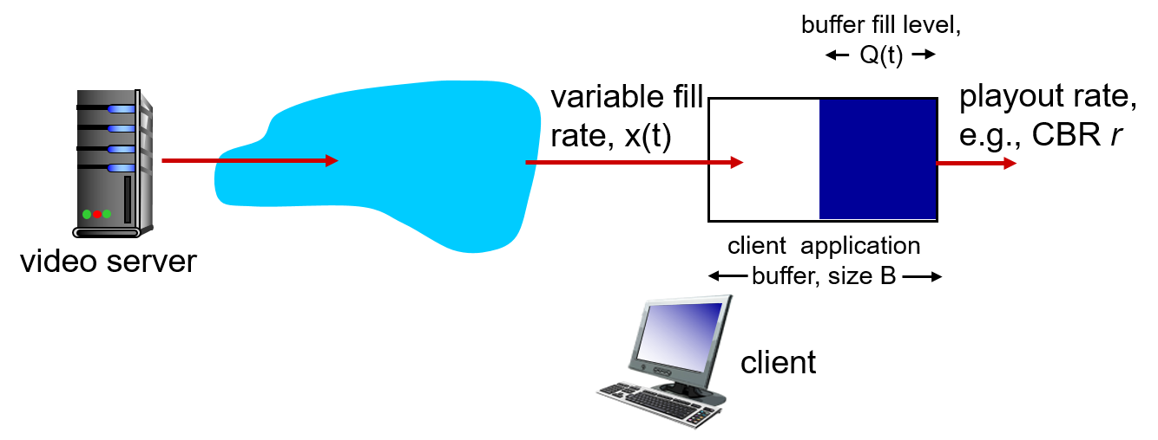
Client-Side Buffering, Playout (1 of 3)

Slide 13
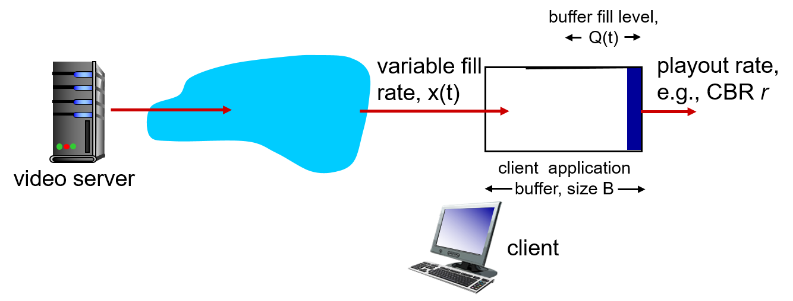
Client-Side Buffering, Playout (2 of 3)
Initial fill of buffer until playout begins at t_{p}
playout begins at t_{p,}
buffer fill level varies over time as fill rate x(t) varies and playout rate r is constant

Slide 14
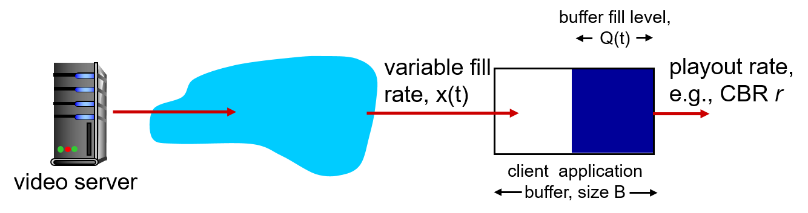
Client-Side Buffering, Playout (3 of 3)
playout buffering: average fill rate
buffer eventually empties (causing freezing of video playout until buffer again fills)
buffer will not empty, provided initial playout delay is large enough to absorb variability in x(t)
initial playout delay tradeoff: buffer starvation less likely with larger delay, but larger delay until user begins watching

Slide 15
Streaming Multimedia: U D P
server sends at rate appropriate for client
often: send rate = encoding rate = constant rate
transmission rate can be oblivious to congestion levels
short playout delay (2-5 seconds) to remove network jitter
error recovery: application-level, time permitting
R T P [R F C 2326]: multimedia payload types
U D P may not go through firewalls

Slide 16
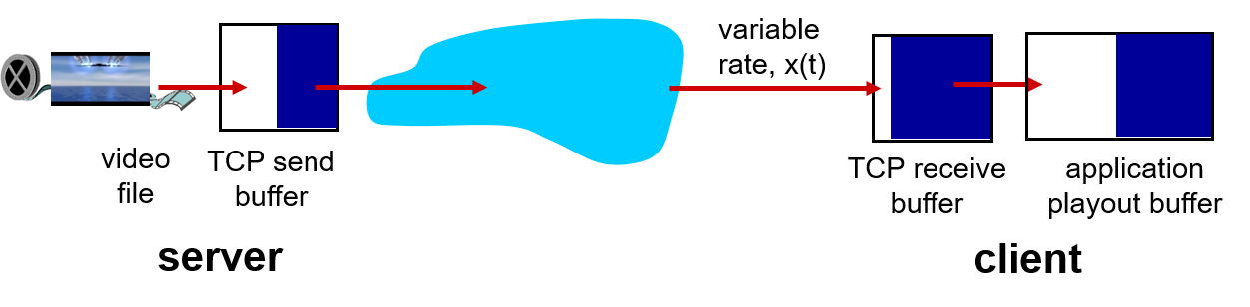
Streaming Multimedia: H T T P
multimedia file retrieved via H T T P GET
send at maximum possible rate under T C P
fill rate fluctuates due to T C P congestion control, retransmissions (in-order delivery)
larger playout delay: smooth T C P delivery rate
H T T P / T C P passes more easily through firewalls

Slide 17
Learning Objectives (3 of 6)
9.1 multimedia networking applications
9.2 streaming stored video
9.3 voice-over-I P
9.4 protocols for real-time conversational applications
9.5 network support for multimedia

Slide 18
Voice - over - I P (V o I P)
V o I P end-end-delay requirement: needed to maintain “conversational” aspect
higher delays noticeable, impair interactivity
< 150 millisecond: good
> 400 millisecond: bad
includes application-level (packetization, playout), network delays
session initialization: how does callee advertise I P address, port number, encoding algorithms?
value-added services: call forwarding, screening, recording
emergency services: 911

Slide 19
V o I P Characteristics
Speaker’s audio: alternating talk spurts, silent periods.
64 k b p s during talk spurt
p k t s generated only during talk spurts
20 msec chunks at 8 Kilo bytes/second: 160 bytes of data
application-layer header added to each chunk
chunk+header encapsulated into U D P or T C P segment
application sends segment into socket every 20 millisecond during talkspurt

Slide 20
V o I P: Packet Loss, Delay
network loss: I P datagram lost due to network congestion (router buffer overflow)
delay loss: I P datagram arrives too late for playout at receiver
delays: processing, queueing in network; end-system (sender, receiver) delays
typical maximum tolerable delay: 400 millisecond
loss tolerance: depending on voice encoding, loss concealment, packet loss rates between 1% and 10% can be tolerated

Slide 21
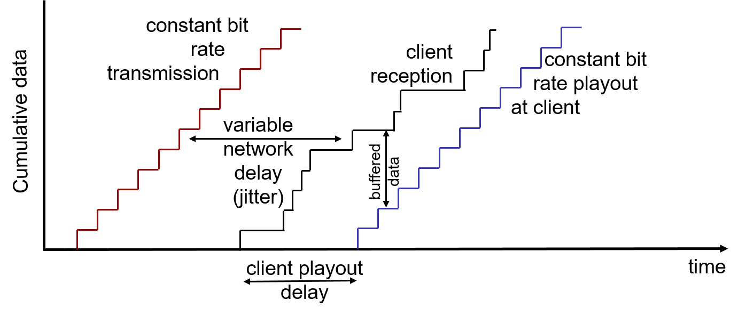
Delay Jitter
end-to-end delays of two consecutive packets: difference can be more or less than 20 millisecond (transmission time difference)

Slide 22
V o I P: Fixed Playout Delay (1 of 3)
receiver attempts to playout each chunk exactly q msecs after chunk was generated.
chunk has time stamp t: play out chunk at t+q
chunk arrives after t+q: data arrives too late for playout: data “lost”
tradeoff in choosing q:
large q: less packet loss
small q: better interactive experience

Slide 23
V o I P: Fixed Playout Delay (2 of 3)
sender generates packets every 20 millisecond during talk spurt.
first packet received at time r
first playout schedule: begins at p
second playout schedule: begins at p’

Slide 24
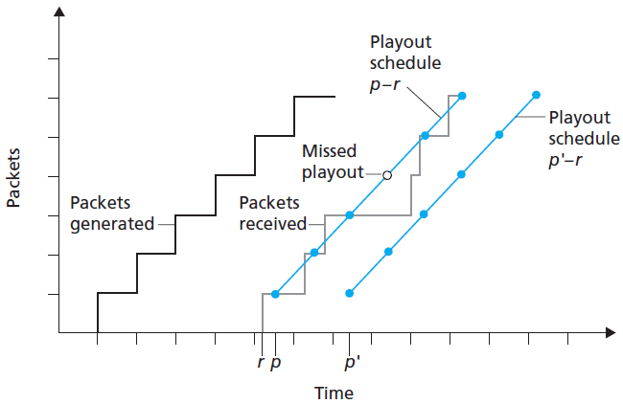
V o I P: Fixed Playout Delay (3 of 3)

Slide 25
Adaptive Playout Delay (1 of 4)
goal: low playout delay, low late loss rate
approach: adaptive playout delay adjustment:
estimate network delay, adjust playout delay at beginning of each talk spurt
silent periods compressed and elongated
chunks still played out every 20 millisecond during talk spurt

Slide 26
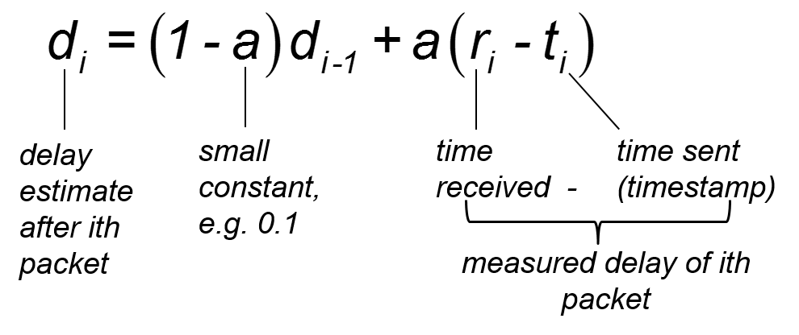
Adaptive Playout Delay (2 of 4)
adaptively estimate packet delay: (E W M A - exponentially weighted moving average, recall T C P R T T estimate):

Slide 27
Adaptive Playout Delay (3 of 4)
also useful to estimate average deviation of delay,
estimates d_{i}, v_{i} calculated for every received packet, but used only at start of talk spurt
for first packet in talk spurt, playout time is:
remaining packets in talkspurt are played out periodically

Slide 28
Adaptive Playout Delay (4 of 4)
Q: How does receiver determine whether packet is first in a talkspurt?
if no loss, receiver looks at successive timestamps
difference of successive stamps > 20 msec -->talk spurt begins.
with loss possible, receiver must look at both time stamps and sequence numbers
difference of successive stamps > 20 msec and sequence numbers without gaps --> talk spurt begins.

Slide 29
V o I P: Recovery from Packet Loss (1 of 6)
Challenge: recover from packet loss given small tolerable delay between original transmission and playout
each A C K/N A K takes ~ one R T T
alternative: Forward Error Correction (F E C)
send enough bits to allow recovery without retransmission (recall two-dimensional parity in Ch. 5)

Slide 30
V o I P: Recovery from Packet Loss (2 of 6)
simple F E C
for every group of n chunks, create redundant chunk by exclusive O R-ing n original chunks
send n+1 chunks, increasing bandwidth by factor
can reconstruct original n chunks if at most one lost chunk from n+1 chunks, with playout delay

Slide 31
V o I P: Recovery from Packet Loss (3 of 6)
another F E C scheme:
“piggyback lower quality stream”
send lower resolution audio stream as redundant information
e.g., nominal stream P C M at 64 k b p s and redundant stream G S M at 13 k b p s
non-consecutive loss: receiver can conceal loss
generalization: can also append (n-1)st and (n-2)nd low-bit rate chunk

Slide 32
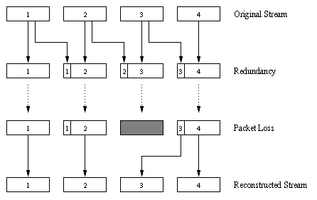
V o I P: Recovery from Packet Loss (4 of 6)

Slide 33
V o I P: Recovery from Packet Loss (5 of 6)
interleaving to conceal loss:
audio chunks divided into smaller units, e.g. four 5 millisecond units per 20 millisecond audio chunk
packet contains small units from different chunks
if packet lost, still have most of every original chunk
no redundancy overhead, but increases playout delay

Slide 34
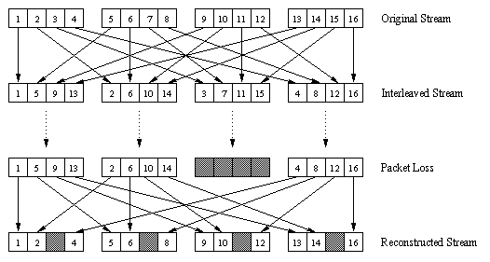
V o I P: Recovery from Packet Loss (6 of 6)

Slide 35
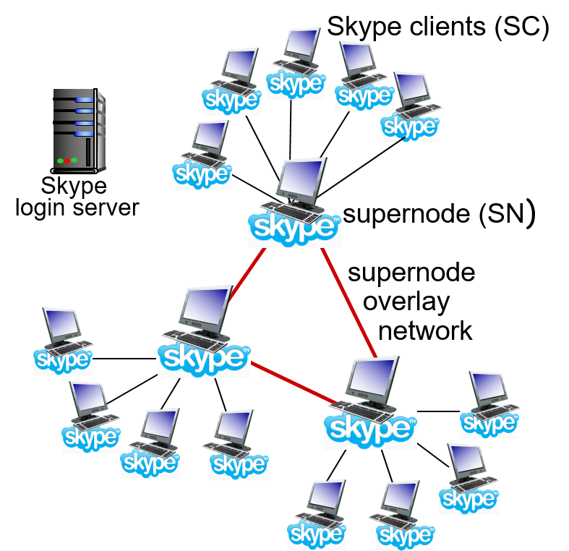
Voice-Over-I P: Skype
proprietary application-layer protocol (inferred via reverse engineering)
encrypted msgs
P2P components:
clients: Skype peers connect directly to each other for V o I P call
super nodes (S N): Skype peers with special functions
overlay network: among S Ns to locate S Cs
login server

Slide 36
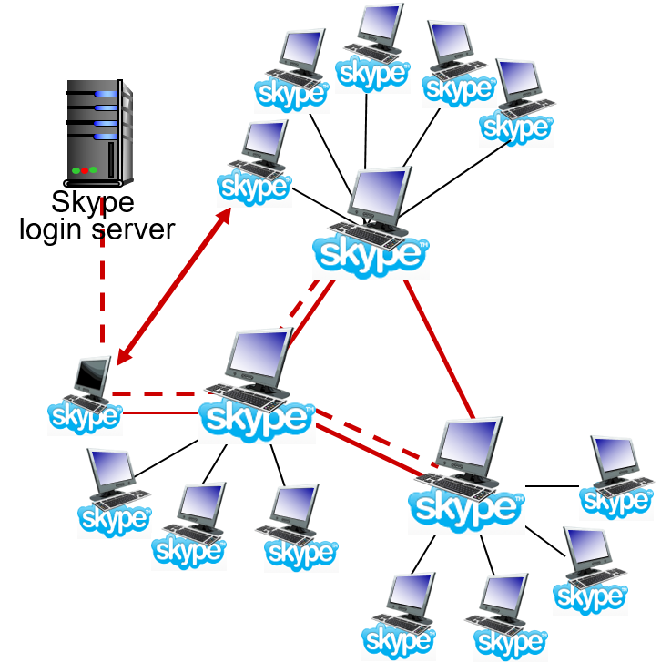
P2P Voice-Over-I P: Skype
Skype client operation:
joins Skype network by contacting S N (I P address cached) using T C P
logs-in (username, password) to centralized Skype login server
obtains IP address for callee from S N, S N overlay
or client buddy list
initiate call directly to callee

Slide 37
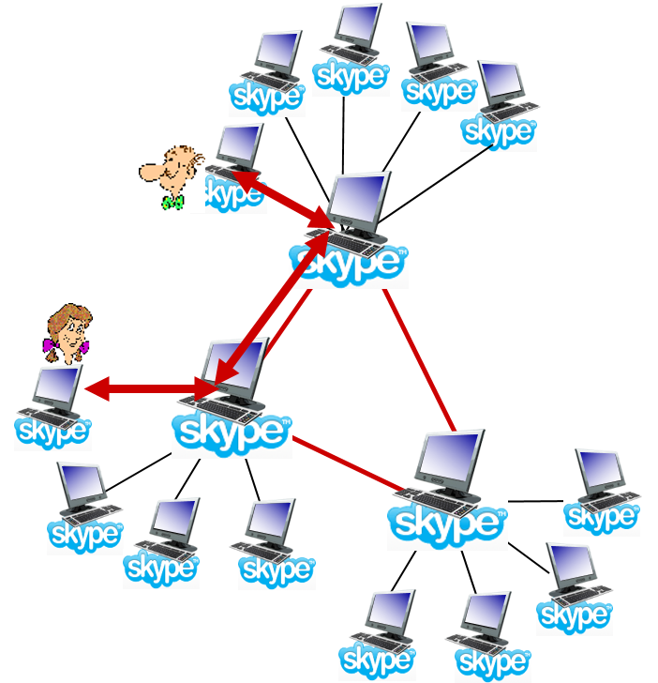
Skype: Peers as Relays
problem: both Alice, Bob are behind “N A Ts”
N A T prevents outside peer from initiating connection to insider peer
inside peer can initiate connection to outside
relay solution: Alice, Bob maintain open connection to their S Ns
Alice signals her S N to connect to Bob
Alice’s S N connects to Bob’s S N
Bob’s S N connects to Bob over open connection Bob initially initiated to his S N

Slide 38
Learning Objectives (4 of 6)
9.1 multimedia networking applications
9.2 streaming stored video
9.3 voice-over-I P
9.4 protocols for real-time conversational applications
9.5 network support for multimedia

Slide 39
Real-Time Protocol (R T P)
R T P specifies packet structure for packets carrying audio, video data
R F C 3550
R T P packet provides
payload type identification
packet sequence numbering
time stamping
R T P runs in end systems
R T P packets encapsulated in U D P segments
interoperability: if two V o I P applications run R T P, they may be able to work together

Slide 40
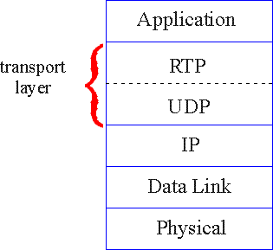
R T P Runs on Top of U D P
R T P libraries provide transport-layer interface that extends U D P:
port numbers, I P addresses
payload type identification
packet sequence numbering
time-stamping

Slide 41
R T P Example
example: sending 64 kbps P C M - encode dvoice over R T P
application collects encoded data in chunks, e.g., every 20 msec = 160 bytes in a chunk
audio chunk + R T P header form R T P packet, which is encapsulated in U D P segment
R T P header indicates type of audio encoding in each packet
sender can change encoding during conference
R T P header also contains sequence numbers, timestamps

Slide 42
R T P and Q o S
R T P does not provide any mechanism to ensure timely data delivery or other Q o S guarantees
R T P encapsulation only seen at end systems (not by intermediate routers)
routers provide best-effort service, making no special effort to ensure that R T P packets arrive at destination in timely matter

Slide 43
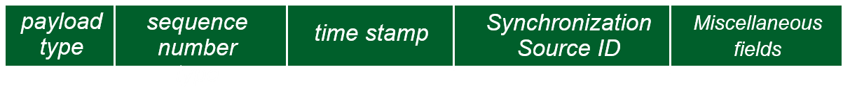
R T P Header (1 of 3)
payload type (7 bits): indicates type of encoding currently being used. If sender changes encoding during call, sender
informs receiver via payload type field
Payload type 0: P C M mu-law, 64 k b p s
Payload type 3: G S M, 13 k b p s
Payload type 7: L P C, 2.4 k b p s
Payload type 26: Motion J P E G

Slide 44
R T P Header (2 of 3)
Payload type 31: H.261
Payload type 33: M P E G 2 video
sequence # (16 bits): increment by one for each R T P packet sent
detect packet loss, restore packet sequence

Slide 45
R T P Header (3 of 3)
timestamp field (32 bits long): sampling instant of first byte in this R T P data packet
for audio, timestamp clock increments by one for each sampling period (e.g., each 125 usecs for 8 KiloHertz sampling clock)
if application generates chunks of 160 encoded samples, timestamp increases by 160 for each R T P packet when source is active. Timestamp clock continues to increase at constant rate when source is inactive.
S S R C field (32 bits long): identifies source of R T P stream. Each stream in R T P session has distinct S S R C

Slide 46
R T S P / R T P Programming Assignment
build a server that encapsulates stored video frames into R T P packets
grab video frame, add R T P headers, create U D P segments, send segments to U D P socket
include seq numbers and time stamps
client R T P provided for you
also write client side of R T S P
issue play/pause commands
server R T S P provided for you

Slide 47
Real-Time Control Protocol (R T C P)
works in conjunction with R T P
each participant in R T P session periodically sends R T C P control packets to all other participants
each R T C P packet contains sender and/or receiver reports
report statistics useful to application: # packets sent, # packets lost, interarrival jitter
feedback used to control performance
sender may modify its transmissions based on feedback

Slide 48
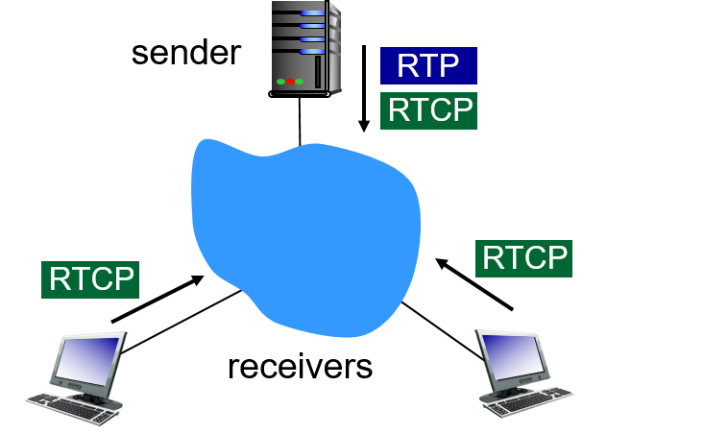
R T C P: Multiple Multicast Senders
each R T P session: typically a single multicast address; all R T P/R T C P packets belonging to session use multicast address
R T P, R T C P packets distinguished from each other via distinct port numbers
to limit traffic, each participant reduces R T C P traffic as number of conference participants increases

Slide 49
R T C P: Packet Types
receiver report packets:
fraction of packets lost, last sequence number, average interarrival jitter
sender report packets:
S S R C of R T P stream, current time, number of packets sent, number of bytes sent
source description packets:
e-mail address of sender, sender’s name, S S R C of associated R T P stream
provide mapping between the S S R C and the user/host name

Slide 50
R T C P: Stream Synchronization
R T C P can synchronize different media streams within a R T P session
e.g., videoconferencing app: each sender generates one R T P stream for video, one for audio.
timestamps in R T P packets tied to the video, audio sampling clocks
not tied to wall-clock time
each R T C P sender-report packet contains (for most recently generated packet in associated R T P stream):
timestamp of R T P packet
wall-clock time for when packet was created
receivers uses association to synchronize playout of audio, video

Slide 51
R T C P: Bandwidth Scaling
R T C P attempts to limit its traffic to 5% of session bandwidth
example: one sender, sending video at 2 M b p s
R T C P attempts to limit R T C P traffic to 100 K b p s
R T C P gives 75% of rate to receivers; remaining 25% to sender
75 k b p s is equally shared among receivers:
with R receivers, each receiver gets to send R T C P traffic at 75/R k b p s.
sender gets to send R T C P traffic at 25 k b p s.
participant determines R T C P packet transmission period by calculating avg R T C P packet size (across entire session) and dividing by allocated rate

Slide 52
S I P: Session Initiation Protocol [R F C 3261]
long-term vision:
all telephone calls, video conference calls take place over Internet
people identified by names or e-mail addresses, rather than by phone numbers
can reach callee (if callee so desires), no matter where callee roams, no matter what I P device callee is currently using

Slide 53
S I P Services
S I P provides mechanisms for call setup:
for caller to let callee know she wants to establish a call
so caller, callee can agree on media type, encoding
to end call
determine current I P address of callee:
maps mnemonic identifier to current I P address
call management:
add new media streams during call
change encoding during call
invite others
transfer, hold calls

Slide 54
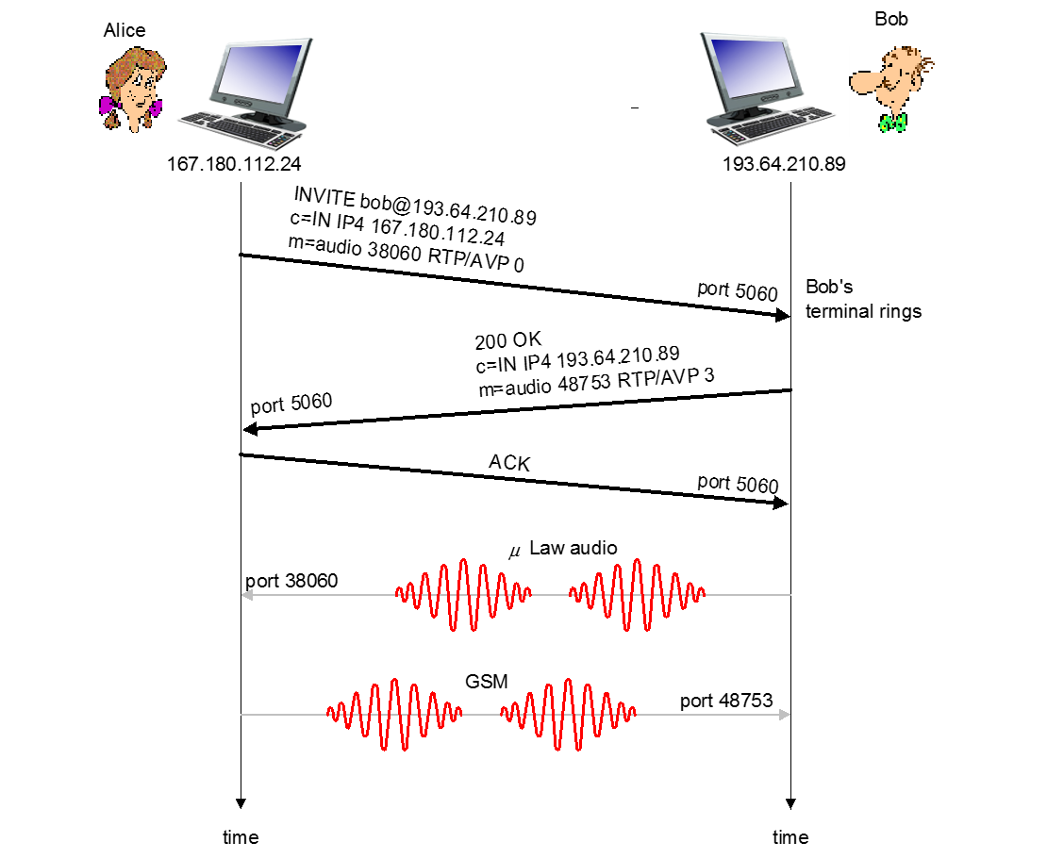
Example: Setting up Call to Known I P Address
Alice’s S I P invite message indicates her port number, I P address, encoding she prefers to receive
Bob’s 200 OK message indicates his port number, I P address, preferred encoding (G S M)
S I P messages can be sent over T C P or U D P; here sent over R T P / U D P
default S I P port number is 5060

Slide 55
Setting up a Call (More)
codec negotiation:
suppose Bob doesn’t have P C M µ law encoder
Bob will instead reply with 606 Not Acceptable Reply, listing his encoders. Alice can then send new INVITE message, advertising different encoder
rejecting a call
Bob can reject with replies “busy,” “gone,” “payment required,” “forbidden”
media can be sent over R T P or some other protocol

Slide 56
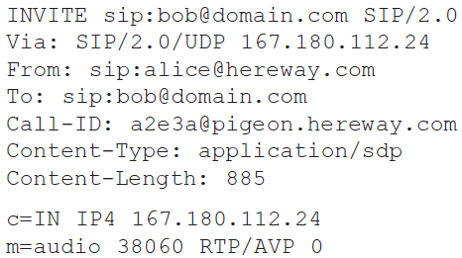
Example of S I P Message (1 of 2)
Notes:
H T T P message syntax
S D P = session description protocol
Call-I D is unique for every call

Slide 57
Example of S I P Message (2 of 2)
Here we don’t know Bob’s I P address
intermediate S I P servers needed
Alice sends, receives S I P messages using S I P default port 506
Alice specifies in header that S I P client sends, receives S I P messages over U D P

Slide 58
Name Translation, User Location
caller wants to call callee, but only has callee’s name or e-mail address.
need to get I P address of callee’s current host:
user moves around
D H C P protocol
user has different I P devices (P C, smartphone, car device)
result can be based on:
time of day (work, home)
caller (don’t want boss to call you at home)
status of callee (calls sent to voicemail when callee is already talking to someone)

Slide 59
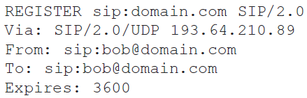
S I P Registrar
one function of S I P server: registrar
when Bob starts S I P client, client sends S I P Register message to Bob’s registrar server
register message:

Slide 60
S I P Proxy
another function of S I P server: proxy
Alice sends invite message to her proxy server
contains address sip:bob@domain.com
proxy responsible for routing S I P messages to callee, possibly through multiple proxies
Bob sends response back through same set of S I P proxies
proxy returns Bob’s S I P response message to Alice
contains Bob’s I P address
S I P proxy analogous to local D N S server plus T C P setup

Slide 61
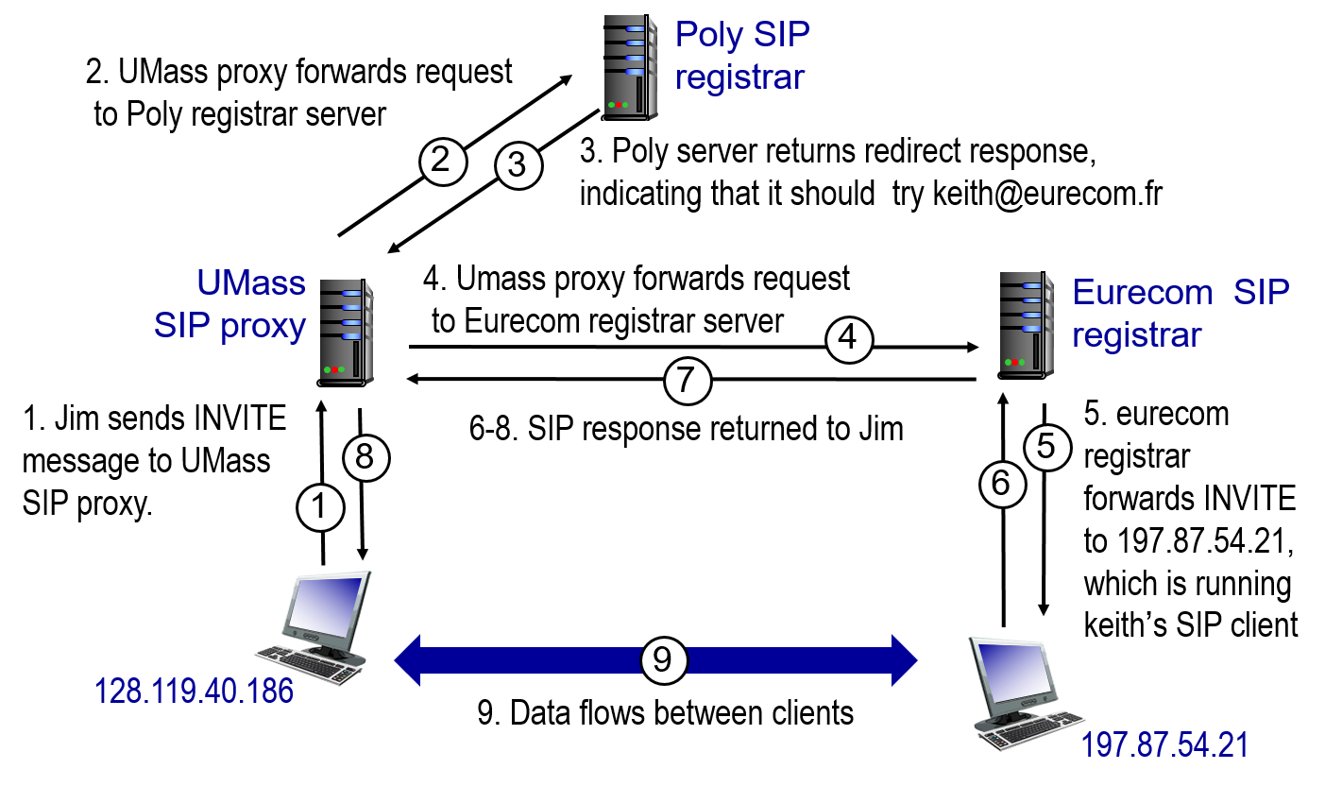
S I P Example: jim@umass.edu Calls keith@poly.edu

Slide 62
Comparison with H.323
H.323: another signaling protocol for real-time, interactive multimedia
H.323: complete, vertically integrated suite of protocols for multimedia conferencing: signaling, registration, admission control, transport, codecs
S I P: single component. Works with R T P, but does not mandate it. Can be combined with other protocols, services
H.323 comes from the I T U (telephony)
S I P comes from I E T F: borrows much of its concepts from H T T P
S I P has Web flavor; H.323 has telephony flavor
S I P uses K I S S principle: Keep It Simple Stupid

Slide 63
Learning Objectives (5 of 6)
9.1 multimedia networking applications
9.2 streaming stored video
9.3 voice-over-I P
9.4 protocols for real-time conversational applications
9.5 network support for multimedia

Slide 64
Network Support for Multimedia
Approach | Granularity | Guarantee | Mechanisms | Complexity | Deployed?
Making the best of best effort service | All traffic treated equally | None, or soft | No network support (all at application) | low | everywhere
Differentiated service | Traffic “class” | None, of soft | Packet marking, scheduling, policing. | med | some
Per-connection Q o s | Per-connection flow | Soft or hard after flow admitted | Packet market, scheduling policing, call admission | high | little to none

Slide 65
Dimensioning Best Effort Networks
approach: deploy enough link capacity so that congestion doesn’t occur, multimedia traffic flows without delay or loss
low complexity of network mechanisms (use current “best effort” network)
high bandwidth costs
challenges:
network dimensioning: how much bandwidth is “enough?”
estimating network traffic demand: needed to determine how much bandwidth is “enough” (for that much traffic)

Slide 66
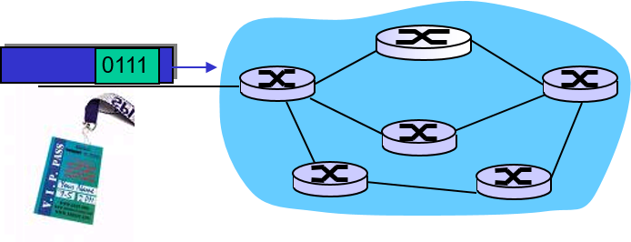
Providing Multiple Classes of Service
thus far: making the best of best effort service
one-size fits all service model
alternative: multiple classes of service
partition traffic into classes
network treats different classes of traffic differently (analogy: V I P service versus regular service)
granularity: differential service among multiple classes, not among individual connections
history: T o S bits

Slide 67
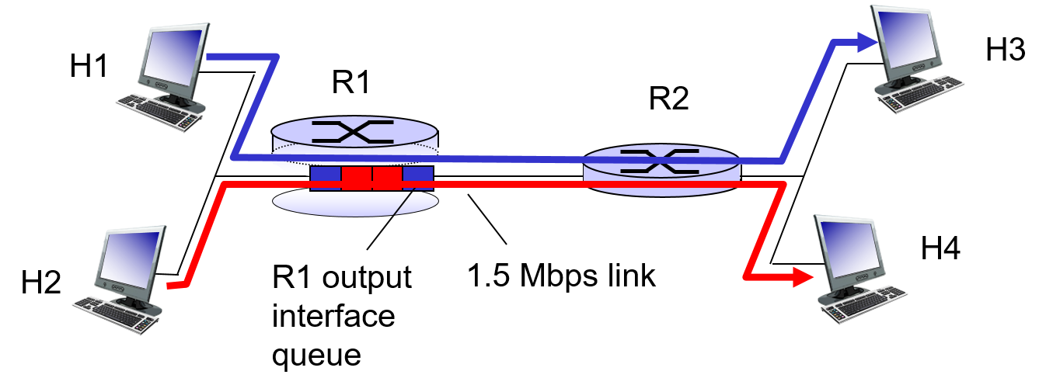
Multiple Classes of Service: Scenario

Slide 68
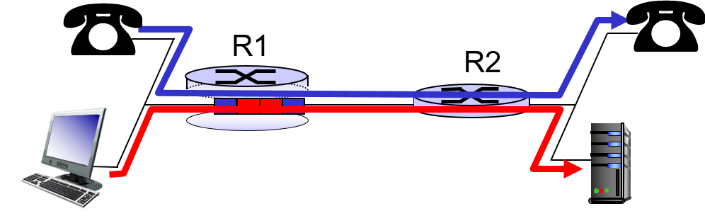
Scenario 1: Mixed H T T P and Voip
example: 1 M b p s V o I P, H T T P share 1.5 M b p s link.
H T T P bursts can congest router, cause audio loss
want to give priority to audio over H T T P
Principle 1
packet marking needed for router to distinguish between different classes; and new router policy to treat packets accordingly

Slide 69
Principles for Q O S Guarantees (More) (1 of 3)
what if applications misbehave (V o I P sends higher than declared rate)
policing: force source adherence to bandwidth allocations
marking, policing at network edge

Slide 70
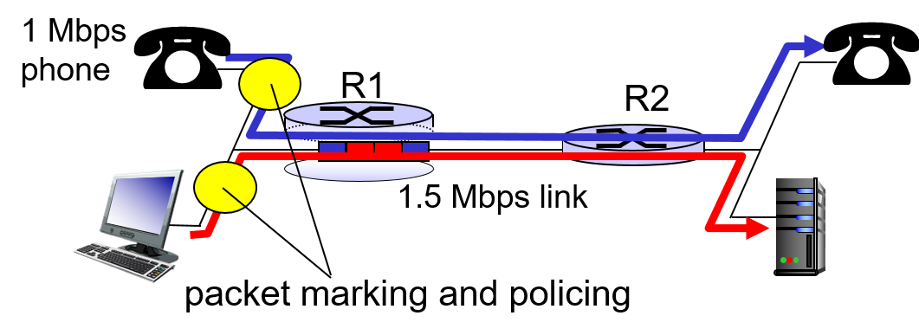
Principles for Q O S Guarantees (More) (2 of 3)
Principle 2
provide protection (isolation) for one class from others

Slide 71
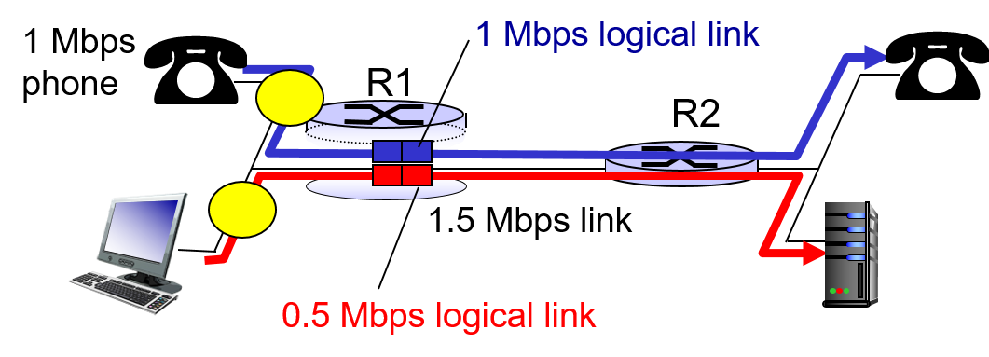
Principles for Q O S Guarantees (More) (3 of 3)
allocating fixed (non-sharable) bandwidth to flow: inefficient use of bandwidth if flows doesn’t use its allocation
Principle 3
while providing isolation, it is desirable to use resources as efficiently as possible

Slide 72
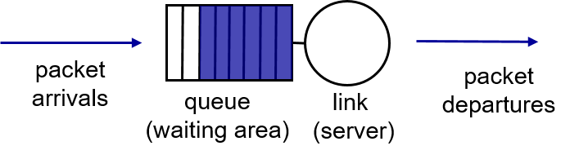
Scheduling and Policing Mechanisms
packet scheduling: choose next queued packet to send on outgoing link
previously covered in Chapter 4:
F C F S: first come first served
simply multi-class priority
round robin
weighted fair queueing (W F Q)

Slide 73
Policing Mechanisms
goal: limit traffic to not exceed declared parameters
Three common-used criteria:
(long term) average rate: how many packets can be sent per unit time (in the long run)
crucial question: what is the interval length: 100 packets per second or 6000 packets per minutes have same average!
peak rate: e.g., 6000 packets per min (p p m) avg.; 1500 p p m peak rate
(max.) burst size: max number of packets sent consecutively (with no intervening idle)

Slide 74
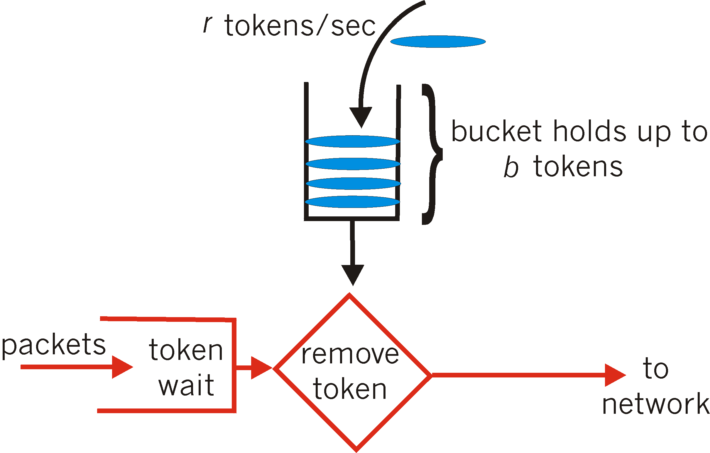
Policing Mechanisms: Implementation (1 of 2)
token bucket: limit input to specified burst size and average rate

Slide 75
Policing Mechanisms: Implementation (2 of 2)
bucket can hold b tokens
tokens generated at rate r token/second unless bucket full
over interval of length t: number of packets admitted less than or equal to (r t + b)

Slide 76
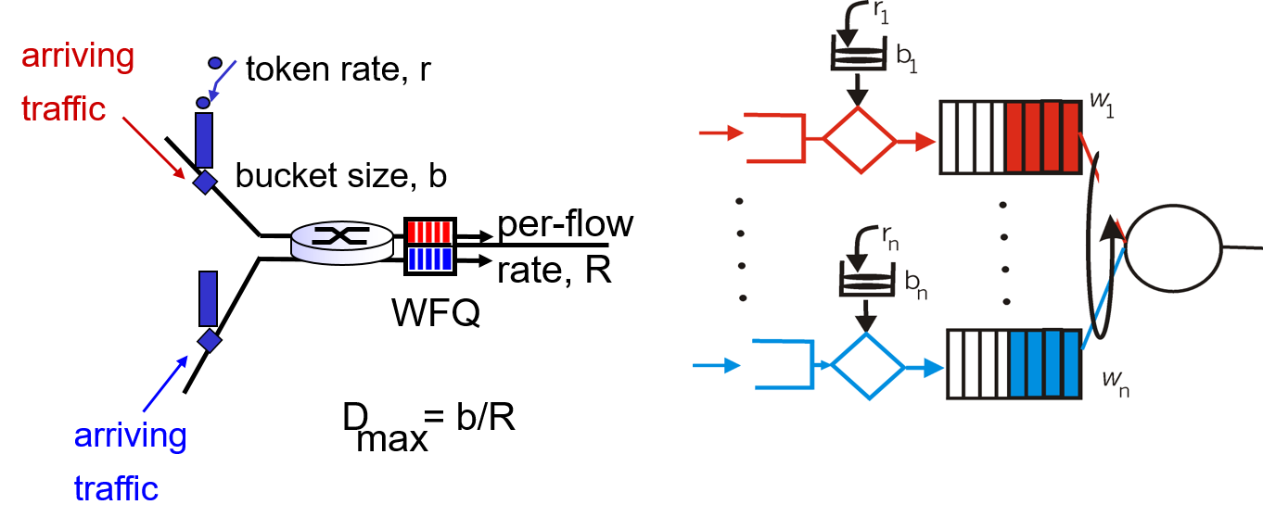
Policing and Q o S Guarantees
token bucket, W F Q combine to provide guaranteed upper bound on delay, i.e., Q o S guarantee!

Slide 77
Differentiated Services
want “qualitative” service classes
“behaves like a wire”
relative service distinction: Platinum, Gold, Silver
scalability: simple functions in network core, relatively complex functions at edge routers (or hosts)
signaling, maintaining per-flow router state difficult with large number of flows
don’t define define service classes, provide functional components to build service classes

Slide 78


Diffserv Architecture (1 of 2)
edge router:
per-flow traffic management
marks packets as in-profile and out-profile
core router:
per class traffic management
buffering and scheduling based on marking at edge
preference given to in-profile packets over out-of-profile packets

Slide 79
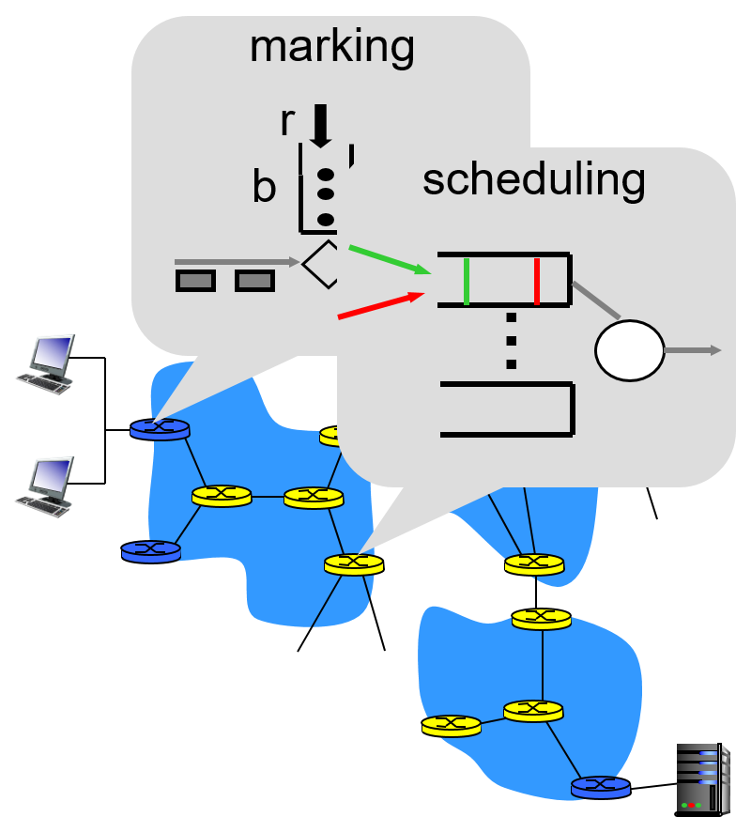
Diffserv Architecture (2 of 2)

Slide 80
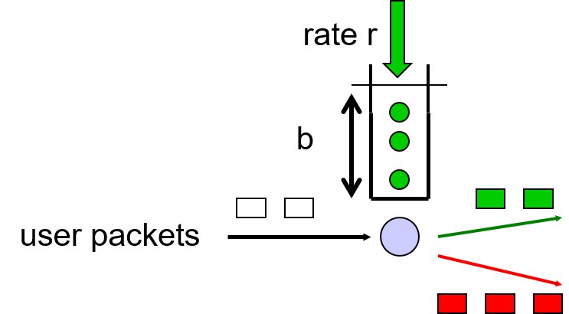
Edge-Router Packet Marking
profile: pre-negotiated rate r, bucket size b
packet marking at edge based on per-flow profile
possible use of marking:
class-based marking: packets of different classes marked differently
intra-class marking: conforming portion of flow marked differently than non-conforming one

Slide 81
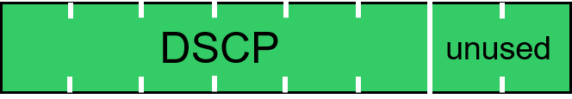
Diffserv Packet Marking: Details
packet is marked in the Type of Service (T O S) in I P v 4, and Traffic Class in I P v 6
6 bits used for Differentiated Service Code Point (D S C P)
determine P H B that the packet will receive
2 bits currently unused

Slide 82
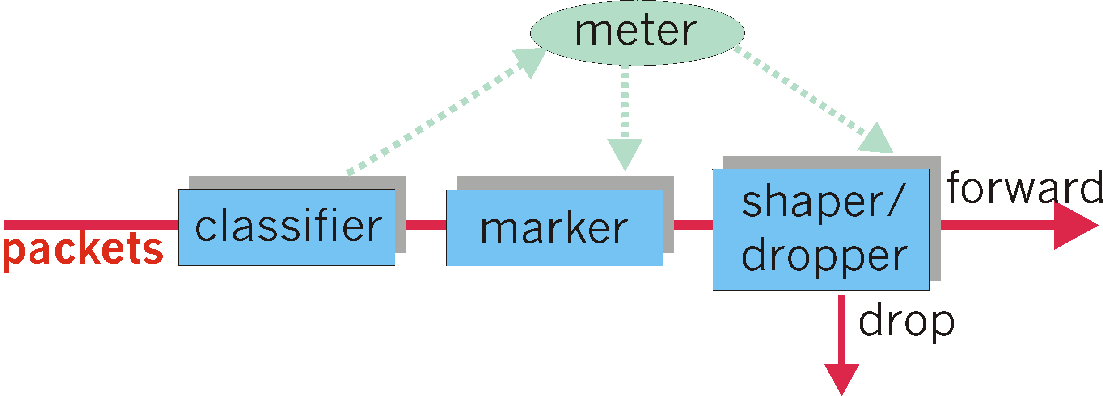
Classification, Conditioning
may be desirable to limit traffic injection rate of some class:
user declares traffic profile (e.g., rate, burst size)
traffic metered, shaped if non-conforming

Slide 83
Forwarding Per-Hop Behavior (P H B)
P H B result in a different observable (measurable) forwarding performance behavior
P H B does not specify what mechanisms to use to ensure required P H B performance behavior
examples:
class A gets x% of outgoing link bandwidth over time intervals of a specified length
class A packets leave first before packets from class B

Slide 84
Forwarding P H B
P H Bs proposed:
expedited forwarding: packet departure rate of a class equals or exceeds specified rate
logical link with a minimum guaranteed rate
assured forwarding: 4 classes of traffic
each guaranteed minimum amount of bandwidth
each with three drop preference partitions

Slide 85
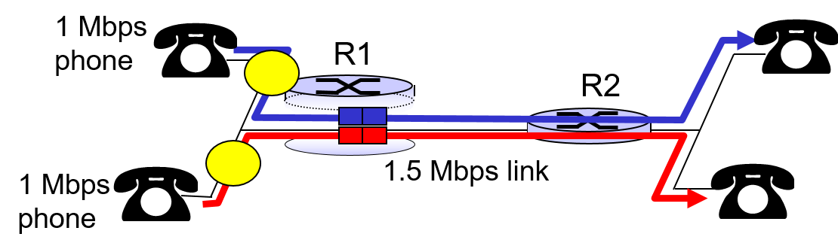
Per-Connection Q O S Guarantees
basic fact of life: can not support traffic demands beyond link capacity
Principle 4
call admission: flow declares its needs, network may block call (e.g., busy signal) if it cannot meet needs

Slide 86
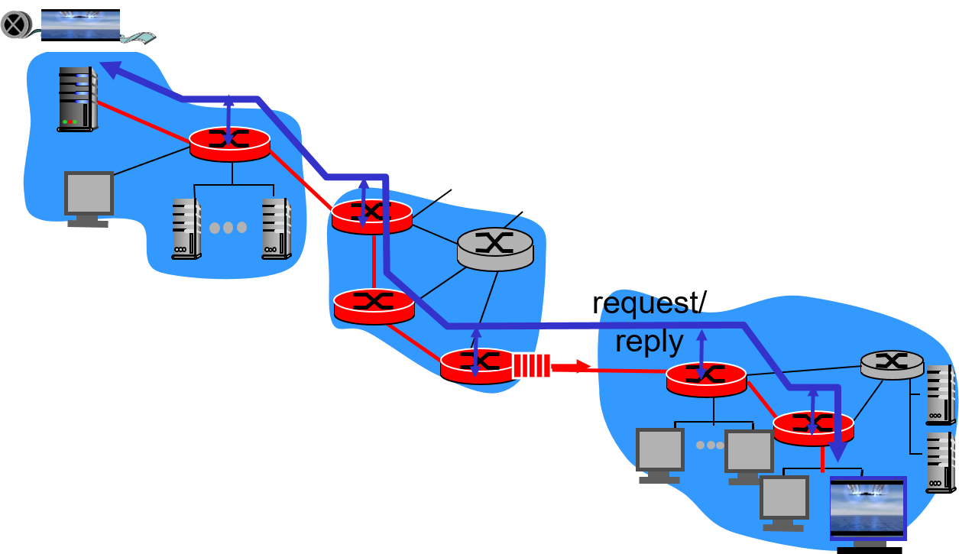
Qos Guarantee Scenario
resource reservation
call setup, signaling (R S V P)
traffic, Q o S declaration
per-element admission control
Q o S-sensitive scheduling (e.g., W F Q)

Slide 87
Learning Objectives (6 of 6)
9.1 multimedia networking applications
9.2 streaming stored video
9.3 voice-over-I P
9.4 protocols for real-time conversational applications
9.5 network support for multimedia

Slide 88

Copyright

