Slide 1
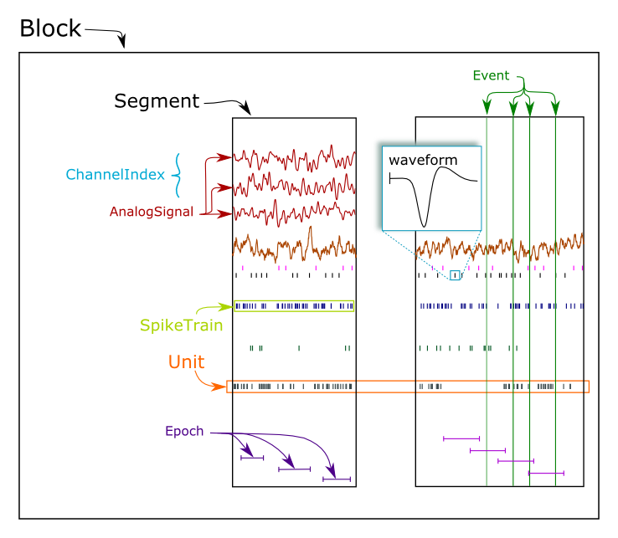
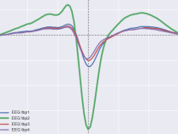
NeoAll
segments : List of Neo Segment - 1 per unit
temp_0
temp_i
temp_N
Neo SpikeTrain
Neo SpikeTrain
Neo SpikeTrain
. . .
. . .
Neo Events (Optional)
Neo Events (Optional)
Neo Events (Optional)
Neo Epochs (Optional)
Neo Epochs (Optional)
Neo Epochs (Optional)
channel_indexes : list of Neo Channel Index – 1 per tetrode and 1 per electrode (if defined)
EEG op - tetrode 1
EEG op - tetrode 2
EEG op
Neo Unit : temp_5
Neo Unit : temp_2
Neo Unit : temp_5
Neo Unit : temp_12
. . .
Neo Unit : temp_12
. . .
Neo Unit : temp_2
unit_shapes : unit template on each wire of the tetrode
unit_preffered_chan : number of the unit preffered micro wire

Slide 2
NeoEpoch
segments : List of Neo Segment - 1 per event (epoch)
event_0
event_i
Neo SpikeTrain :
unit_0
Neo SpikeTrain :
unit_0
unit_1
unit_1
.
.
.
.
.
.
unit_N
unit_N
. . .
. . .
Neo Analog Signals :
Neo Analog Signals :

Slide 3

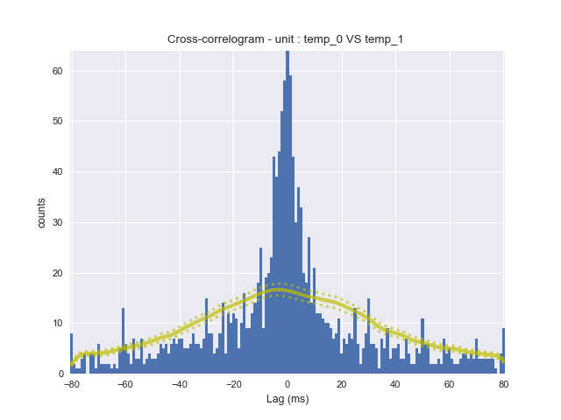
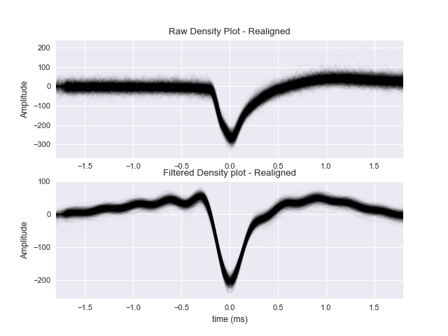
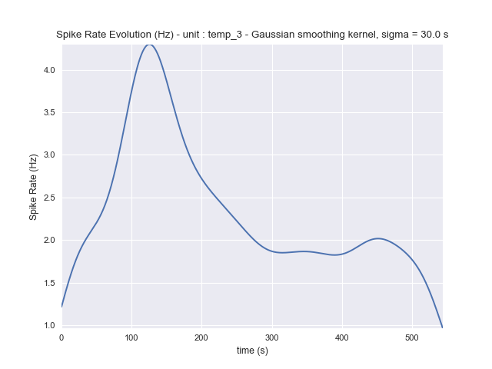
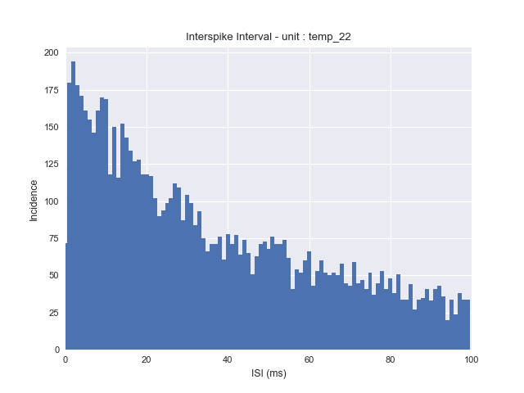
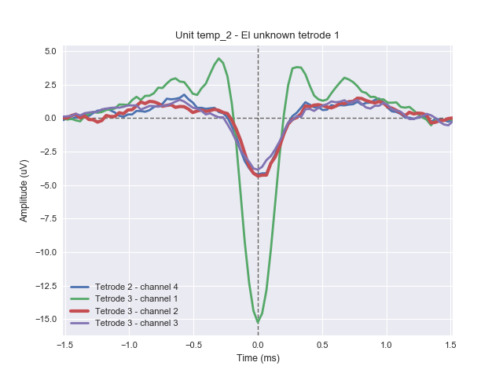
NeoAll
Cross Correlogram
Density Plot
Spike Rate Evolution
Inter Spike Interval
Unit Template

Slide 4
Spike Rate Evolution
Inter Spike Interval
Unit Template
Cross Correlogram
Density Plot
NeoAll

Slide 5
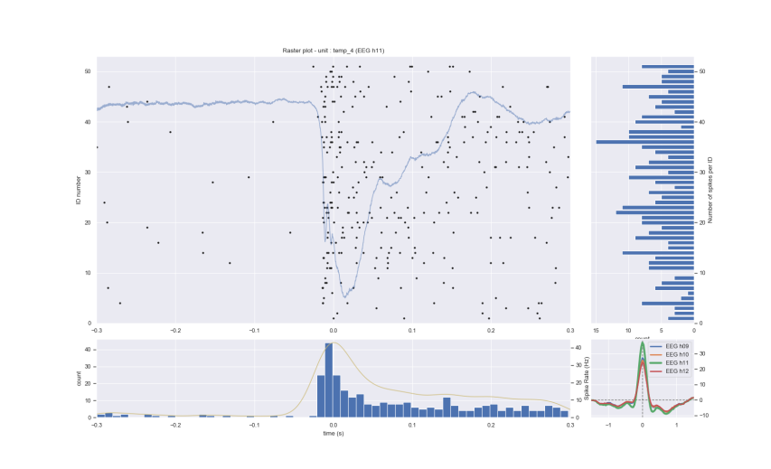
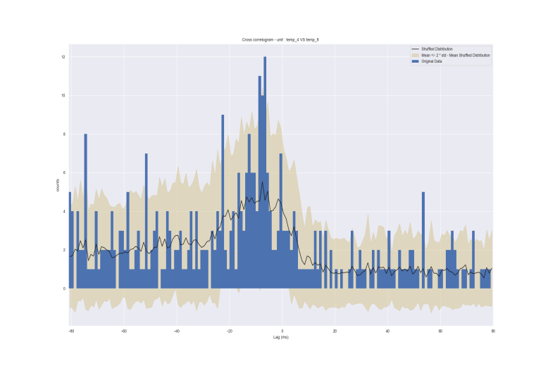
NeoEpoch
Rasterplot
Cross Correlogram (around events)

