Slide 1
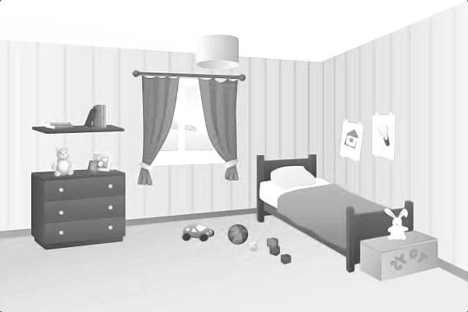

Hot and cold
It’s under the bed.
What a surprise!
1
2
3
4
5

