Slide 1
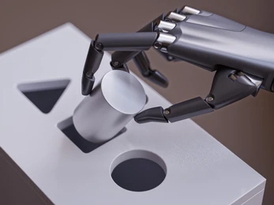
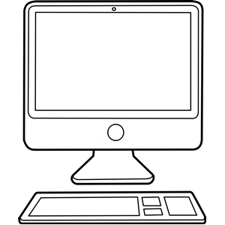
TRY
Digital methodologies to spare your brain
ALMA Department
of
Computing
Maria Jesus LOPEZ
Martin TOURNEBOEUF

