Slide 1
Welcome
Nubis Training
September 2016
irc #nubis-users

Slide 2
Welcome
Introduction
Notes on this training
Request for feedback

Slide 3
Welcome
The fallacy of easy

Slide 4
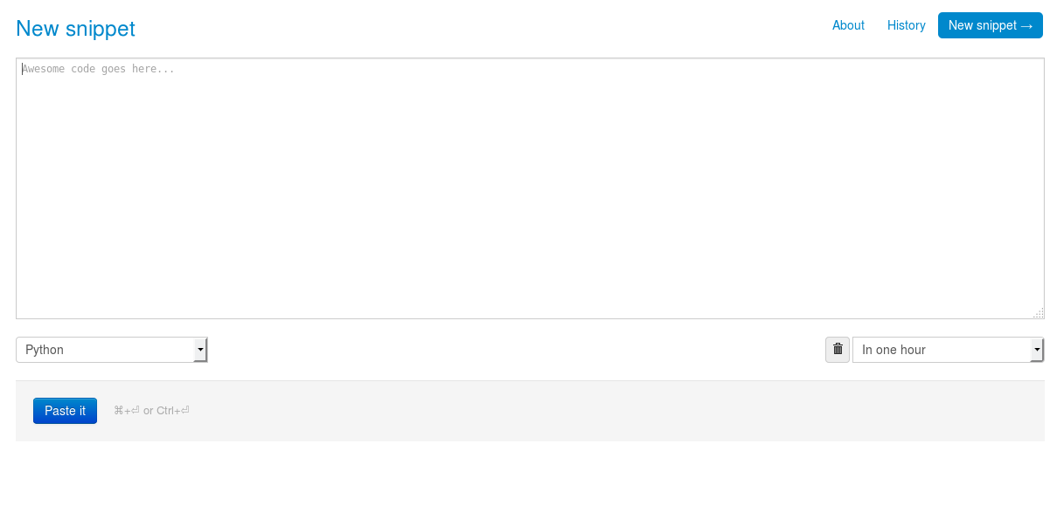
Welcome
The Dpaste Application

Slide 5
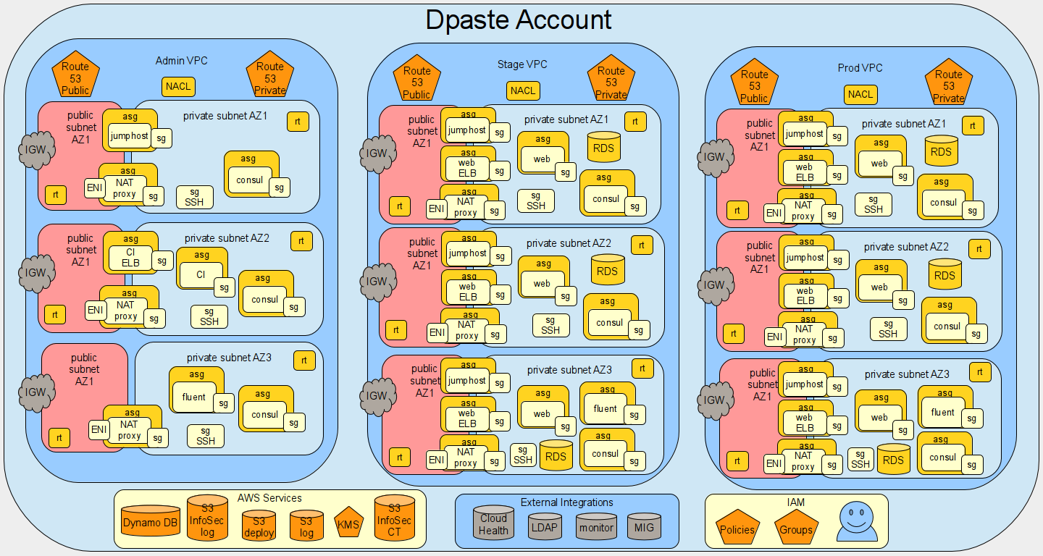
Welcome

Slide 6
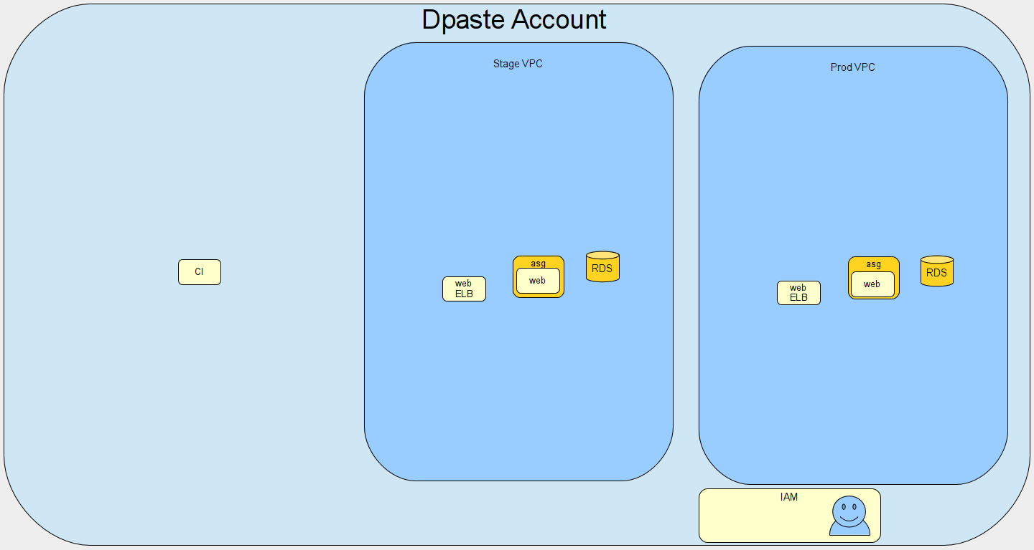
Welcome

Slide 7
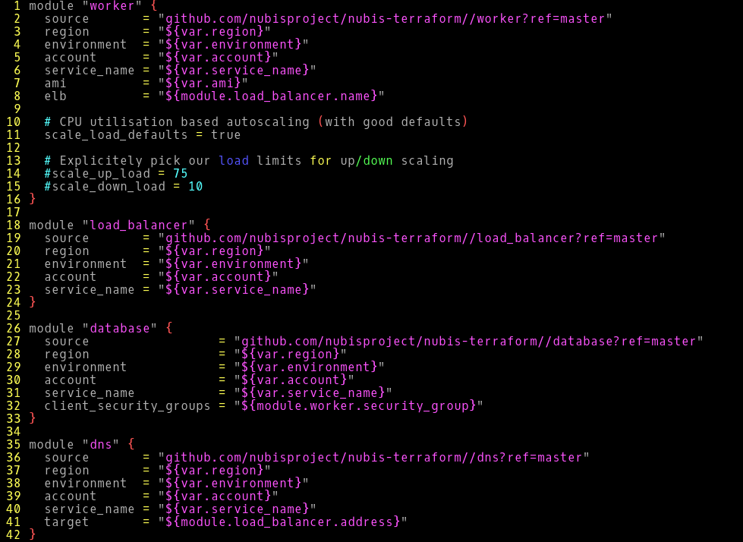
Welcome

Slide 8
Welcome
What we will cover
Introduction
New Operating Principles
Exercise One
Nubis Overview
        Nubis Account
        Nubis Deployment
Exercise Two
Demonstrations
Working Labs

Slide 9
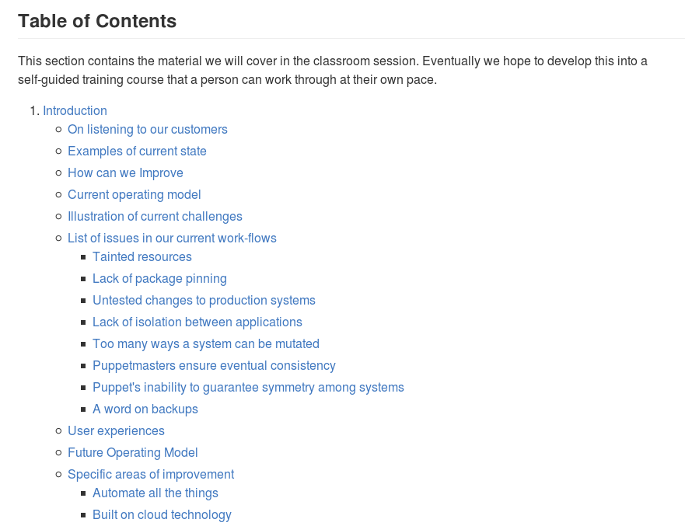
Welcome
We are open source
https://github.com/nubisproject

Slide 10
Welcome
Q & A

