Slide 1
SAVE YOUR BACKUP CODES
Keep these backup codes somewhere safe but accessible.
1. 9401 7784 6. 3602 0140
2. 7577 5732 7. 2668 7536
3. 3953 5084 8. 5881 6034
4. 6416 7269 9. 5262 1443
5. 7714 6079 10. 6639 919
(lijw1987@gmail.com)
* You can only use each backup code once.
* Need more? Visit https://g.co/2sv
* These codes were generated on: Nov 3, 2021.
10 eight-digit codes
account field
date field

Slide 2
Compromised by adversary
Multiple Clients
Source-based
Encrypted Deduplication
🔒
Chunk
FeatureSpy
Enclave
Cloud
🔒
🔒
🔒

Slide 3
Adversary fakes chunks and skips detection
Chunk
Enclave
Source-based
Encrypted Deduplication by Client
Feature Extraction
Similarity Detection
Encryption
Chunk
FeatureSpy

Slide 4
Adversary fakes chunks and bypasses detection
Chunk
Enclave
FeatureSpy
Features Extraction
KeyGen
Encryption
Source-based
Deduplication
Chunk
Attack Detection
in Unprotected Memory

Slide 5
Adversary fakes chunks and bypasses detection
Chunk
Enclave
FeatureSpy
Chunk
Features Extraction
MLE Key
Generation
Encryption
Source-based
Deduplication
PoW
Attack Detection
in Unprotected Memory

Slide 6
FeatureSpy
Enclave
Feature Key Generation
Attack Detection
Chunk
Features Extraction
Similarity-Preserving
Encryption
Source-based
Deduplication
MLE Key Generation
SGX-based PoW
in Unprotected Memory

Slide 7
IV
...
🔑
Encrypt
🔑
Encrypt
🔑
Encrypt
+
C₁
+
C₂
+
C_{n}
M₁
M₂
M_{n}

Slide 8
IV
🔑
Encrypt
🔑
Encrypt
🔑
Encrypt
✂
M₁
+
M₂
+
...
M_{n}
+
C₁
C₂
C_{n}

Slide 9
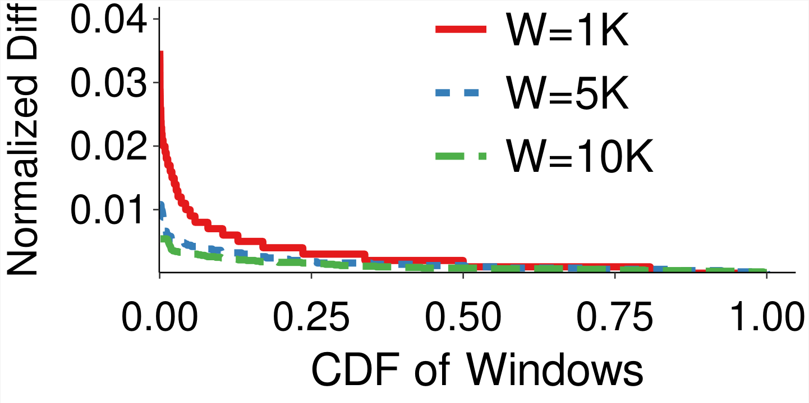
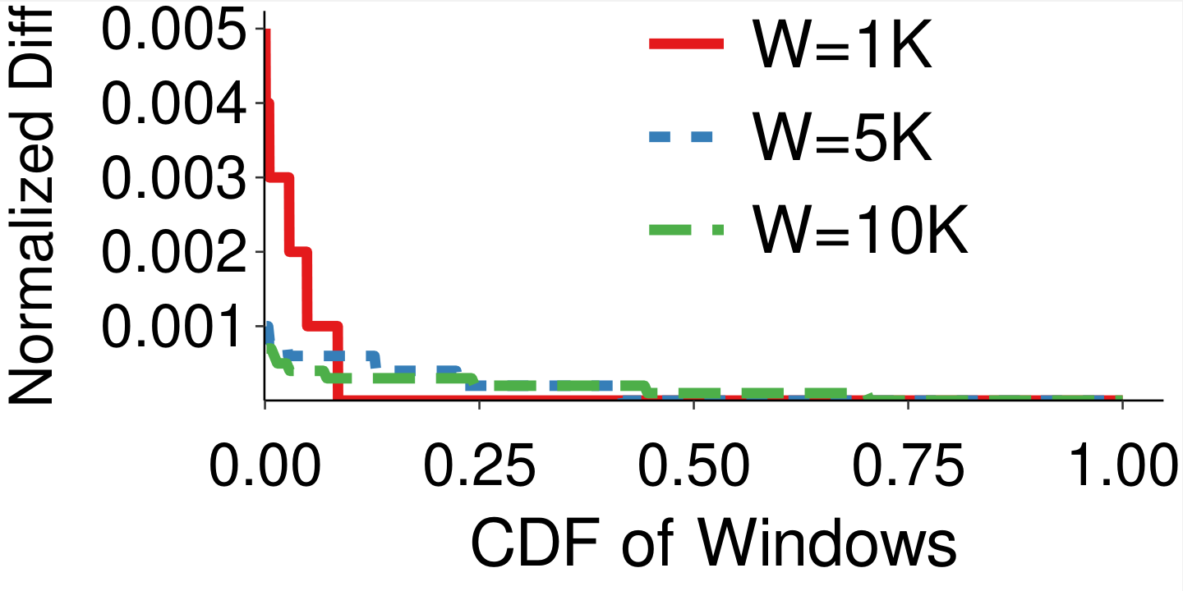
Small normalized difference
Linux Dataset
CouchBase Dataset

Slide 10
Plaintext Chunk
allFeature
firstFeature
minFeature
Indicator
H
E
MLE Key
E
Indicator
Ciphertext Chunk

Slide 11
allFeature/firstFeature/minFeature
H
Feature Key
Features
Indicator
E
Ciphertext Chunk
Trimmed
Chunk
E
MLE Key

